Slide 1
Secure Software Development
10/20/2018
Kennon Bittick
GTRI – CIPHER – NVD - SWA

Slide 2
Agenda
Introduction
Designing Secure Software
Design Patterns
Common Bugs
Resources
Validating Secure Software
Static Analysis
Dynamic Analysis
Final Tips

Slide 3
Introduction – Why Do We Care?
Security bugs are a subclass of bug and often first present themselves as a regular bug
Fewer security bugs means a better user experience
We care about user safety and privacy
We don’t want to end up on the news
Using best practices to write secure code tends to produce better written and more maintainable code

Slide 4
Designing Secure Software – Design Patterns
Design patterns are common methods, techniques, or ideas to solve software problems
Design patterns tend to be reusable and good or “clean” solutions to problems
Learning common security-related design patterns can help developers keep cognizant of common issues and how architecture and code decisions can improve software security

Slide 5
Designing Secure Software – Trust Boundaries
A trust boundary is “a boundary where program data or execution changes its level of ‘trust’” - https://en.wikipedia.org/wiki/Trust_boundary
Think of your program or system as having areas with different data rights or trust properties
Examples:
A program before and after user input has been sanitized and validated
A program before and after a user has been cryptographically verified
A UNIX application that has components that run as root and components that run as an unprivileged user
An secure database that should only be accessed in very controlled ways
Trust boundaries isolate different areas of your system.

Slide 6
Designing Secure Software – Simple Trust Boundary
Trust Boundary
Command Line
Main Application
Code
Input
Validation
IO

Slide 7
Designing Secure Software – Complex Trust Boundary
SSN Broker
Process
Trust Boundary
Process 1
API
Internet
Process 2
Normal DB
IO
Process 3
SSN DB

Slide 8
Designing Secure Software – Trust Boundaries
Trust boundaries provide logical isolation of different application components with different properties
At a minimum, isolate the outside world from the internal application
Boundaries should have explicit, controlled interfaces for communication
Make interfaces with careful consideration to user roles and permissions

Slide 9
Designing Secure Software – Input Validation
When we decide on a trust boundary and create an interface through which components can cross trust boundaries, how do we make sure the access is controlled and correct?
Must carefully validate all input from outside a trust boundary
Data formats (Protobuf, MsgPack, JSON, XML, etc.)
Check that all types are correct
Check that all values are within expected bounds
Integer and floating point ranges
None/Null/Nil only where allowed
Strings are valid
Prefer enums where appropriate
Ensure appropriate permissions

Slide 10
Designing Secure Software – Defense in Depth
It is best to have multiple layers of defenses between trust boundaries
Network-Based
Firewalls
Intrusion Detection Systems
Anomaly Detection
Host-Based
Anti-virus
Principle of Least Privilege for users (and separate accounts when privilege is necessary)
Operating System Hardening
Linux: PaX, grsecurity, SELinux
Windows: ProcessMitigations

Slide 11
Designing Secure Software – Simplicity
Simple code is usually easier to reason about, making it easier to find security bugs before someone else does
Common non-security design patterns apply here
Single Responsibility Principle
Don’t Repeat Yourself
KISS
Make extensive use of namespacing and other code organizational constructs
Avoid “clever” code when a simpler paradigm will work
Common culprits: functional programming, lambdas, closures, metaclasses, template metaprogramming

Slide 12
Designing Secure Software – Session Management
When managing user session, prefer systems provided by your standard library or framework where possible
Salt, hash, and stretch passwords before storing (if you’re using a standard library or popular framework, this is done for you)
Session cookies/tokens should be pseudorandom. Do not use any identifiable information or guessable numbers
Do not increment a counter
2FA

Slide 13
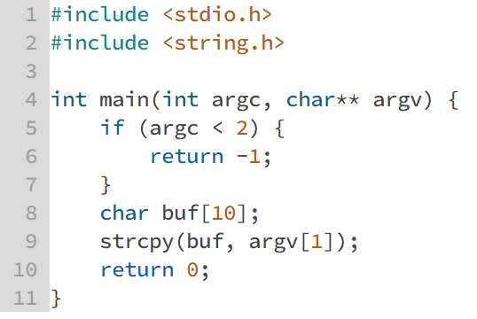
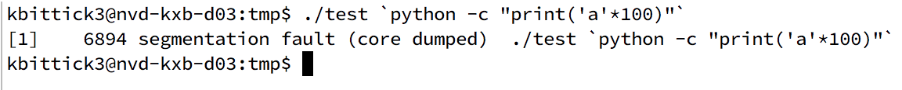
Designing Secure Software – Buffer Overflow
Occurs when you read too much data into a buffer and the write continues passed the bounds of the buffer
Results:
Crash (denial of service)
Overwriting data on the stack
Overwriting metadata -> arbitrary code execution

Slide 14
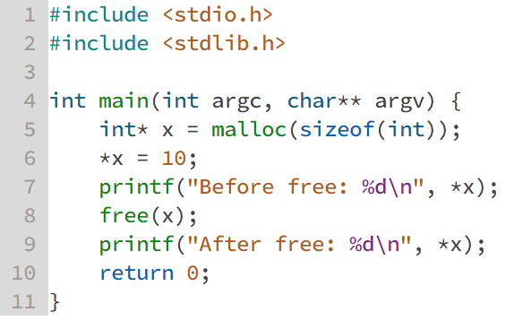
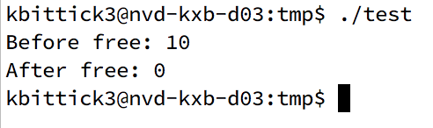
Designing Secure Software – Use After Free
Occurs when you use dynamic memory after it has been free’d
According to the specification, this is undefined behavior
X could be 10, 0, or any arbitrary value

Slide 15
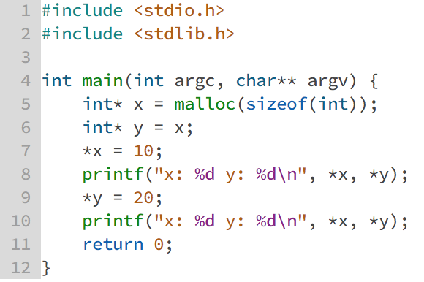
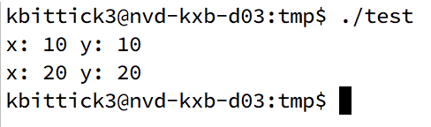
Designing Secure Software – Pointer Aliasing
Occurs when two pointers are allowed to take on the same value. A dereferencing of one pointer will result in the same value as the other
Sometimes, this is what you want
Often it is not

Slide 16
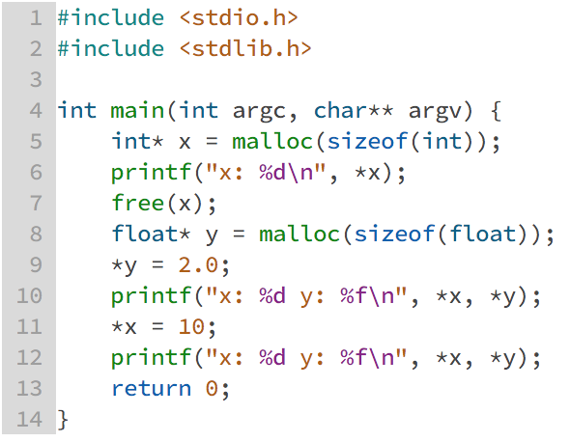
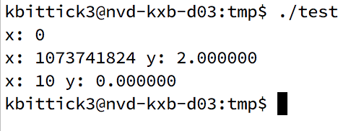
Designing Secure Software – Type Confusion
Because of the use after free issue, x and y are allowed to alias to the same address, but with different types
A change to one effects the other in unintuitive ways
integer 10 is not the same thing as float 10.0
This gets even worse with complex types like structs and classes
Particularly a problem in code with function pointers

Slide 17
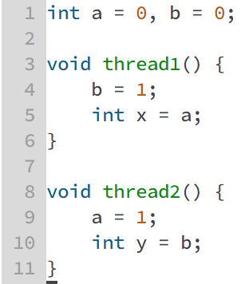
Designing Secure Software – Race Conditions
What are the possible values of x and y?
(0, 1), (1, 0), and (1, 1) are obvious since these instructions can interleave
(0, 0) is also possible depending on your architecture’s memory consistency model and cache mechanism
If you’re writing multithreaded code, you must have a deep understanding of computer platforms or make use of safe language-provided abstractions

Slide 18
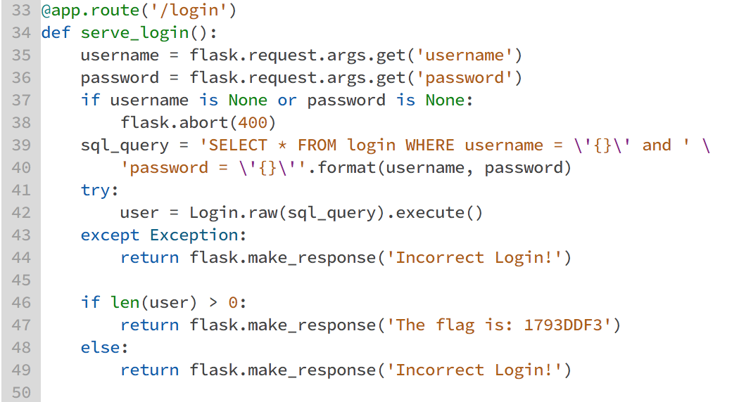
Designing Secure Software – SQL Injection
SQL string constructed with unsanitized user input
Insertion of control characters allows modification of the semantics of the SQL query
‘ or ‘1’ = ‘1

Slide 19
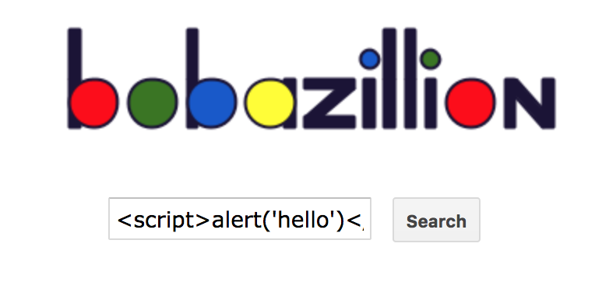
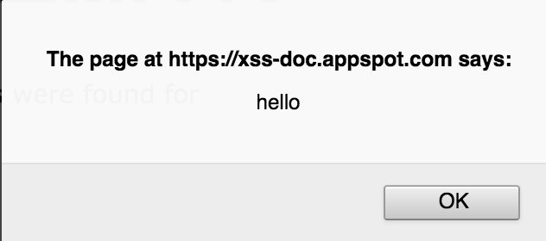
Designing Secure Software – XSS
Cross Site Scripting occurs when a web page renders user input without sanitization and can interpret the input as code (HTML or JavaScript)
This can occur as a result of an HTTP parameter (reflected XSS) or from storing data in the web application database (stored XSS)
Can allow execution of arbitrary code in the browser of a victim
https://www.google.com/intl/am_AD/about/appsecurity/learning/xss/

Slide 20
Designing Secure Software – Resources to Learn More
Secure Coding
OWASP Top 10: https://www.owasp.org/images/7/72/OWASP_Top_10-2017_%28en%29.pdf.pdf
CERT C Coding Standard: https://wiki.sei.cmu.edu/confluence/display/c/SEI+CERT+C+Coding+Standard
Language-specific style guides and best practices guides
Read the docs
If you’re using a language, platform, or library extensively, read the documentation. Not the tutorial or quick start guide, the actual documentation
Avoid guessing on functionality. Don’t just assume that because something appears to work that it doesn’t have side effects
Microsoft Secure Development Lifecycle: https://www.microsoft.com/en-us/sdl

Slide 21
Validating Secure Software – Static Analysis
Static analysis tools analyze code without actually executing it
Tools range from extremely simple to mind bogglingly complex
Many sophisticated tools are expensive, but there are also many free options
Adding static analysis tools to your build process can catch bugs (of all kinds, not just security bugs) before your project even gets built

Slide 22
Validating Secure Software – Static Analysis
Code reviews
Static analysis starts before running any tools with normal pull requests
Rather than assuming the code is correct and reading it with that mindset, assume it is incorrect and try to figure out how to break it
Linters
Quick and dirty pass over source code to find errors or issues
Often mostly a syntax and style checker, but some can find more subtle bugs as well
Even if just a style checker, linters are extremely valuable in keeping code hygiene and uniformity, which keeps code easy to read and maintain
This is particularly important when collaborating

Slide 23
Validating Secure Software – Static Analysis
Compiler warnings
Static analysis built right into your compiler
Particularly with C/C++, DO NOT IGNORE WARNINGS
They are almost never spurious. And if they are, use a pragma at the offending location rather than ignoring the warnings
- Wall, -Wextra, -pedantic
Additionally, when building C/C++, use exploit mitigations
-fstack-protector
-pie
-Wl,-z,relro
Clang sanitizers (address, cfi, etc.)

Slide 24
Validating Secure Software – Static Analysis
Analysis Techniques
These are the techniques you see more often in commercial products
Control Flow Analysis – how does a program’s execution flow?
Data Flow Analysis – how does data flow through a program?
Aliasing Analysis – which pointers can alias?
Value Range Analysis – what value or range of values can a variable hold at a particular time?
Formal Methods
The big guns. These techniques have historically suffered from scalability problems on large codebases, but the technology is getting better and they have substantial application these days
Formal program verification
Model checking
Static Symbolic Execution
Abstract interpretation

Slide 25
Validating Secure Software – Dynamic Analysis
Dynamic analysis tools run a program and analyze it as it runs to find bugs

Slide 26
Validating Secure Software – Dynamic Analysis
Tests
Good, normal tests that look at functionality around boundary values often find security issues as well
Write tests specifically with security in mind
Unit tests
Verify that input validation is working properly
Check authentication code
Integration
Validate your trust boundaries
Regression
If you find a security bug, make sure it doesn’t crop up again
Human tests
Application penetration testing can uncover issues

Slide 27
Validating Secure Software – Dynamic Analysis
Fuzz testing
Repeatedly run programs with large number of inputs and observe behavior
Be on the lookout for crashes, hangs, and invalid accesses
Can be as simple as throwing random data at the application or considerably more complex
AFL is the most popular open source fuzzer
Valgrind
Dynamic analysis toolkit for UNIX systems
The default (and most commonly used) tool is memcheck, which finds a slew of memory corruption errors
If you are writing C/C++ and are not using Valgrind, you should be

Slide 28
Final Tips
Know your tools
Read the docs
Understand your platform (browser or operating system)
Think carefully about user roles, permissions, and trust boundaries
When dealing with cryptography, use a well-vetted library. READ THE DOCS. It is easy to misuse even well-designed and popular cryptography libraries
Use managed languages when appropriate
Python/Java/JavaScript/Rust over C/C++
If using C/C++, follow best practices. RAII, smart pointers, careful memory management, bounds checking

