Slide 1

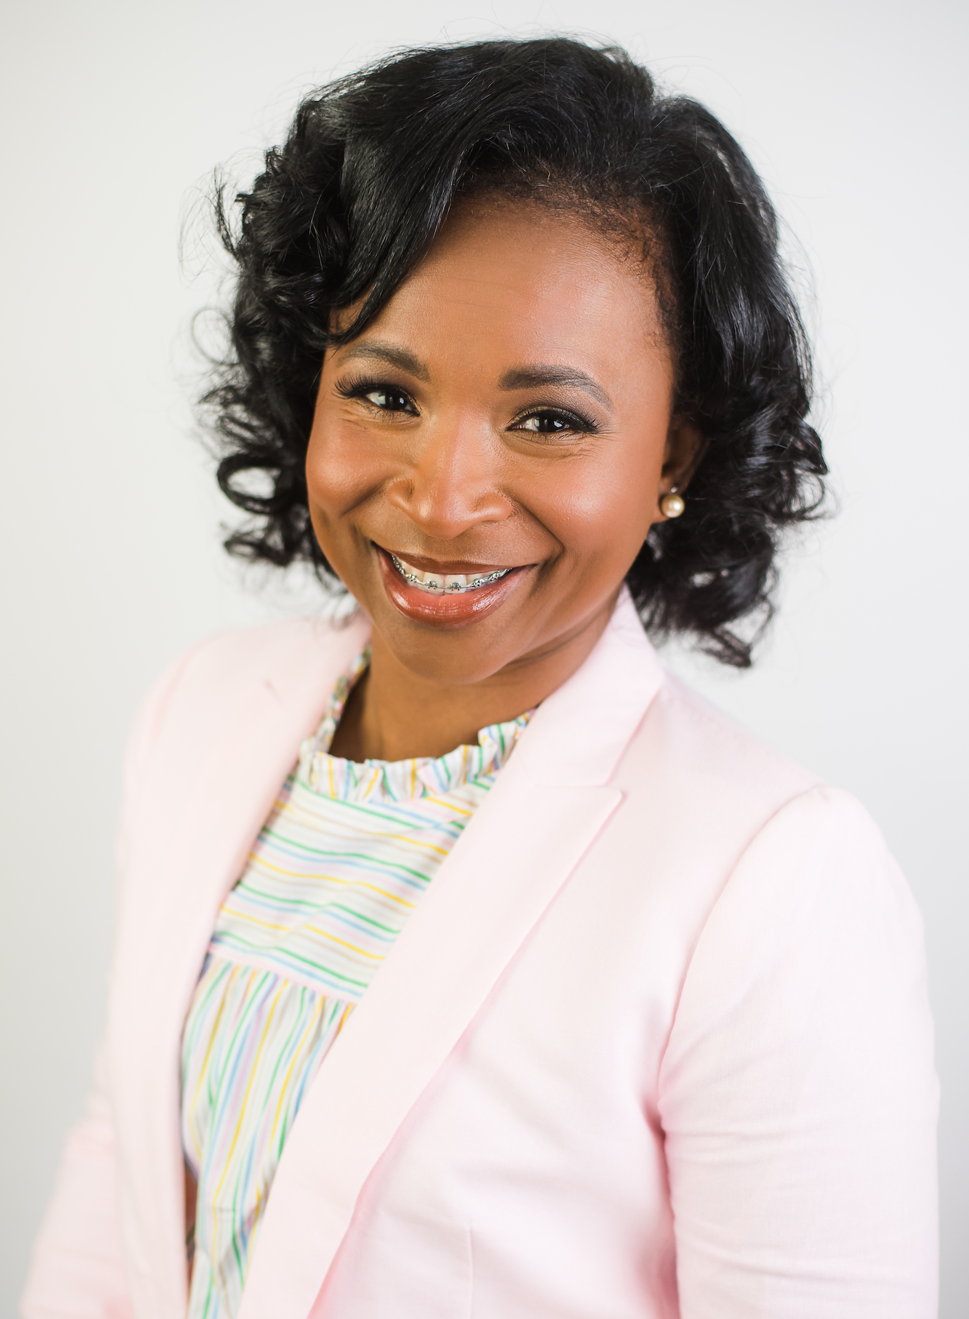
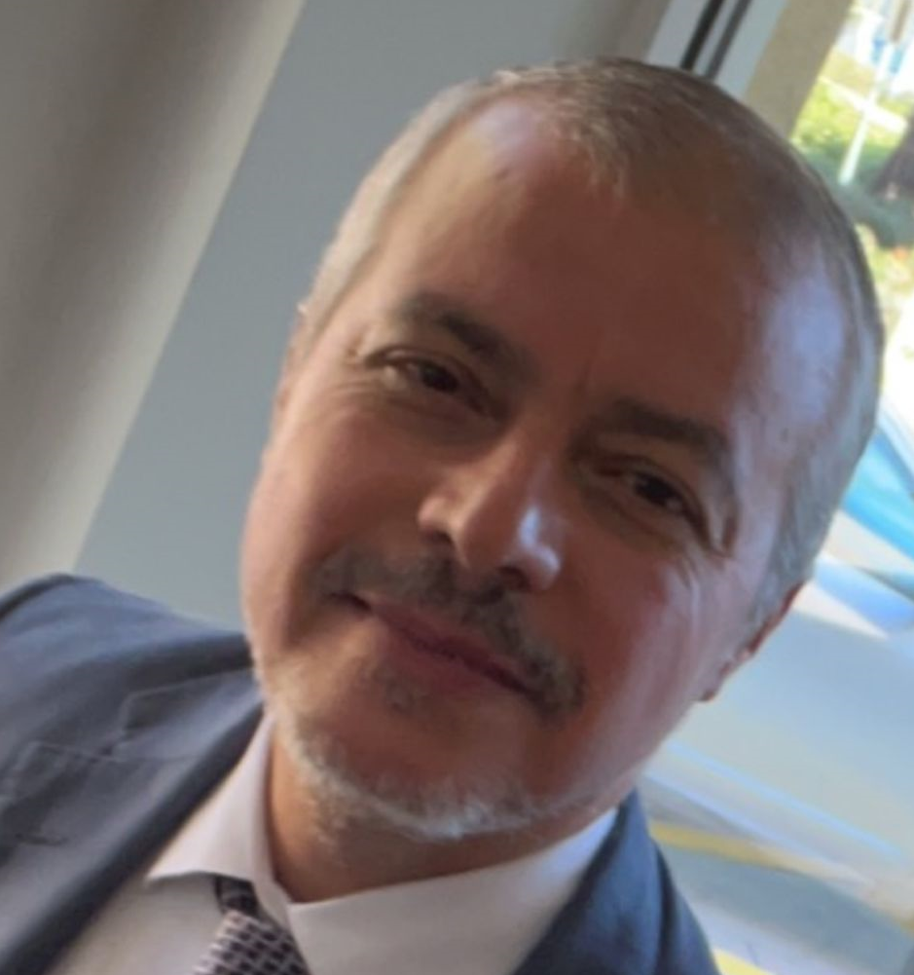
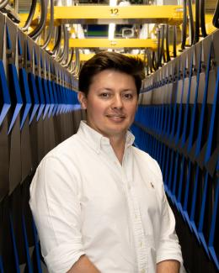
Crypto Squad
Team Member
Sabrina Perry, KeyCracker
Mississippi Valley State University
Mentor
Izzat Almadi, Code Enforcer
Texas A&M
Mentor
Fernando Posada, Byte Master
Oak Ridge National Laboratory
Target Course: Intro to Cybersecurity
Course Goals:
(1) Introduce basic concepts of Cybersecurity and HPC into the course. (2) Create practical exercises to give students hands-on experience using essential tools.
GitHub Repo: https://github.com/suhbrina-perry/FacultyHackHPC
Team Song: Technologic by Daft Punk

