Slide 1
RecallScope
Pharmaceutical distribution
Batch recall accounting
with the evidence attached
Team Console
October 2026
Notes:
RecallScope is a working pharmaceutical distributor and wholesaler workspace. This pitch describes the pharmaceutical release. All showcased organisations and transactions are fictional. The demonstration does not claim industrial validation, regulatory certification, medical safety, or measured customer savings. The owner selected distributors/wholesalers as the target workflow.

Slide 2
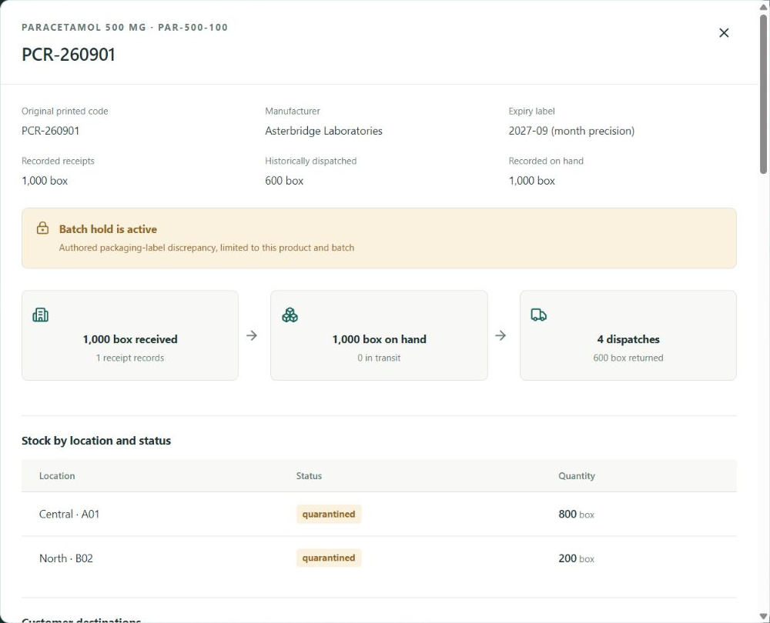
The batch-to-customer evidence gap
A distributor must identify the affected product and batch, find its destinations, and explain what happened to each quantity.
Receipts and dispatch records hold the facts. A recall needs a connected record of stock, returns and recipient responses.
A missing link stays visible. It never becomes a safety conclusion.
RecallScope / Pharmaceutical distribution
02
Notes:
Primary context: NPRA GDP third edition, stock reconciliation, quarantined returns and recall recording: https://www.npra.gov.my/~npraweb/images/Guidelines_Central/Guidelines_on_Regulatory/2018/GUIDELINE_ON_GDP_3rd_Edi_2018.pdf
NPRA public recall scope and product/batch fields: https://www.npra.gov.my/index.php/en/consumers/safety-information/product-recall.html
The slide states the operational problem addressed, not a measured frequency or delay. Screenshot: work/screenshots/pharma-trace.jpg, actual local pharmaceutical app on 3 October 2026, labelled sample records. Each screenshot uses its own source asset.

Slide 3
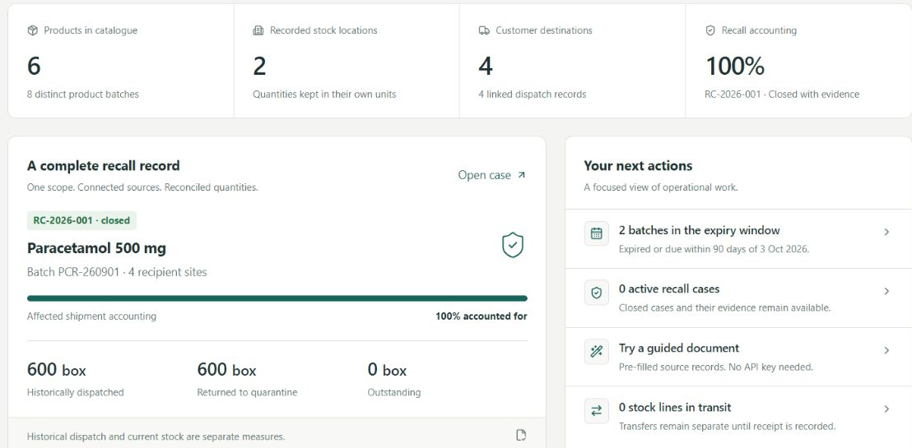
A distributor’s working record
Product identity, warehouse movements and customer destinations share the same batch history.
RecallScope / Pharmaceutical distribution
03
Notes:
Actual app screenshot: work/screenshots/pharma-overview.jpg, captured 3 October 2026. The screen uses a controlled reference date and authored sample distributor data. Features implemented in product/app/pharma/workspace.tsx and product/lib/pharma/domain.ts include catalogue and product-scoped batch identity, exact units, expiry precision, FEFO suggestions, warehouse stock accounts, delivered shipments and returns. Existing ingredient-tracing data remains separate under /bakery. No clinical workflow is part of this product.

Slide 4
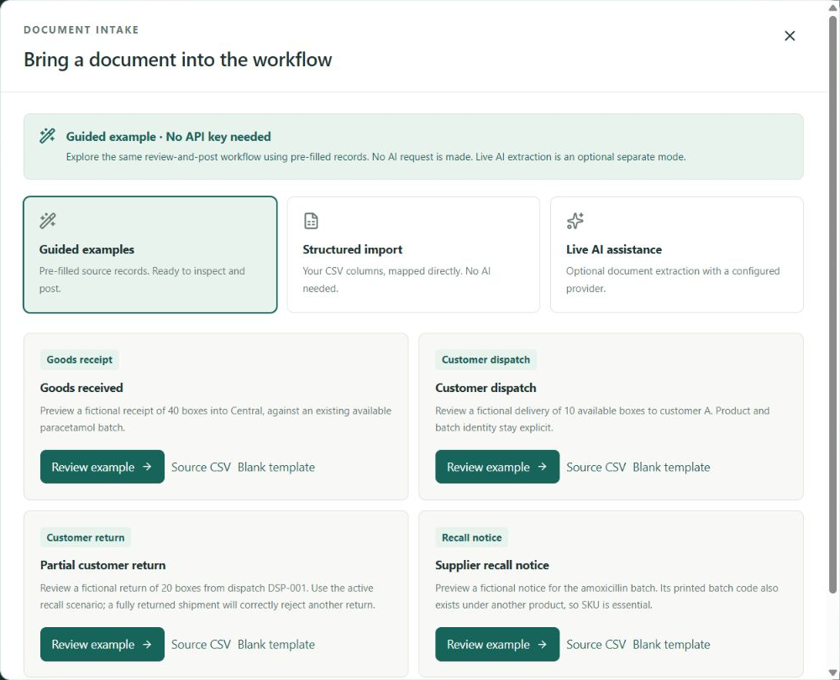
Document review without an API key
Guided examples
Pre-filled records demonstrate the review and posting workflow. No AI request occurs.
Structured CSV
Map source columns, correct fields and approve an atomic import.
Optional live AI
Fireworks or OpenAI proposes records for review. Keys stay on the server.
RecallScope / Pharmaceutical distribution
04
Notes:
Actual screen: work/screenshots/pharma-guided.jpg. Guided examples are authored fictional records, and the interface says no AI request is made. CSV parsing is deterministic. Both feed a server-side stored draft that requires a review note and explicit approval before posting. Fireworks is the development provider and the OpenAI option remains implemented. Provider keys stay server-side; per-workspace and global budgets bound optional paid requests. This slide does not imply that guided examples are model output or that a live pharmaceutical AI extraction was measured.

Slide 5
One recall, reconciled
1,000 boxes received. 600 boxes dispatched to four recipient sites.
Recorded measure | Before returns | Partial returns | All returned
Customer returns | 0 | 100 | 600
Stock on hand | 400 | 500 | 1,000
Outstanding shipment accounting | 600 | 500 | 0
All quantities are boxes of one product and batch. Returns enter quarantine and form part of on-hand stock.
Authored example with exact expected totals
05
Notes:
Data source: product/lib/pharma/seed.ts and deterministic domain tests in product/tests/pharma-domain.test.ts. Initial receipt 1,000 boxes, transfer 200 Central to North, dispatches 250 + 150 + 100 + 100 = 600 boxes. Before returns, 400 boxes remain on hand. Partial returns 50 + 30 + 20 = 100 yield 500 on hand and 500 outstanding. Completing the remaining 500 returns yields 600 total returns, 1,000 on hand and zero outstanding. Historical shipment exposure is never added to on-hand stock. The complete fixture includes evidenced acknowledgement and an explicit closure decision. Quantities describe fictional records, not an industrial trial.

Slide 6
Rules behind each posted record
AI proposes. Deterministic checks and an explicit operator decision govern posting.
Decision boundary | Implemented behavior
Product and batch identity | Equal batch codes on different products stay separate.
Inventory and unit accounting | Transfers conserve stock. Returns cannot exceed delivered quantities.
Access and concurrent edits | Server roles, workspace isolation and stale-write checks guard updates.
Evidence and serial custody | Source records, decision history and serialized unit positions stay inspectable.
Software verification uses synthetic records and reproducible checks
06
Notes:
Implementation evidence: product/lib/pharma/domain.ts, intake.ts, store.ts, interoperability.ts and API routes under product/app/api/pharma. Automated tests exercise identity/date/unit invariants, receipt/transfer/dispatch/return accounting, role denial, separate sessions, stored draft review, duplicate prevention and concurrent writes. Serialized-unit custody and nested package relationships are implemented; packaging changes no stock quantities. Health checks and source hash manifests provide operational diagnostics. Regulatory compliance, external ERP integration and pharmaceutical authenticity are not claimed.

Slide 7
A focused entry into an established market
Established alternative | Documented focus
TraceLink Targeted Recalls | Recall communication, affected sites and reporting
SAP ATTP | Pharmaceutical serialization, aggregation and integrations
Odoo Inventory | Lot and serial tracking, expiry and FEFO allocation
RecallScope’s proposed position
Document-to-recall accounting for distributor teams, with an inspectable source behind each decision.
Commercial hypothesis: an organisation subscription with warehouse allowances and optional metered extraction.
RecallScope / Pharmaceutical distribution
07
Notes:
Dated desk research, 3 October 2026. Sources: TraceLink Targeted Recalls https://www.tracelink.com/products/product-orchestration/targeted-recalls; SAP Advanced Track and Trace for Pharmaceuticals https://www.sap.com/uk/products/scm/track-trace-pharmaceuticals.html; Odoo expiry documentation https://www.odoo.com/documentation/19.0/applications/inventory_and_mrp/inventory/product_management/product_tracking/expiration_dates.html. Summary source: docs/PHARMA-ALTERNATIVES.md. Recall management, lot tracking and serialization are established capabilities. This pitch makes no claim that those competitors lack any capability, that RecallScope is cheaper or faster, or that its approach is validated demand. The pricing structure is a planning hypothesis. Hosting, extraction, storage and support costs need measured input; no revenue, customer count, market share or savings is invented.

Slide 8
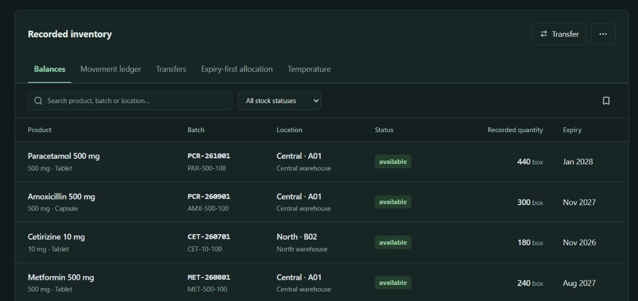
The demonstration
A judge can review a source record, post it, trace a batch and export the evidence without an API key.
The product pairs a clear distributor workflow with visible accounting and recoverable decisions.
RecallScope
recallscope.console3096.chatgpt.site
Team Console
08
Notes:
The no-key demonstration is fully functional using guided records or CSV. Original screenshots show actual app state captured on 3 October 2026: work/screenshots/pharma-stock-night.jpg. Public project URL: https://recallscope.console3096.chatgpt.site/ . GitHub source: https://github.com/HackIndiaXYZ/ai-first-startup-hackathon-build-a-startup-using-ai-only-console . The release documentation records the deployment revision and validation scope. Reasons this entry can be compelling are a specific user, a complete workflow, meaningful deterministic engineering and inspectable outcomes. No competition prize is guaranteed.

