Slide 1
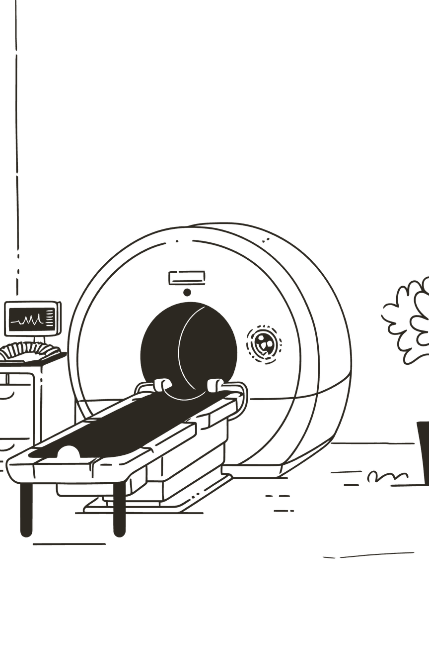
AI-Powered Lung Cancer Detection: A Leap Forward in Early Diagnosis
Revolutionizing healthcare through deep learning and transfer learning for accurate, early-stage lung cancer detection using convolutional neural networks.
Team: Codevengers
Ansh kumar
Divya
Kunal
Hritik
Notes:
1

Slide 2



The Critical Challenge: The Silent Threat of Lung Cancer
Global Health Crisis
Diagnostic Delays
Early Detection Challenge
Lung cancer claims over two million new cases annually, ranking as a leading cause of cancer-related deaths worldwide.
Traditional methods are time-consuming, expensive, and subjective, often leading to delayed or missed diagnoses when time is critical.
Subtle abnormalities in CT scans make manual interpretation difficult, yet early detection remains paramount for improving patient survival rates.
Notes:
2

Slide 3

Our Solution: VER-Net - A Hybrid Transfer Learning Approach
Novel Hybrid Architecture
VER-Net combines multiple pre-trained transfer learning models stacked together, leveraging existing knowledge to overcome data scarcity and improve generalization.
High-Precision Detection
Designed specifically for lung cancer detection using CT scan images, acting as a powerful assistive tool for clinicians with exceptional accuracy.
Enhanced Efficiency
Significantly improves diagnostic speed and accuracy, enabling faster screening and more reliable classification of lung abnormalities.
Notes:
3

Slide 4
Technology Stack & System Architecture
01
02
03
Data Augmentation & Preprocessing
Transfer Learning
Hybrid Model Integration
Fine-tuning pre-trained models (VGG16, VGG19, Xception, ResNet-50, MobileNetV2) on curated lung CT scan datasets.
Stacking and training combined models to create VER-Net's powerful ensemble architecture.
Enhancing dataset variability through resizing to 224x224 pixels, random rotation, flipping, and normalization techniques.
04
05
Classification
Interpretable Output
Mapping CT scan images to distinct lung cancer classes: Normal, Benign, and Malignant subtypes with high confidence.
Generating predictions with Grad-CAM visualizations for clinical interpretability and trust.
Notes:
4

Slide 5
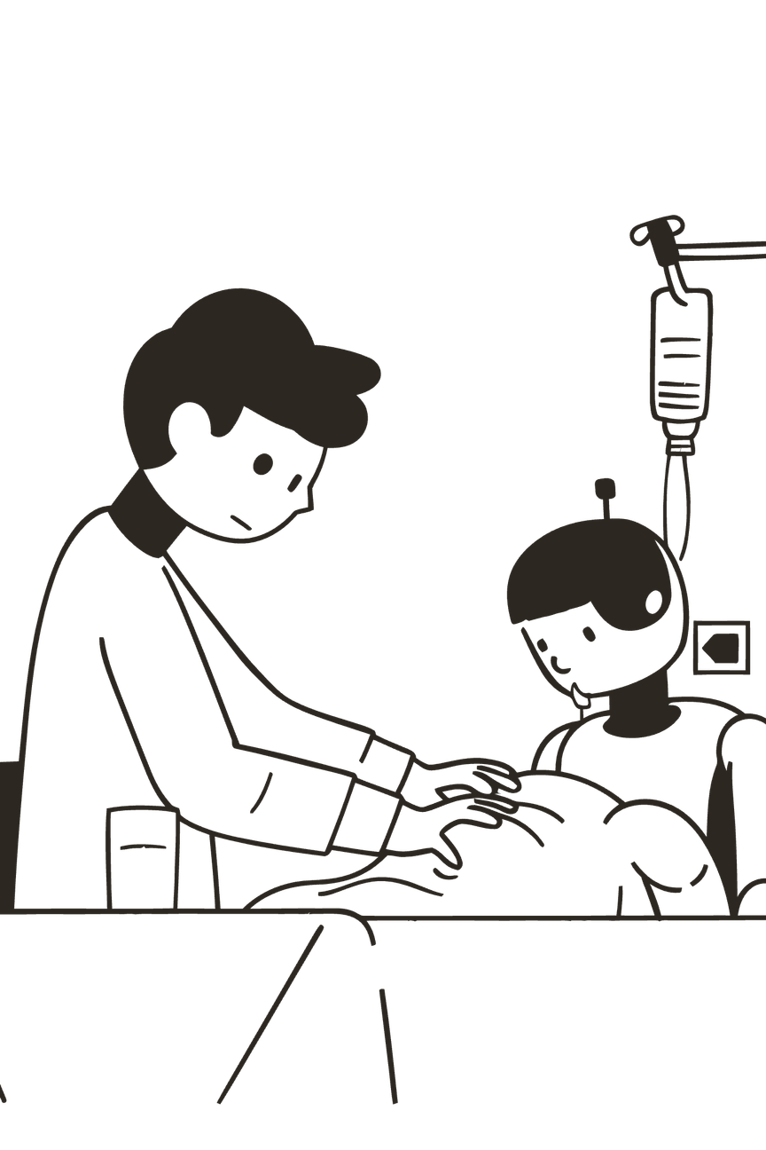



Expected Impact & Use Cases: Transforming Patient Care
91%
4X
Precision & Accuracy
Faster Screening
VER-Net achieved 91% accuracy, precision, recall, and F1-score in multiclass classification, outperforming other models.
Automates initial CT scan analysis, reducing clinician workload and enabling focus on complex cases.
100%
Improved Accessibility
Democratizes advanced diagnostics for deployment in low-resource healthcare settings worldwide.
Screening Programs
Rapidly analyze large volumes of CT scans for population-level lung cancer screening initiatives.
Diagnostic Assistance
Provide clinicians with a reliable second opinion, reducing diagnostic errors and improving patient outcomes.
Subtype Classification
Differentiate between various lung cancer types for targeted, personalized treatment plans.
Notes:
5

Slide 6
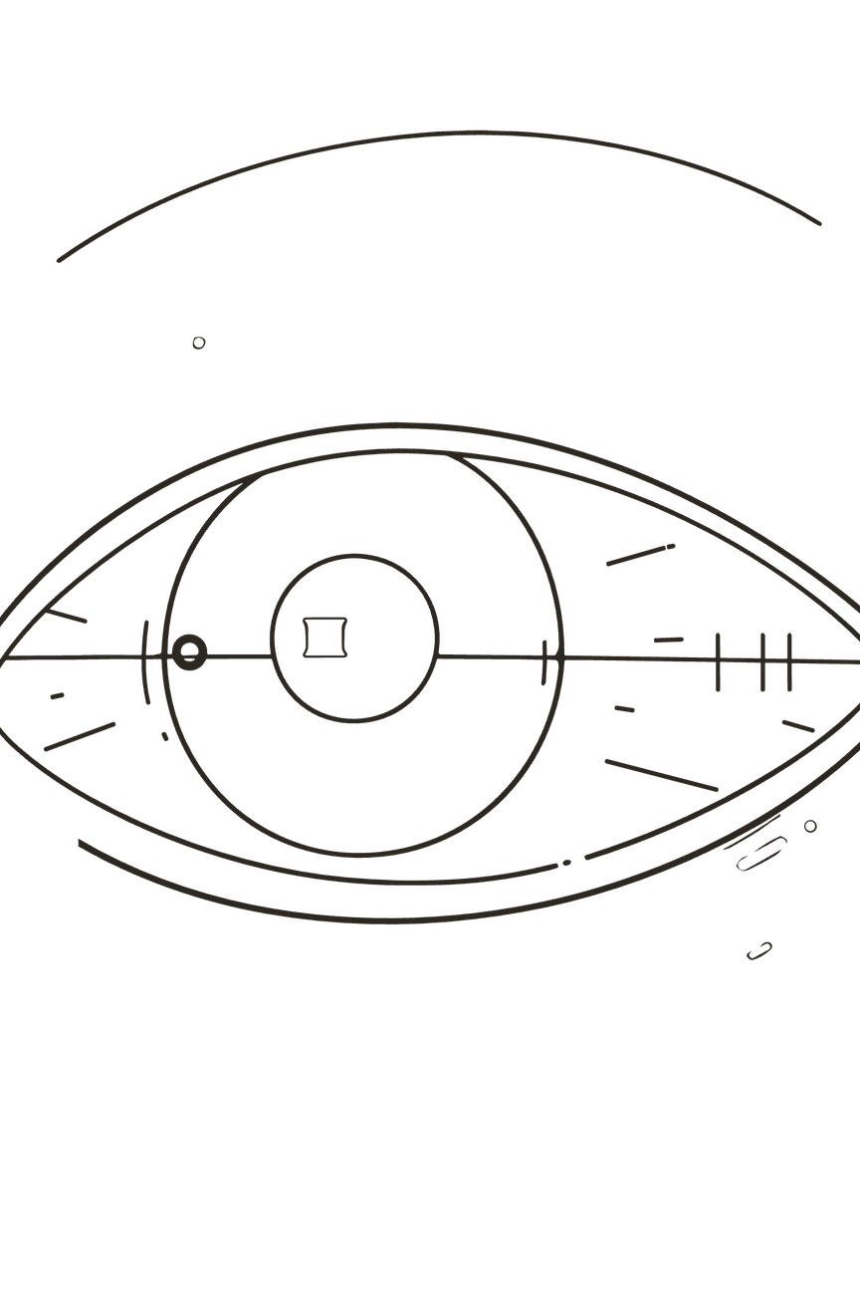



The Future of Lung Cancer Detection: Scalability & Innovation
Innovation
VER-Net's hybrid architecture and robust preprocessing offer a novel, effective approach to lung cancer classification.
Feasibility
Demonstrated high performance metrics utilizing established deep learning techniques and accessible tools.
Scalability
Framework adaptable to other medical imaging modalities and diseases, including various cancers and organ conditions.
Electronic Health Records Integration
Real-Time Analysis
Seamless connection with patient records for comprehensive diagnostic workflows and longitudinal patient monitoring.
Development of streaming analysis capabilities for immediate results during CT scan procedures, enabling faster clinical decisions.
Explainable AI Features
Enhanced interpretability tools providing clinicians with clear reasoning behind classifications, building trust and transparency.
Notes:
6

