Slide 1
PROXA ECHO
Conversational AI Avatar Platform
Real-time voice · Live2D avatars · Multi-persona HCP simulation
Team CodeWithMay | HackIndia Conversational AI Hackathon 2026
Round 2 — 5 June 2026
▶ LIVE DEMO READY

Slide 2



THE PROBLEM
Why Proxa Labs Needs This
Cost
Latency
Risk
Prohibitive Token Costs
One-Way API Design
Dangerous Platform Lock-In
Existing third-party avatar APIs are priced for marketing videos — not enterprise-scale conversational AI. At thousands of reps × daily sessions, costs spiral uncontrollably.
Current providers were built for video generation, not real-time dialogue. The architecture forces awkward workarounds that introduce unacceptable latency for conversational simulation.
No control over pricing changes, API deprecations, or roadmap direction. A single pricing update from a third-party could shut down the entire Proxa Echo product.

Slide 3




OUR SOLUTION
Proxa Echo
An open-source, browser-native conversational AI avatar engine — built for Proxa Labs' exact requirements.
Real-Time Voice
Live2D Avatars
LLM Streaming
Zero Install
600ms silence detection
Continuous STT
WebGL rendering
15 emotion states
Claude · GPT-4 · Ollama
SSE token streaming
Runs in Chrome & Safari
Docker-ready

Slide 4
ARCHITECTURE
How It Works End-to-End
1
2
3
4
Voice Input
LLM Engine
TTS Pipeline
Live2D Avatar
→
→
→
Web Speech API
Continuous STT
Claude / GPT-4
SSE Streaming
Google Neural2
Sentence chunks
Lip sync · Emotion
Expression system
Stateless Backend
SSE Transport
Emotion Tags
Provider Swap
Every request carries full history. Horizontal scaling with zero config behind any load balancer.
Server-Sent Events stream text tokens and base64 MP3 audio chunks simultaneously to the browser.
LLM prefixes each reply with [EMOTION:X]. Parsed client-side to trigger Live2D expressions instantly.
Change LLM_PROVIDER= in .env. No code changes needed. Supports Ollama, Claude, and GPT-4.

Slide 5
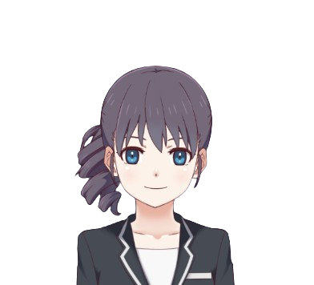

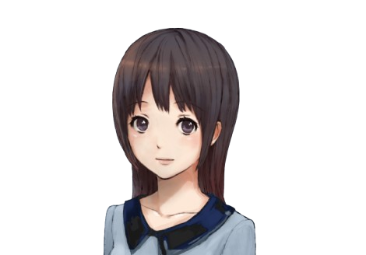

PERSONA SYSTEM
4 Clinical HCP Personas
Each with distinct voice, personality, clinical focus, and Live2D avatar
💊
🏥
🥗
🧠
Haru
Izumi
Emma
Dr. Aiko Tanaka
Pharmacist
Registered Nurse
Dietitian
Psychologist
Drug interactions · Bioavailability · Formulary
Patient safety · Dosing · Side-effects
Nutrition interactions · Lifestyle · Metabolism
Dependency risk · Cognitive effects · Therapy
Analytical
Neural2-F
Empathetic
Neural2-C
Curious
Neural2-E
Calm
Neural2-H

Slide 6
AVATAR INTELLIGENCE
Real-Time Emotion & Lip Sync
LLM Response
Tag Parser
Live2DManager
Expression
[EMOTION:happy]
Response text...
→
Regex extracts
emotion label
→
.setEmotion()
before full reply
→
Smile.exp3.json
+ motion group
15 Supported Emotions
neutral
happy
sad
angry
surprised
blushing
curious
thinking
concerned
analytical
engaged
calm
excited
proud
embarrassed
Lip sync: Web Audio API RMS amplitude → CubismLipSyncUpdater → ParamMouthOpenY

Slide 7




INTEGRATION QUALITY
Built for Proxa Labs' Stack
avatar.config.json — Zero-code persona deploy
LLM Provider Swap
{
Set LLM_PROVIDER=anthropic in .env. Claude, GPT-4, or Ollama — one line, zero code changes.
"name": "Dr. Priya Sharma",
"role": "Cardiologist",
Stateless Architecture
"specialty": "Interventional",
All conversation state lives client-side. Backend is trivially horizontally scalable behind AWS ALB.
"traits": "direct, evidence-based",
Docker + AWS-Ready
"dialogueBehavior": "concise",
Docker Compose for local dev. Container-ready for ECS or Cloud Run. No persistent storage needed.
"ttsVoice": "en-US-Neural2-H",
"systemPrompt": "You are..."
React Embed-Ready
}
AvatarCanvas.jsx is a self-contained React component. Drop it into any existing React app.

Slide 8
JUDGING CRITERIA
How We Score Against the Brief
40%
Conversational Realism
Strong
Live2D WebGL · 15 emotions · Sentence-chunked TTS · Sub-1s perceived latency
30%
Technical Completeness
Meets Req.
Voice → STT → LLM → TTS → Avatar full pipeline · Multi-turn (14 turns) · Mobile Chrome + Safari
20%
Integration Quality
Strong
Stateless API · JSON persona config · Single .env provider swap · Docker Compose · AWS-deployable
10%
Code Quality
Strong
README + TECHNICAL.md + Licensing docs · MIT licence · Clean folder structure · .env.example

Slide 9


LIMITATIONS & ROADMAP
What We Know, What Comes Next
Known Limitations
Roadmap
Next
Phoneme-accurate lip sync (Rhubarb WASM) · WebRTC audio streaming
Amplitude-only lip sync
Mouth driven by audio RMS, not phonemes. Convincing but not frame-perfect.
Q3
Azure Cognitive STT fallback for Firefox/iOS · 5+ avatar personas
Firefox / iOS Safari STT
webkitSpeechRecognition is Chromium-only. Text input always works as fallback.
Q4
SCORM / LMS integration · Session recording & playback · Analytics dashboard
Live2D sample model licence
Bundled models are under Live2D Free Material Licence — not MIT. Commercial deployment requires purchase or custom models.

Slide 10
PROXA ECHO
Where AI Meets the Clinic.
Open-source · MIT licence · Docker-ready · Claude/GPT-4/Ollama
< 1s
15
4
Perceived latency
Emotion states
HCP personas
Team CodeWithMay · HackIndia 2026
https://github.com/HackIndiaXYZ/conversation-ai-hackathon-2026-codewithmay

