Slide 1

1
GOVERNMENT COLLEGE OF ENGINEERING ,KARAD
(An Autonomous institute of govt. of Maharashtra)
MINI PROJECT USING DESIGN TOOLS PROJECT
REPORT
TITLE: -TEMPERATURE MONITORING SYSTEM USING ANDROID
PROJECT GUIDE:-SHAH MADAM

Slide 2
2
GROUP MEMBERS:-
NAME: | ROLL NO: | SIGN:
RIGVED V.PURNEKAR | 16151270
MAHESH V SHEJUL | 16151271
AKASH DESHMUKH | 14153201
Sign of project guide

Slide 3
3
INDEX:
CONTENTS | PAGE NO.
ABSTRACT | 4
INTRODUCTION | 5
BLOCK DIAGRAM | 6
CIRCUIT DIAGRAM | 7
COMPONENTS AND THEIR DESCRIPTION | 8-10
PROGRAM | 11
WORKING | 12
OBSERVATIONS
APPLICATIONS
ADVANTAGES,DISADVANTAGES
RESULT/CONCLUSION
FUTURE SCOPE

Slide 4
4
ABSTRACT:-
This article describes a temperature monitoring system on an Android smartphone. Temperature is sensed by a temperature sensor installed in the circuit and is sent over Bluetooth to the smartphone. An Android application is used in the smartphone to display temperature data. The system provides easy monitoring of process data on a smartphone.
You can connect the smartphone wirelessly with the system and monitor the process variable, when desired. The system can easily be customised to monitor other process variables also.

Slide 5
5
1. INTRODUCTION
This project explains about a simple low cost circuit which can be mainly used in large scale industries to detect the high temperature or low temperature and take immediate action. this circuit is used to measure or sense the temperature at a place.it indicates temperature on the android application which is paired with the HC05 bluetooth module.this circuit makes use of the LM35 temperature sensor which is a 3 pin centigrade temperature sensor IC. It directly senses the temperature and sends the data to the arduino device.
The block diagram of the temperature monitoring system consists of a temperature sensor, Arduino UNO,HC05 bluetooth module and an android application on which the final output can be seen. The temperature sensor senses the temperature and sends it to the arduino which sends the digital data to the bluetooth module and could be seen by pairing the device with android.
Complete project is built around the microcontroller named Arduino UNO. and the source code is developed using an open source software called ARDUINO that helps you to write, compile, debug and run arduino programs by uploading the program to the board.to upload the code into arduino we connect the board to the PC by USB cable connected to the board.

Slide 6
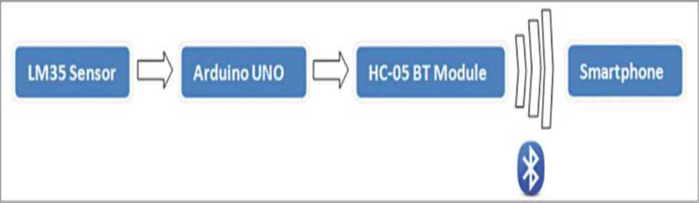
6
2. BLOCK DIAGRAM
DESCRIPTION: -
The block diagram of temperature monitoring system consist of a temperature sensor ,arduino UNO,HC05 bluetooth module and the android application which is present on smartphone.LM35 senses the temperature and sends it to the arduino UNO board which then sends the data to the bluetooth module and then in the end by pairing the bluetooth module with the smartphone we can see the temperature being displayed on the screen in degree centigrade.

Slide 7
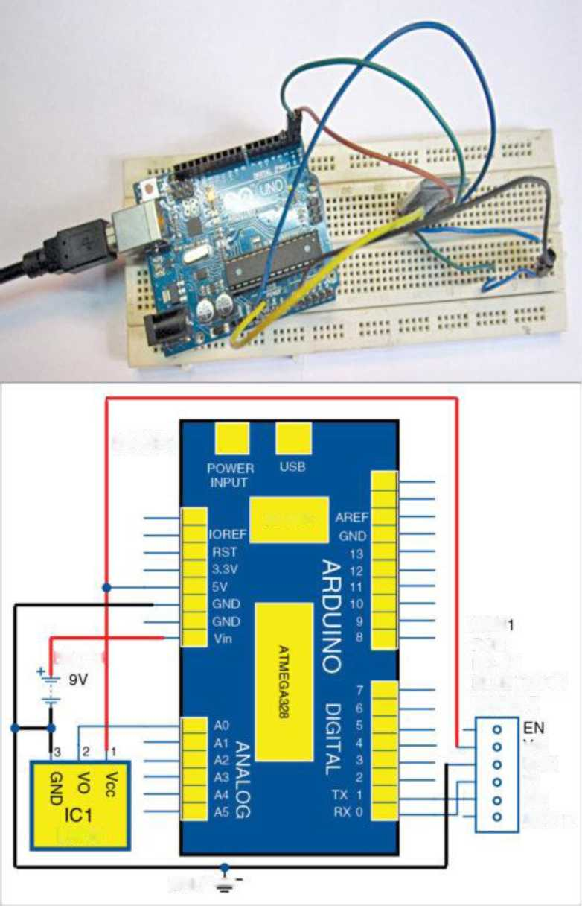
7
3. CIRCUIT DIAGRAM:-
B0ARD1
DRIVE fl
CON
BATT.1
FOR
HC-05
BLUETOOTH
MODULE
vcc
GND
Tx
Rx
STATE
LM36
GND“=

Slide 8
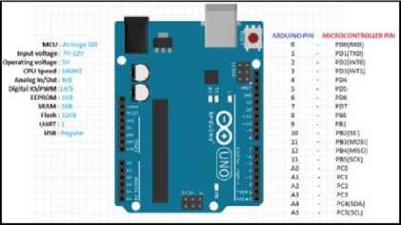
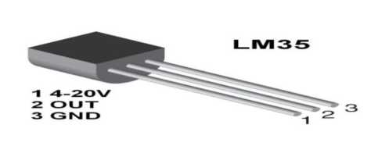
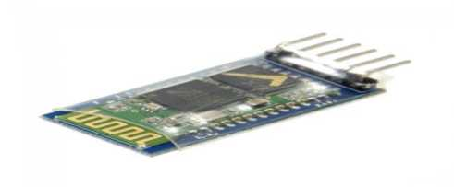

8
4. COMPONENT LIST AND THEIR DESCRIPTION:-
• Arduino UNO:
• LM35(TEMPERATURE SENSOR):
• HC-05 BLUETOOTH MODULE:
• BATTERY (9V):

Slide 9
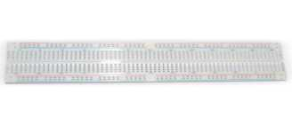
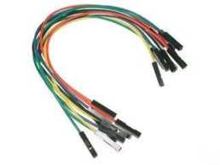
9
Bread Board:
Connecting wires:

Slide 10
10
ARDUINO UNO:
The Arduino UNO is an open-source microcontroller board based on the Microchip ATmega328P microcontroller and developed by Arduino.cc.The board is equipped with sets of digital and analog input/output (I/O) pins that may be interfaced to various expansion boards (shields) and other circuits. The board has 14 Digital pins, 6 Analog pins, and programmable with the Arduino IDE(Integrated Development Environment) via a type B USB cable.It can be powered by a USB cable or by an external 9 volt battery, though it accepts voltages between 7 and 20 volts. It is also similar to the Arduino Nano and Leonardo.
LM35(TEMPERATURE SENSOR):
LM35 series are precision integrated circuit (IC) temperature sensors, whose output voltages are linearly proportional to Celsius (Centigrade) temperature. LM35, thus, has an advantage over linear temperature sensors calibrated in ° Kelvin You are not required to subtract a large constant voltage from its output to obtain convenient Centigrade scaling.LM35 does not require any external calibration or trimming to provide typical accuracies of ±14°C at room temperature and ±3/4°C over a full -55 to +150°C temperature range. Scale factor is 10mV/°C. Vout pin of LM35 temperature sensor is connected to analogue input pin A0 of Arduino Uno on the transmitter side.
HC-05 BLUETOOTH MODULE:
HC-05 module is an easy to use Bluetooth SPP (Serial Port Protocol) module, designed for transparent wireless serial connection setup. Serial port Bluetooth module is fully qualified Bluetooth V2.0+EDR (Enhanced Data Rate) 3Mbps Modulation with complete 2.4GHz radio transceiver and baseband. It uses CSR Bluecore 04-External single chip Bluetooth system with CMOS technology and with AFH(Adaptive Frequency Hopping Feature). It has the footprint as small as 12.7mmx27mm. Hope it will simplify your overall design/development cycle.

Slide 11
11
5.ARDUINO PROGRAM-
int i = 0; float temp =0;
void setup()
{
Serial.begin(9600);
}
void loop() {
i=analogRead(A1);
temp=(i/1024.0)*500; (i/1024.0)*500;
Serial.println(temp);
delay(2000);
}

Slide 12
12
6. WORKING
• Design the circuit as per the circuit diagram shown above.
• The lm35 temperature sensor senses its surrounding temperature in the form of AC voltage.
• The output of lm35 sensor which is the AC voltage is given as input to the arduino.
• The Arduino converts the AC voltage of sensor to the DC voltage.
• According to the program, the DC voltage is converted into the required temperature which is then given as an input to the HC05 bluetooth module.
• The HC05 bluetooth module is paired with the smartphone app where we can see the temperature sensed by the sensor in degree celcius.

Slide 13
13
7. OBSERVATIONS:-
Sr. No | SURROUNDING CONDITIONS | TEMPERATURE
1. | WHEN TEMPERATURE SENSOR IS IN NORMAL ENVIRONMENT
2. | WHEN TEMPERATURE SENSOR SURROUNDED BY HOT BODY

Slide 14
14
8. APPLICATION S: -
• It can be used in environmental temperature monitoring.
• It is used in large scale industries where it can detect if the temperature of the
surrounding is above a permissible level or not.
• it can be used to monitor temperature sensitive products such as foods, pharmaceuticals, some chemicals etc because they can get degraded after the exposure to temperatures outside of an acceptable range.

Slide 15
15
9.ADVANTAGES:-
•It is a wireless system.
•It gives better performance and reliability.
• Light in weight.
• Compact in size.
• It is portable so we can carry it to anywhere
10. DISADVANTAGES:-
• The Bluetooth module has low range so we cannot operate it for long distances.
• Due to temperature variations, sometimes its efficiency may decrease.

Slide 16
16
11. RESULT/CONCLUSION
Hence, we can monitor the surrounding temperature in degree celcius with the help of temperature sensor using arduino by pairing the smartphone with Bluetooth module.the output was verified by monitoring the temperature at different conditions such as extreme hot conditions,extreme cold conditions and also normal conditions.
12. FUTURE SCOPE:-
The temperature monitoring system is a simple whereas useful circuit with which the temperature can be monitored using LM35 temperature sensor. in the future, the circuit can be enhanced by connecting it to a GSM module so that in industrial area when a machine crosses the set temperature around its surroundings, we can inform the control room by sending a message so that the damage can be avoided.

