Slide 1
IPV6 Attacks
Death by powerpoint
Executed by Claymore

Slide 2
Legal BS
The content presented in this talk, titled ‘IPV6 Attacks,' is intended strictly for educational and informational purposes only. The speaker does not endorse or encourage illegal or unethical activities of any kind. The methods, techniques, and information discussed are to be understood as theoretical considerations and are shared with the sole aim of improving network and system security and to raise awareness about potential vulnerabilities.
The speaker and any affiliated parties will not be responsible for any misuse of the information provided in this talk. The audience is cautioned against the illegal or unauthorized use of any technique or information discussed, as such actions may lead to legal consequences and penalties under law.
This talk does not provide exhaustive coverage of the topic and should not be relied upon for making decisions regarding network or system security or for engaging in any form of system exploitation. Attendees are responsible for their actions and are advised to seek professional advice before implementing any strategies or techniques discussed in this talk.
Your participation in this talk indicates your understanding and acceptance of these terms.

Slide 3
What this talk is and isn’t
What this talk is:
Information about the differences between IPv6 and IPv4.
Examples of what happens when you treat IPv6 like the unloved stepchild.
A high-level overview of how to mitigate some of the consequences of neglecting IPv6.

Slide 4
What this talk is and isn’t (cont.)
What this talk isn’t:
Intro to IPv6 networking (If you don't know it, Google it! For now, just shake your head and pretend you understand what's happening).
Advice on how to set up your IPv6 network securely.
Attacks against the IPv6 protocol itself.
Attacks against IPv6 Internet based address (mostly)

Slide 5
IPv4 vs IPv6
Fight!
IPv4 has 32 bits for address giving us approximately 4.3 billion unique addresses (And we have used them all!)
IPv6 has 128 bits for address giving a LOT of address (3.4 * 10³⁸)
IPv4 uses base 10 to create an address e.g. 192.168.0.1
IPv6 uses Hex (base 16) to create an address e.g. 2001:4860:4860:0000:0000:0000:0000:8888 or 2001:4860:4860::8888
IPv4 Requires manual configuration via DHCP or static assigned IP address
IPv6 Supports Automatic address configuration through SLAAC
IPv4 has RFC 1918 address spaces which can’t be routed over the internet
IPv6 Has ULA address which can’t be routed over the internet

Slide 6
Things people forget about IPv6
All modern operating system prefer IPv6 over IPv4
Most ISPs will assign you a IPv6 Subnet (normally a /32 but sometimes just a /64)!
Unless you firewall off IPv6 at your gateway your devices will more than likely get a IPv6 address and will be on internet at large.
Some ISPs are now locking down non-ephemeral ports (ports below 1024 as per RFC-6056)
Although IPv6 is the prefered/default for operating systems this is not true for firewall software. Meaning just cause you blocked port 445 on IPv4 doesn’t mean it's blocked on IPv6.

Slide 7
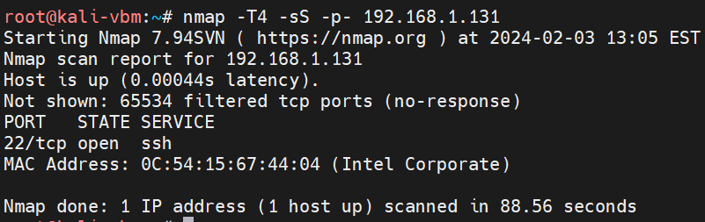
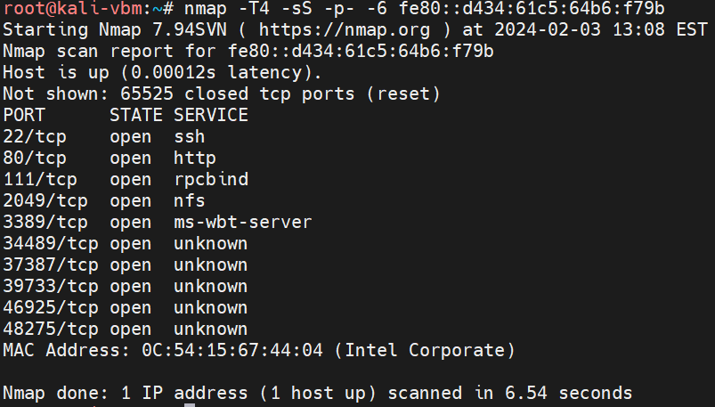
Firewall what firewall?
Although the OS defaults to IPv6 Most Firewalls Don’t!
IPv4 Firewalls Rules might not be on IPv6 for the same machine.

Slide 8
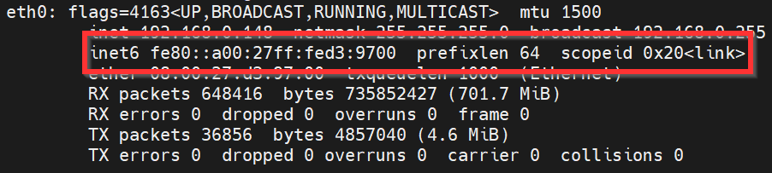
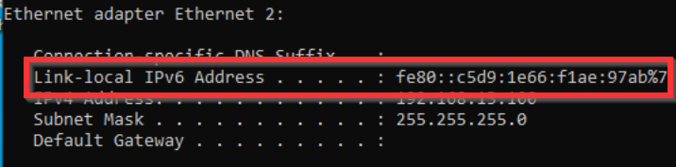
How do I know IPv6 is enabled
Link Local probably is!

Slide 9
Finding other host on the local network
ping6 ff02::1
Reveals all link local address on your network
ping6 ff02::2
Reveals the router for the link local address
Scan6 -v -i <interface> -L
Cleaner output then ping6 above
Nmap/masscan for IPv6 (Good Luck!)
TCPDUMP (All I see is red head, blonde, and brunette)

Slide 10
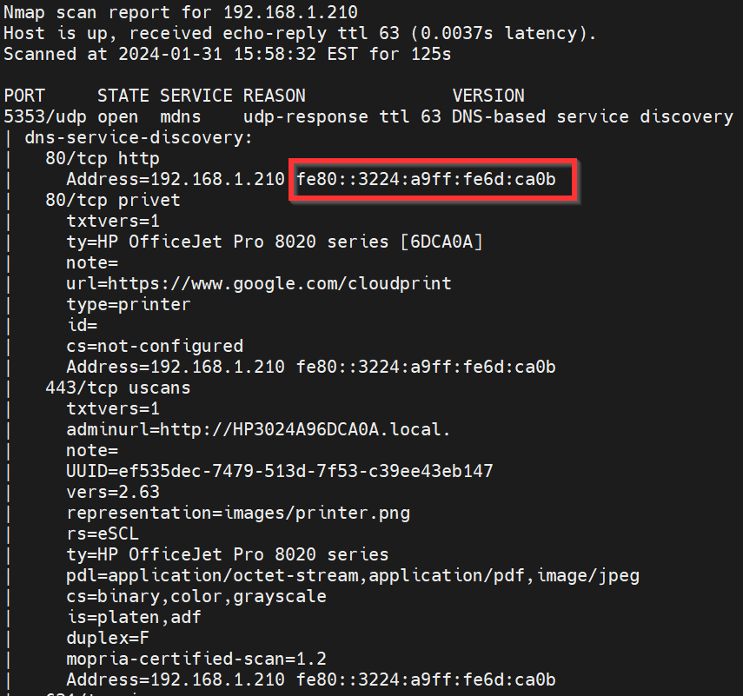
MDNS is always a problem
MDNS
nmap --open -vvv -sUC -sV -p5353 <ipv4 target subnet>

Slide 11
IPv6 Take over!
IPv6 Take over occurs when a network isn’t actively using IPv6 but it is enabled on host within a internal network. A malicious actor then abuse NDP (Network Discovery Protocol) to redirect the flow of the network traffic as they wish (MITM Attacks).

Slide 12
Wait! WTF is NDP
NDP is ARP for IPv6 but it uses ICMPv6 messages
It adds 5 new messages types to ICMP:
1.) Router Solicitation (where is the router)
2.) Router Advertisements (I am the router)
3.) Neighbor Solicitation (marco?)
4.) Neighbor Advertisement (POLO!)
5.) Redirect (I am busy! Go ask them!)

Slide 13
Unsolicited Router Advertisements
RA packets are by default sent to a multicast address (the whole network)
RA packets can be sent without being asked for them (You know you like it)
RA packets can contain information other than Route information.
DNS server/DNS settings
All RA packets are accepted (I knew you liked it) and based on the information provided the host reconfigures itself accordingly.
In other words if the route wasn’t there before it is now!
Default routes are chosen based on a multitude of factors (don’t bother if another router is present).
DNS is updated if not present for IPv6 already and SOA’s are added/updated based on TTL.

Slide 14
Ok, but how do we abuse this?
We send out a rogue RA message:
Setting ourselves as the default route (allowing all internet bound traffic to pass through us)
Add ourselves as the primary dns server for the network.
Or Both
Leveraging the above we perform a MITM attack.
Intercepting traffic and forcing it to be decrypted to get clear text passwords
Perform Pass the Hash Attacks
NTLMv2 Relay Attacks
Session Riding
MITM6 by Dirk-jan with impacket tool kit by FORTRA
https://github.com/dirkjanm/mitm6
https://github.com/fortra/impacket

Slide 15
But How do i fix this?
If you aren't using IPv6, make sure it is disabled on all hosts and devices on your network.
Insure firewall rules cover both IPv4 and IPv6.
Run regular network scans.
Employ network monitoring (IDS/IPS).

Slide 16
The End?
Any Question?
Comments?
Complaints?
Insults?

