Slide 1

smashing the CISSP
By Stephanie “Sasha” Thomaston

Slide 2
Objective
Learn how to effectively study for the CISSP and other certifications
Methods of studying
Tip and Tricks for certifications

Slide 3
WhoamI
Military 10 years total.
Military Police 6 years Navy and Air Force (2 deployments to Kuwait )
Navy deployment worked in Tactical Ops Center (secret squirrel stuff)
Air Force deployment 240B gunner, and search pit and ECP control
Current Cyber System Operations Specialist in Air Force on mission defense team.
Civilian
Wix.com | tech support and Product Ops. Monitor
Cyber Security Consultant
Currently Sr. ISSO for an Intelligence command.
Education
Security+ (2018)
B.A in Linguistics
M.S in Cyber Security Management (2018)
Executive Doctor of business in information security (2022)

Slide 4

Experience requirements
Candidates must have a minimum of five years cumulative paid work experience in two or more of the eight domains of the CISSP CBK. Earning a four-year college degree or regional equivalent or an additional credential from the (ISC)² approved list will satisfy one year of the required experience. Education credit will only satisfy one year of experience.

Slide 5
Not Enough Experience
You can do the Associate of (ISC)² without the work experience.

Slide 6
Domains of CISSP
Domain 1. Security and Risk Management
Domain 2.
Asset Security
Domain 3. Security Architecture and Engineering
Domain 4. Communication and Network Security
Domain 5.
Identity and Access Management (IAM)
Domain 6.
Security Assessment and Testing
Domain 7.
Security Operations
Domain 8.
Software Development Security

Slide 7
Make it All Fit
You will need to fill out a form that asks for your experience and will give you an option to choose from one of the 8 domains.
You will also need to provide proof that you worked at your employment and education.

Slide 8
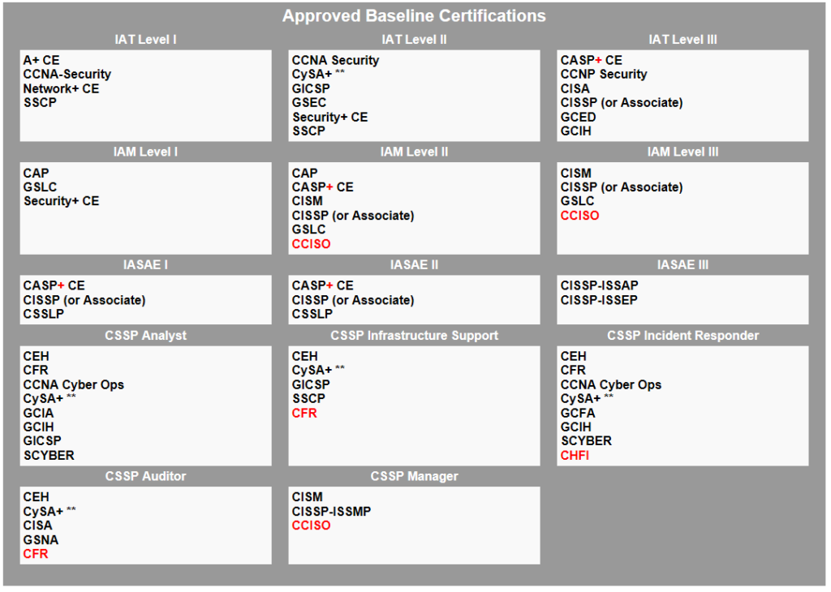
DOD 8570

Slide 9
Lets get in to it

Slide 10
My key concepts
Reading
Practice Test
Videos

Slide 11
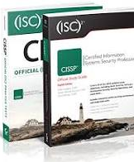
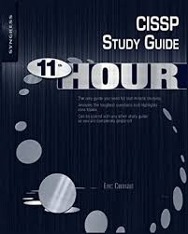
Reading
(ISC)2 CISSP Certified Information Systems Security Professional Official Study Guide & Practice Tests Bundle
Eleventh Hour CISSP: Study Guide (Syngress Eleventh Hour) 1st Edition
Read 3 days before the test

Slide 12
Practice test
*****Boson practice test*****
(ISC)2 CISSP Certified Information Systems Security Professional Practice Tests question (in book and online)
Kelly Handerhan CISSP review question

Slide 13
Videos
**Kelly Handerhan Cybrary CISSP**
Why you WILL pass the CISSP - CyberTrain.IT 10-min Series Kelly Handerhan
CISSP Cert Prep by: Mike Chapple with the book
Larry Greenblatt - CISSP 2018 Exam Tips YouTube

Slide 14

Mindset for the CISSP

Slide 15
Take the hat off
You need to go against what your hacker ways want you do…
DO NOT FIX THE PROBLEM... You are not a “doer” on this exam you are not the hacker, you are not the worker. Not Hands on… Get away from technical think about change control. Follow the process. Don’t look for Heavy tech solutions.
Senior Management is responsible.
You can have too much security. Three Bears… You want it just right. ID values of your assets.
Security > Technology
Think like a manager.
MOST important is HUMAN LIFE!!

Slide 16
No Going Back
The CISSP test uses Computerized Adaptive Testing (CAT) This more precise evaluation enables us to reduce the maximum exam time from 6 hours to 3 hours, and it reduces the items necessary to accurately assess a candidate’s ability from 250 items on a linear, fixed-form exam to as little as 100 items on the CISSP CAT exam. You can answer up to 150 questions.
Long story short you cannot go back and answer your questions and the questions that you answer incorrectly or correctly will determine the questions that you get.

Slide 17
Know your weakness
Understand what areas you are weak in

Slide 18
Know your strengths
Understand what areas you might not need to press in too much

Slide 19
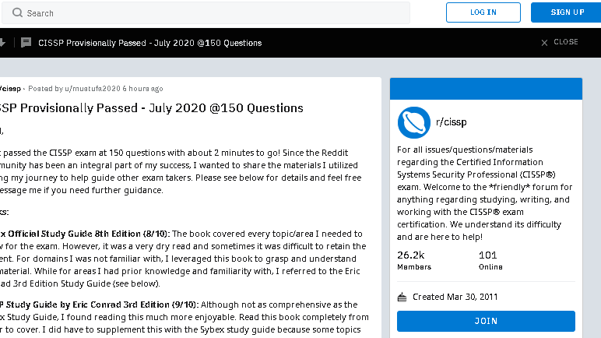
Living on Reddit to get more ideas

Slide 20
Tips and TrickS
Using something to read aloud to you. If you get the kindle addition of the book it can be read aloud
There are also apps that can read PDFs aloud if you find the pdf version of the book
Take notes
Use Quizlet for flashcards
Practice Test on your phone with the online Sybex CISSP question
Find someone to study with.
Make a schedule
Schedule the TEST******

Slide 21

Thank You
You can do it!!!!

