Slide 1



Team Unknown

Slide 2
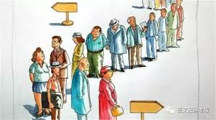
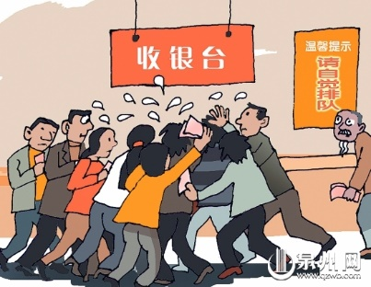
Registration Day!!!

Slide 3


Prototype & Testing

