Slide 1



Team Platina
SRM Institute of Science and Technology
Batch of 2021
Himanshu Giri
Tarun Verma
Prakhar Srivastava
Diksha Bubna

Slide 2

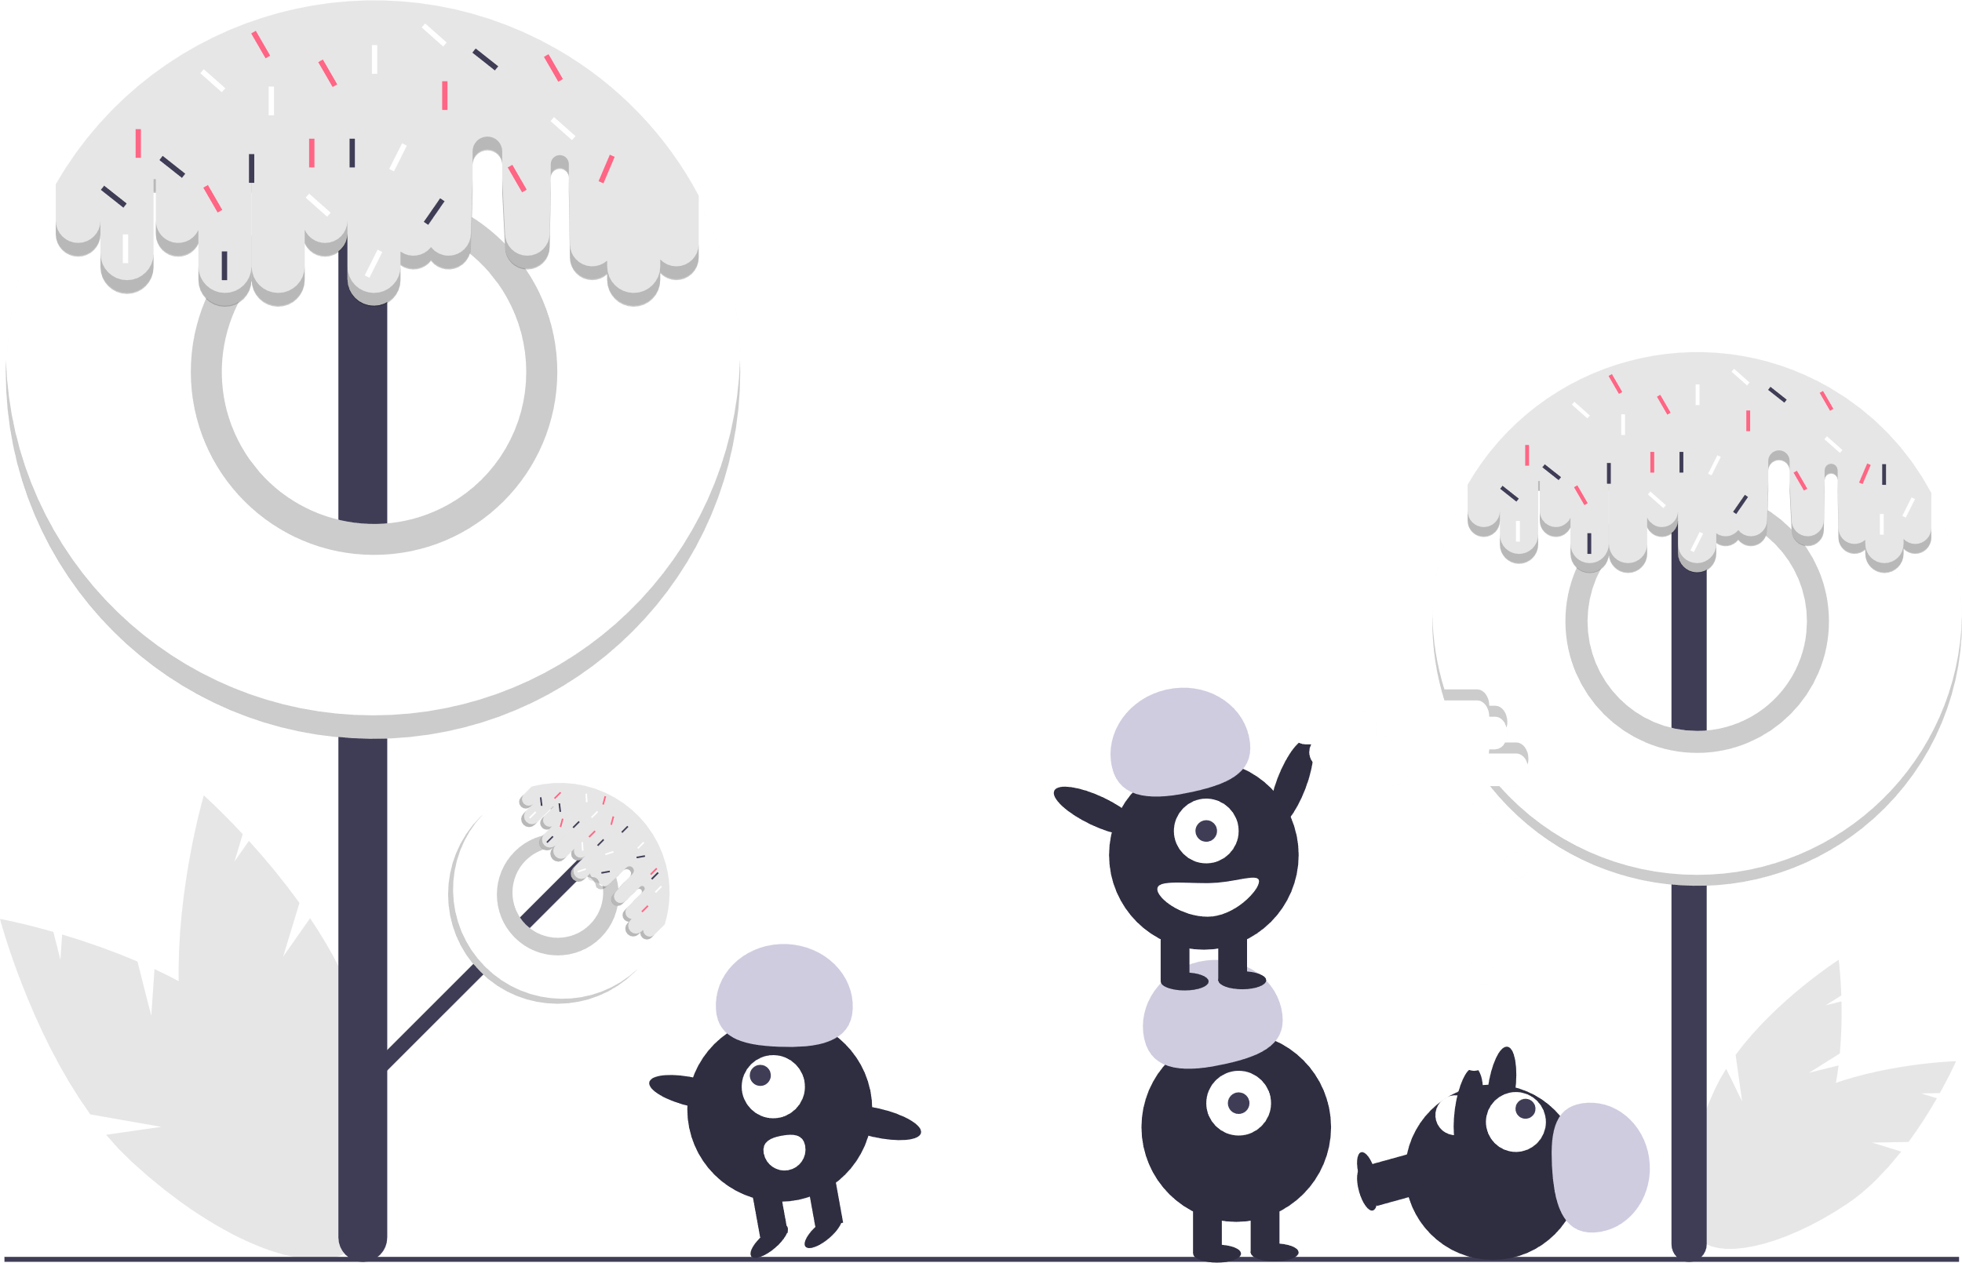
About Us
We are passionate about problem solving and have therefore participated in various hackathons some of which include SIH 2019, SIH 2020, HackRx 2020, Grid 2.0. Apart from that we have also worked on projects like Voice Prescription (Problem Statement of SIH 2020), Image Processing using ML, Classification & Identification of Satellite Images of Land Masses. Our group is composed of people who are interested in various fields like Data Science, Machine Learning, Web and App Development.

Slide 3

Face Detection Algorithm
The objective is to create a face detection API based utility that will accept or reject the input image along with assigning a fitment score as a criterion of acceptance or rejection. The model assigns values to the input images. On the predefined set of criteria's, the images are either accepted or rejected. In case if an image is rejected the model even provides the reason of rejection along with suitable measures that could be taken into account for improving the input image in order to improve the acceptance rate.
OUR PROPOSED SOLUTION
We plan to create an ML model for the mentioned problem statement. The purpose of the system is to evaluate quality of face images for identification and to detect face images that do not satisfy the image quality requirements. The system consists of separate tests. The tests are organized in a hierarchical way so the low-level tests are executed first and the high-level tests are executed last. The requirements are designed to ensure good conditions for automatic face recognition. The low level tests consist of Image Validation for attributes like Size – Dimension checking using Pillow, Blur – Convolving a single channel image with 3x3 laplacian kernel and checking variance using OpenCV. The high level tests consist of Feature Identification, Expression Identification, Watermark Detection by the use of CNN with NumPy library and Tensorflow, Cartoon Detection using OpenCV, and Extraction of final image along with fitment score.

Slide 4

Our Approach
We plan to create an ML algorithm to obtain the desired results at the maximum possible efficiency in the least amount of time Hence to obtain the result we divide the model into 4 segments.
Input Image Validation, Feature Identification, Expression Identification, and Assigning score and finally we the extraction of final image in form of usable thumbnails

Slide 5

Process Flow
1. Input image validation:-
Check for size and resolution , DPI , watermark , cartoons , occlusion , pictures from ID cards, picture having multiple people - remove such images
2. Identification of features:-
This step includes identification of facial expressions and the professionalism of dressing
3. Fitment score:-
This step includes the calculation of the image’s fitment score
4. Image verification:-
Checking if the background of the image is relevant and the quality of the image is as required
5. Output:-
The output will contain the fitment score, the enhanced image and the thumbnail

Slide 6



USP
Using ANN to learn patterns of
interest from previously
uploaded images to reduce
the processing time.
Protects the privacy by removing or
blurring out the details like phone
numbers, addresses from the
image background
The Intelligent Model – identifies
the inappropriate images,
distinguishes between different
types of watermarks, intelligently
edits the photo while not over
exposing the image.
The Model stops piracy by
discouraging the use of
pirated things and watermarks.
Various ML Libraries to improve the
input photo.

Slide 7

Risks, Challenges and Dependencies
Risks:
1. Differentiating between the types of watermarks.
2. Removing Personal Data from the Accepted photos.
3. Enhancing the image meanwhile not degrading the quality of the input image.
4. Providing an efficient output from the model.
Challenges:
Low Resolution
Varying Illumination
Occlusion
Background Noise
Dependencies:
Machine Learning
Libraries – OpenCV, Pillow, Tesseract, Tensorflow, Scikit-Image, SciPy, Matplotlib, NumPy.
Deep Learning – CNN & ANN

Slide 8


Future Enhancement
Social Media Handle – In case of a group photo the model could learn about how a person looks, by following and obtaining their photos from their social media handles and selecting the best one out of the given scenario.
2. Confidentiality - Identifying the source of image in case of presence of a watermark on images to notify the user about the presence of image on some other sites.

Slide 9


Anything Else
We are highly inspired by the idea of developing a product which would be used by the people of our country for enhancing their lives . We are thankful for the opportunity and are looking forward to work on this project.

