Slide 1
SNAP Product Co-Purchasing Networks

Slide 2
Team Phoenix
Yaswanth Biruduraju|2024|Manipal Institute of Technology
Mihir Agarwal|2024|Manipal Institute of Technology
Pratinav Seth|2024|Manipal Institute of Technology
Siddharth Singh|2024|Manipal Institute of Technology
Mentors
V
A

Slide 3
Problem Statements (SNAP Co-purchasing)
Given the product which the user has selected:
Displaying similar products
Recommending products
Clustering products into confidence levels
Top products in each cluster
Related products using similarity metrics

Slide 4
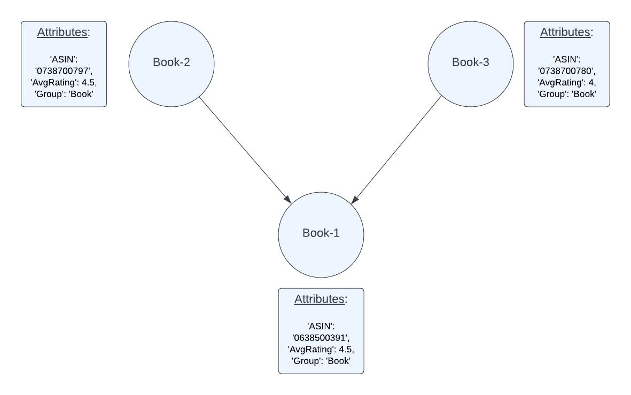
Data Set
Metadata
Containing information about each product
Transactional data
Contains Co-purchase information (i.e edges of the graph)
Both these data sets are combined to make a directed graph, representing the relationship between the nodes.

Slide 6
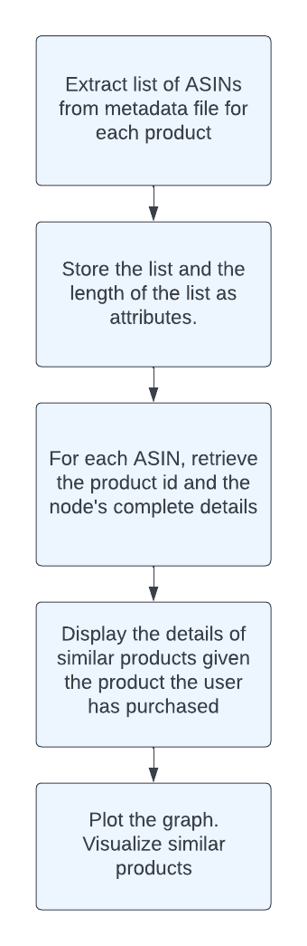
Similarity
Information of similar products are extracted from the metadata using pandas and dask
Enhances user experience drastically as a user is more likely to purchase a product if comparison of prices and features between competing products is shown.
Increases user engagement time - increases likelihood of a purchase.

Slide 7
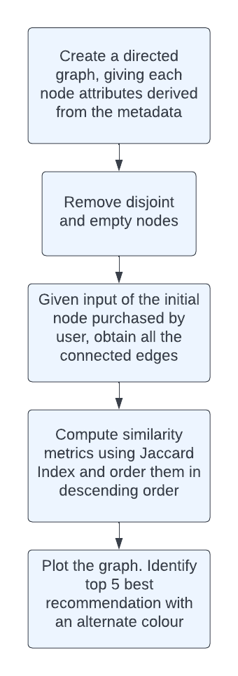
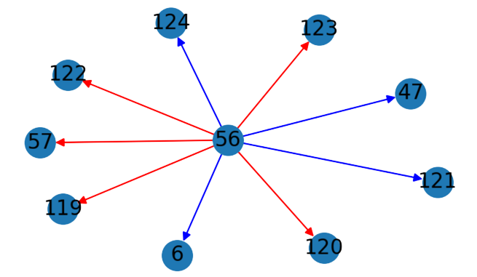
Recommendations
Provides users the best recommendations based on co-purchasing history using a similarity metric
Leads to increase in sales per order
Increases personalization
Leads to increase in user engagement - higher likelihood of purchasing a product
Red - Recommended edges
Blue - Connected but not recommended

Slide 8
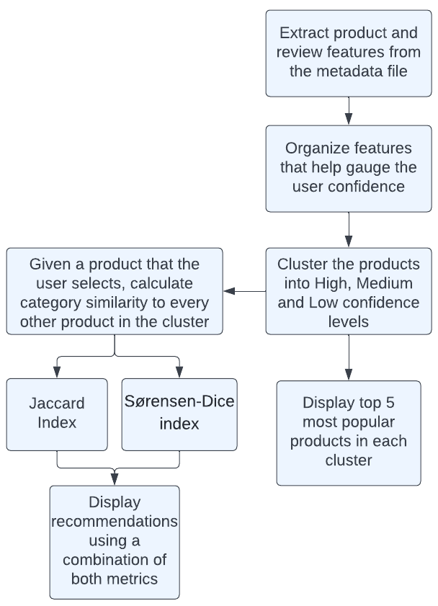
Clustering based Recommendation
By Clustering we aim to group together products based on the User Experience and Confidence
Reduces cost of exploring the graph, as problems can now be contained in a subgraph
We try to recommend users product of similar categories based on the subgraph using similarity metrics and the most popular items in the subgraph

Slide 9
Unique selling point
Multiple metrics (Jaccard and Sorensen-Dice indices) are combined to give meaningful recommendations within the cluster
Helpfulness - User reviews have been considered to determine which products are more trustworthy(confidence)
Recommendation: Due to the use of similarity metric, the results can be concentrated to only meaningful recomm
Front End - Our solution is consumed by a end - to - end webapp written using Streamlit

Slide 10
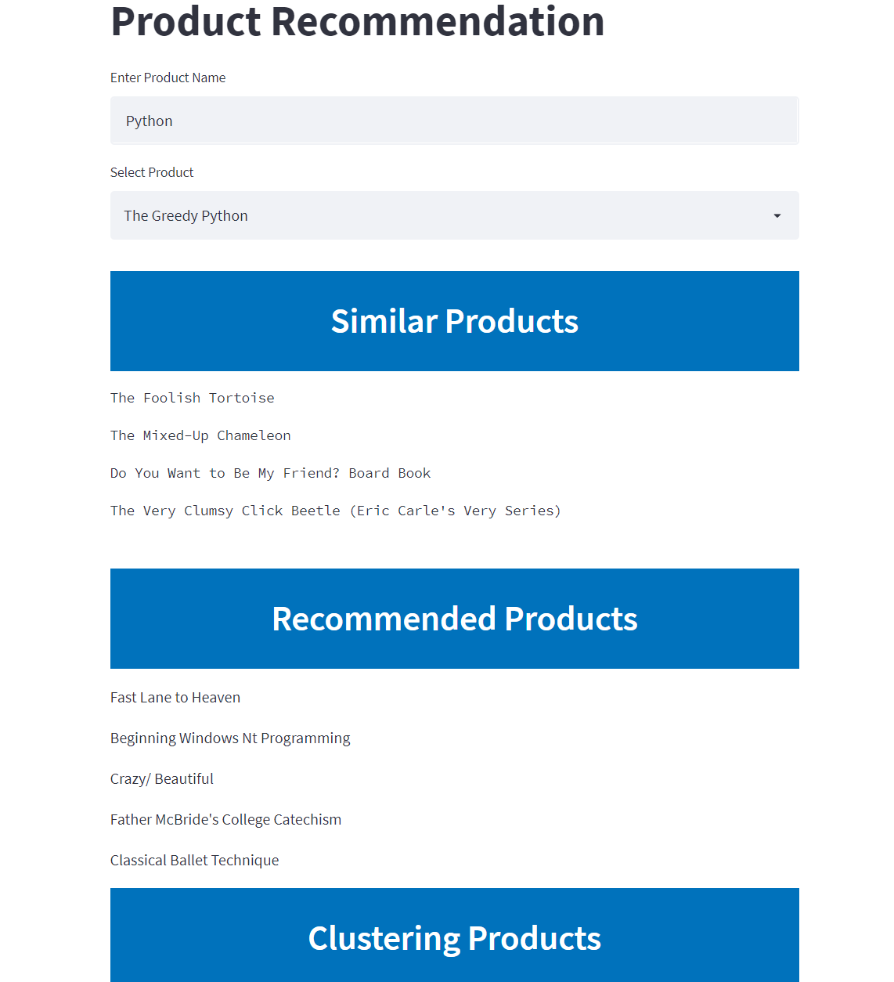
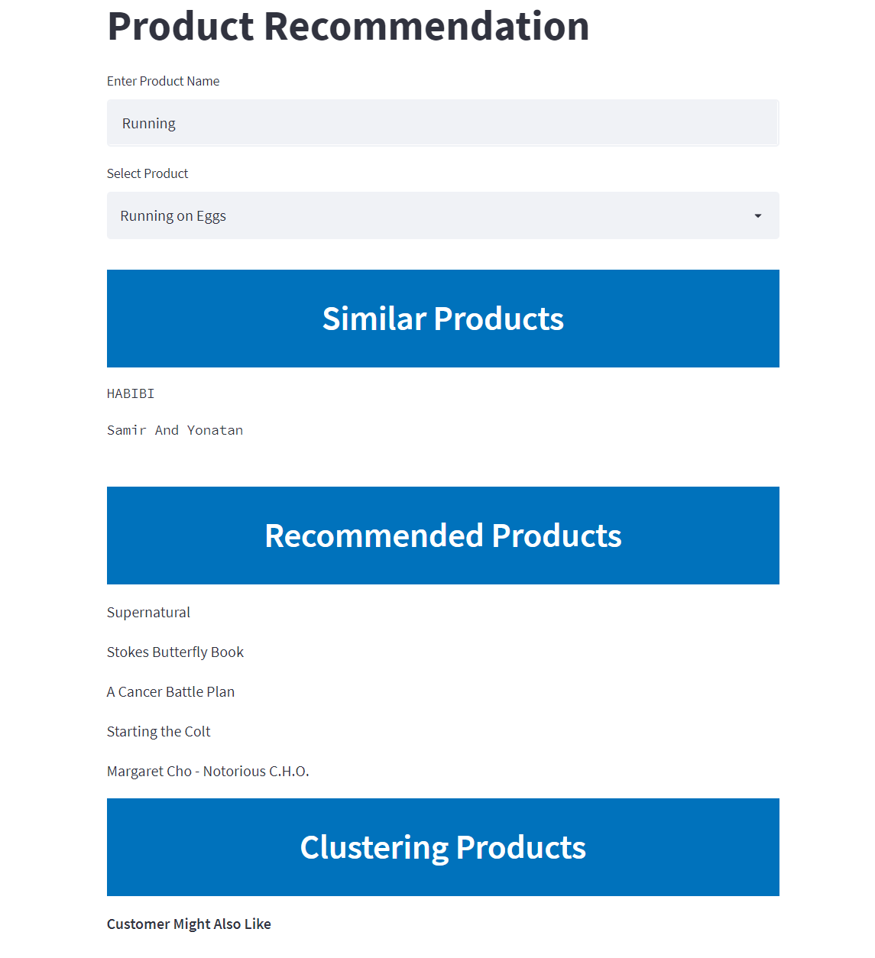
Screenshots From API

Slide 11
Conclusion
Scope
Concept can be applied to all e-commerce platforms
Ease of implementation
It is challenging to implement on new platforms, as each platform has its own properties and constraints - Manpower intensive.
Scalability
Can be scaled to large domains by using efficient pre-processing
Single layer recommendation engine will not suffice for extremely large data, a multi-layered approach is required

Slide 12
How it relates to Bajaj Finserv
Bajaj Mall
Overhead
Memory - Intensive
Specialized talent required
Future Ideas:
Predict New Relationships Between Products
Classify Spam Products
Cold Start - Product placement
Behavioural patterns (user - graph)
User profiling

