Slide 1


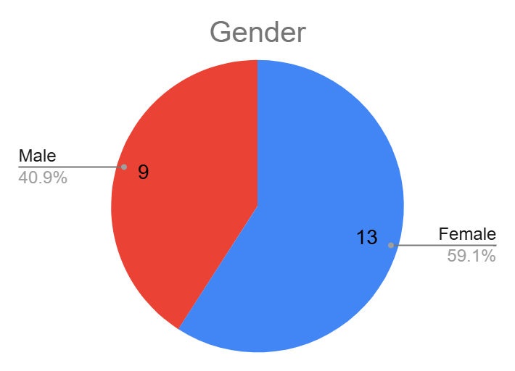
Students Details : Gender Distribution
Gender | Number of Students
Female | 13
Male | 9
Total | 22

Slide 2
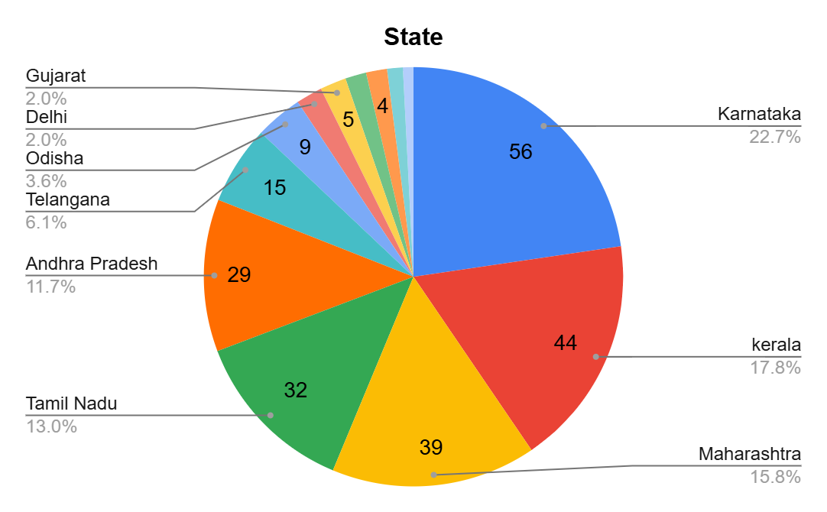
Students’ State Wise Details
State | Number of students
Karnataka | 56
Kerala | 44
Maharashtra | 39
Tamil Nadu | 32
Andhra Pradesh | 29
Telangana | 15
Odisha | 9
Delhi | 5
Gujarat | 5
Bihar | 4
Goa | 4
Punjab | 3
Himachal Pradesh | 2
Total | 247

Slide 3
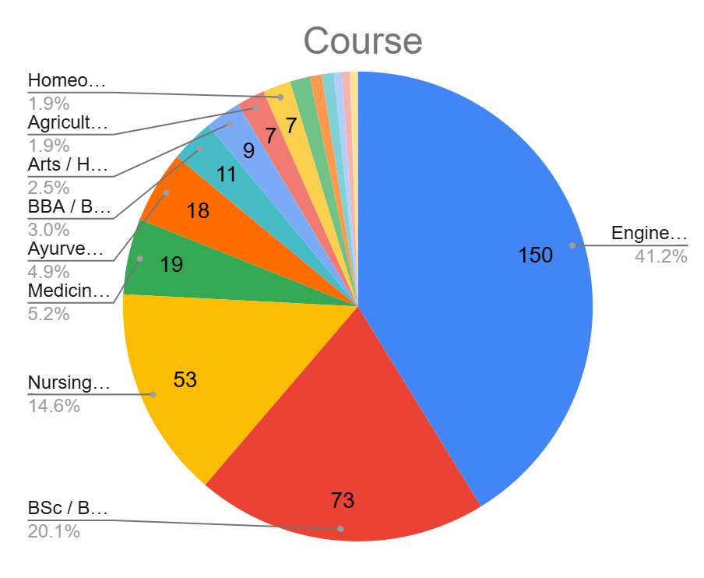
Students’ Degree Course Wise Details: InCred
Course | Number of Students
Engineering / Diploma in Engineering | 150
BSc / BSc Honours / BSc (Paramedical) | 73
Nursing / Pharmacy | 53
Medicine (M.B.B.S) | 19
Ayurvedic Medicine | 18
BBA / BCom / BCom Honours | 11
Arts / Humanities | 9
Agriculture | 7
Homeo medicine | 7
Dental surgery | 5
BCA/ BCA Honours | 3
BsMs- Integrated PG | 3
CA- Chartered accountancy | 2
Law | 2
Veterinary Medicine | 2
Total | 364

