Slide 1
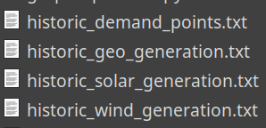
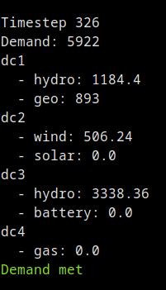
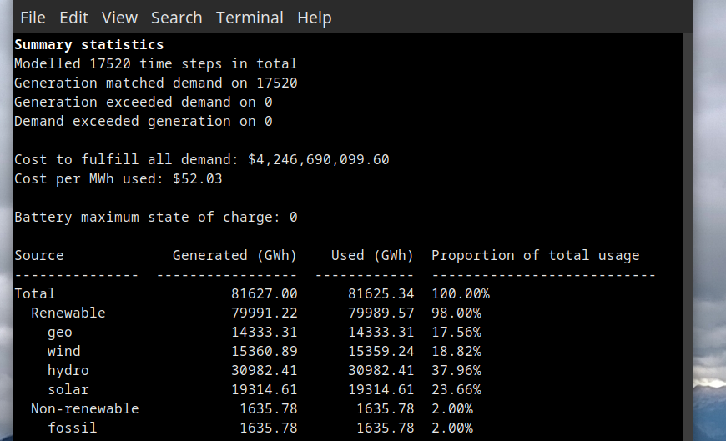
The Model
Files representing the 17,520 historical data points (“time steps”)
For each time step
    Determine the DC1 “base generation”
        Geothermal
        Mandatory 20% hydro
    If not enough, use other renewable sources (DC2)
      Wind first as we incur costs even if the energy is not used
    If still not enough, use batteries/hydro (DC3)
      Batteries charged from excess wind wen not being used
    Small amounts of gas used as
    a last resort only
      >=98% renewable generation

