Slide 1
L.A.M.D.A Quest
Live Action Modding with Dynamic Associations
Kevin Bajaj, Gred Ervin, Thomas Ford, Sean Hannah, Chris Hogan, Grant Steuart

Slide 2
A Game by Programmers, for Programmers
L.A.M.D.A Quest is a 2D, browser-based, adventure game featuring a custom-built programming language that teaches players how to write small programs and attach them to objects in the game, allowing for a customizable, challenging, and completely original gaming experience.

Slide 3
Creating a Mod for Minecraft
Stop playing the game
Learn a modding framework
Write your code in an editor or IDE
Compile your code
Load the game with your new mod
Learn Java
Play the modified version

Slide 4
Creating a Mod with the L.A.M.D.A Engine
Pause the game
Type in a script with help from the cheatsheet
Unpause the game

Slide 5
HackScript: A simple scripting language that allows users to create and attach scripts to game entities dynamically during gameplay.
Specify properties of clicked objects
tunic.color: blue
Set conditions on game entities
if enemy.distance < 2: attack()
Set timers
every 2000: heal()

Slide 6
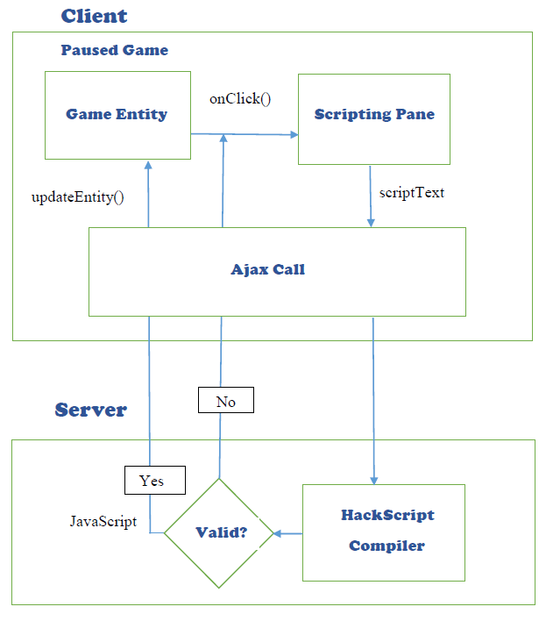
Scripting Architecture

Slide 7
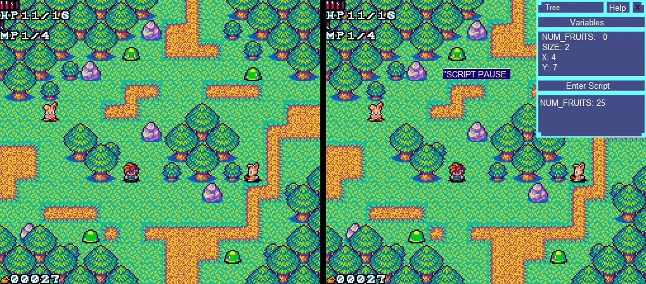
Example Screenshot

Slide 8
Game Mechanics - Progression
Can program enemies that are sufficiently weaker than you
Progressing through the game opens up more private functions and properties
Enemies drop hard drives that unlock functions and syntax
Discourage misuse of programming power through point system

Slide 9
Game Mechanics – Units and Items
Interesting enemy units
Programmable companions
Programmable attacks, spells, and weapons

Slide 10
Game Mechanics – Maps and Levels
Procedurally generated tile maps
First semester goal: Sandbox world
Second semester goal: Level design (dungeons)

Slide 11
Timeline
This Semester
Write and test scripting language and compiler
Write base game shell with tile maps and collisions
Write map generator
Write framework for injecting scripts into game objects
Next Semester
Add elements to HackScript
Add art, enemies, items, powers, etc.
Add structured levels in the form of dungeons
Time Permitting
2 player “Scripting Skirmish” mode

