Slide 1
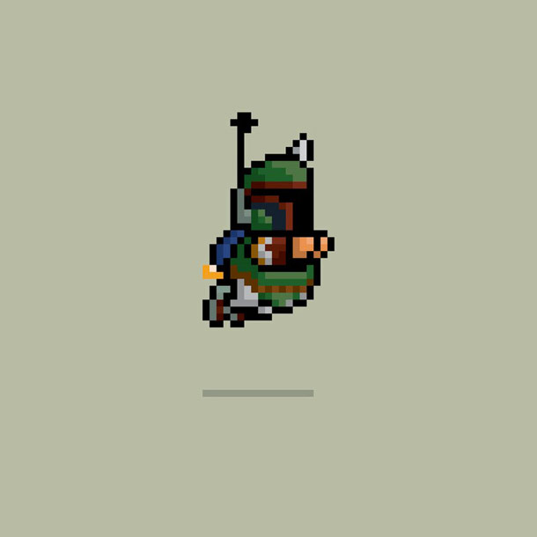
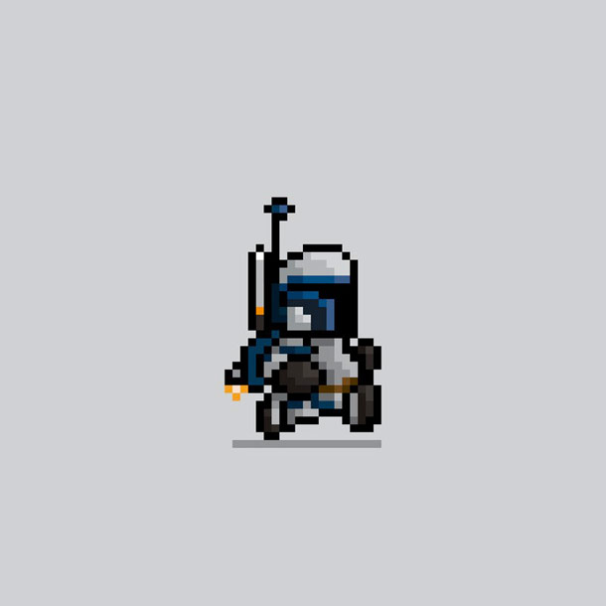
L.A.M.D.A. Quest
Description
Innovations
L.A.M.D.A Quest is a 2D, browser-based, adventure game featuring a custom-built programming language that teaches players how to write small programs and attach them to objects in the game, allowing for a customizable, challenging, and completely original gaming experience.
Offers more freedom and variety than traditional RPGs
Allows for unlimited replayability
Teaches elements of programming with a simplified, custom language
Player created scripts are compiled and attached to game elements as running code
Technical
Goals
The core framework uses the Phaser game engine, written in JavaScript
Application backend utilizes Node.js
The HackScript lexer and parser were created with Jison
The main technological challenge is injecting compiled HackScript into the running game within a canvas element on a web page
By the end of February we plan to have all of the game elements (compiler, script injection, game shell, procedural terrain generation) working together as well as a five minute playable level.
The demo will have music, sound effects, and a unique design style
By the end of the semester, we hope to have a refined, polished game with level advancement, saved states, various enemies and items, and the ability to use more complex HackScript constructs.

