Slide 1
L.A.M.D.A Quest
Live Action Modding with Dynamic Associations

Slide 2
A Game by Programmers, for Programmers
L.A.M.D.A Quest is a 2D adventure game featuring a custom-built
programming language that teaches players how to write small
programs and attach them to objects in the game, allowing for
a customizable, challenging, and completely original gaming
experience.

Slide 3
Creating a Mod for Minecraft
Stop playing the game
Learn a modding framework
Write your code in an editor or IDE
Compile your code
Load the game with your new mod
Learn Java
Play the modified version

Slide 4
Creating a Mod with the L.A.M.D.A engine
Pause the game
Type in a script with help from the cheatsheet
Unpause the game

Slide 5
HackScript: A simple scripting language that allows users to create and attach scripts to game entities dynamically during gameplay.
Specify properties of clicked objects
tunic.color: blue
Set conditions on game entities
if enemy.distance < 2: attack()
Set timers
every 2000: heal()

Slide 6
Game Mechanics
Sandbox world -- encourages creativity and exploration
Randomly spawning enemies
Procedurally generated world
Programmable companions
Programmable attacks, spells, and weapons
Can program enemies that are sufficiently weaker than you
Progressing through the game opens up more private functions and properties
Enemies drop hard drives that unlock functions and syntax
Discourage misuse of programming power through point system

Slide 7
Timeline
This Semester
Write and test scripting language and compiler
Write basic game with exploration of tile maps and collisions
Write map generator
Write framework for injecting scripts into game objects
Next Semester
Debug
Add art, enemies, items, powers, etc.
Add quest mode with specific goals
Time Permitting
2 player “Scripting Skirmish” mode

Slide 8
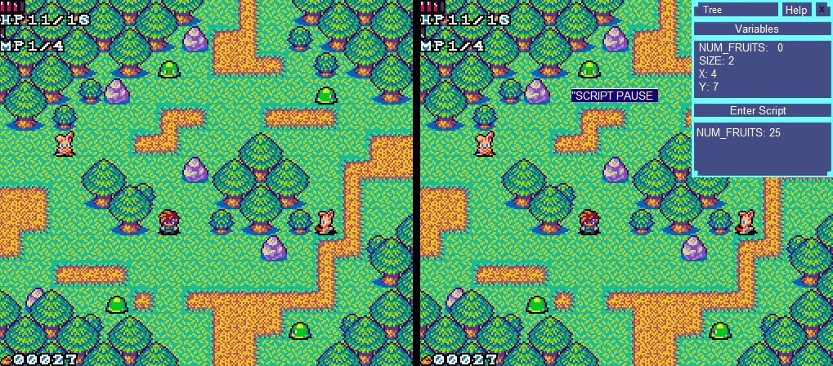
Example Screenshot

