Slide 1


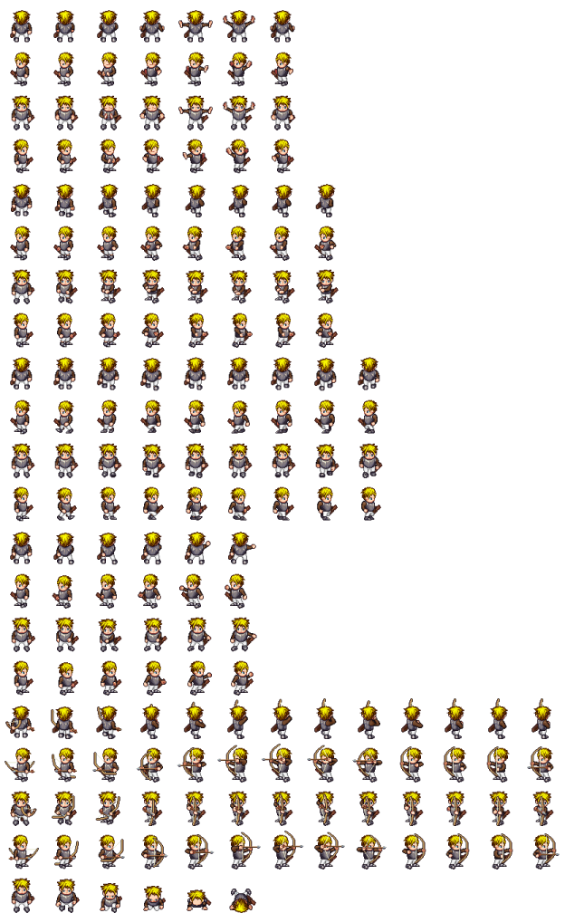
L.A.M.D.A. Quest
Description
Innovations
L.A.M.D.A Quest is a 2D, browser-based, adventure game featuring a custom-built programming language that teaches players how to write small programs and attach them to objects in the game, allowing for a customizable, challenging, and completely original gaming experience.
Offers more freedom and variety than traditional RPGs
Allows for unlimited replayability
Teaches elements of programming with a simplified, custom language
Player created scripts are compiled and attached to game elements as running code
Technical
Phaser
We ended up using a single state to control the game, and we had to find a workaround to load new maps as appropriate (because by default maps are associated with states, and phaser only expects one map per state).
In Phaser you can set collisions with specific tiles or even entire layers (as we have done with the GameEntities layer for world object).
Finally after digging through the Phaser docs we discovered that we could create a Sprite (a Phaser class) from objects on the object layer. Phaser does support collisions with Sprites, and instantiate Sprites from the object layer will keep any unique properties set in Tiled.
The core framework uses the Phaser game engine, written in JavaScript
Application backend utilizes Node.js
The HackScript lexer and parser were created with Jison
The main technological challenge was injecting compiled HackScript into the running game within a canvas element on a web page

