Slide 1


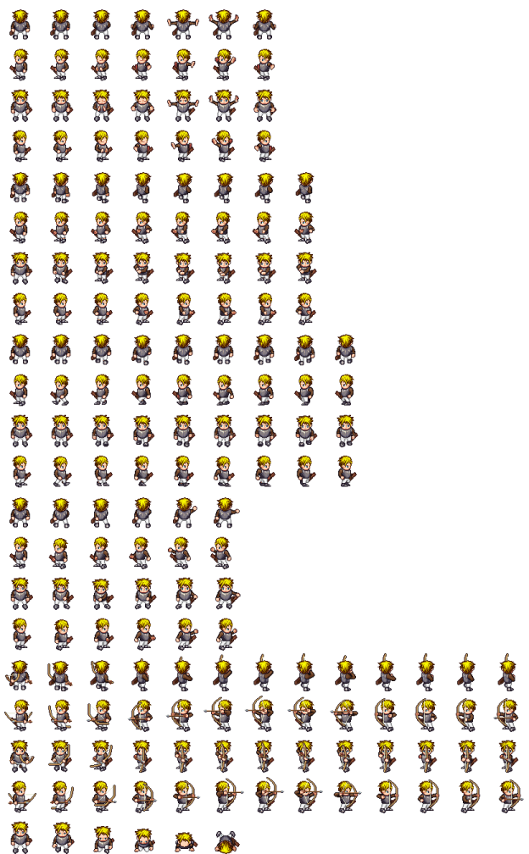
L.A.M.D.A. Quest
Description
Innovations
L.A.M.D.A Quest is a 2D, browser-based, adventure game featuring a custom-built programming language that allows players to write small programs and attach them to objects in the game, allowing for a customizable, challenging, and completely original gaming experience.
Offers more freedom and variety than traditional RPGs
Allows for unlimited replayability
Player created scripts are compiled and attached to game elements as running code
Technical
Limitations
The core framework uses the Phaser game engine, written in JavaScript
Application backend utilizes Node.js
The HackScript lexer and parser were created with Jison
The main technological challenge was allowing the player the freedom to script anything while still keeping the game challenging.
The Phaser engine is made for small, one-screen games. We were trying to build a large, multi-map RPG. This made it difficult to change maps.
Since HackScript didn't support functions, its capabilities were limited. Most functionality required hard-coded support in the engine.
We got a working engine built, but we didn't spend as much time on level design.

