Slide 1
Hack The Brain Paris 2016 Hackathon
Raphaël Dallaporta, photograph
Nicolas Paris, programmist

Slide 2
Scientific background: To clarify what succeeds life, we will ask to guinea pigs and modelise their thoughts as a cloud of covariances.
We will then immortalize the resulting clouds on their mobile phone
Will the guinea pigs accept to share their mind ?
Will the guinea pigs accept to share their smartphone ?

Slide 3
step1 : capture the eeg for 60 sec
step2 : apply algorithm
step3 : generate a covariance cloud
step4 : exhibition of the result

Slide 4
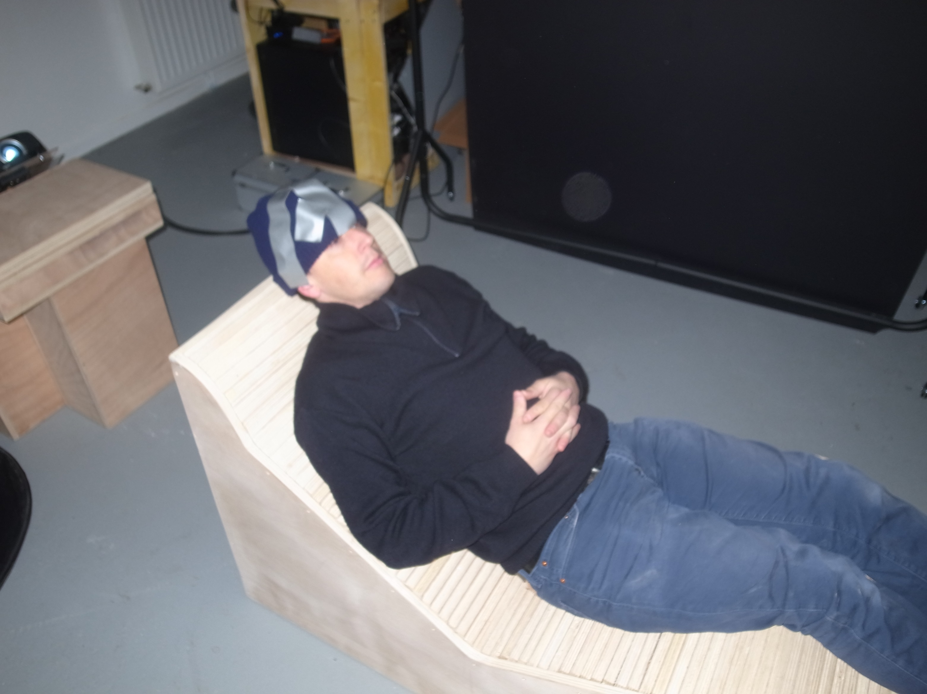

How to deal without EEG helmet ?

Slide 5
-> use of an open-data EEG record
.ov format

Slide 6
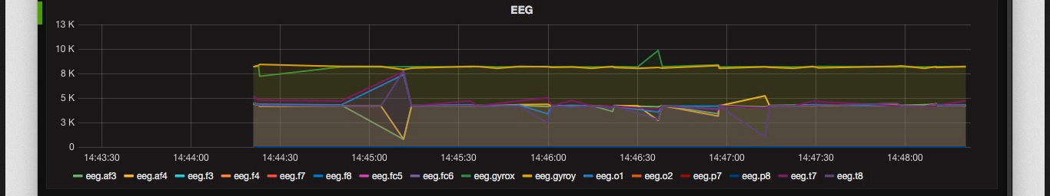
How to display the EEG signal, in real-time way ?

Slide 7
Fork of an existing EEG brain monitoring project
Use of grafana software
http://svds.com/brain-monitoring-kafka-opentsdb-grafana/
In progress

Slide 8
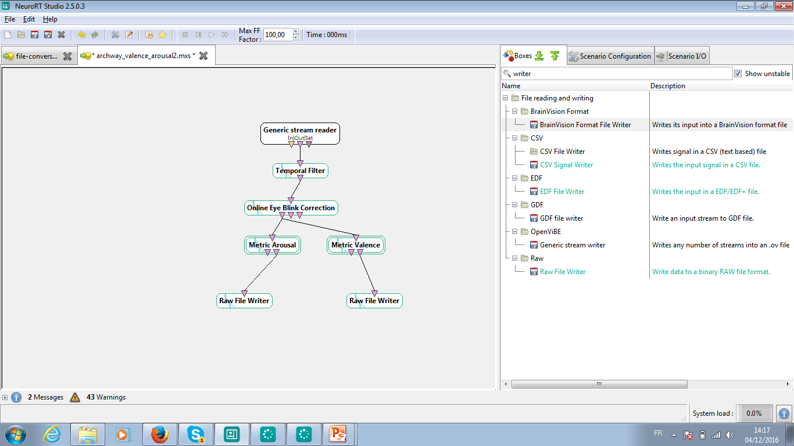

Slide 9
Use of the blink eyes correction
Focus algorithm on focus and attention of the guinea pig
Simplify the process by producing scores as raw file results
To be done: an integrated website, running the pipeline with the mensia archway API

Slide 10
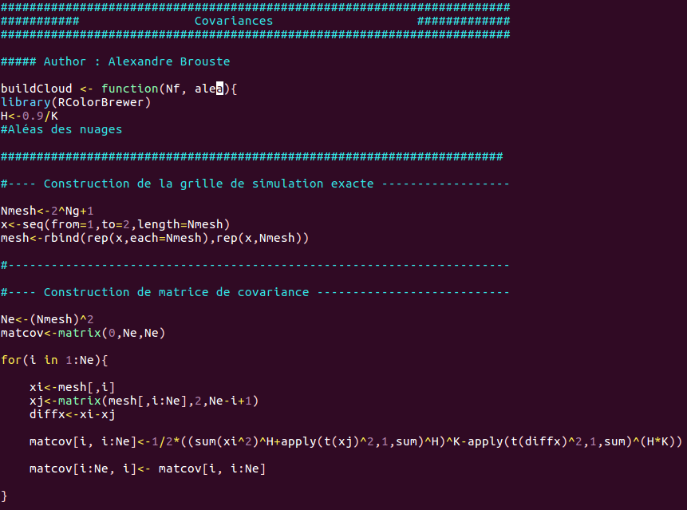
z
How to build a cloud from
the brain scores ?

Slide 11
Implement the cloud generation as a R script
Put the R script behind a web service
Pass the two parameters to the web service
Get back the cloud picture
Demo avalaible : http://np-complet.1s.fr/cloud/

Slide 12
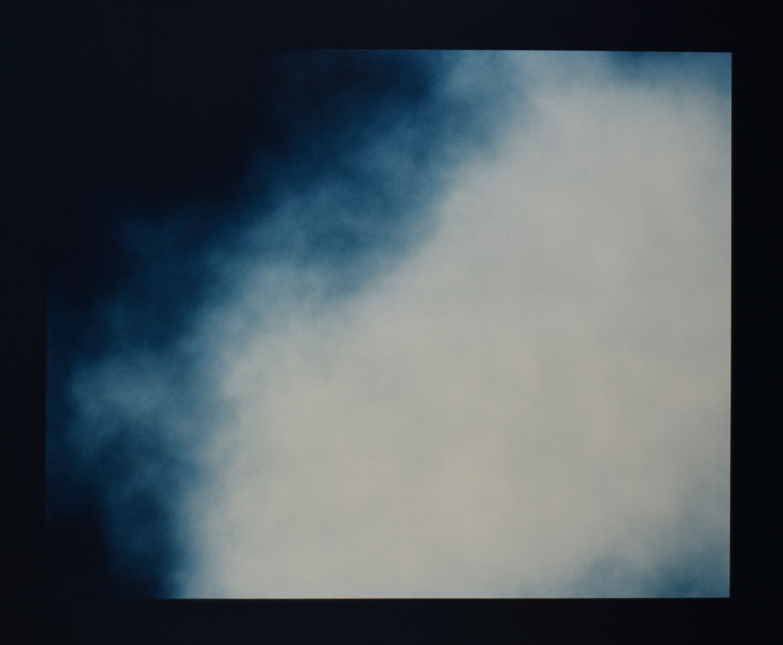

Slide 13
Ask the guinea pig for his smart phone
Display the cloud as background
Exhibit the smart phone in a Reliquary

Slide 14
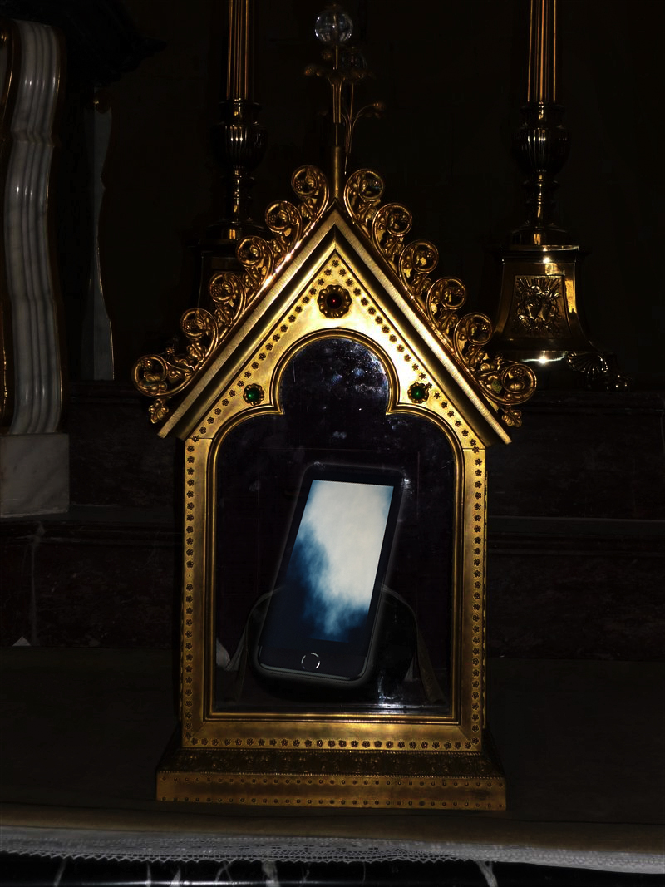
What appens after life ?

Slide 15
Thanks
Questions ?

