Slide 1


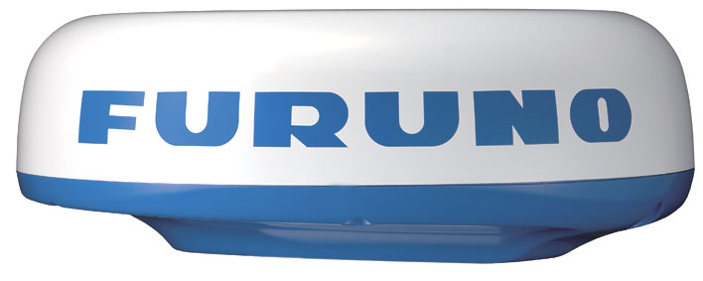

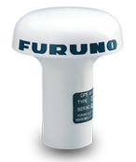
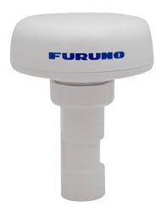



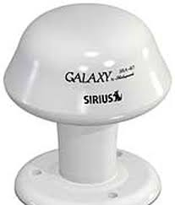
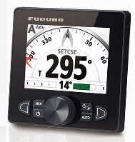
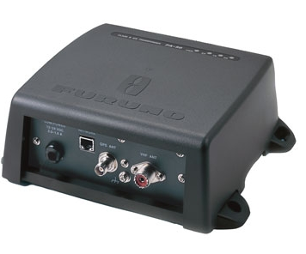
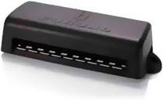

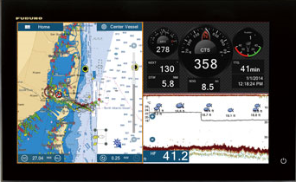
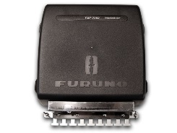
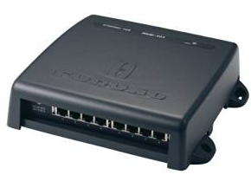

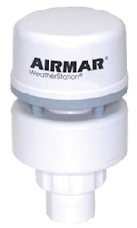
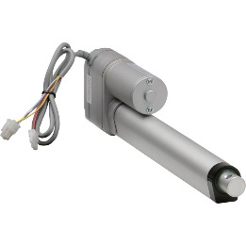
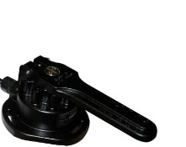
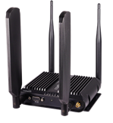

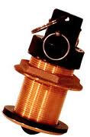

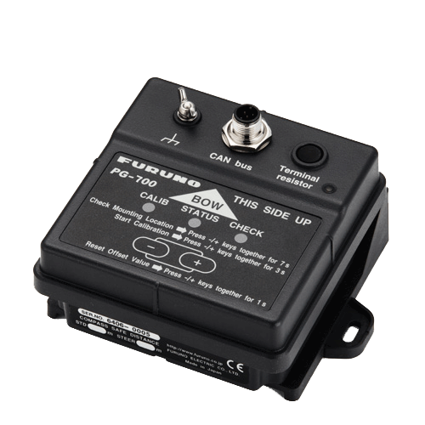
Radar
DRS4D
VHF
Antenna
FAB-151D
Legend
SiriusXM Satellite
GPS Satellite
NMEA2000 (CAN) Backbone
Ethernet
Termination Resistor
NMEA2000 (CAN)
Satellite Signal
Coaxial
Cell Signal
GPS Antenna
GPA017
Furuno Proprietary Cable
WiFi Signal
Satellite Weather Antenna
WX1-005-003
GPS Receiver
GP330B
Autopilot Control
FAP-7011C
Class B AIS Transponder
FA50
NMEA2000 Junction Box FI-5002
Autopilot Processor
FAP-7002
Satellite Weather Receiver
BBWX3
HUB101
NavNet TZtouch 2
TZTL15F
MDF
Weather Station
220WX
Linear Actuator
Rudder Reference FAP-6112
Integrated Heading Sensor
PG700
Modem / Wi-Fi router
COR 1BR1100
Email Server
Depth, Speed & Temperature Sensor
DST-800MSF
Cell Tower

