Slide 1
Hack the Solar System:
The Hidden Face of Venus
Jennifer Shin, Adam Ibrahim

Slide 2
Challenge
To use radar data from the Magellan satellite’s Venus trip to create an elevation map compatible with OpenSpace.
OpenSpace uses the NASA Ames Stereo Pipeline (ASP). Figuring out how to feed Magellan radar data into ASP main avenue.

Slide 3
Challenge
Main trouble is that Magellan took images before the ISIS software that gets data into the appropriate format for ASP was developed.
To do things in ASP with Magellan one would need to figure out how to get the Magellan Full-Resolution Basic Image Data Record (F-BIDR) images into a format suitable for ASP.

Slide 4
Exploration Process
Work with OpenSpace on linux. Doesn’t compile!
Serendipitous meeting of a partner!
Tactical retreat! We focus on tasks independent of OpenSpace: reading the Magellan radar image format (Basic Image Record Data, BIDR), and getting it to work with ASP.
BIDR seems proprietary to NASA. There are documents describing format of file bytes, we try to find extant tools to read and work with images.

Slide 5
F-BIDR is not a single image file...
Each orbit for which F-BIDR data exists is represented by a set of 20 files. In addition, indices to the image files have been added for each F-BIDR. The files are: FILE_01. - Summary BIDR Volume Information FILE_02. - Orbit Header FILE_03. - EDR Data Quality Summary FILE_04. - S/C ephemeris file FILE_05. - SCLK/SCET conversion coefficients FILE_06. - DSN monitor records FILE_07. - Quaternion pointing coefficients FILE_08. - Processing bandwidth

Slide 6
F-BIDR is not a single image file...
FILE_09. - Decommutation and decalibration data FILE_10. - Engineering data FILE_11. - Radar burst header records FILE_12. - Per-Orbit Parameters FILE_13. - Image data in oblique sinusoidal projection FILE_14. - Processing parameters for oblique sinusoidal data FILE_15. - Image data in sinusoidal projection FILE_16. - Processing parameters for sinusoidal data FILE_17. - Processed radiometric data FILE_18. - Cold-sky calibration results FILE_19. - Processing monitor record FILE_20. - Additional BIDR volume information

Slide 7
Exploration Process
ASP also requires SPICE data; records the position and orientation of both Venus and the spacecraft taking the radar imagery, and the radar data. To create a DEM (Digital Elevation Model), to figure out which part of Venus a radar image maps.
Conversations, soul searching, sleepiness, and sleep.

Slide 8
Exploration Process
The Magellan Satellite had an altimeter! This means it recorded data on the heights of the surface. How is this challenge not done yet?
It seems that the altimeter is not always reliable. Some areas had errors in elevation as high as 1 km, especially around mountainous areas.

Slide 9
Next Steps
Taking the BIDR data out of that format. Other papers have viewed it as images. Find tools or contact authors for their software.
Figure out what the ASP requires to work with the BIDR data:
Are greyscale images of the surface enough for ASP?
ASP requires images from different angles of the same object. We’ll have to match radar images which image same area from different angles.
How do we link up the SPICE data with the radar images?

Slide 10
Questions/Roadblocks
Do BIDR pixel values translate immediately to a greyscale image of Venus’s terrain? The images were not from visible light, but radio signals.
Once we work BIDR images into something ASP can work with, how do we pair up images of same objects from different angles? ASP’s job? Our job?

Slide 11

Next Steps
Can existing processes in ASP be used to import F-BIDR directly?
Best Case Scenario:

Slide 12
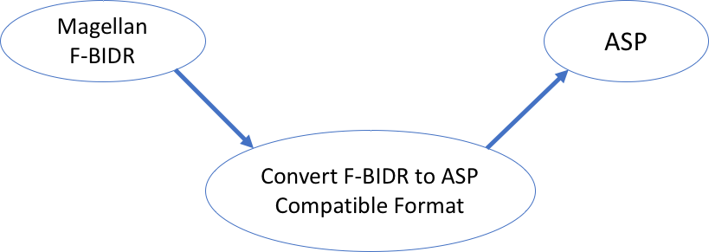
Next Steps
Open Question: Does F-BIDR need to be converted to ASP Compatible format?

Slide 13
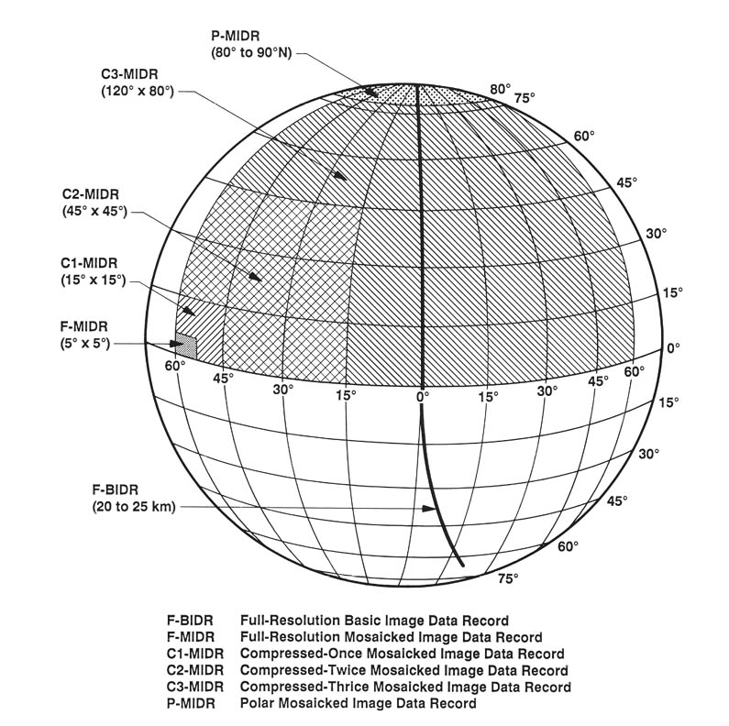
Next Steps
Open Question: Can other formats be used for ASP?
(F-MIDRs, C1-, C2-, and C3-MIDRs)
https://history.nasa.gov/JPL-93-24/p10.htm

Slide 14
Next Steps
Can advances in digital terrain image analysis be leveraged to convert F-BIDR into a usable format for ASP?
Notes:
Mike’s Notes:
- What progress we made?
- What did we learn along the way?
- Next steps? What's left to do?
- Problems we encountered?

Slide 15
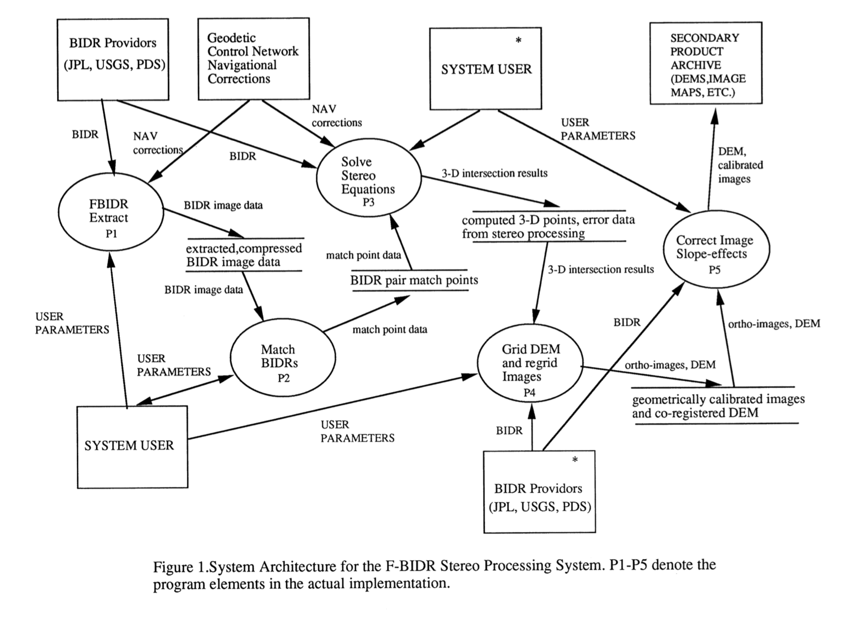
Takeaway: More complicated than it sounds...

Slide 16
Resources
https://www2.jpl.nasa.gov/magellan/guide12.html#12.7
https://pds.nasa.gov/ds-view/pds/viewProfile.jsp?dsid=MGN-V-RDRS-5-BIDR-FULL-RES-V1.0
https://www.asprs.org/wp-content/uploads/pers/1991journal/dec/1991_dec_1561-1570.pdf
https://pds-imaging.jpl.nasa.gov/documentation/MGN-FBIDR-SIS-SDPS-101-RevE.pdf

