Slide 1
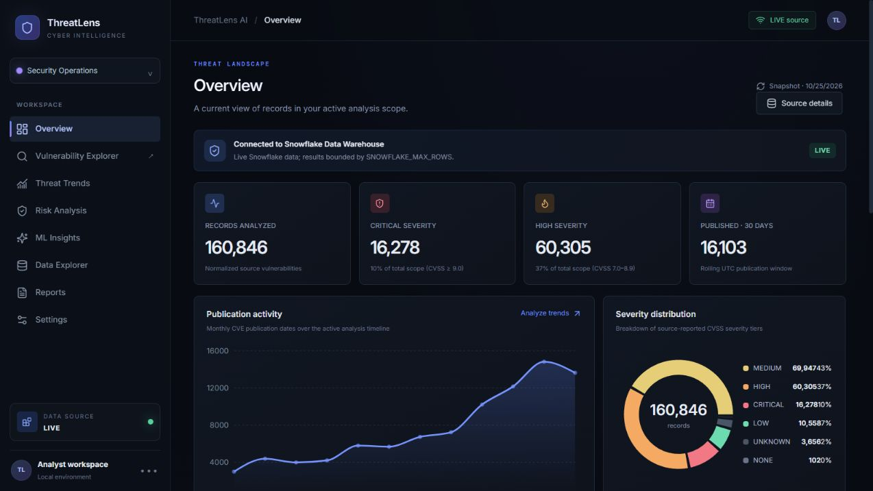
TEAM NGB × TEAM NOVA ECOSYSTEM
ThreatLens AI
Snowflake-centered vulnerability intelligence
Public NVD data, source-backed CVSS, explainable triage, and task-specific security ML.
HACKTOBER • CHALLENGE 02
Production dashboard • Vercel • current source status visible in the app
LIVE SNOWFLAKE SOURCE
160,846 active NVD-origin CVEs
Project overview and system architecture | 25 October 2026
Notes:
Introduce ThreatLens AI as Team NGB’s Hacktober project in the Team Nova ecosystem. Production evidence: README.md, docs/architecture.md, snowflake/setup.md. Live app: https://threatlens-ai-zoro-b535.vercel.app. Dashboard screenshot captured from screenshots/overview.png. The Snowflake table contains 160,846 active records as verified on 25 October 2026.

Slide 2
01 / PRODUCT
Project overview
A practical analyst workspace for public vulnerability data.
ThreatLens reads NVD-origin CVE records from Snowflake, keeps official source values intact, and brings discovery, filtering, analysis, and reporting into one web application.
WHAT IT SOLVES
WHAT IT DELIVERS
WHO IT SUPPORTS
• Large CVE catalogs are hard to explore
• Missing source scores must stay visibly missing
• Research signals need a clear trail to the NVD record
• Live Snowflake-backed Explorer
• Source CVSS and a separate local triage heuristic
• Held-out dataset metrics and downloadable reports
Security analysts
Developers and researchers
Hackathon collaborators
Core principle: CVSS remains source evidence; ThreatLens priority remains a disclosed heuristic.
THREATLENS AI / TEAM NGB × TEAM NOVA
02
Notes:
Sources: README.md; docs/architecture.md; docs/methodology.md. Live deployment: https://threatlens-ai-zoro-b535.vercel.app.

Slide 3
02 / DATA
Dataset and source provenance
SELECTED PUBLIC SOURCE
SOURCE-REPORTED SEVERITY MIX
NIST National Vulnerability Database
MEDIUM
69,947
CVE API 2.0 and annual feeds for 2024–2026 are loaded into the canonical Snowflake table. NVD is the data origin; Snowflake is the live storage and compute layer.
HIGH
60,305
160,846
CRITICAL
16,278
active records in the live application scope
LOW
10,558
164,568
3,722
table rows before
withdrawn-record filtering
rejected / withdrawn
records excluded
ALSO: UNKNOWN 3,656 • NONE 102
7,378 records have no CVSS score. ThreatLens displays them as unscored; it does not invent a CVSS value.
Data published 2023-11-28 to 2026-10-24. Snowflake SAMPLE_DATA contains TPC-H / TPC-DS, not cybersecurity data.
THREATLENS AI / TEAM NGB × TEAM NOVA
03
Notes:
Sources: docs/dataset.md; snowflake/setup.md; NVD CVE API 2.0 https://nvd.nist.gov/developers/vulnerabilities-2.0; NVD terms https://nvd.nist.gov/developers/terms-of-use. Counts verified read-only in Snowflake on 25 October 2026.

Slide 4
03 / BLUEPRINT
Five-stage hackathon workflow
01
02
03
04
05
Discover
Scope
Prepare
Evaluate
Deploy
NVD CVE catalog
Hugging Face datasets
Marketplace discovery
Vulnerability, code flaw,
intrusion templates
Goal and metric validation
Snowpark normalization
Separate task models
Cortex fallback path
Held-out metrics
Contribution API
Append-only SQL ledger
React + Flask production
Native Streamlit source
Exports and feedback
Implemented
Implemented
Implemented / gated
Ledger not enabled
Web app live
This is a working five-stage product flow. Account-only services stay marked as gated until the required Snowflake access is enabled.
THREATLENS AI / TEAM NGB × TEAM NOVA
04
Notes:
Sources: docs/architecture.md; README.md; docs/coco-workflow.md; snowflake/contributions.sql. Status wording reflects current repository and account permissions.

Slide 5
04 / RUNTIME
System architecture
PUBLIC DATA + INGEST
SNOWFLAKE CORE
APPLICATION + ANALYTICS
NVD CVE API 2.0
Annual feeds (2024–2026)
Authorized importer
loads NVD rows to Snowflake
THREATLENS_DB
THREATLENS.VULNERABILITIES
Canonical CVE fields
160,846 active records
X-Small warehouse
React + Vite dashboard
Flask REST API on Vercel
Read-only Snowflake provider
Python analytics and reports
load
query
ADDITIONAL PATHS
Snowpark + Streamlit source uses an authenticated Snowflake session for in-warehouse transforms and priority drill-down.
Hugging Face task models stay separate from NVD training. Optional AI uses server-side provider settings and a local fallback.
THREATLENS AI / TEAM NGB × TEAM NOVA
05
Notes:
Sources: docs/architecture.md; snowflake/setup.md; README.md; backend/app/services/provider.py; backend/app/routes/api.py. Live endpoint evidence: https://threatlens-ai-zoro-b535.vercel.app/api/health.

Slide 6
05 / SNOWFLAKE
Snowflake is the data and compute core
LIVE CANONICAL TABLE
WAREHOUSE CONTROLS
THREATLENS_DB.THREATLENS
VULNERABILITIES
• X-Small warehouse
• 60-second auto-suspend
• 2-credit monthly monitor cap
• Application service role is read-only
CVE_ID • DESCRIPTION • PUBLISHED
CVSS_SCORE • SEVERITY • CWE
AFFECTED_PRODUCTS • SOURCE_URL
IN-WAREHOUSE TRANSFORMS
160,846
7,378
Snowpark cleans and normalizes CVE fields, then computes a separate 0–100 TRIAGE_SCORE. Source CVSS is preserved as-is.
active records
without source CVSS
Cortex AI_COMPLETE is implemented with fallback, but this trial account currently blocks completion.
THREATLENS AI / TEAM NGB × TEAM NOVA
06
Notes:
Sources: snowflake/setup.md; snowflake/exploration.sql; snowflake/snowpark_transforms.py; streamlit_app.py. Snowflake AI_COMPLETE docs: https://docs.snowflake.com/en/sql-reference/functions/ai_complete. The Snowpark transform was read-only tested against the current table on 25 October 2026.

Slide 7
06 / PROJECT STUDIO
Dataset and project discovery
DISCOVERY CATALOG
PROJECT TEMPLATES
NVD CVE 2.0
Connected • live Snowflake table
01 Vulnerability prioritization
Source CVSS coverage • severity • remediation review
CVEfixes
Public code-fix research data
02 Code flaw classifier
Cybersecurity Attacks
Public labeled event examples
Macro F1 • class recall • grouped holdout checks
Shared sample data
TPC-H / TPC-DS; not cyber data
03 Intrusion detection
Macro F1 • false positives • per-class recall
Marketplace listings
Account and listing dependent
Scope validation checks template, dataset, goal, and success metrics. Project briefs stay in browser storage.
THREATLENS AI / TEAM NGB × TEAM NOVA
07
Notes:
Sources: backend/app/routes/api.py (/api/project-catalog, /api/datasets, /api/project-scopes); frontend Project Studio; docs/dataset.md. NVD dataset page: https://nvd.nist.gov/developers/vulnerabilities-2.0. Hugging Face cards: https://huggingface.co/datasets/hitoshura25/cvefixes and https://huggingface.co/datasets/vinitvek/cybersecurityattacks.

Slide 8
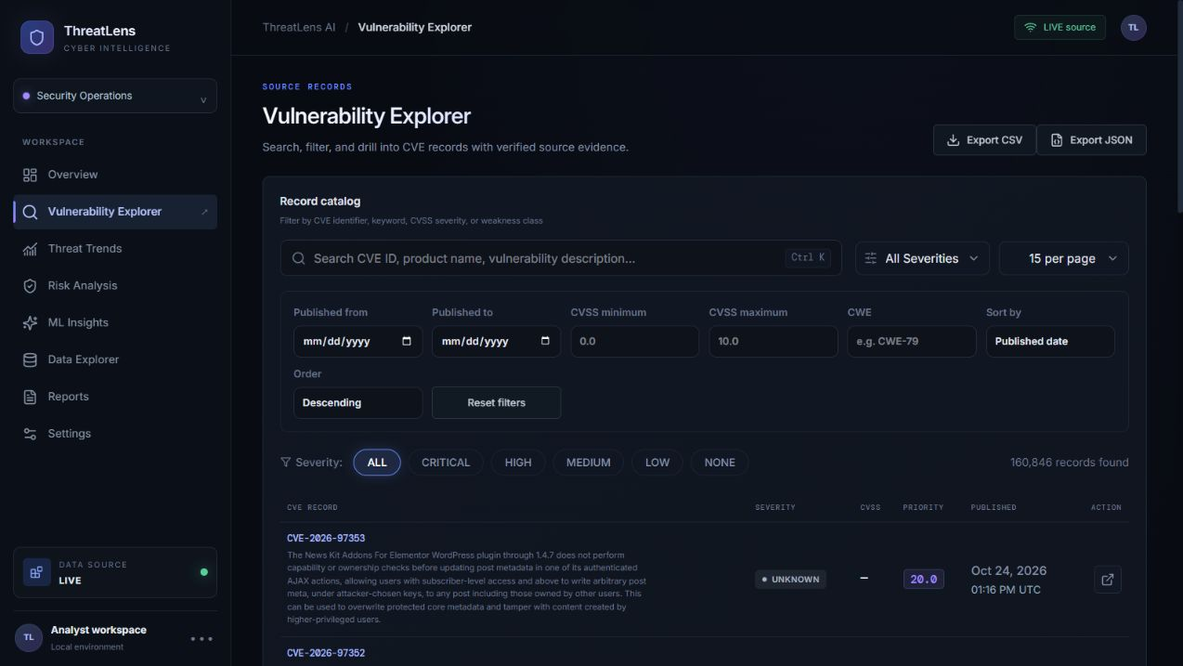
07 / PRODUCT EXPERIENCE
Vulnerability Explorer
Find and verify CVEs
Search records, filter by severity and CVSS range, narrow by publication date or CWE, then open the linked NVD record.
SOURCE-AWARE FIELDS
• Official CVSS
• Source severity
• Published timestamp
• CWE and affected products
• NVD evidence link
CSV / JSON exports follow active filters.
THREATLENS AI / TEAM NGB × TEAM NOVA
08
Notes:
Source: screenshots/explorer.png, captured from the running app connected to Snowflake. UI behavior and fields: README.md and backend/app/routes/api.py.

Slide 9
08 / ANALYTICS + ML
Explainable analysis and held-out evaluation
SEPARATE THE OFFICIAL SCORE FROM LOCAL RANKING
GROUPED OR HELD-OUT TEST RESULTS
CVSS and severity come from NVD. The CVSS Analysis view orders by the source score. ThreatLens triage is a separate heuristic:
TASK
MACRO F1
ACCURACY
TEST N
Code flaw
0.6904
0.6917
2,413
80% normalized CVSS + 20% 365-day recency
Severity text
0.7148
0.7537
1,539
Missing source CVSS stays unscored in CVSS analysis. A priority score is an investigation aid, not proof of exploitation.
Incident type
0.8580
0.8829
2,648
Code examples are split by CVE ID to reduce leakage. Scores describe the selected datasets only.
Separate Hugging Face datasets power these task models. Held-out scores describe dataset performance, not real-world detection.
Honeypot attack classification is skipped: its source sample has only one labeled class.
THREATLENS AI / TEAM NGB × TEAM NOVA
09
Notes:
Sources: docs/methodology.md; data/models/training_report.json; backend/app/analytics/core.py; screenshots/ml-insights.png. CVEfixes: https://huggingface.co/datasets/hitoshura25/cvefixes. Event examples: https://huggingface.co/datasets/vinitvek/cybersecurityattacks.

Slide 10
09 / TEAM WORKFLOW
Collaboration and audit traceability
AUDITABLE EVENT MODEL
01 Contribution
02 Peer review
03 Evaluation
Code • docs • dataset • model
Reviewer • target • rating
Metric name • value • artifact
API + SQL ARE READY
CURRENT ACCOUNT STATE
GET /api/contributions reads event and evaluation history. POST validates events and requires a server-only write token. The SQL table is append-only by design.
Audit table and dedicated writer role are not configured. Production returns no fabricated contribution scores; held-out model results remain available.
CoCo requests failed before analysis with an account service-entitlement message; no CoCo output is claimed.
THREATLENS AI / TEAM NGB × TEAM NOVA
10
Notes:
Sources: backend/app/routes/api.py (/api/contributions); snowflake/contributions.sql; docs/architecture.md; docs/coco-workflow.md. CoCo attempt details and request ID are recorded in docs/coco-workflow.md.

Slide 11
10 / TRUST
Security, provenance, and safe interpretation
Read-only application role
Backend-only secrets
Web service can query the CVE table; it has no table-write or schema-create grant.
Snowflake key-pair credentials and AI provider keys stay in server-side environment variables.
Bounded queries
Cost guardrail
Default result cap is 500,000 rows; configured maximum is 1,000,000. Inputs are validated.
X-Small warehouse auto-suspends after 60 seconds; resource monitor caps monthly use at 2 credits.
Source fidelity
AI guardrail
NVD origin is distinct from a Marketplace listing. Missing score and product fields remain missing.
External analysis runs only on user request. Cortex failure returns local deterministic analysis.
THREATLENS AI / TEAM NGB × TEAM NOVA
11
Notes:
Sources: snowflake/setup.md; docs/dataset.md; docs/methodology.md; docs/coco-workflow.md; README.md. NVD terms: https://nvd.nist.gov/developers/terms-of-use.

Slide 12
11 / DELIVERY
Production deployment and project checks
PRODUCTION WEB APPLICATION
VERIFIED QUALITY CHECKS
threatlens-ai-zoro-b535.vercel.app
57
backend tests passed
React + Vite frontend
Flask API functions on Vercel
Snowflake source confirmed LIVE
Health, catalog, summary, and contribution APIs return 200
13
frontend tests passed
PASS
frontend production build
SOURCE REPOSITORY
github.com/yogesh-37911/Threat-Lens-Ai
LIVE
Snowflake data source • 160,846 records
Production commit: 2219289
Team NGB × Team Nova open-source project
No production errors were returned in Vercel’s last-30-minute error-log query.
THREATLENS AI / TEAM NGB × TEAM NOVA
12
Notes:
Sources: Vercel production deployment for commit 2219289; README.md; frontend package test/build output; backend/tests. Live endpoints: https://threatlens-ai-zoro-b535.vercel.app/api/health, /api/project-catalog, /api/summary, /api/contributions.

Slide 13
12 / HONEST STATUS
Remaining account gates
CoCo entitlement
CoCo chat returned a service-entitlement / usage-limit error before producing SQL or analysis.
Cortex generation
AI_COMPLETE code is present, but this trial account rejects completion; local fallback is active.
Contribution ledger
Create the audit table and a separate service role with SELECT + INSERT grants.
Snowflake Streamlit
Source app is ready; deploy as a Snowflake Streamlit object with suitable schema grants.
Dataset eligibility
NVD data is public and stored in Snowflake, but it is not a Marketplace listing. Confirm the challenge’s eligibility rule.
No CoCo use, Cortex output, Marketplace installation, or audit score is represented as complete.
THREATLENS AI / TEAM NGB × TEAM NOVA
13
Notes:
Sources: docs/coco-workflow.md; docs/dataset.md; snowflake/setup.md; README.md. AI_COMPLETE reference: https://docs.snowflake.com/en/sql-reference/functions/ai_complete.

Slide 14
13 / PRESENTATION FLOW
Live demo walkthrough
01
Start at Overview
Show LIVE source badge and 160,846 active records.
02
Open the Explorer
Filter by severity, dates, CVSS, or CWE; open the source record.
03
Explain the score
Separate NVD CVSS from ThreatLens’ local recency heuristic.
04
Review ML results
Show held-out task metrics and explain dataset limits.
05
Close with account truth
State CoCo, Cortex, audit, and Marketplace eligibility gates clearly.
Demo order: live data → evidence-backed CVE → explainable analytics → measured limits
THREATLENS AI / TEAM NGB × TEAM NOVA
14
Notes:
Sources: live application https://threatlens-ai-zoro-b535.vercel.app; screenshots/overview.png; screenshots/explorer.png; screenshots/ml-insights.png; docs/methodology.md.

Slide 15
TEAM NGB × TEAM NOVA ECOSYSTEM
ThreatLens AI
PROJECT REFERENCES
NVD CVE API 2.0
Snowflake-powered CVE intelligence
nvd.nist.gov/developers/vulnerabilities-2.0
Dataset and eligibility review
docs/dataset.md
Thank you
Questions and feedback welcome
Architecture and account status
docs/architecture.md
Methodology and ML limits
docs/methodology.md
CoCo request record
docs/coco-workflow.md
Live app
threatlens-ai-zoro-b535.vercel.app
GitHub: yogesh-37911/Threat-Lens-Ai
Snowflake connection and verification
snowflake/setup.md
HACKTOBER 2026 • CHALLENGE 02 • HALLOWEEN ARCHITECTURE EDITION
15
Notes:
Primary references: README.md, docs/architecture.md, docs/dataset.md, docs/methodology.md, docs/coco-workflow.md, snowflake/setup.md, and data/models/training_report.json. Official sources: NVD CVE API 2.0 https://nvd.nist.gov/developers/vulnerabilities-2.0; NVD terms https://nvd.nist.gov/developers/terms-of-use; Snowflake AI_COMPLETE https://docs.snowflake.com/en/sql-reference/functions/ai_complete. Live app https://threatlens-ai-zoro-b535.vercel.app; repository https://github.com/yogesh-37911/Threat-Lens-Ai.

