Slide 1
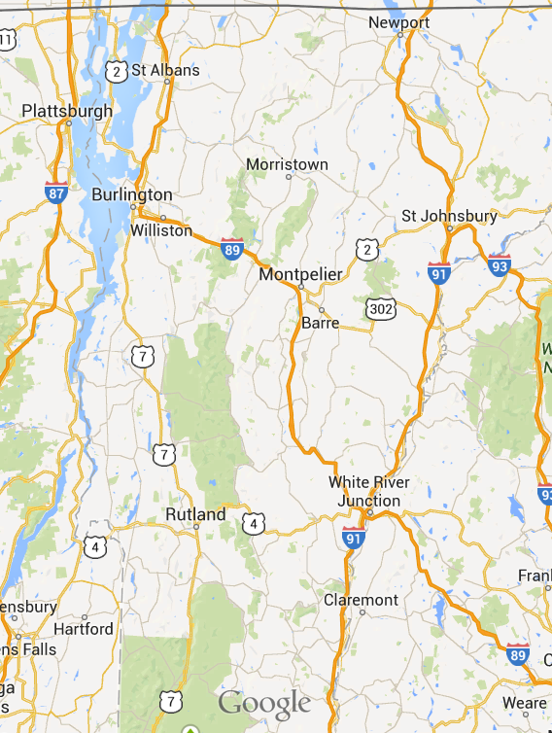
SOLARIZING VERMONT
Reach Our 2050 Goal!
Choose location (drop down)…
Add Solar Panels
Save Map
Start Over
Load Map
Annual kWh Usage: XXX,XXX
Average kWh Usage/household: X,XXX
Selected panels
Area: XXX
Power: XXX
Delete Selected
This app developed by Team Stone for HackVT 2014 using date supplied by Efficiency Vermont

