Slide 1
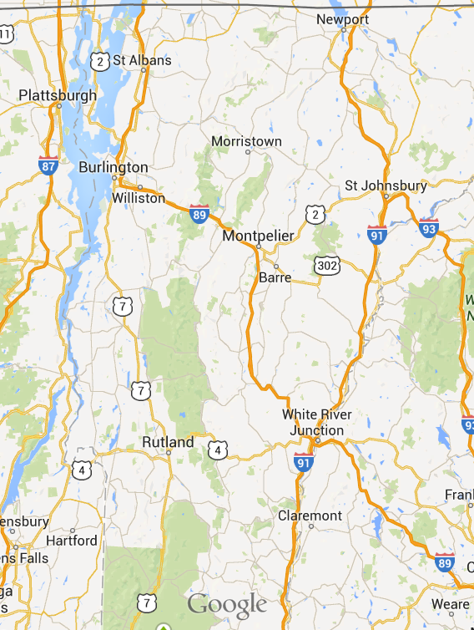
Choose location (drop down)…
SOLARIZING VERMONT
Choose location to get started
Selected Town Name
Annual kWh Usage: XXX,XXX
Average kWh Usage/household: X,XXX
Add Solar Panels
Save Map
Start Over
Load Map
Selected panels
Area: XXX
Power: XXX
Delete Selected
This app developed by Team Stone for HackVT 2014 using date supplied by Efficiency Vermont

