Slide 1



Slide 2
Java as a platform for polyglot programming.
Arkadiusz Galwas
arkadiusz.galwas@sap.com

Slide 3
Introduction
Java is widespread in IT industry.
#1 according to language popularity indexes like TIOBE or PYPL
#2 technology according to Stack Overflow’s survey
More than 222 thousands of active Java repositories on GitHub (#2)
Extremely popular for enterprise class systems : about 90% of Fortune 500 companies use Java today

Slide 4
Introduction
What is good about Java?
Great number of Open Source libraries
Great number of programming tools
Available for various platforms
Large community
Backward compatibility
Notes:
Test

Slide 5
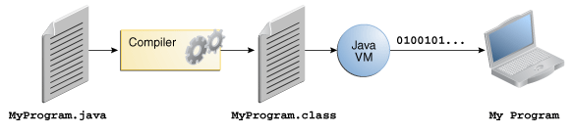
Java as a polyglot programming platform
Java is compiled to byte code which is executed on Java Virtual Machine. JVM offers performance optimizations, memory management, concurrency, security, diagnostic interfaces and more.
Java Virtual Machine is battle tested on production
Since Java SE 7 platform there is support for Non-Java languages.

Slide 6
Java as a polyglot programming platform
We can divide JVM languages into three categories:
New languages having features Java doesn’t have
Ports of existing languages
Experimental languages

Slide 7
Java as a polyglot programming platform
Why to bother about alternative languages on Java platform?
Programmer can choose any language and use existing Java libraries
Programs written in Java may use libraries written in other languages
Systems running on Java platform may follow polyglot programming philosophy

Slide 8

Introducing Kotlin
Implemented by JetBrains, the creators of IntelliJ IDE.
Statically typed, object oriented with some functional features
Available for backend, frontend and mobile development
Has very small runtime and no additional SDK
Provides nice syntactic sugar for Java APIs
Addressed for developers already knowing Java
Easily interoperate with Java

Slide 9
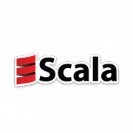
Introducing Scala
Created by professor Martin Odersky
Mix of object oriented and functional language
Scalable language : grows along with developer
Expressive and concise
Very rich SDK
Number of Open Source Scala libraries
Great for backend programming : asynchronous and concurrent applications, Big Data analysis

Slide 10
Wrapping up
Should I learn Java? Yes, you should!
Should I learn many languages or only one (Java of course ;) )? Yes, the more the better!

Slide 11
THANK YOU

