Slide 1

How Gopher survive in the Internet jungle?
Adam Szecówka
Piotr Miśkiewicz
Adam Szpakowski
Mateusz Szostok

Slide 2

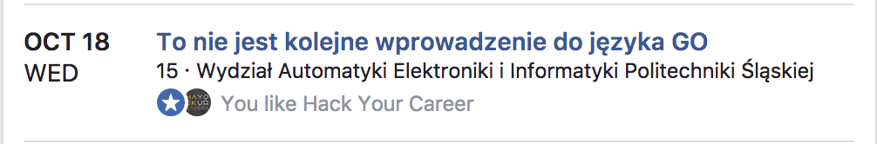
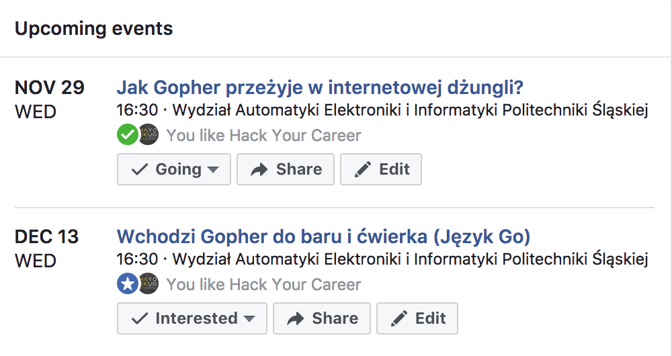
Hack your career

Slide 3
Agenda
Environment setup
So you want to expose your app on the Internet?
Introduction to concurrency in GO
Live coding

Slide 4
Environment setup
Go installed: https://golang.org/doc/install
$GOPATH configured. Since Go 1.8 if not specifed, following defaults are applied:
$HOME/go on Unix-like systems
%USERPROFILE%\go on Windows
Add $GOPATH/bin to $PATH
IDE: https://www.jetbrains.com/go/download/
Curl | Postman | httpie
git
git clone https://github.com/SAPHybrisGliwice/gopher-concurrency to $GOPATH/src/github.com/SAPHybrisGliwice/gopher-concurrency

Slide 5
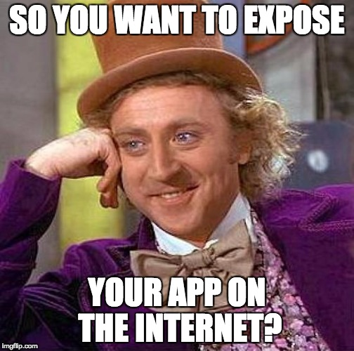

Slide 6
DoS – Denial of Service
When?
Hackers’ attack
Unintentional denial of service
the Reddit hug of death, the Digg effect, Wykop effect
Errors

Slide 7

DoS – Denial of Service
Protection
In computer networks, rate limiting is used to control the rate of traffic sent or received by a network interface controller and is used to prevent DoS attacks

Slide 8
Concurrency in Go
goroutines
channels
select statement

Slide 9
Goroutines
A goroutine is a lightweight thread managed by the Go runtime.
go myFunction()
go func() {
// some code
}()

Slide 10
Channels

Slide 11
Channels
ch := make(chan int)
ch <- 100

Slide 12
Channels
ch := make(chan int)
ch <- 100
v := <- ch
for v := range ch {
}

Slide 13
Buffered Channels
ch := make(chan int, 4)
ch <- 100

Slide 14
Buffered Channels
ch := make(chan int, 4)
ch <- 200

Slide 15
Buffered Channels
ch := make(chan int, 4)
ch <- 300

Slide 16
Buffered Channels
ch := make(chan int, 4)
ch <- 400

Slide 17
Buffered Channels
ch := make(chan int, 4)
ch <- 500

Slide 18
Buffered Channels
ch := make(chan int, 4)
ch <- 100
v := <- ch

Slide 19
Buffered Channels
ch := make(chan int, 4)
v := <- ch

Slide 20
Buffered Channels
ch := make(chan int, 4)
v := <- ch

Slide 21
Select statement
The select statement lets a goroutine wait on multiple communication operations.
A select blocks until one of its cases can run.
select {
case ch1 <- 1:
// some code
case <- ch2:
// some code
}
select { case ch2 <- 2:
// some code case <- time.After(time.Second):
// timeout handling }

Slide 22
Example 3: Leaky Bucket
Drawback of previous solutions:
Global limiter does not free up resources
Normal and malicious users are treated in the same way

Slide 23
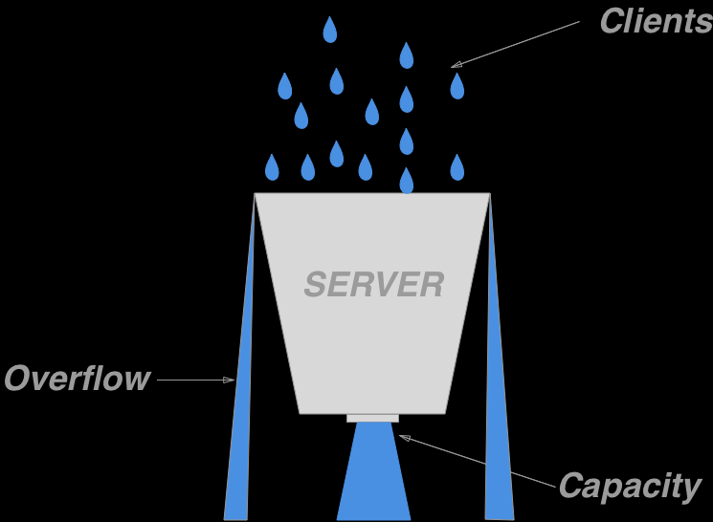
Leaky Bucket Algorithm

Slide 24
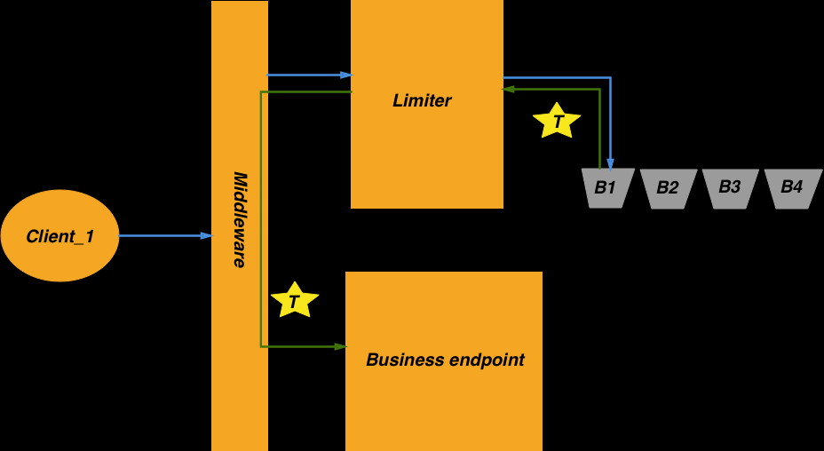
Leaky Bucket Algorithm

Slide 25
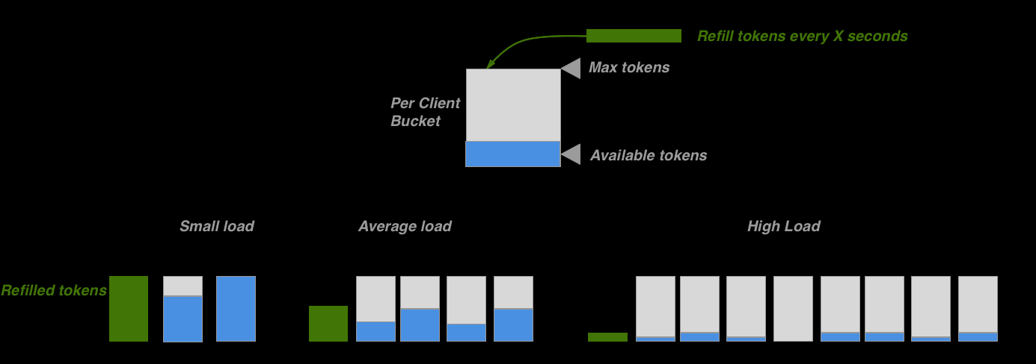
Leaky Bucket Algorithm

Slide 26
Demo time

Slide 27
Thank you.
Contact information:
adam.szecowka@sap.com
piotr.miskiewicz@sap.com
adam.szpakowski@sap.com
mateusz.szostok@sap.com
Partner logo

