Slide 1
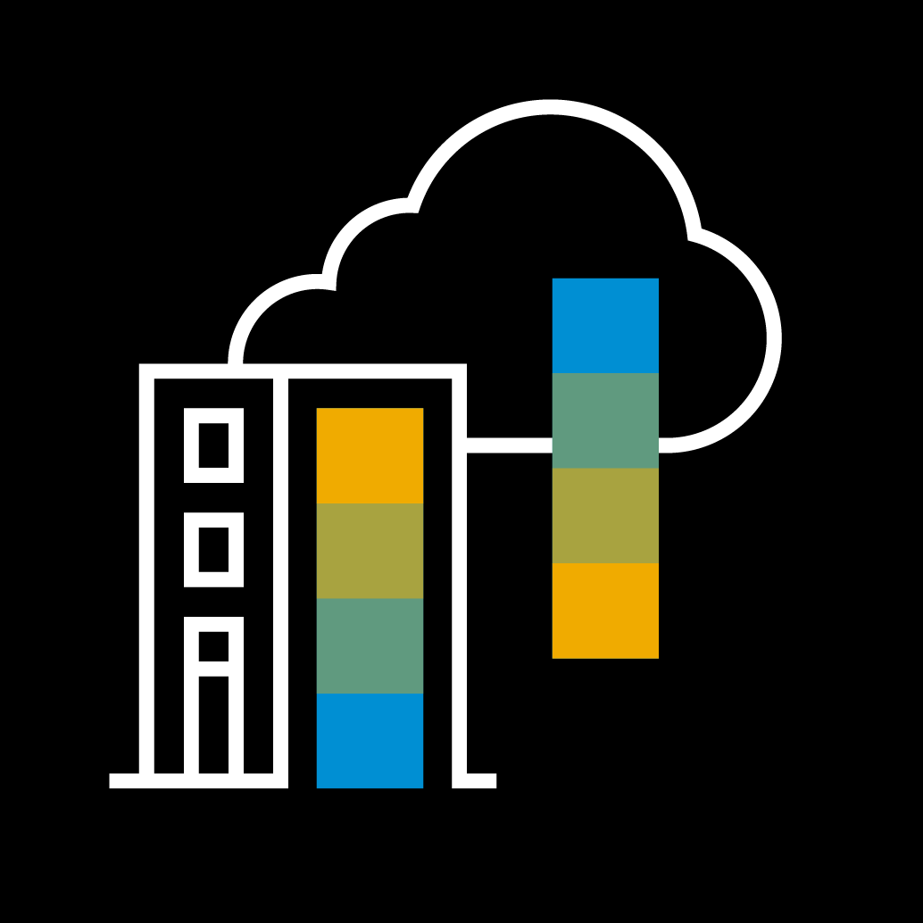
Devops Community Chapter 2 Czyli: jak przestałem klikać I pokochałem automatyzację

Slide 2
Agenda
Evolution of deployment mechanisms
From servers to containers
From containers, where?
Kubernetes automatization
Smarter deployments
Autoscaling
Helm – deploying simple
How to automate the automat?

Slide 3
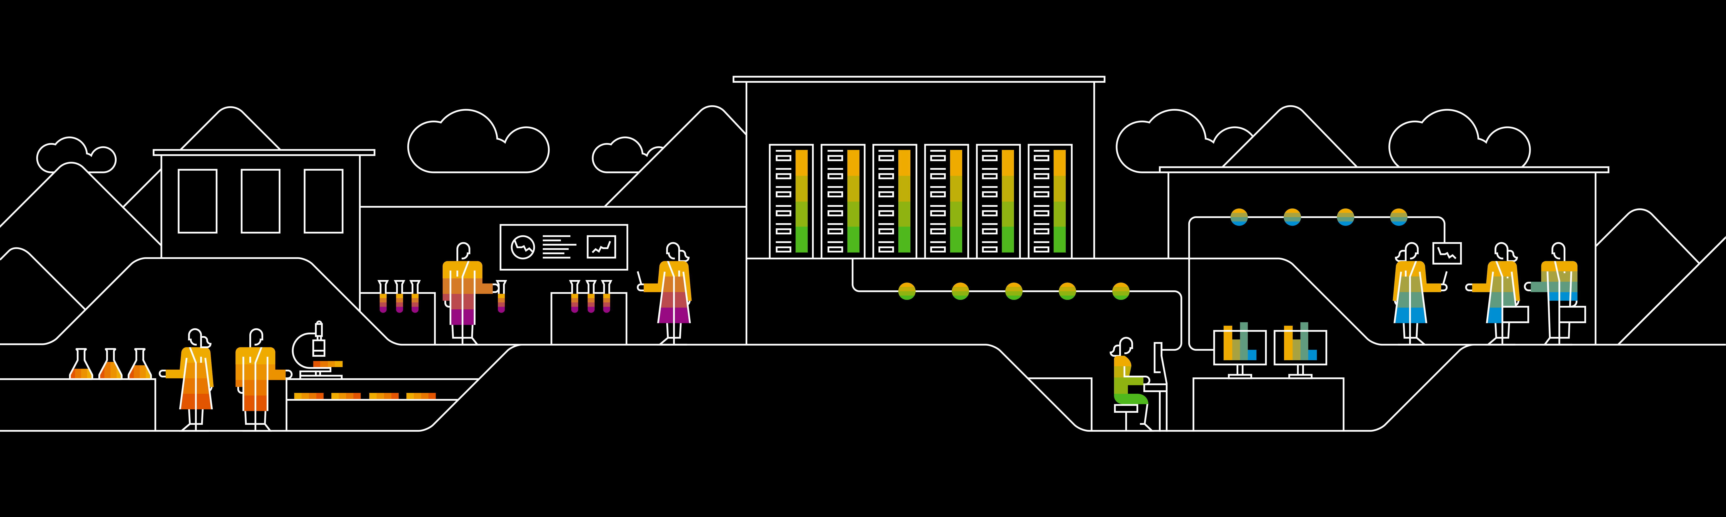
Divider page

Slide 4
Info - Adam

Slide 5
Smarter deployments in Kubernetes

Slide 6
Slajdy od Tomków
First level
Second level
Third level

Slide 7
Helm – The package manager for Kubernetes

Slide 8

What is Helm?
„ Helm is a tool that streamlines installing and managing Kubernetes applications. Think of it like apt/yum/homebrew for Kubernetes.”
Helm has two parts: a client (helm) and a server (tiller)
Tiller runs inside of your Kubernetes cluster, and manages releases (installations) of your charts.
Helm runs on your laptop, CI/CD, or wherever you want it to run.
Charts are Helm packages that contain at least two things:
A description of the package (Chart.yaml)
One or more templates, which contain Kubernetes manifest files

Slide 9
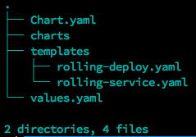
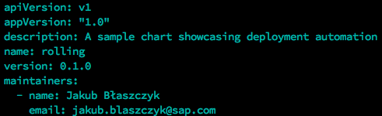
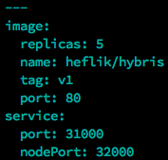
Example Chart structure
Chart.yaml – Metadata of the chart (name, version, maintainers)
Charts directory – Your local dependencies
Templates directory – Your code: kubernetes manifests + go based templates
Values.yaml – Your default values.

Slide 10
Lets improve the previous deployment – Rolling Release

Slide 11
Insert page title (sentence case)
First level
Second level
Third level
First level
Second level
Third level
First level
Second level
Third level

Slide 12
Insert page title (sentence case)
First level
Second level
First level
Second level

Slide 13
Insert page title (sentence case)
First level
Second level
First level
Second level
First level
Second level

Slide 14
Insert page title (sentence case)
First level
Second level
First level
Second level
First level
Second level
First level
Second level

Slide 15
Thank you.
Partner logo

