Slide 1
Importance of asking questions

Slide 2
WHAT IS HTML?
- HTML stands for Hyper Text Markup Language
- HTML describes the structure of webpages using HTML elements also called tags
- Browsers use the tags to render a webpage

Slide 3
DOM (Document Object Model)
- The DOM is a standard for accessing documents. Different types of DOM: Core DOM, XML DOM, HTML DOM
- When a HTML document is loaded in a browser it gets made into a HTML DOM
- The HTML DOM is a standard for getting, changing, deleting HTML elements
In the HTML DOM all HTML elements are represented as nodes
See live dom: https://software.hixie.ch/utilities/js/live-dom-viewer/

Slide 4

HTML DOM tree structure

Slide 5
HTML TAGS
- <!DOCTYPE html>
- <html> - within this tag the browser looks for html elements
- <head> - Includes metadata, title, scripts, encoding
- <meta> - Tag used for describing metadata
- <body> - What is actually displayed on the webpage
- <header> - Top part of a webpage (usually menu bar, logo)
- <main> - Main content excluding menus, logo
- <section> - Defines sections of a webpage fx chapter, header, footer
- <footer> - Defines the bottom of a webpage

Slide 6

CSS (Cascading Style Sheets)
“A small waterfall, typically one of several that fall in stages down a steep rocky slope.”
“A process whereby something, typically information or knowledge, is successively passed on.”

Slide 7
CSS (Cascading Style Sheets)
- Stylesheet language to describe the visual presentation of a document written in HTML
- CSS is used to tell the browser how it should render (display) the HTML elements

Slide 8
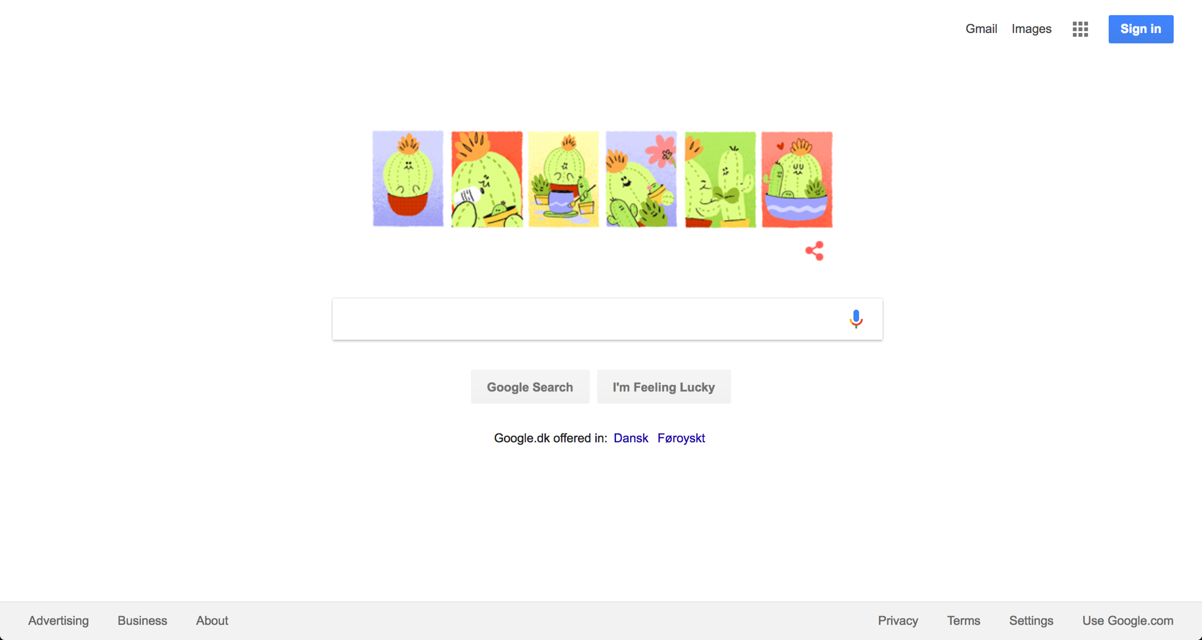
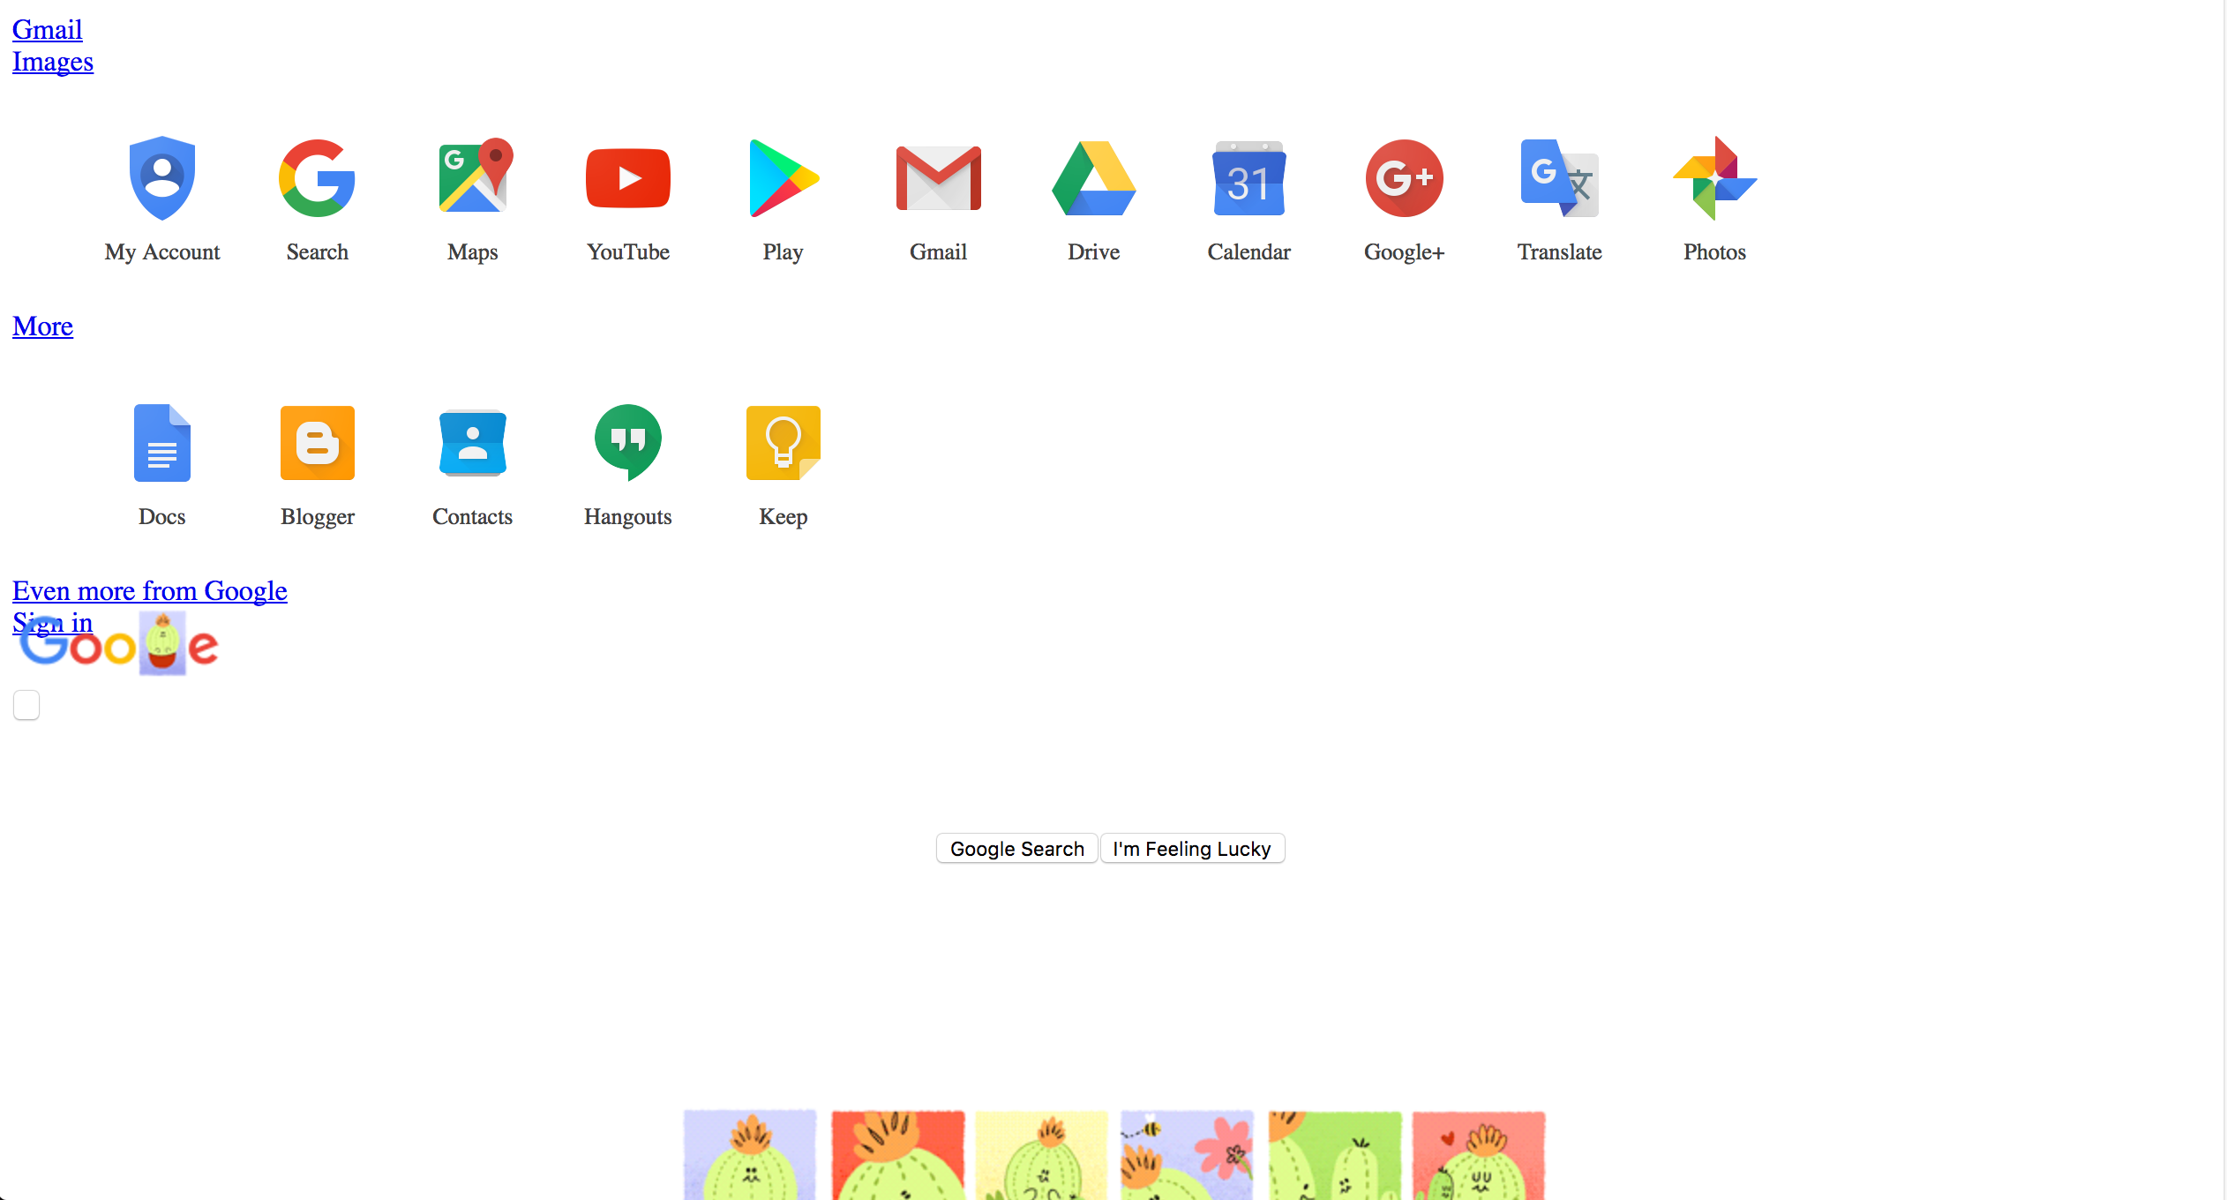
CSS gives your website “clothes on”

Slide 9
CSS SELECTORS
Type selector
  div {
    background-color: red;
  }
Class selector
  .container {
    background-color: red;
  }
Id selector
  #container {
    background-color: red;
  }
CSS contains of selectors and rules.
Selectors “selects” chunks of HTML and rules tell how to render that particular chunk of HTML.
Remember that rules will be applied to all elements that match your selector.

