Slide 1
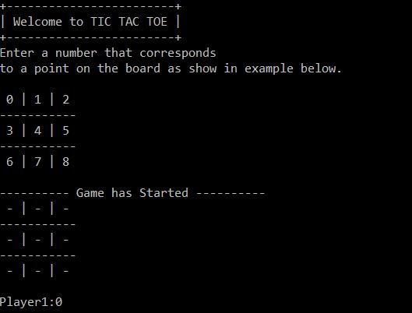
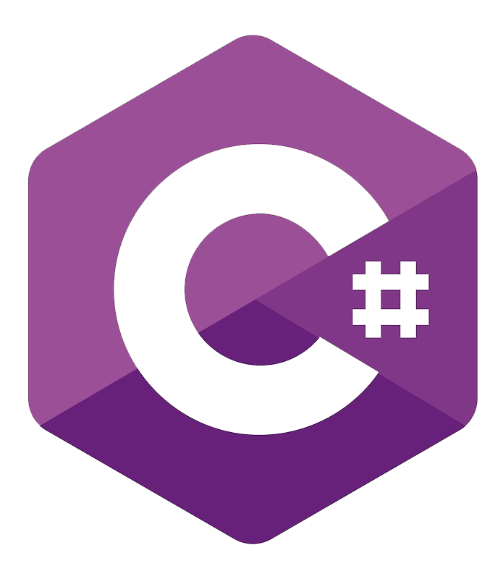
Lesson 1: Introduction to C# & Building the Console Game
HackYourFuture Belgium
.NET Master Class
Week 1
Notes:
🎤 Instructor: "Welcome to the first lesson of our C# master class! Over the next weeks, we’ll build a full-fledged game, starting from a simple console application to an interactive multiplayer experience using web technologies."

Slide 2

Introduction & Expectations
What is C#?
How does it compare to JavaScript?
What will we build?
Goals for today: first console app, data types, loops, arrays, error handling, and starting Tic-Tac-Toe
Notes:
Introduction & Expectations (~15 min)
📝 Explain: C# is a statically typed, compiled, object-oriented language primarily used for backend development, offering strong type safety and performance optimizations.
🎯 Ask: Has anyone ever worked with statically typed languages before?
🎯 Ask: How do you think C# compares to JavaScript?
📝 Explain: C# is strongly typed; JavaScript is weakly typed. C# is compiled; JavaScript is interpreted (JIT-compiled).

Slide 3
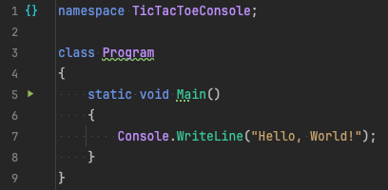
Your First C# Program
A simple Hello, World! program
Main() as the entry point
Notes:
Your First C# Program (~15 min)
📝 Explain:
class Program → Defines a class (everything in C# belongs to a class).
static void Main() → The entry point of the program.
Console.WriteLine("Hello, World!"); → Outputs text to the console.
✅ This is the simplest way to print output to the console. ❌ However, all logic is inside Main(), which is not ideal for structured programs.
👨‍💻 Live Coding: Write and run it in Rider.
📝 Explain: Running the app in Release or Debug mode (breakpoints) or compiling without running.
🎯 Ask: Create a new console application and modify the message to say Hello [your name]

Slide 4
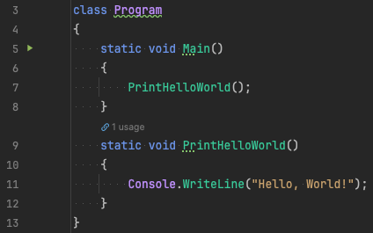
Better Code: Using Methods
Introduce encapsulation: keeping Main() clean
Notes:
Better Code: Using Methods (~5 min)
📝 Explain: A function in C# is called a “Method”.
🎯 Ask: Why using methods is better than writing everything in Main()?
📝 Explain:
Encapsulation: Keeps Main() clean and readable.
Reusability: The PrintHelloWorld() method can be called multiple times.
Modularity: Easy to expand or modify without affecting Main().

Slide 5
Understanding C# Data Types
C# is strongly typed → must declare variable types
Common types:
Type | Example | Description
string | "Hello" | Text values
int | 42 | Whole numbers
double | 3.14 | Decimal numbers
bool | true | True/False
char | 'A' | Single characters
Notes:
Data Types & Variables (~20 min)
🎤 Instructor: "In C#, you must declare the type of every variable. Let’s look at the most common ones."
📝 Explain: Common Types
👨‍💻 Live Coding:
string playerName = "Alice";
int playerScore = 10;
bool isGameOver = false;
📝 Explain:
Variable naming limitations (must start with letter or underscore, contains only letters and numbers, no special characters).
string, int, double, bool and char are all shortcuts.
There are others like float (Single) or decimal (Decimal).
🎯 Ask Students:
What happens if we try to store "Hello" in an int variable?
How does this compare to JavaScript’s dynamic typing?

Slide 6

Working with Strings
Three ways to format strings:
Notes:
String Manipulation (~20 min)
🎤 Instructor: "C# has multiple ways to handle strings. Let’s look at them.”
🎯 Ask Students:
Which of these approaches is most readable?
Format "My name is ___ and I am ___ years old.”.

Slide 7

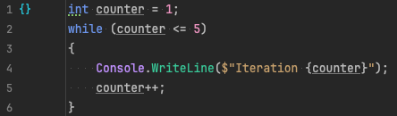
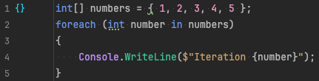
Loops in C#
for:
while:
foreach:
Notes:
Loops (~30 min)
📝 Explain: Loops allow us to repeat actions. C# has for, while, and foreach.
👨‍💻 Live Coding: Showcase Rider autocomplete.
🎯 Ask Students:
When would you use for instead of while?
Write a loop that prints numbers 1 to 10.

Slide 8

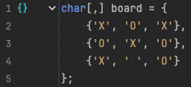
Arrays in C#
Why use arrays? Store multiple values
Examples:
Notes:
Arrays (~30 min)
👨‍🏫 Explain:
Arrays let us store multiple values.
Normally declared with fixed size.
👨‍💻 Live Coding:
Single-Dimensional Array
Multidimensional Array
🎯 Ask Students: Create an array of your favourite dishes and print them.

Slide 9

Handling User Input
Console.ReadLine() reads user input
Notes:
🎯 Ask Students: Write a program that greets the user.

Slide 10
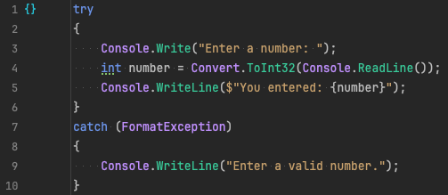
Handling Errors with Try-Catch
What happens if a user enters invalid input?
Introduce try-catch:
Notes:
Error Handling (~30 min)
👨‍🏫 Explain:
What happens if the user enters text instead of a number?
Catch by type.
Caught exception available via variable.
👨‍💻 Live Coding: Show exception without try-catch in debug mode.
🎯 Ask Students: Modify this to handle DivideByZeroException.

Slide 11
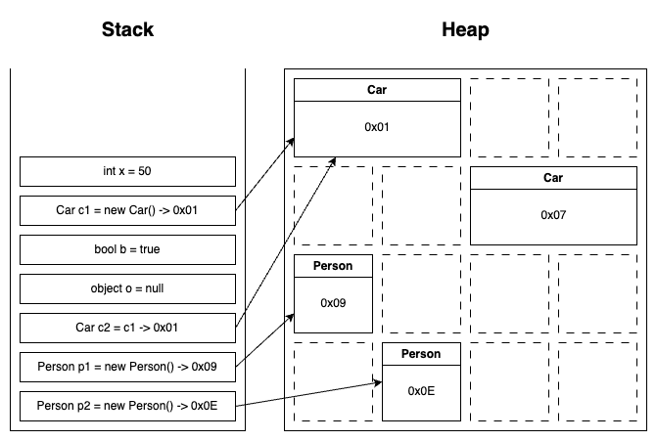
Understanding Stack vs. Heap Memory
Stack stores value types (fast, automatically cleaned)
Heap stores reference types (objects, strings, arrays)
Notes:
Stack vs. Heap (~20 min)
👨‍🏫 Explain:
Memory Management: What happens when we store values in memory?
Equality between value types and reference types
🎯 Ask Students:
Why strings are in the heap (immutable with variable size)?
What happens when we change a string value?

Slide 12
Starting Tic-Tac-Toe
Step 1: Print the board
Step 2: Handle user moves
Step 3: Check for win condition
Notes:
Tic-Tac-Toe (~45 min)
👨‍💻 Live Coding
🎯 Ask Students:
How would you allow the user to choose a position?
How to check for win condition?

Slide 13
Wrap-Up & Next Steps
Recap: C# Basics, data types, loops, arrays, error handling
Next week: Expanding Tic-Tac-Toe logic
Questions & feedback
Notes:
🎤 Instructor: "Great job today! Next time, we’ll improve our Tic-Tac-Toe logic with user moves."

