Slide 1

Cookbook
A recipe discovery web app by Group 4 — combining thousands of global dishes with a personal cohort collection.
Build by Diana, Hamed, Yana, and Yusup, mentored by Jim.
Presented by Yusup

Slide 2
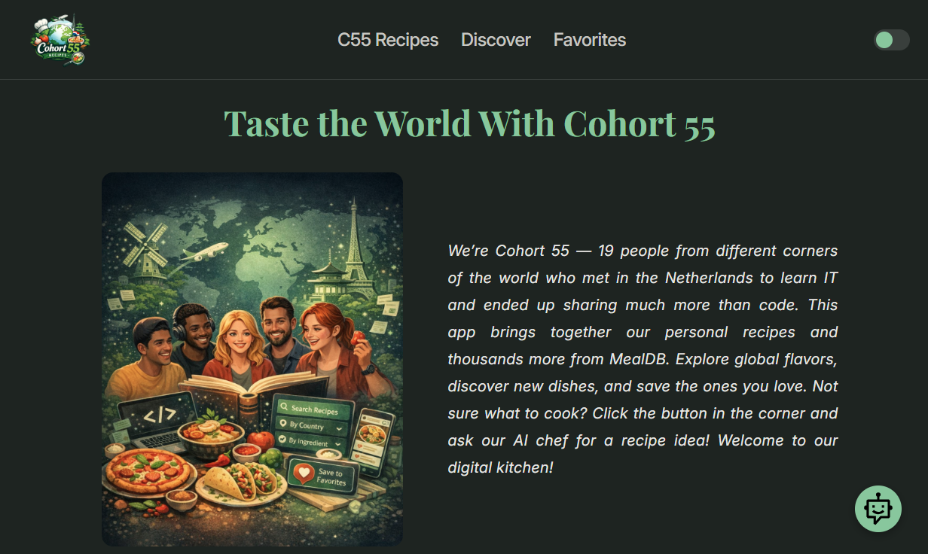
Meet the App
Cookbook is designed to feel intuitive across every device. The mobile interface features a theme toggle for light/dark mode, a menu for seamless navigation, and a floating AI chatbot where users can ask questions and receive personalized recipe suggestions — all within a clean, accessible layout.

Slide 3
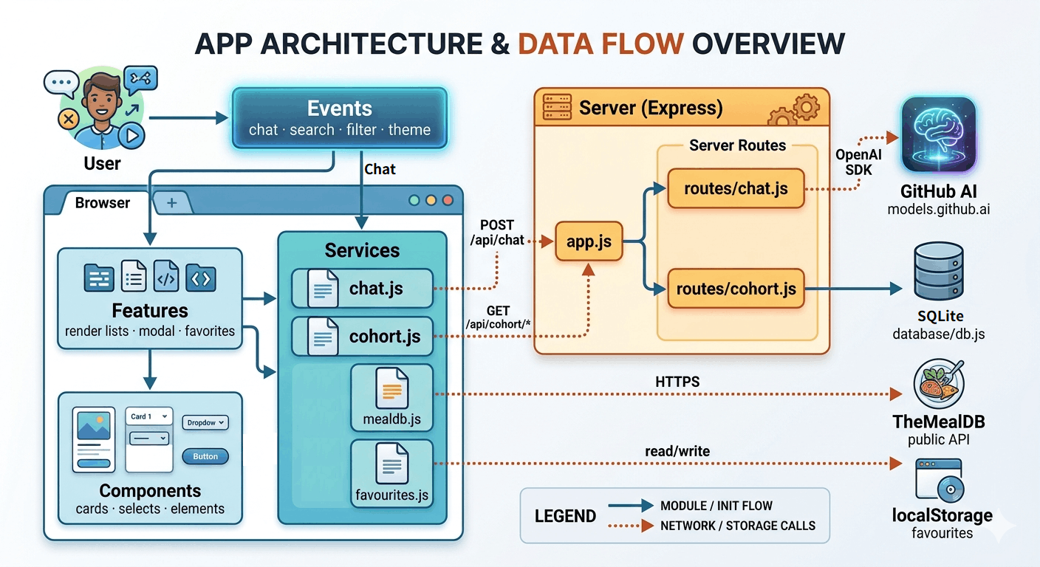
Frontend Architecture (Yana)
events/
handle user interactions
components/
reusable UI elements
services/
services/ — frontend middleman that sends
HTTP requests between the browser and the
server.
features/
take data from services and render it to the DOM
The DOM is the browser’s tree-like model of a web page. JavaScript uses it to read, change, and react to HTML content on the page.

Slide 4
Frontend (Hamed)
mealdb.js
Calls TheMealDB public API directly from the browser for global recipe data
favorite.js
Saves and reads favorite recipes using
browser local storage — lightweight and
client-side

Slide 5
Backend-Frontend (Diana)
chat.js
POSTs user messages to our backend, which forwards them to GitHub Models API (GPT-4.1)
cohort.js by Yana
Fetches cohort recipes from Express,
which reads from the SQLite database
routes/chat.js — receives messages, calls GitHub Models API with a structured system prompt, returns JSON
routes/cohort.js — handles SQLite queries, exposes REST endpoints for fetch, filter, and search

Slide 6
Backend (Yusup)
app.js ( backend configurator)
sets up the Express server, registers middleware like Morgan and JSON parsing, and registers the routes — routes/cohort.js at /api/cohort and routes/chat.js at /api/chat
CI/CD, Supertest integration, README.md
Supertest wraps Express app and simulates HTTP requests in memory, so you test your real routes and real database responses without spinning up a server.

Slide 7
Deep dive into chat feature
When the user clicks the Send button, handlerChat.js picks up the click event and calls fetchChatReply() in services/chat.js, which sends a POST request to /api/chat on the server.
routes/chat.js receives the request, loads the system prompt from server/utils/prompt.js, and uses the OpenAI SDK to build and send the call to the GitHub Models API. The AI returns a JSON object with title, instructions, and ingredients.
The server validates that title and instructions exist, then sends the result back to the browser with res.json({ reply: parsed }).
services/chat.js receives the response and returns data.reply to handlerChat.js, which passes the recipe object to renderChatResult() in features/renderChatResult.js. That function calls createChatCard() from components/createChatCard.js to build the card and displays it in the chat window.

Slide 8

Live Demo
See Cookbook in action — from browsing global recipes to chatting with the AI assistant.
https://c55-core-project-group-4-cookbook.onrender.com/

Slide 9

Thank You
That concludes our presentation of Cookbook — a recipe discovery app built with care, clean architecture, and a touch of AI. We welcome any questions from the audience.
Frontend
Backend
Modular structure with features, components, services, and events
Express + SQLite + GitHub Models API (GPT-4.1)
Highlights
AI chatbot, TheMealDB integration, and CI/CD pipeline

