Slide 1
AI QUEST-AN INTERNAL KNOWLEDGE SHARING PLATFORM
Team ID: Ai q-230344
Team: Hackaholics
Team Members:
1.Pranav Kodlinge 2.Shriniwas Prachand
3.Aayush Agrawal 4.Utsavi Bagri

Slide 2





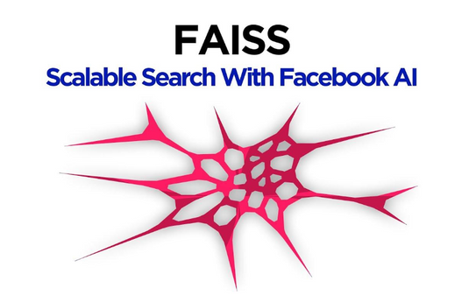
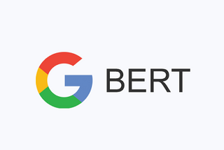




TECHSTACK
REACTJS AND TAILWIND CSS:FRONTEND
EXPRESSJS AND NODEJS: BACKEND
MONGODB:DATABASE
VERCEL:HOSTING
FLASK API : FOR WEB AND ML INTEGRATION
GPT-2/BERT/TRANSFORMERS
HUGGING FACE
FAISS
Wikipedia api
REACTJS
Hackaholics

Slide 3
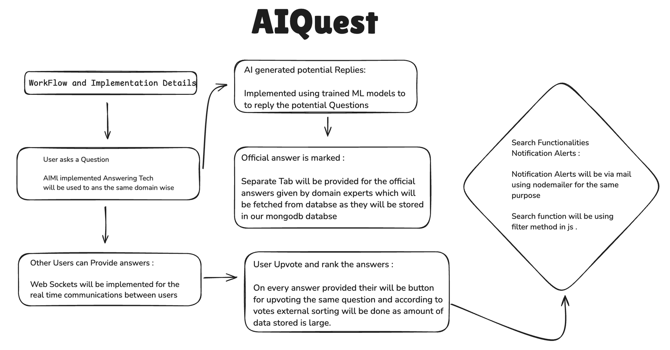
Hackaholics

Slide 4
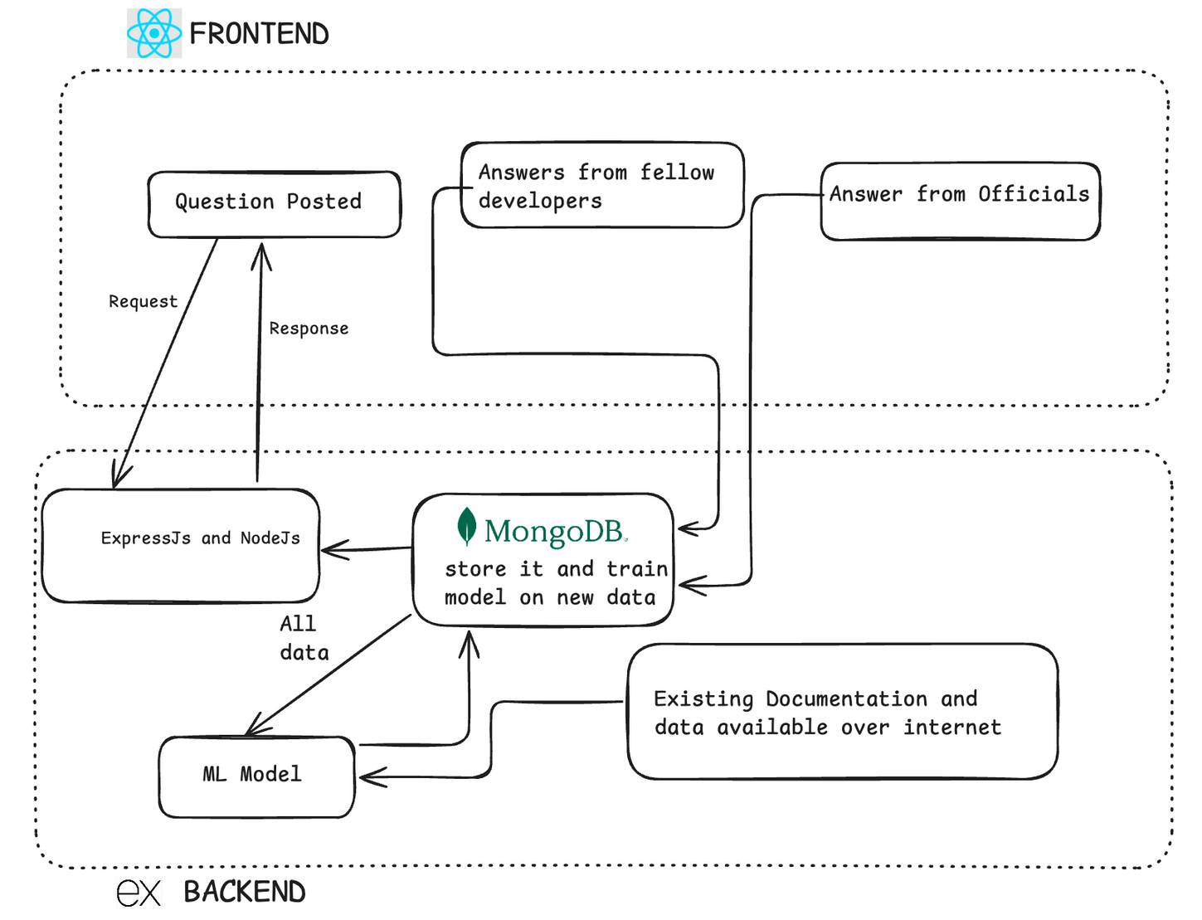
SYSTEM DIAGRAM
Hackaholics

Slide 5
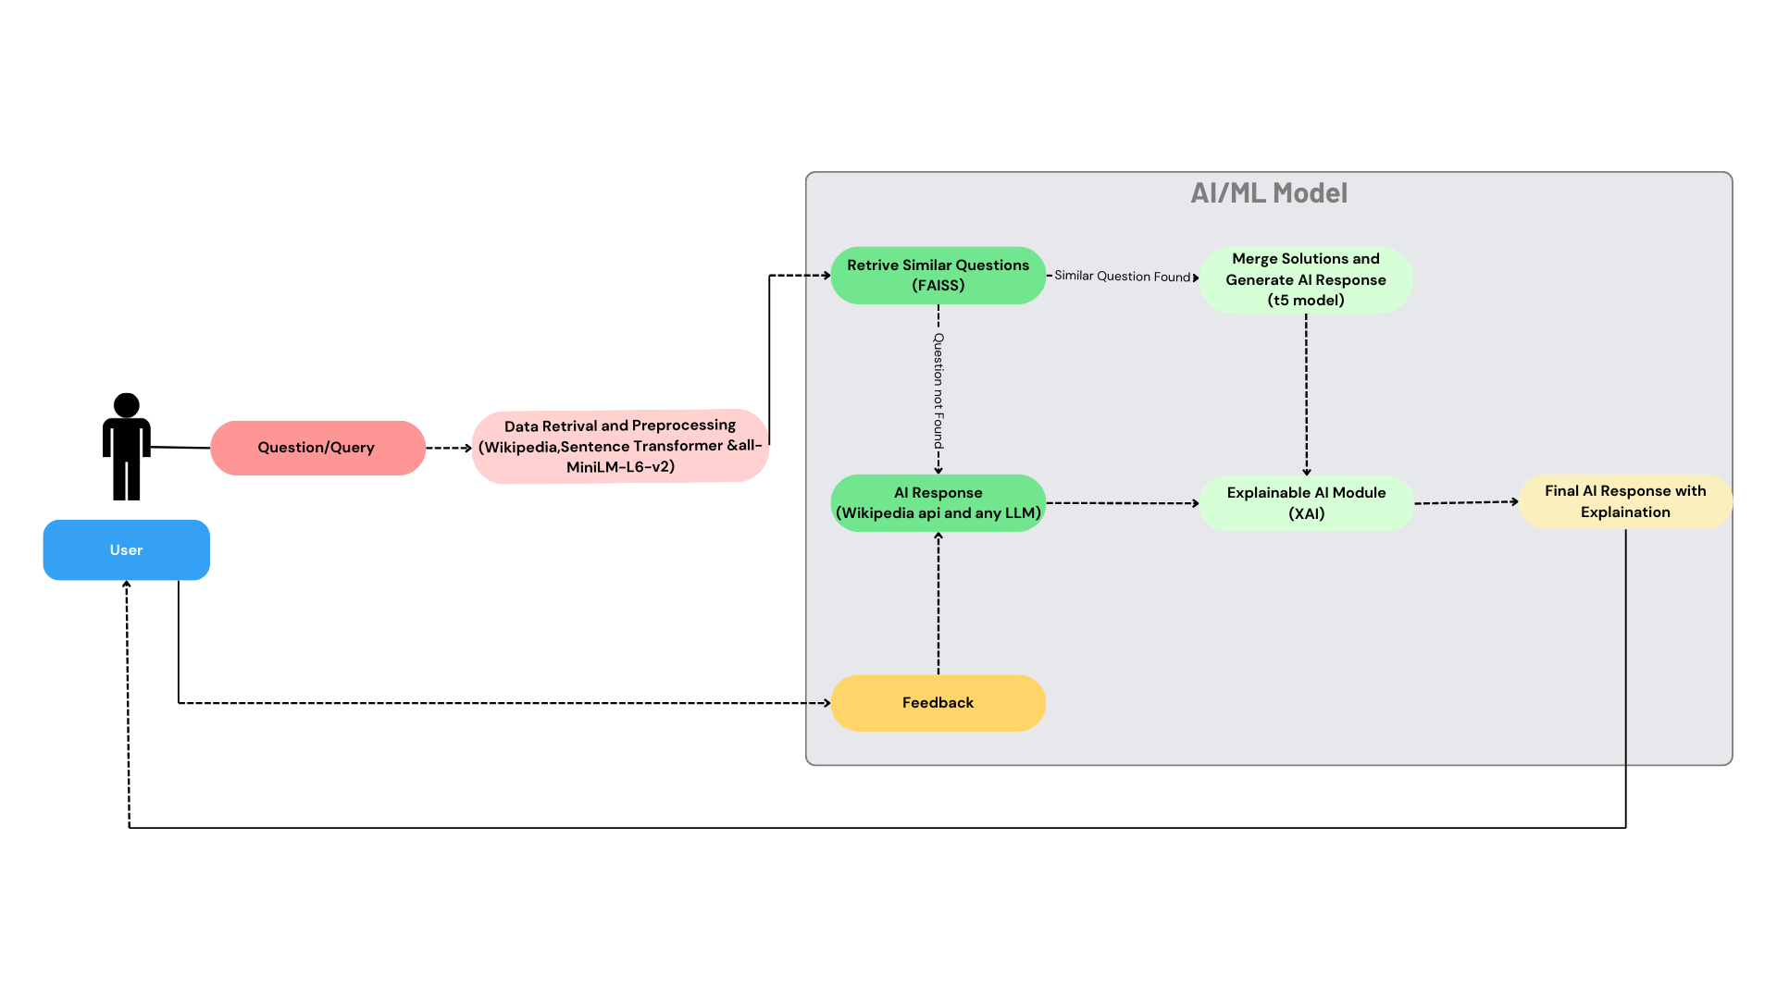
AI/ML Workflow Diagram

Slide 6
CONCLUSION
Key Highlights :
Comprehensive Knowledge Sharing: "AI Quest" simplifies access to information, making knowledge more relevant and accessible.
Innovative Tech Stack: Built on ReactJS, Express, MongoDB, and Flask, ensuring a scalable and high-performance platform.
Future Vision: Continuous improvements with emerging NLP models and analytics for deeper insights.
Empowering Collaboration: Transforming internal knowledge into a valuable resource to drive informed decisions and innovation.
Future Enhancements (In few days):
Enhanced Query Retrieval:
FAISS will manage historical questions and merge answers for complex queries.
LLM Integration:
Advanced LLMs (e.g., OpenAI GPT) to handle diverse topics with better context.
Feedback Mechanism:
Users can rate answers, improving quality over time via retraining.
Explainable AI Module:
Transparent reasoning with insights into content retrieval and answer generation.
Dynamic Answer Fusion:
Combining information from FAISS and LLMs for detailed and robust responses.
Refer Codes
Github Link
https://github.com/Hackaholics05/AIQuest
Video Link
https://drive.google.com/drive/folders/1fGb6zKqOWDN1ij1xcumscECi9k2fkzuv

