Slide 1
VisionX
Team_ID:Qual-230367 Team: Hackaholics
Team Members:
1.Pranav Kodlinge 2.Shriniwas Prachand
3.Aayush Agrawal 4.Utsavi Bagri

Slide 2











TECHSTACK
REACTJS AND TAILWIND CSS:FRONTEND
EXPRESSJS AND NODEJS: BACKEND
MONGODB:DATABASE
VERCEL:HOSTING
FLASK API : FOR WEB AND ML INTEGRATION
Tensorflow and Keras
OpenCV
Numpy
Matplotlib
Python
REACTJS
Hackaholics

Slide 3
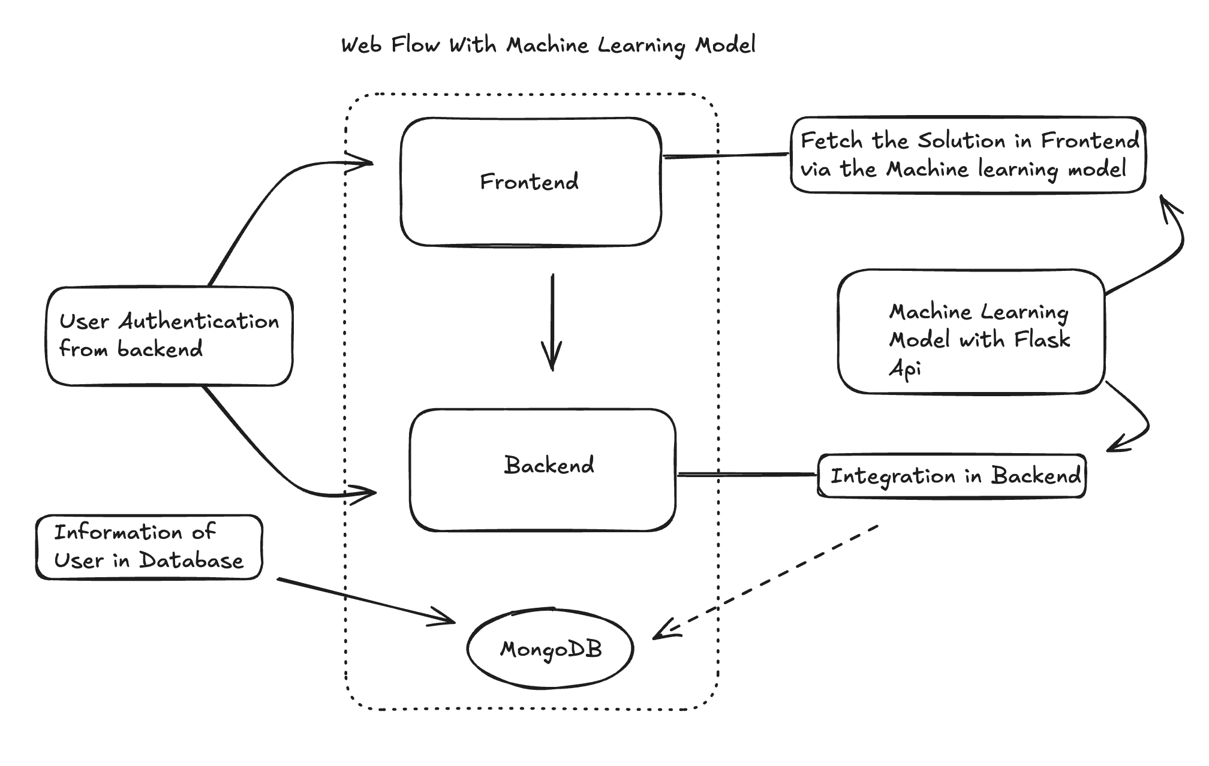
Hackaholics

Slide 4
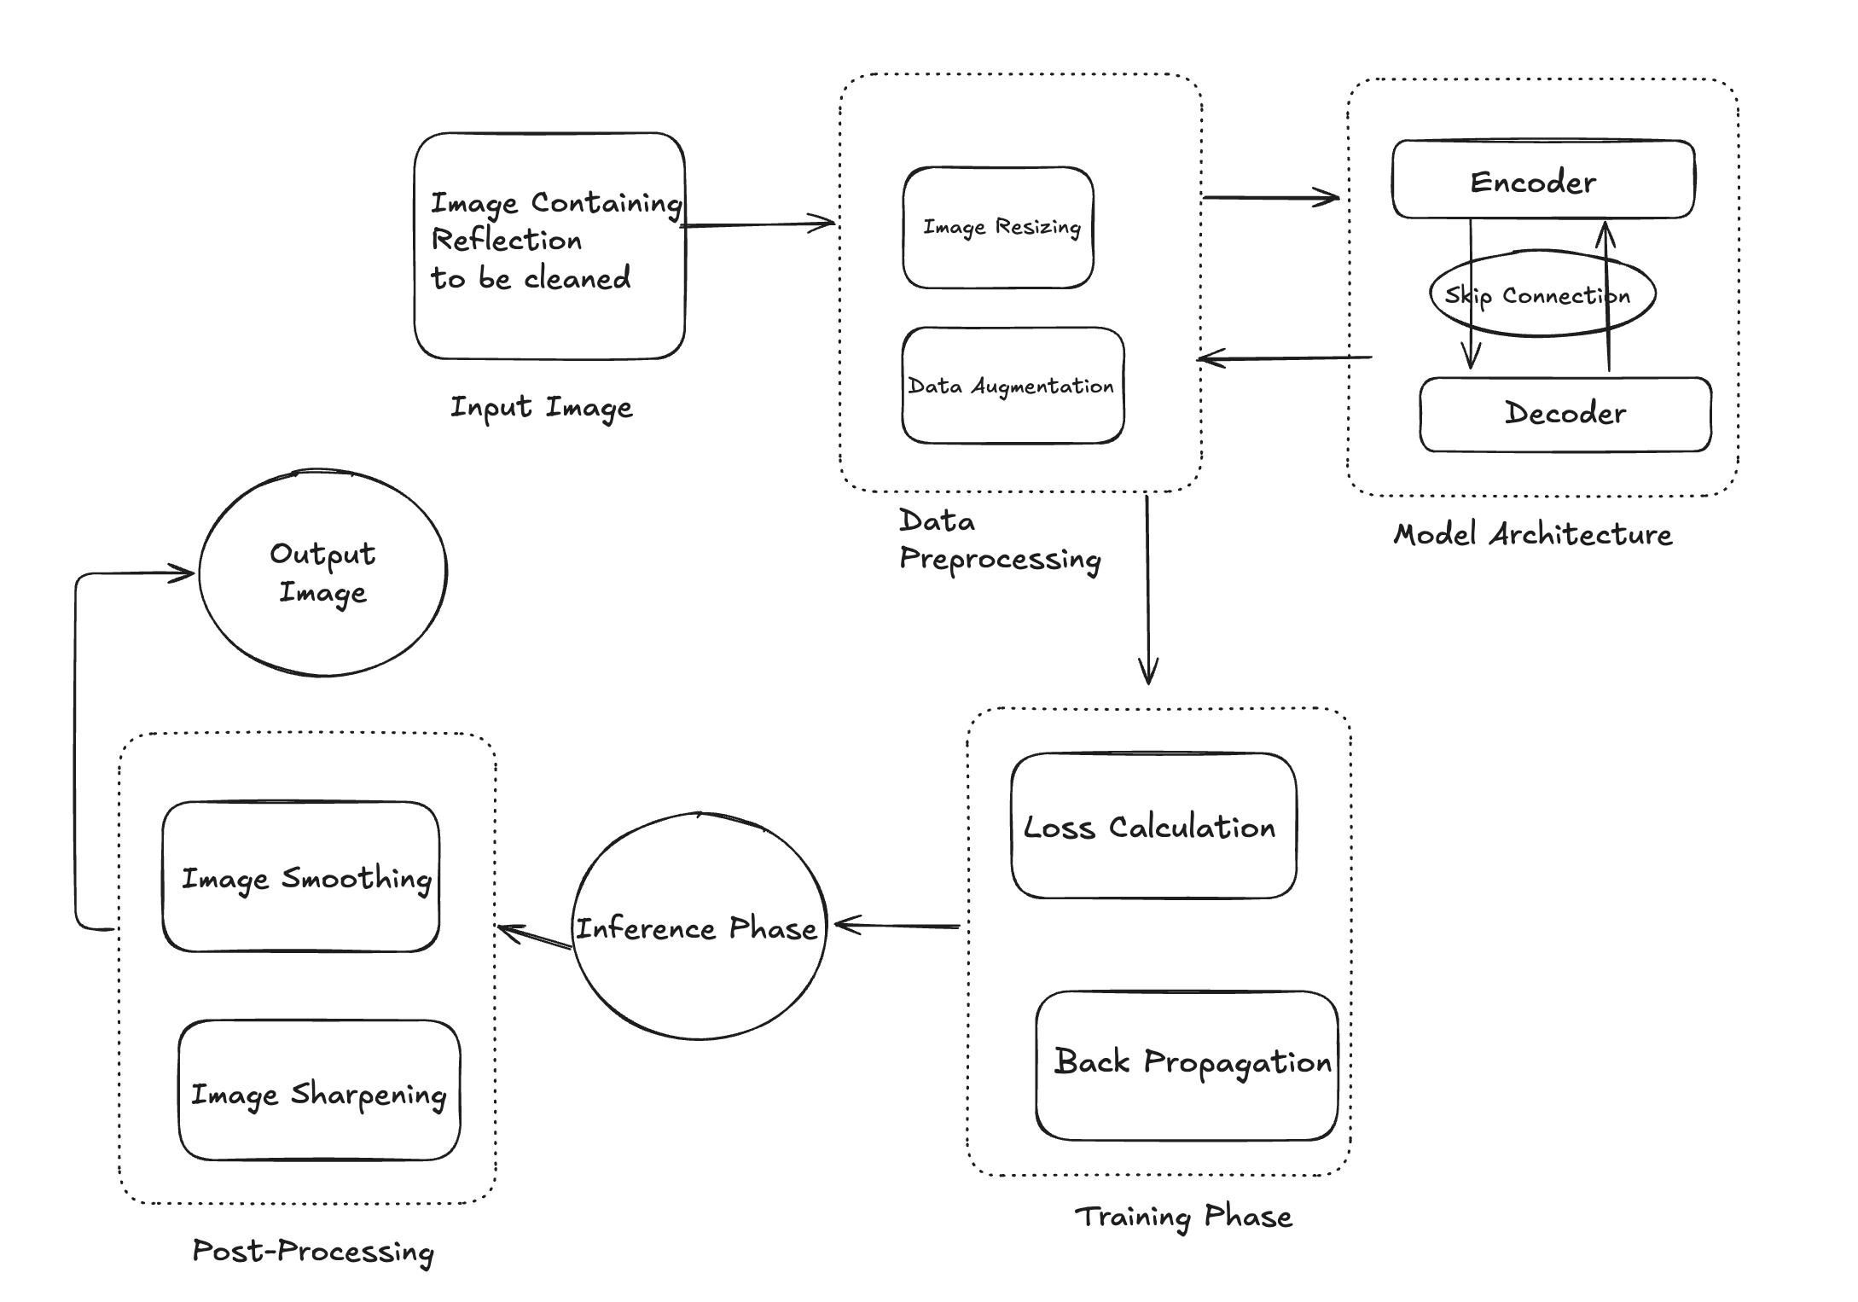
SYSTEM DIAGRAM
Hackaholics

Slide 5
CONCLUSION
This workflow provides an efficient, structured approach to reflection removal, ensuring high-quality image restoration.
Using encoder-decoder architectures, especially with skip connections, enables the model to learn to separate reflections effectively.
Data preprocessing and augmentation enhance model robustness, creating a comprehensive dataset that improves performance on varied input images.
A carefully chosen loss function, such as Mean Squared Error (MSE) or perceptual loss, optimizes the model's accuracy in removing reflections.
Post-processing techniques like image smoothing and sharpening further refine the output, reducing artifacts and improving visual appeal.
This approach is well-suited for applications like photography, surveillance, and other imaging tasks where reflections obscure important content.

