Slide 1
Disclaimer
Information regarding potential product is only intend to outline general product concept and direction. The information mentioned is not a commitment, promise or legal obligation
The future development, release, and timings are indicative in nature and are subject to change at our sole discretion
July 2021

Slide 2
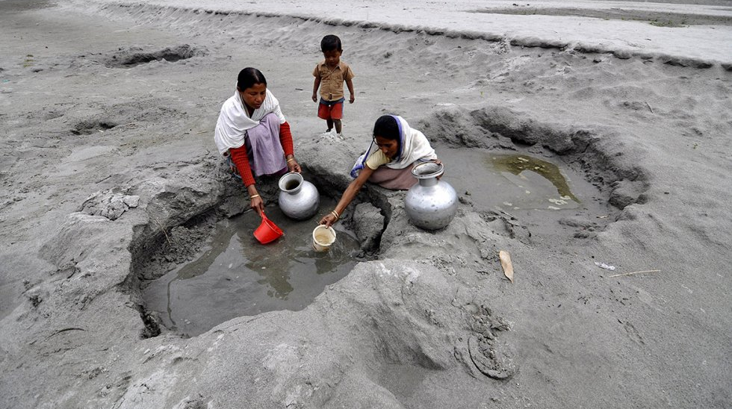
Clean water and sanitization: a global crisis
According to the World Health Organization,
2.2
billion
people around the world do not have safely managed drinking water services.
4.2
billion
people do not have safely managed sanitation services.
3
billion
people lack basic handwashing facilities. These services are critical in preventing the spread of COVID-19 and other diseases.

Slide 3
Solution Architecture – Call for Code 2021

