Slide 1
Agenda
Print solutions flow diagram
How to generate pdf file using with iText
Sample pdf

Slide 2
Print Solution
Flow Diagram
Flat File
Java Print Module
(iText)
PDF
Layout as a baseline
iText- convert layout to pdf format
Pdf- as expected pdf file

Slide 3
How to generate pdf file using with iText
We build a Microservice in Spring boot
Basic Design Principle for iText
// Create new pdf file
PdfDocument pdf = new PdfDocument(new PdfWriter(CREATED_PDF));
Document document = new Document(pdf);
document.add(Expected Format)(addCell, setBorder ,Margin, font etc)
document.close();

Slide 4
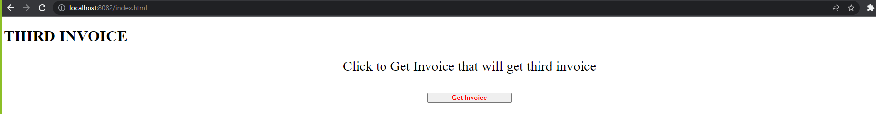
URL : - http://localhost:8082/index.html
UI – UI build in HTML and JavaScript (We can use any front technology)
Once you click Get Invoice button your pdf will download

Slide 5
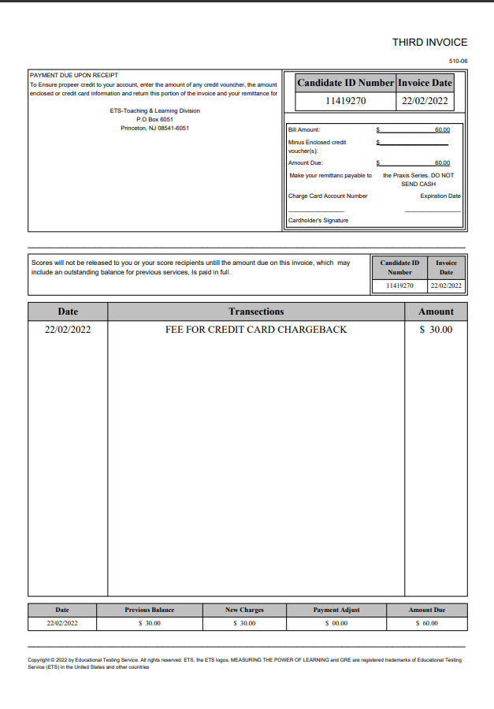
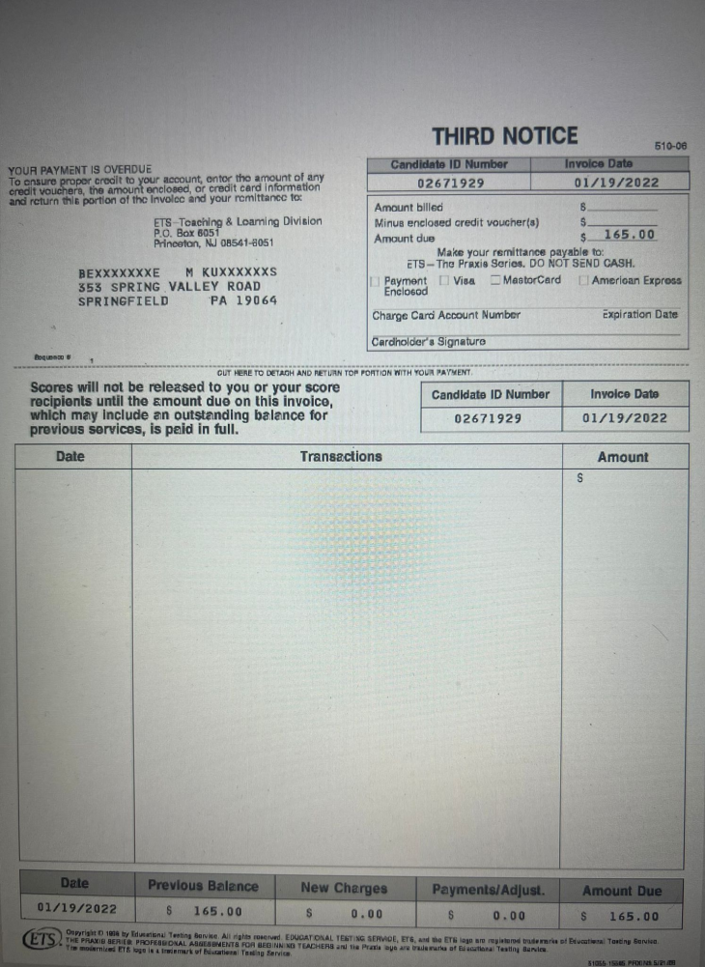
Sample pdf
iText

Slide 6
Questions Please

