Slide 1
The Impact of Weather on a Film’s Theatrical Launch
Os colegas da Francisca

Slide 2
Scope/Intro
Is it possible to correlate the impact of the weather on past ticket sales by looking at Comscore daily sales values for Portugal?
Is it possible to correlate the impact of weather throughout a film’s release with the total sales value using Opus Data dataset?
Attempt to correlate changes in the weather with a decrease or increase in cinema ticket sales.

Slide 3
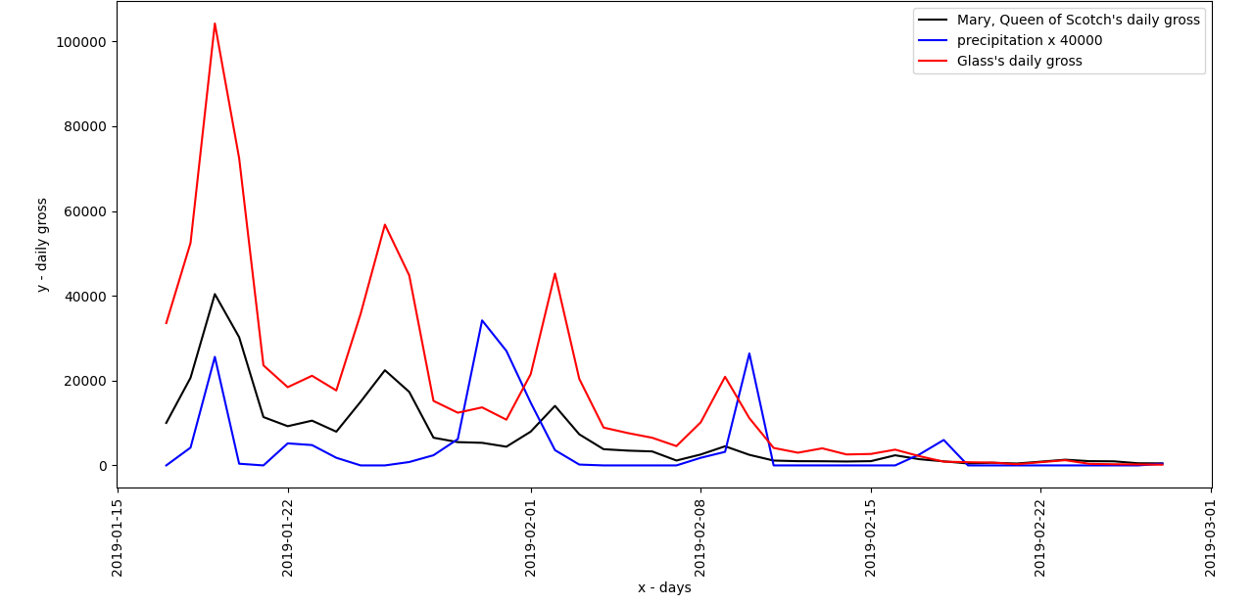
Impact of the weather on daily cinema tickets sales
Dataset: Daily sales values for Portugal, of the films Glass and Mary, the Queen of Scotch, analyzed between the 17th of January and the 27th of February (comscore dataset) as well as the weather information for these period of time (AccuWeather)
Measure the impact of the weather on cinema ticket sales week by week, comparing ‘good’ weeks with ‘bad’ weeks, and comparing ‘good’ days in ‘bad’ weeks with ‘bad’ days in ‘good’ weeks.
Temperatures rose linearly however that can be misleading because as time passes ticket sales lower
Daily gross and precipitacion

Slide 4
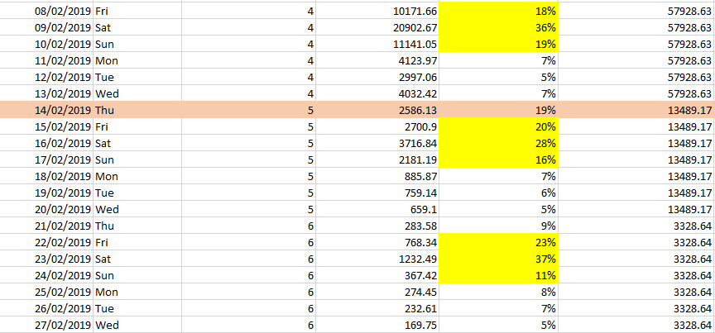
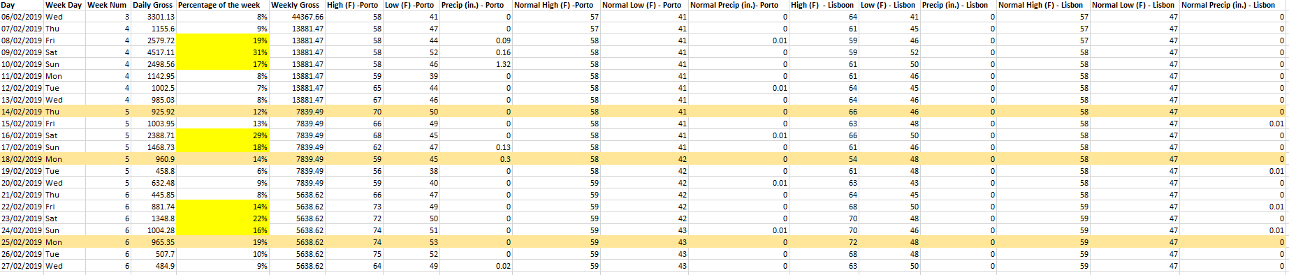
Unexpected days
Events as Valentines Day
As weeks pass the percentage levels and mondays have more affluence

Slide 5
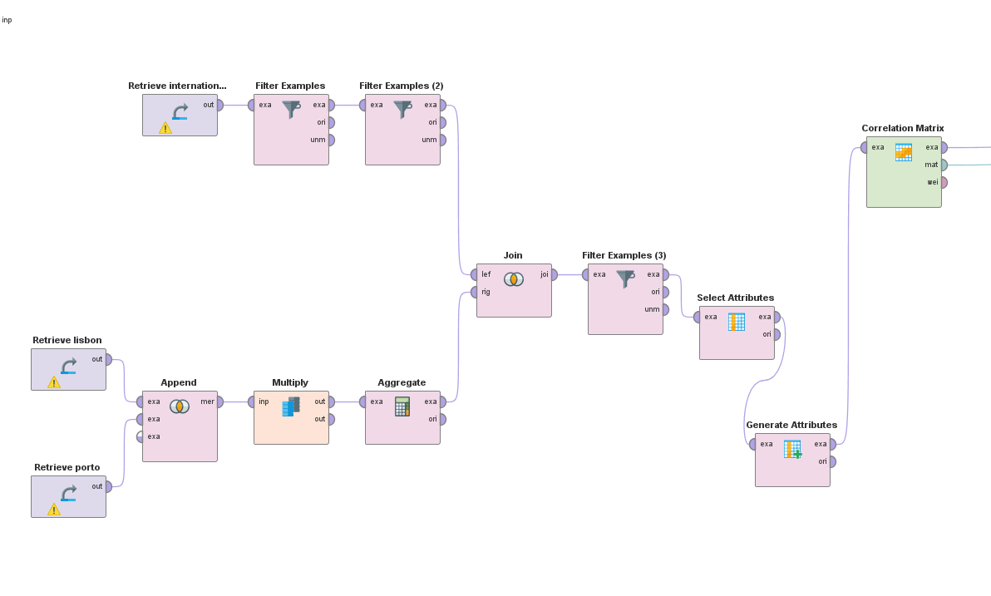
Impact of weather on a film release
Used film release information from Opus Data and crossed the release data with the weather dataset
Studied correlation on the United Kingdom and Portugal
Dataset: 173 films in the UK and 87 films in Portugal
Process to study the correlation between the film release information and the weather, Portugal

Slide 6
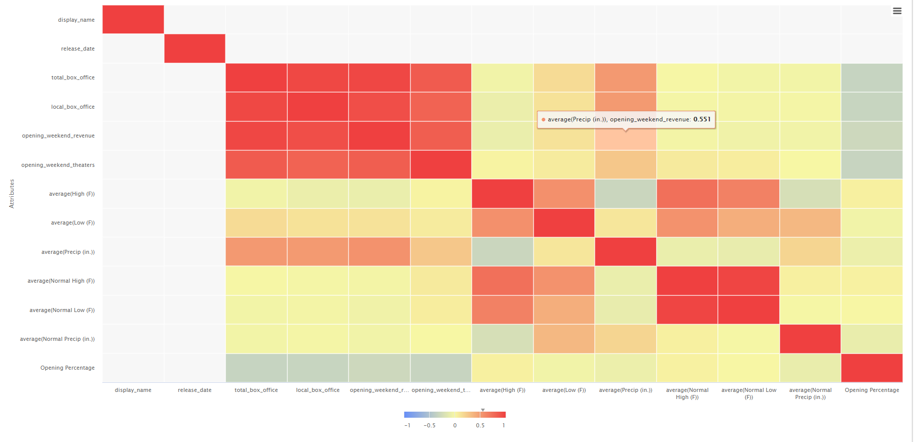
Outcomes
Approximately 0.551 correlation between precipitation and the opening weekend revenue
In Portugal, there seems to be a correlation between the weather (especially precipitation) and the success of a film launch
In the UK that does not seem to happen, as the correlation between them was close to 0
Portugal
Hypothesis: The different sun exposure and culture of each country has an effect on how people are affected by the weather (Source: Current Results, 2021)

Slide 7
Predicting the film’s launch success
The sample used for creating this model was the film’s launched between the 1st of january and the 31th of march 2019 (79 films after cleansing for Portugal and 63 for UK)
It was taken into account the genre of the film and it’s production size as well
Our target was the ‘Opening Percentage’ (opening_weekend_revenue/total_box_office)*100
Applied k-NN to create the model

Slide 8
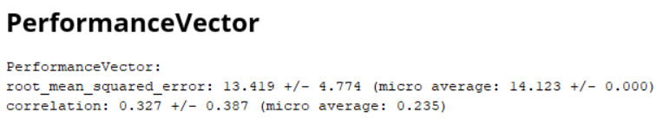
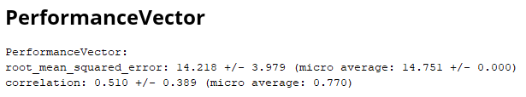
Conclusions - Portugal/UK Weather Model
Advantages:
Can predict in more or less reliably the impact of the theatrical launch of a film
The impact of the weather was noticed, when removed the model would have worst performance
The process created is easily used for other datasets
The Portugal model achieved better results, what cements our hypothesis
Disadvantages:
Valid for a short period of time (01/01 - 31/03)
Only valid for the said countries
Model for UK
Model for Portugal

Slide 9
Os colegas da Francisca
André Ávila
Dinis Sousa
Francisca Silva
João Malva

Slide 10



Technologies used

