Slide 1
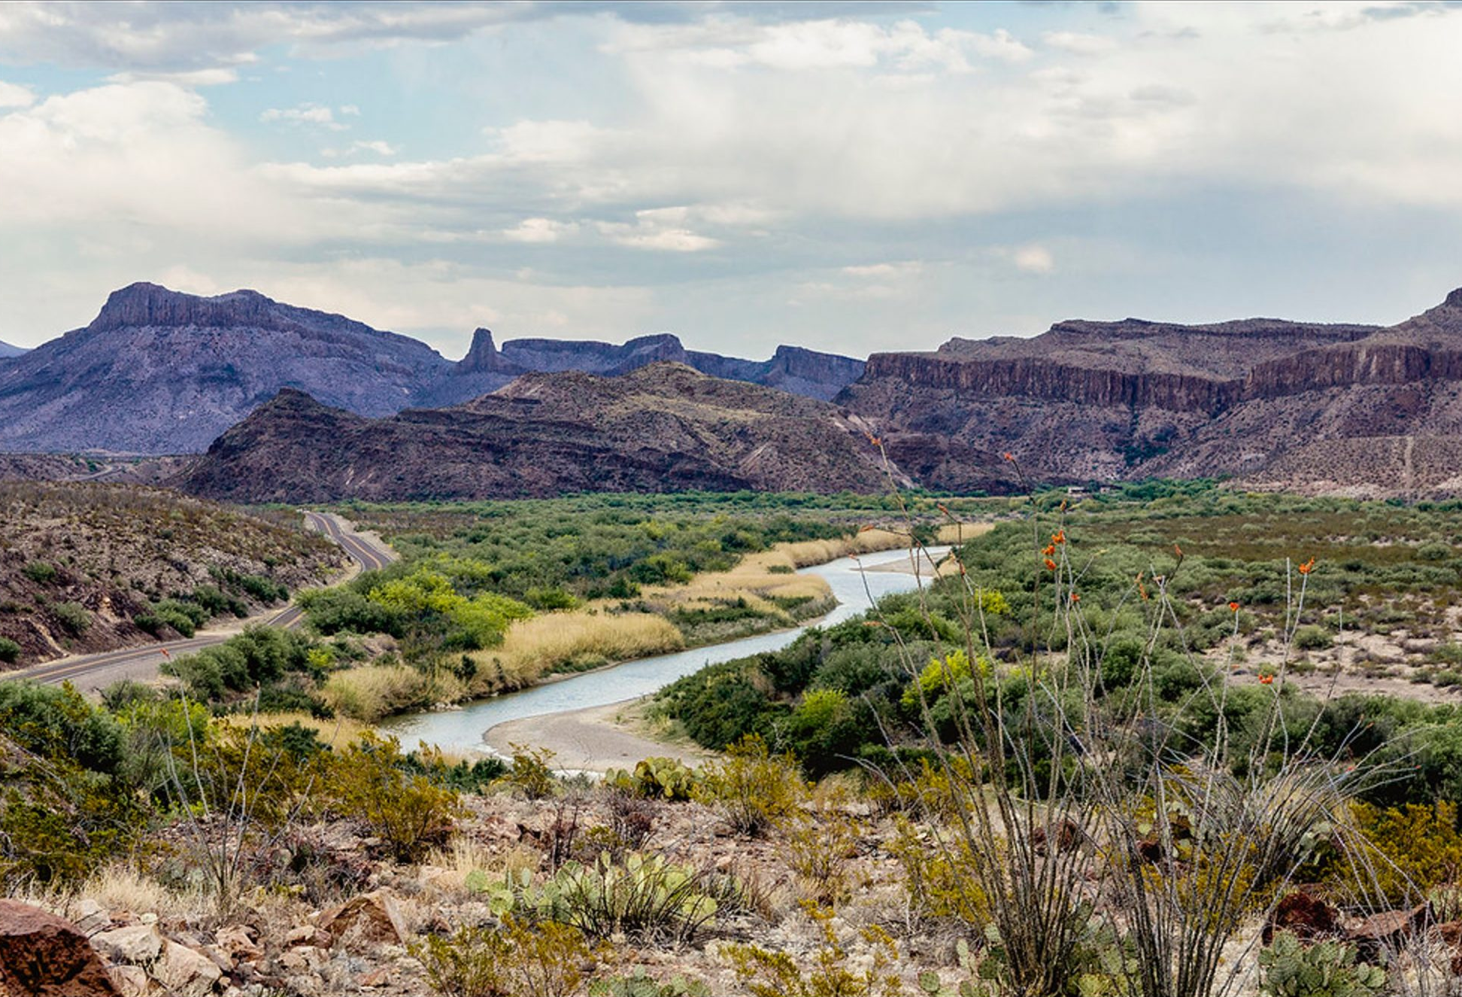
Team 04: QFalcon
OQI Hackathon 2026 · BUAP · Puebla
Resilient Release Scheduling
for the International Falcon Reservoir
Classical Optimization for Transboundary Water Management
Río Grande / Río Bravo Basin · SDG 6.4 · SDG 6.5 · SDG 13.1
26
+0.021
0.020 s
Weeks optimized
ΔSRS achieved
DP runtime
Hackathon-Puebla-2026 / Equipo_04
Notes:
Presentación del Equipo 04. Trabajo clásico: DP exacta y baseline de umbral. Mencionar uso de IA al llegar a la sección de baselines.

Slide 2
Problem Formulation
The Challenge
C_crit
The International Falcon Reservoir (Mexico–USA, Río Grande/Bravo) operated at critically low storage throughout 2025–2026 — below 12 % of design capacity.
Decision variable: the weekly release adjustment u(t), so that the optimized release is
R(t) = R_obs(t) + u(t)
where u(t) = 0 reproduces historical operation.
Penalizes weeks where
S(t) < Smin = 25 % Smax
→ prevents depletion
C_dev
Penalizes large deviations
from historical releases
→ operational realism
Storage Resilience Score (objective)
C_smooth
SRS = −(w₁·C_crit + w₂·C_dev + w₃·C_smooth)
Penalizes abrupt week-to-week
changes in the release policy
→ operational smoothness
Maximize SRS ≡ Minimize penalized cost
Aligned with SDG 6.4 · SDG 6.5 · SDG 13.1
Notes:
C_crit dominates because the reservoir was below Smin during all 26 weeks of the analysis window. The optimizer's primary task is to redistribute releases to keep more water in the reservoir early.

Slide 3
Data & Official Parameters
IBWC Data Sources
Official Benchmark — T = 26 weeks, L = 5 levels.
Discharge.Best Available@08461300
→ R_obs(t), observed historical release
Parameter | Value
Smax (official IBWC) | 3,288,726,000 m³
Smin = 0.25 × Smax | 822,181,500 m³
S₀ (initial) | 375,611,223 m³ (11.4 % cap.)
Δu = 0.25 × median(R) | 2,804,363 m³/week
u_max = 2Δu | 5,608,725 m³/week
η (balance constraint) | 0.10
w₁ | 5.479 × 10⁻²⁰
w₂ | 1.223 × 10⁻¹⁶
w₃ | 3.179 × 10⁻¹⁷
Total Storage.Web-Daily@08461200
→ S(t) and ΔS_obs(t) weekly change
falcon_reservoir_constants.json
→ Smax verified by 2 independent methods
Discharge in m³/s integrated over 15-min intervals → weekly volume (m³/week).
⚠ S₀ = 375 Mm³ < Smin = 822 Mm³ — reservoir starts in the critical zone.
Notes:
Two independent derivation methods (scraping + storage/percentage) both give Smax = 3,288,726,000 m³ exactly. This is stored in falcon_reservoir_constants.json in the repo.

Slide 4
Baseline Methods
Baseline 1 — Historical Replay
Baseline 2 — Threshold Rule (Eq. 18)
u(t) = 0 for all t
u(t) = −Δu if S(t) < Smin
u(t) = 0 otherwise
Reproduces exact historical operation.
No optimization applied.
SRS = −0.311534
27 of 27 weeks below Smin
Ccrit dominates — Cdev = Csmooth = 0
Deterministic conservation rule.
SRS = −0.290423 (balanced)
✓ Feasible | ΔSRS = +0.021111
Reduces releases in 11 of 26 weeks
SRS Comparison (higher is better)
Notes:
MENCIONAR USO DE IA AQUÍ en voz: Claude (Anthropic) fue utilizado como herramienta de apoyo en documentación, derivaciones matemáticas y scaffolding de código. Los algoritmos, decisiones de diseño y resultados son del equipo. Nota: la threshold_pure (sin reparar) viola el balance acumulado: retiene 72.9 Mm³ vs límite ±31.2 Mm³. La versión balanced la corrige automáticamente.

Slide 5
Classical Method — Exact Dynamic Programming
Why Exact Dynamic Programming?
Optimal Weekly Policy (T = 26)
5²⁶ = 1.49 × 10¹⁸ candidate schedules
Week | R_obs (Mm³) | u(t) | S_opt (Mm³)
1 | 3.30 | −2.80 | 384
2 | 8.21 | −2.80 | 387
3 | 6.27 | −2.80 | 410
4 | 9.47 | −2.80 | 414
5 | 12.06 | −2.80 | 409
6 | 18.43 | −2.80 | 398
7 | 15.91 | −2.80 | 389
8 | 11.27 | −2.80 | 385
9 | 12.18 | −2.80 | 379
10 | 11.76 | −2.80 | 377
11 | 10.70 | −2.80 | 393
12 | 10.38 | 0.00 | 390
13–26 | (varies) | 0.00 | —
Brute-force is impossible. DP exploits the cumulative structure:
S_opt(t) = S_hist(t) − q_t · Δu
where q_t = Σ k_τ (integer sum of adjustment levels).
State space: (t, q_t, k_{t-1}). DP is optimal within
the discrete level set — verified by brute-force on T=12.
SRS = −0.290423 | ΔSRS = +0.021111 | Runtime = 0.020 s | Feasible ✓
11 weeks conserving, 15 weeks at u=0.
Cumulative adjustment: −30.85 Mm³ (within ±31.15 Mm³ budget).
Notes:
Policy: reduce by −Δu for the first 11 weeks to conserve water, then return to historical operation. The DP finds this is optimal because the balance constraint prevents retaining more.

Slide 6
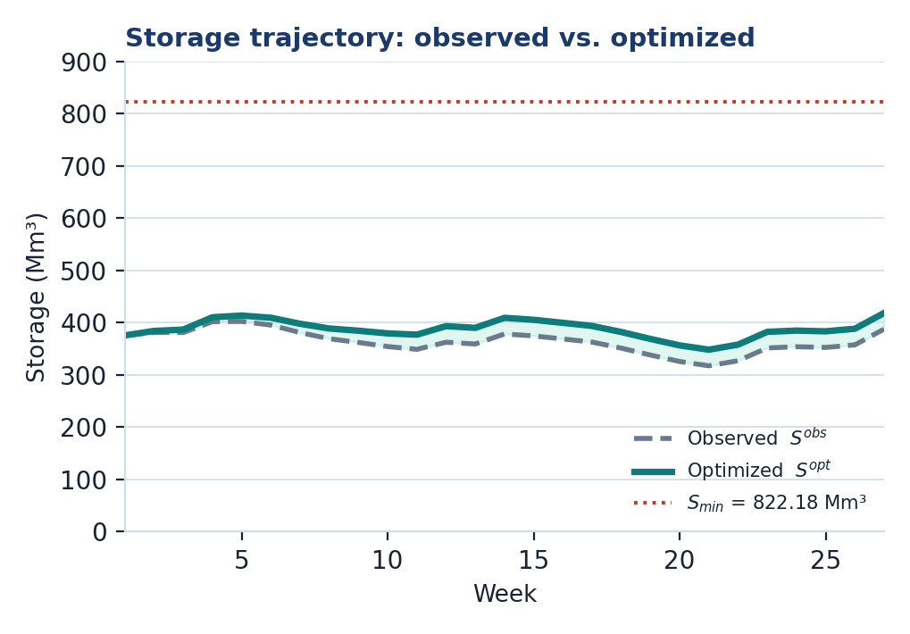
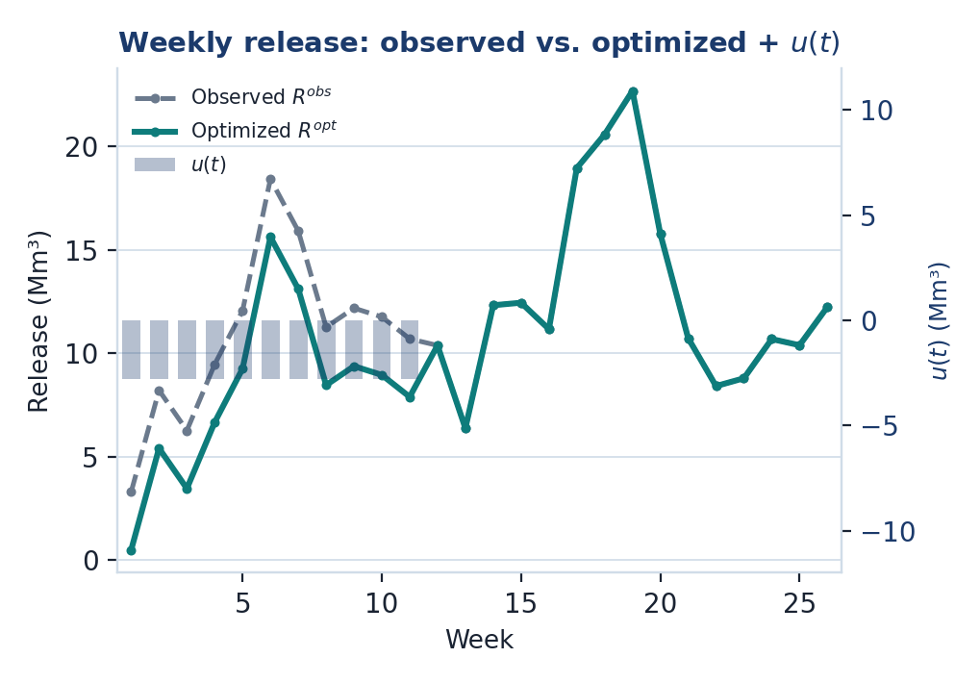
Optimized Policy — Results Visualized
T = 26 · L = 5
311.5 → 280.7 Mm³
9.65% → 10.59%
30.85 / 31.15 Mm³
Total volume released (−9.9%)
Minimum storage vs. capacity
Cumulative balance budget used (99.0%)

Slide 7
Benchmarking & Scaling
Official Benchmark Comparison (T = 26, L = 5, Smax = 3,288,726,000 m³)
Method | SRS | ΔSRS vs hist. | Feasible | Runtime
Historical (u = 0) | −0.311534 | +0.000000 | ✓ | —
Threshold Rule (balanced) | −0.290423 | +0.021111 | ✓ | < 0.01 s
Dynamic Programming (exact) | −0.290423 | +0.021111 | ✓ | 0.020 s
✓ Brute-force (T = 12, L = 3, 3¹² = 531,441 schedules, 4.93 s) gives dSRS_vs_dp = 0.000000 — DP is formally verified as optimal within the discrete level set.
Scaling Analysis (classical DP — real results from team runs)
Instance | T | L | L^T (schedules) | ΔSRS (DP) | Runtime
Debug | 5 | 3 | 3⁵ = 243 | +0.000000 (u*=0) | < 0.001 s
Small | 12 | 3 | 3¹² ≈ 5×10⁵ | +0.000000 (u*=0) | ~0.004 s
Medium | 26 | 5 | 5²⁶ ≈ 1.5×10¹⁸ | +0.021111 | 0.020 s
Large | 52 | 5 | 5⁵² ≈ 2×10³⁶ | +0.051236 | 0.51 s
Notes:
Hallazgo T=12 y T=5 (debug): la política óptima es u*=0 para la ventana de datos disponible con L=3. Esto no es un error — la restricción de balance hace que las reducciones que se pueden lograr no mejoren el SRS cuando el horizonte es corto. Brute force runtime en T=12: 4.93 s para 531,441 combinaciones. DP: ~0.004 s. Speedup de ~1,200x.

Slide 8
Extended Benchmark Comparison
T = 26 · L = 5 · all methods
Method | SRS | ΔSRS vs hist. | Feasible | Runtime
Historical (u = 0) | −0.311534 | +0.000000 | ✓ | —
Threshold Rule (literal, Eq. 18) | −0.288934 | +0.022600 | ✗ balance violated | < 0.001 s
Threshold Rule (balanced) | −0.290423 | +0.021111 | ✓ | < 0.001 s
Dynamic Programming (exact) | −0.290423 | +0.021111 | ✓ | 0.020 s
Simulated Annealing (quantum-inspired) | −0.291188 | +0.020346 | ✓ | 6.594 s
Why not report the literal threshold rule as the winner? Its SRS is nominally higher, but it reduces releases by 72.9 Mm³ — far beyond the ±31.15 Mm³ cumulative-balance budget — so it is inadmissible under the official constraints.
−0.290423 = −0.290423
6.594 s vs. 0.020 s
DP-exact matches the balanced threshold rule exactly — confirms both find the true optimum within the discrete level set.
Quantum-inspired annealing (SA) needs ~330× the runtime of exact DP and still converges to a slightly worse SRS — DP remains the strongest classical baseline.

Slide 9
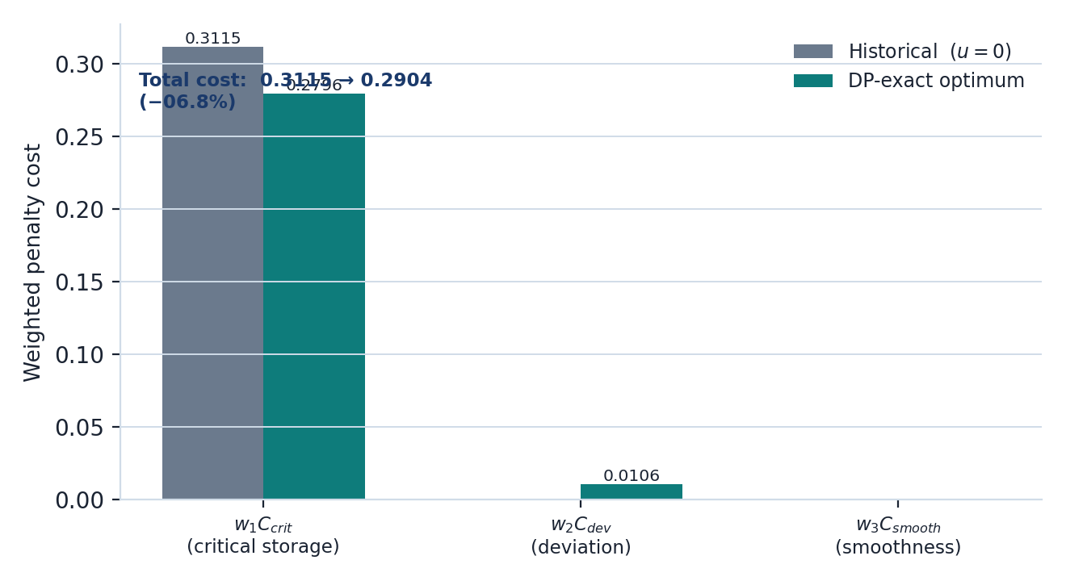
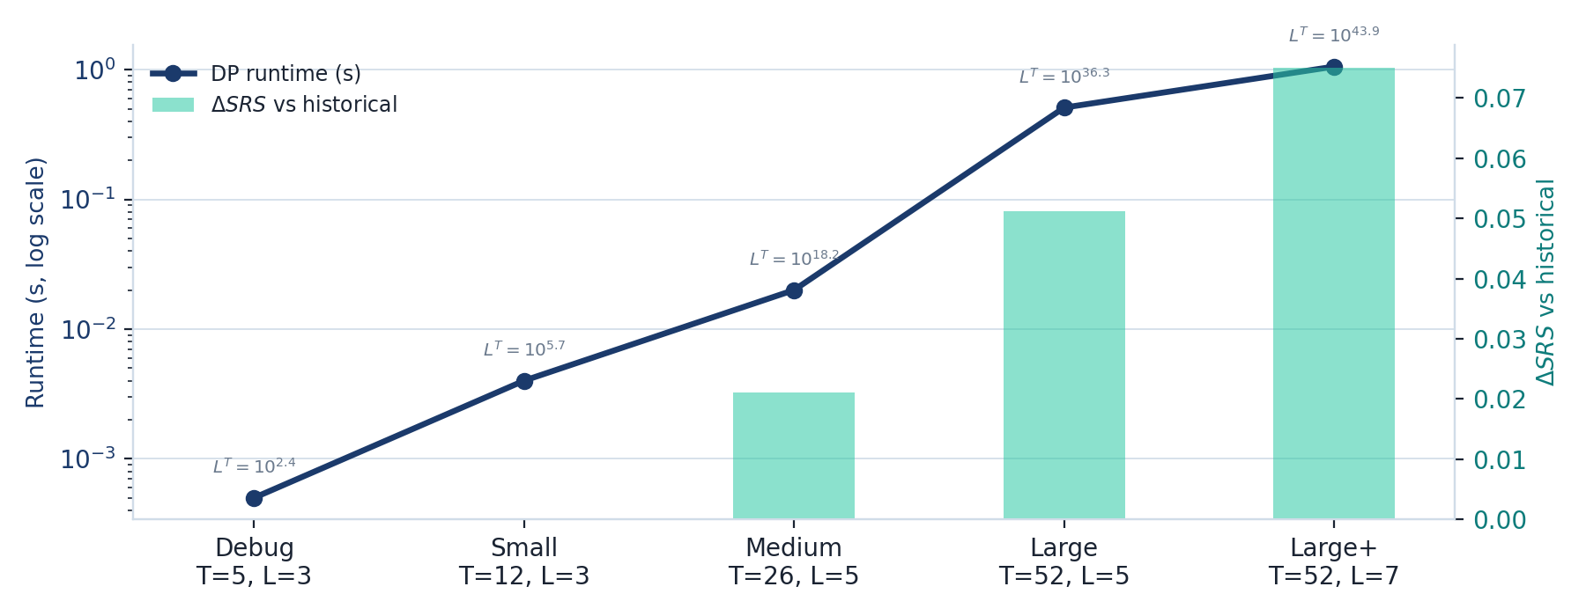
Cost Decomposition & Scaling Trend
DP cuts the critical-storage penalty from 0.3115 to 0.2796 (net cost −6.8%), paying only a small deviation (0.0106) and smoothness (0.0003) cost.
New scaling point: T = 52, L = 7 → 7⁵² ≈ 10⁴³ schedules solved exactly in 1.056 s (ΔSRS = +0.075) — runtime stays far below the combinatorial growth.

Slide 10
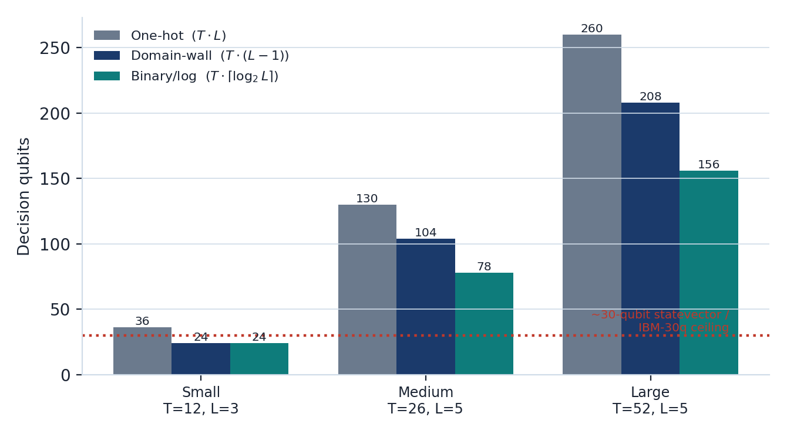
Quantum Track — QUBO / QAOA Formulation
Encoding
One-hot: x(t,ℓ) ∈ {0,1}; u(t) = Δu · Σℓ qℓ·x(t,ℓ); one-hot rule Σℓ x(t,ℓ) = 1 per week.
QUBO terms
C_dev, C_smooth expand exactly (quadratic in bits); C_crit uses a soft penalty for the MVP; storage bounds never bind → dropped (0 extra qubits).
Balance constraint
1-slack exact encoding, only ≈log₂(0.8T) extra qubits — correct and nearly free vs. a biased soft penalty.
Pluggable encodings
Key finding: official Smin = 822.18 Mm³ (not the team’s earlier 162.2 Mm³ preliminary) puts the 6-year drought-regime reservoir below threshold all year — C_crit ≠ 0, making optimization genuinely non-trivial, especially at L ≥ 5.
One-hot / binary(log) / domain-wall are interchangeable — binary cuts T12/L3 from 36 → 24 qubits, fitting a 30-qubit statevector simulator.

Slide 11
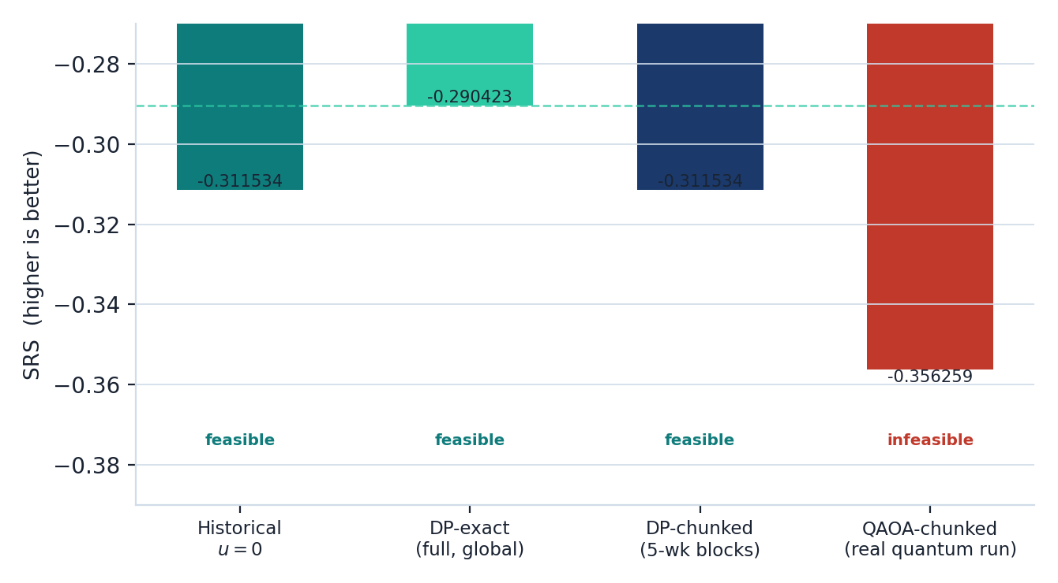
Quantum Track — QAOA Results & Roadmap
Instance | Encoding | Qubits | Status
Debug T5/L3 | one-hot | 17 | AR = 1.000 exact ✓
Small T12/L3 | binary | 24 | AR = 1.31 feasible ✓
Medium T26/L5 (chunked, 5-wk blk.) | domain-wall | 25/blk | SRS −.3563 4/6 feasible ✗
Gap vs. full DP (0.066 total):
• 0.021 from temporal chunking (blocks can’t redistribute across boundaries)
• 0.045 from QAOA itself (p = 1 depth, soft per-block balance)
IBM Qiskit Runtime plan:
domain-wall, 4 qubits/week, 7-week blocks (28q ≤ 30q budget), T=26 split 7+7+7+5.
Honest conclusion: no quantum advantage yet on this benchmark. Next: XY-mixer (drop one-hot penalty), deeper QAOA (p>1, INTERP init), hard per-block balance.

Slide 12
Conclusions
Best feasible result: ΔSRS = +0.021111 (DP & Threshold Rule) — 6.78 % reduction in total penalized cost
Problem Formulation
Classical Optimum
Reservoir scheduling encoded as discrete optimization over T=26 weeks × 5 levels. SRS metric with 3 penalty terms, 4 operational constraints verified.
DP finds the exact optimal within the discrete level set: u* = −Δu for 11 weeks then 0. Runtime: 0.020 s. Formally verified by brute-force at T=12.
Scalability
Limitations & Next Steps
DP scales from 5²⁶ ≈ 10¹⁸ to 7⁵² ≈ 10⁴³ in < 1.1 s. Search space grows exponentially; DP keeps runtime polynomial via cumulative-state reduction.
Simplified hydrological model; no treaty/legal constraints. QAOA now implemented: exact at debug scale, chunked at T26/L5 (25 qubits/block) — not yet beating DP.
Notes:
Cierre: el problema tiene estructura combinatoria clara y DP lo resuelve óptimamente en < 0.1 s. La formulación QUBO ya está derivada (130 variables binarias, verificada matemáticamente) y lista para ejecutarse en hardware cuántico cuando esté disponible.

