Slide 1
A PROJECT ON DISPLAY BOOKSHELVES
Group-3(QEA21QE001)
TEAM MEMBERS EMPLOYEE ID
Sindhujaa Guntupalli 899241
Hemani Jasti 899244
Asha Deepika Mosangi 899242
Mitta Bhagya Vyshnavi 899128
Mullamuri Premchand 899092

Slide 2
Contents
About Urban Ladder
Project Description
Test scenario (smoke, regression)
Automation test cases
Functional requirement document.
Requirements and specifications(i.e. workflow or Algorithms etc..,)
Test summary report
Guidelines and documentation

Slide 3

Urban Ladder
Urban Ladder is an omnichannel furniture and decor retailer based out of Bangalore, India.
(URL:https//www.urbanladder.com/)
Urban Ladder has both online and offline business model for distribution.
Logo of UL

Slide 4
Project Description
Display the name & price of first 3 Bookshelves below Rs. 15000, with Storage type as open & exclude out of stock From.
From Collections, retrieve all sub-menu items under Being-At-home and store in a List; Display the same.
Gift cards - choose "Birthday/Anniversay"; fill customize the gift card; fill from to details with any one input invalid (example: email); Capture & display the error message.

Slide 5
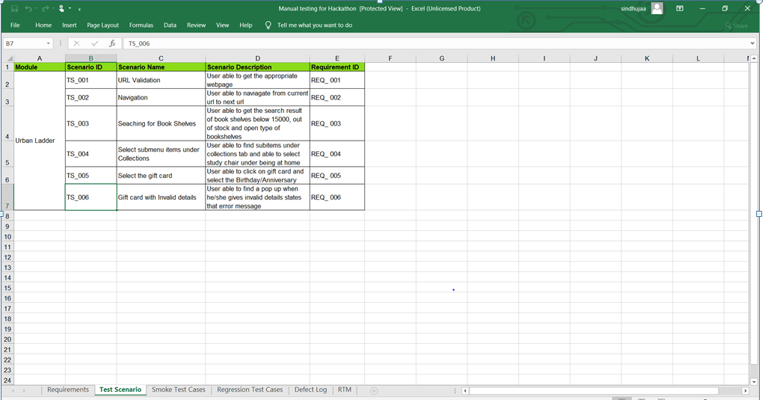
Test Scenario Sample

Slide 6
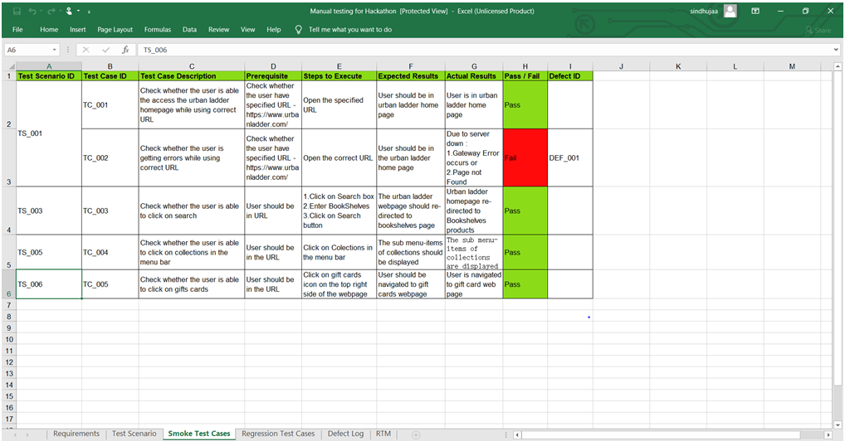
Test Cases

Slide 7
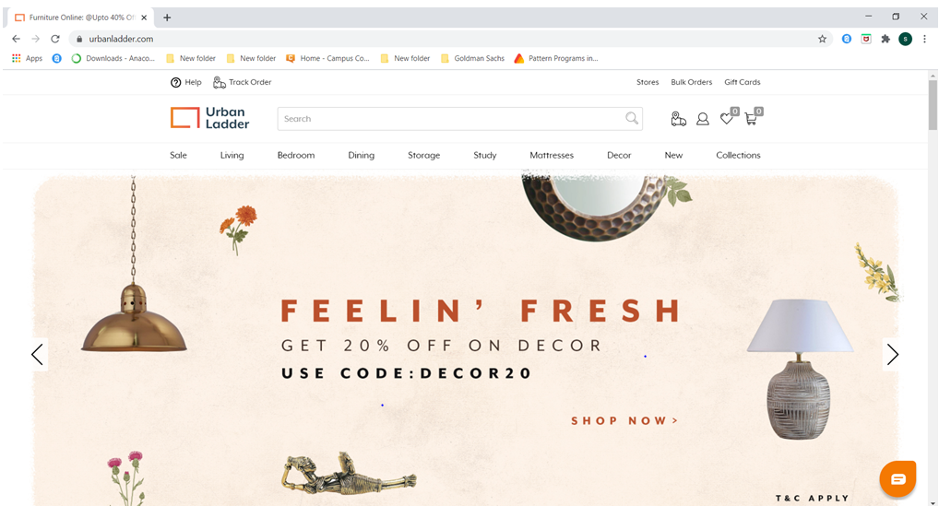
Home Page of Urban Ladder

Slide 8

Workflow to find Bookshelves
Launch Browser
Open Urban Ladder site
Search for BookShelves in search box
Close POP_UP
Go to storage menu and Select BookShelves
Apply Price ,Type Filters and Exclude Out Of Stock
Display first three BookShelves

Slide 9
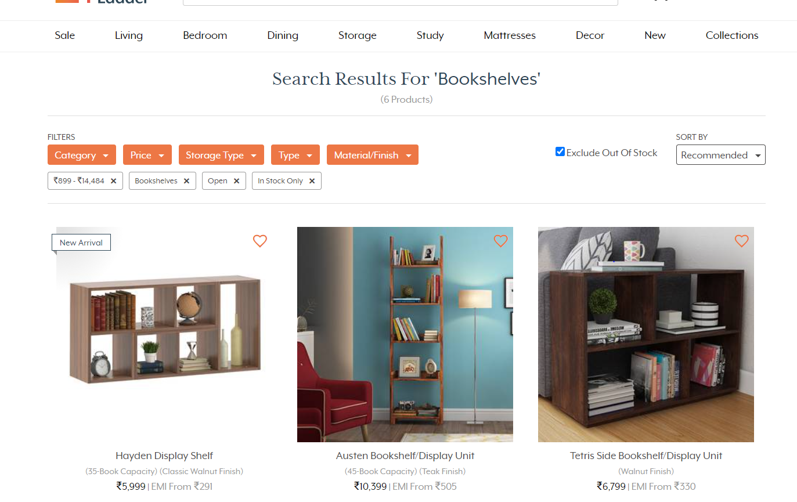
First three Bookshelves
Applied Filters

Slide 10
Workflow to find items in Being-at-home
Open Urbanladder site Home Page
Click Collections in Top-Menu
Move to Being-at-home
Retrive Sub-Menu items and Strore in a list
Display first three StudyChairs

Slide 11
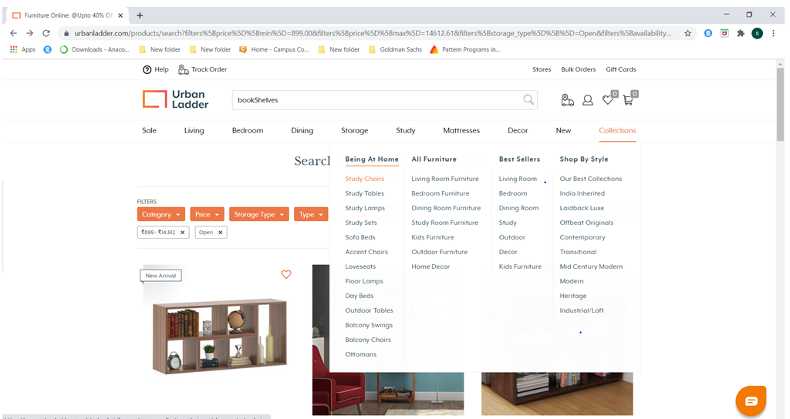
Retrieving submenu items Being At Home:
1. Select Collection
2. Retrieve all Sub-Menu Items

Slide 12
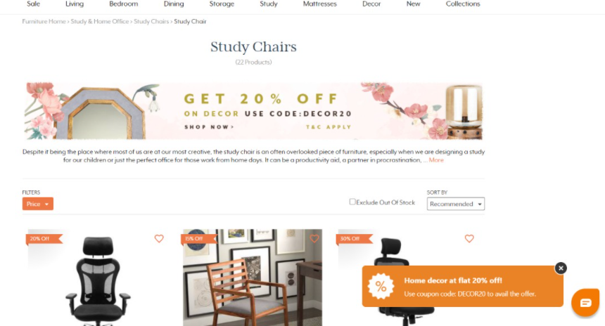
First three Study Chairs

Slide 13
Workflow to choose Birthday Gift cards
Open Urban Ladder Home Page
Fill the Recipient’s and Your Name
Click GiftCards in
Top-Menu
Enter Invalid emails and Click Confirm
Scroll down and Choose Birthday/Anniversary
Capture the Text in Error Toast Message
Customize GiftCard by Selecting Amount and Data

Slide 14
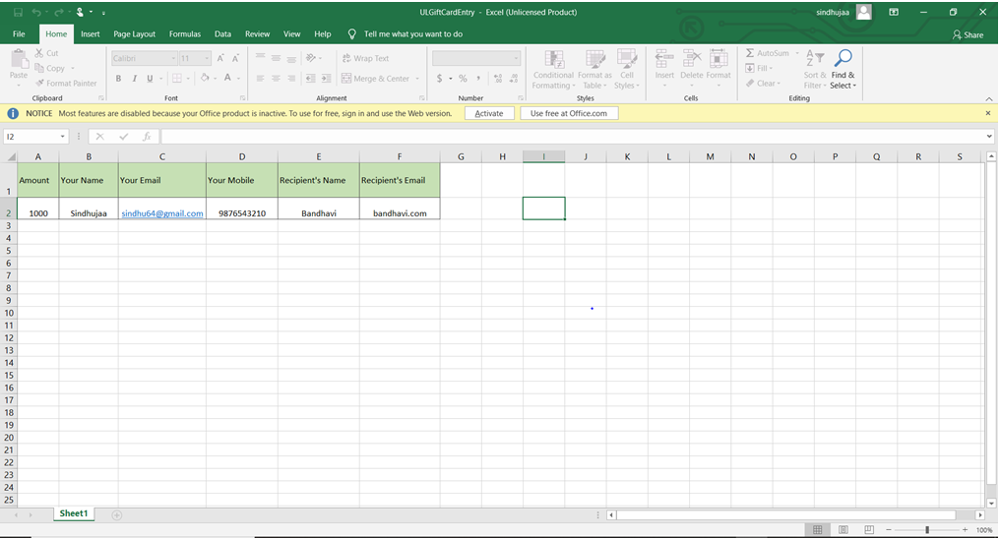
Input data For Gift Cards in Excel

Slide 15
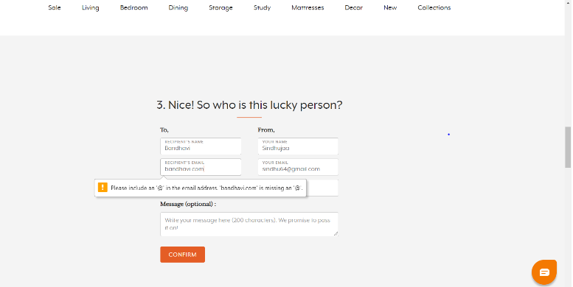
Gift card Toast Message
Error message pop up

Slide 16
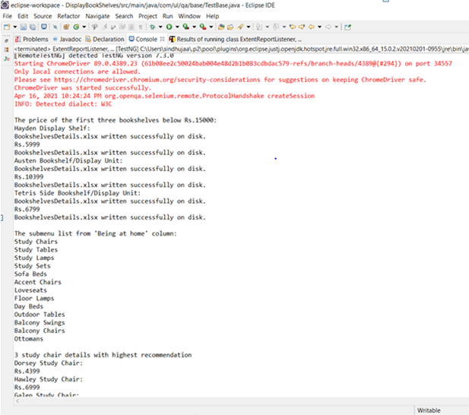
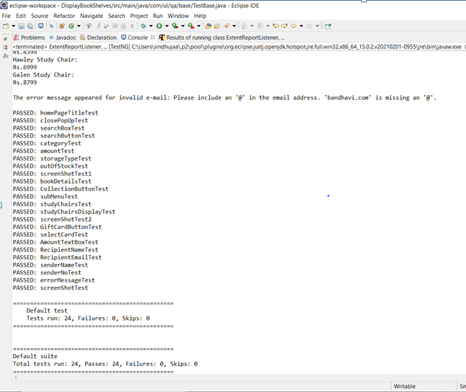
Console Output

Slide 17
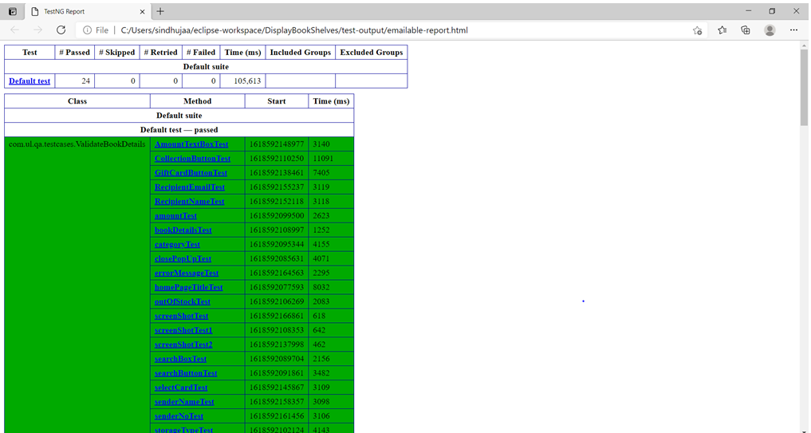
Final Report

Slide 18
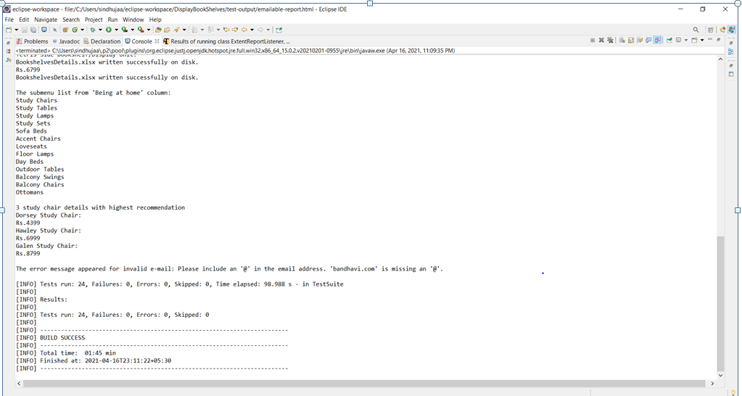
Result in Maven

Slide 19
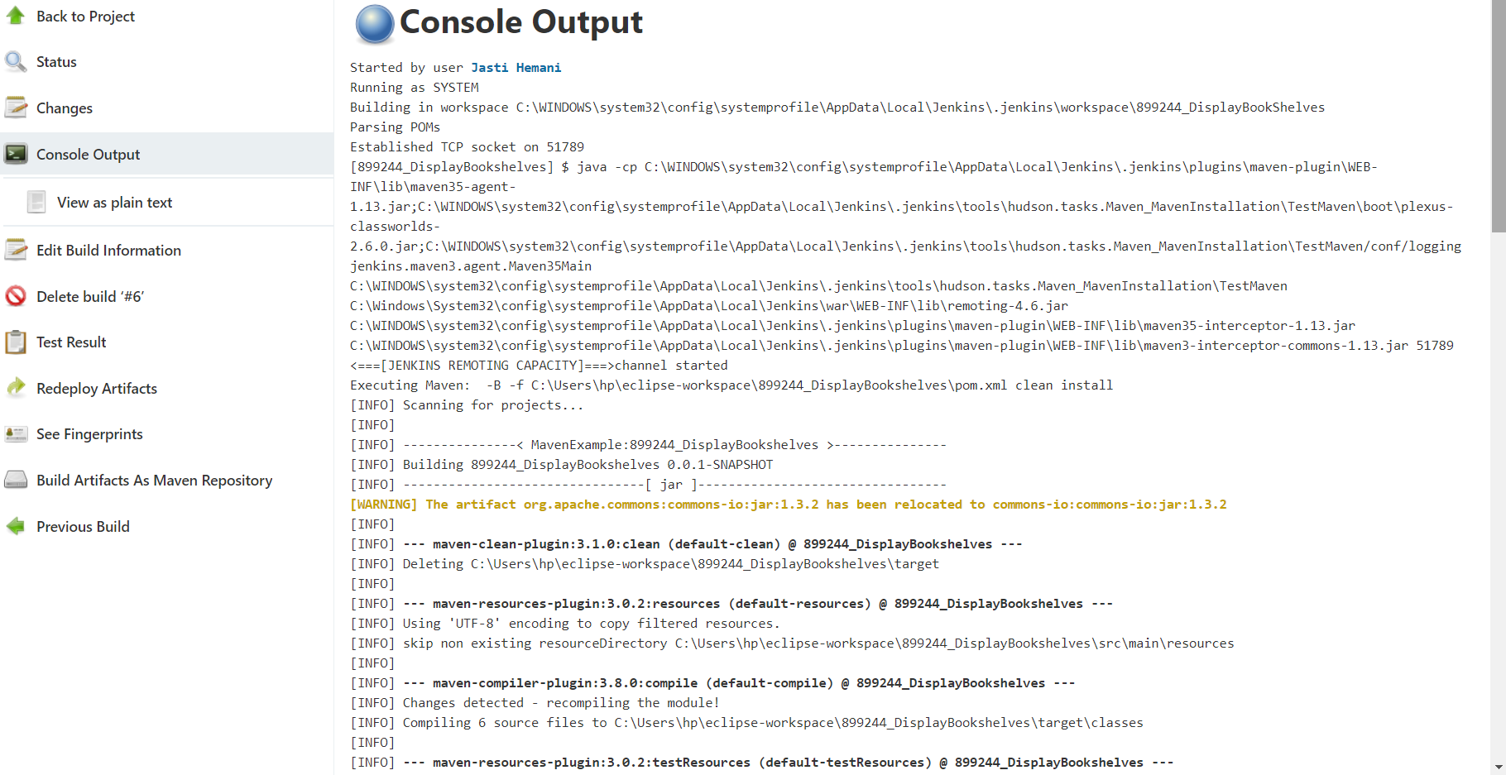
Result in Jenkins

Slide 20
Key Automation Scope
Handling alert, drag & drop, search option
Extract menu items & store in collections
Navigating back to home page
Scrolling down in web page
Filling form (in different objects in web page)
Capture warning message

Slide 21
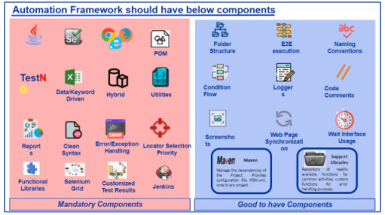
Tools and Components

Slide 22


