Slide 1
AERIS
Volunteer Organizer
Created by:
Geoffrey Xue, Aiden Cohen, Akshay Joshi, Kitiara Moore

Slide 2
MODES
01
02
COVID TRACKER
AIR POLLUTION MAP

Slide 3
Currently the two values that are tracked by the Aeris system are COVID-19 cases and air pollution, however it can be expanded to track other statistics

Slide 4
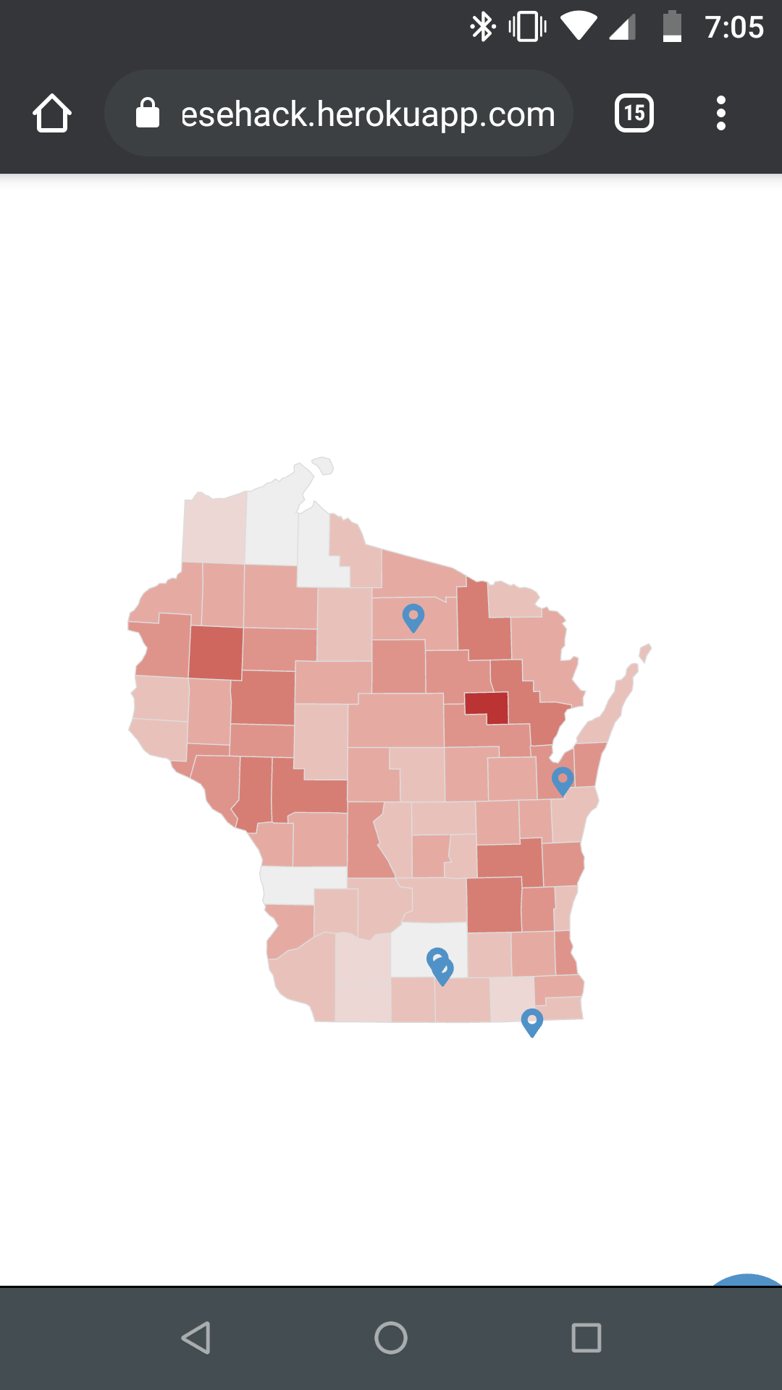
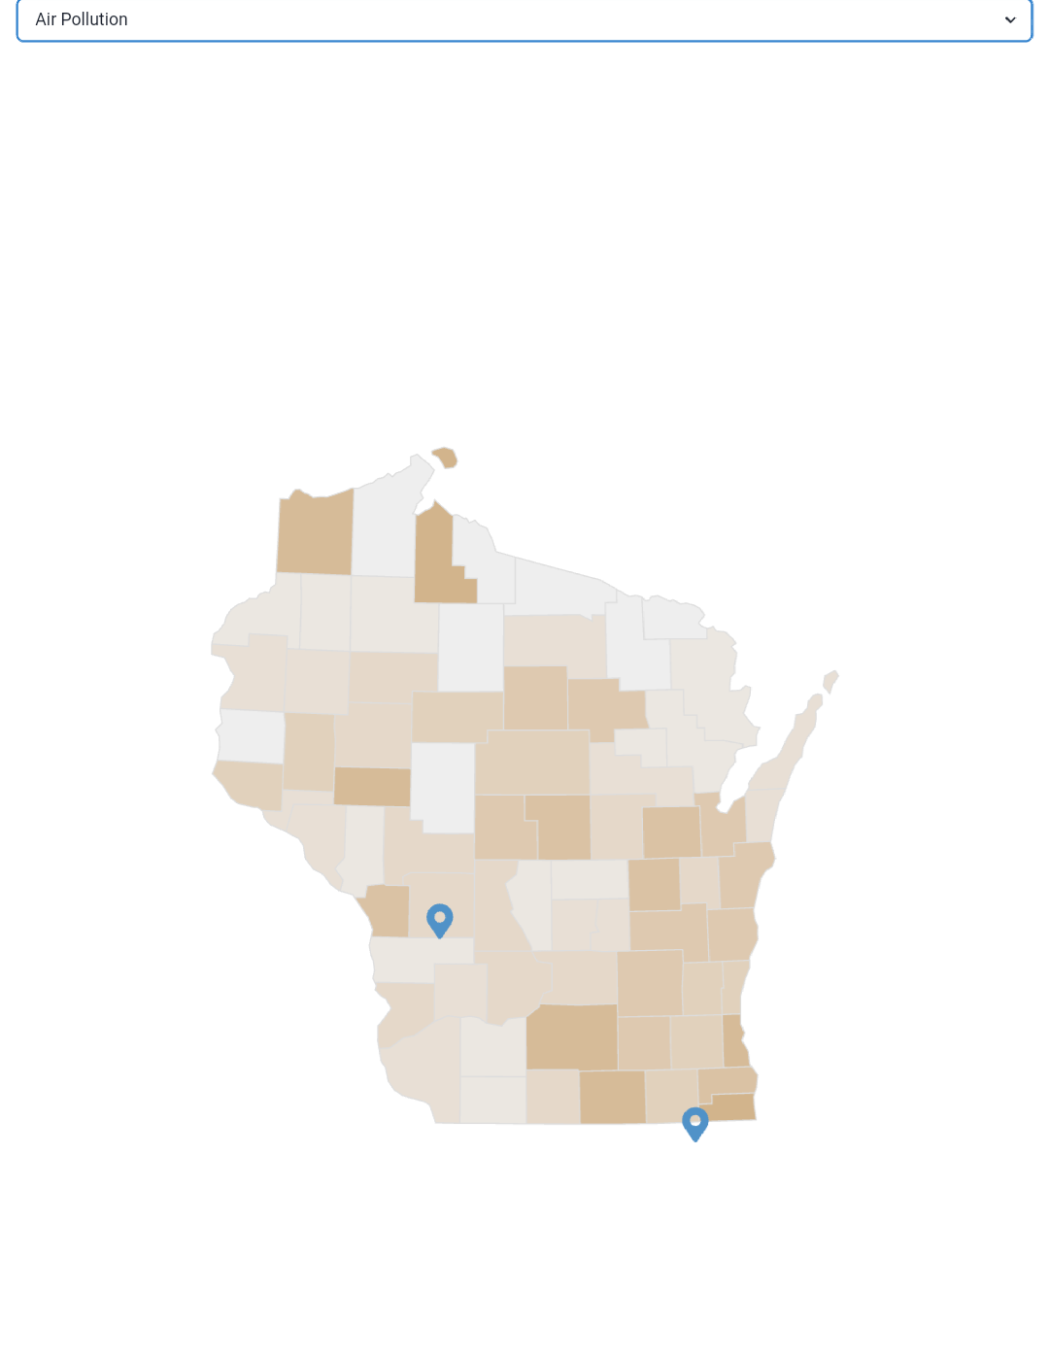
THE MAP

Slide 5
Organization side
Volunteer side
Updating map to visualize case distribution
See what other organizations are doing in the area, allows for easy coordination
Show events to interested volunteers
Easily see the case numbers of the areas around them
See what opportunities to volunteer there are in their area
Plan events that fit their schedule

Slide 6
Demo Time!

Slide 7
https://cheesehack.herokuapp.com

Slide 8
HOW IT WORKS

Slide 9
Hosting
Hosting is accomplished through Heroku, where two different websites are setup.
A Flask backend is running on cheesehack-backend.herokuapp.com
A Reactjs frontend is running on cheesehack.herokuapp.com
Communication between the two apps is done through HTTP requests, where the frontend queries a backend API for information on the DB/processing
Logins are done through Auth0, which provides an API for processing user data after oauth login

Slide 10
Frontend
React with Chakra
React router, react-simple-maps, react-icons, react-big-calendar,
Visualize map data with d3-geo and topojson
Create an account using email to access all features
Map and Calendar tabs to schedule events
Map icons change color to indicate what events are signed up for
Simple, fluid web app, easy navigation

Slide 11
Backend
Flask API
Multiple endpoints that process data and serve it to frontend
Connects Frontend to database
Takes in form data and fills in fields (conversion from address to Lat +Long)
MYSQL Database
Scraped data off of government websites and loaded it into a mysql database.
Foreign Key constraints to easily organize data across 5 tables
Table structure is scalable to take in increasingly more amounts of data

Slide 12
Potential
Impact

Slide 13
EASILY ACCESS PUBLIC HEALTH DATA
Data can be hard to find
Multiple statistics with map for visualization
Allows anyone with access to the app to see easy to understand visualizations
Public can make more informed decisions

Slide 14
Communication
Facilitates communication and organization between community groups
Easily see what issues are being taken care of and what need more resources

Slide 15
Community Empowerment
Anyone can create an account for a user or organization
Allow smaller community orgs to plan events and get word out

Slide 16
Ease of involvement
Shows users many options for involvement in their area
Allows users to find volunteer opportunities they can access

Slide 17
Any Questions?

