Slide 1


SMART Contracts for the smart Era

Slide 2
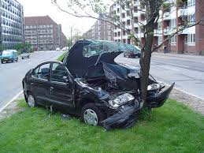
It’s not fair….
Ever wondered why those “reckless” drivers are paying the same amount of money for their insurance as you?

Slide 3
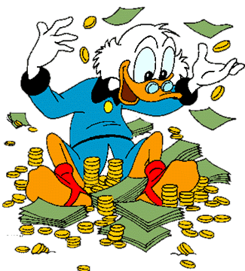
…wanna change that?
Imagine saving money by driving safe!

Slide 4
Join the era of smart contracts!

Slide 5
