Slide 1
LLM agents: the model and its memory
My part of DressMe: the LLM that powers the agents, and how it remembers
The LLM: OpenAI GPT-4o
Memory: how the agent remembers
Sees images
Calls tools
Feedback
Long-term
Short-term
judges pattern, material and style
decides when to search the wardrobe
user corrections, used to measure accuracy
the user's wardrobe in Supabase
messages of one question (max 4 rounds)
Strict JSON
Easy to switch
No chat history: each question starts fresh from the stored wardrobe.
always answers in a fixed format
gpt-4o-mini with one variable
GPT-4o temperature per task (low = stable answers)
3.0
0.3
2.0
0.2
2
1
4
1.0
0.1
agents
tool
max rounds
0
0.1
0.2
0.3
0.4
1
Notes:
This slide introduces the LLM and its memory model: GPT-4o, 2 agents, 1 tool, 4 max rounds.

Slide 2
Actions and tools: the two agents
Each agent uses GPT-4o plus one tool, search_wardrobe, on the stored wardrobe
Input
Detect
Colour
GPT-4o
Wardrobe
photo or camera
YOLO finds the item
measured from pixels
adds style, season...
saved per user
Tools used: search_wardrobe (Python) · OpenAI API · Supabase · FastAPI + React
Agent 1: Stylist
Agent 2: Duplicate guard
Answers questions with the user's real clothes
Stops the same item from being saved twice
Question
GPT-4o
Answer
Live scan
Stable?
Already owned?
warm jacket?
picks filters
+ matching items
camera + YOLO
held 1.4 s
GPT-4o + search
Searches again if needed (max 4 times)
filters
results
Stops when it has a good answer
Checks before saving. A similar item is still allowed.
yes
no
search_wardrobe
Not added
Saved
finds items
duplicate
new item
2
Notes:
Two agents share the same GPT-4o plus search_wardrobe tool: the Stylist and the Duplicate guard.

Slide 3
AI techniques and safeguards
What makes the agents smart, and what keeps them safe
Safeguards
Fine-tuned vision
Agentic RAG
YOLO trained on 20 clothing classes
searches real data, then answers
✓
Limited loops: max 4 tool rounds, no runaway cost
✓
Real answers only: uses the user's own items
LLM
agents
Tool-using agents
Smart prompting
✓
Checked data: invalid values are rejected
plan, search, check, adjust
clear rules and fixed word lists
✓
Safe fallback: simple rules if GPT-4o fails
✓
Private data: each user sees only their items
Structured outputs
Human in the loop
JSON checked before saving
users can fix mistakes
✓
No duplicates: checked before saving
3
Notes:
Six techniques around the LLM, and six safeguards that bound cost, accuracy, and privacy.

Slide 4
ADVANCED DATA SCIENCE PROJECT
DressMe
01
RAG AI Stylist
Grounded fashion knowledge
Three implemented agents.
Three different kinds of intelligence.
02
Trip Agent
Help Me Pack planning
A technical report on the RAG AI Stylist, the Help Me Pack Trip Agent,
and the Avatar & Try-On pipeline.
03
Avatar & Try-On
SUPERVISOR: JIHENE JEBRI
Body-aware visual try-on
October 2026
Branches: rag/try1 · helpmepack/try1 · avatar/try1 + current working tree
DressMe / Agent implementation report
COVER 04 / 30
Notes:
Three prototypes, three intelligence strategies: retrieval, tool-using optimization, and deterministic vision/geometry.

Slide 5
WHAT THIS DECK COVERS
The same six questions, for three agents
Each section covers LLM, memory, actions, tools, pipeline, and AI techniques.
01
RAG AI Stylist
04
Cross-agent comparison
Hybrid retrieval, grounded answers, citations
What is shared and what is deliberately different
02
Trip Agent / Help Me Pack
05
Prototype evidence
Tool calling, weather, CP-SAT, checklist
Branches, files, metrics, and reproduction
03
Avatar & Try-On
06
Conclusion
Pose, silhouette, Blender/MPFB2, optional GPT-4V
What is real, what is next
DressMe / Agent implementation report
AGENDA 05 / 30
Notes:
The deck is deliberately symmetric: every agent gets the same six-slide treatment.

Slide 6
THREE AGENTS AT A GLANCE
Different problems need different intelligence
One retrieves knowledge, one computes a plan, one builds a body.
01
02
03
RAG AI Stylist
Trip Agent
Avatar & Try-On
Knows and cites
Decides and computes
Constructs and fits
LLM: GPT-4o
LLM: GPT-4o
LLM: optional GPT-4o Vision
Technique: hybrid RAG
Technique: tool calling + CP-SAT
Technique: vision + SciPy + geometry
Output: answer + sources
Output: capsule + checklist
Output: body-shaped GLB
Implemented
Implemented
Implemented
The shared design rule: use the model for language, and deterministic tools for correctness.
DressMe / Agent implementation report
OVERVIEW 06 / 30
Notes:
This comparison frames the rest of the deck: the three agents are intentionally different.

Slide 7
PROTOTYPE EVIDENCE
Every section maps to a branch and to running code
No architecture-only claims: each agent has implementation artifacts.
Idea | Branch | Commit | What is real
RAG AI Stylist | rag/try1 | 5f7f6b4 | FastAPI, hybrid retrieval, citations, eval set
Trip Agent | helpmepack/try1 | 8d90269 | 10 tools, CP-SAT, weather, checklist, UI
Avatar & Try-On | avatar/try1 | 22eebcb | Blender/MPFB2, MediaPipe, Three.js, GLB, optional GPT-4V
Two-photo capture | working tree | uncommitted | Local pose + silhouette, SciPy fitting, 128 detail targets
Current branch: avatar/try1. The two-photo capture and optional GPT-4V work is explicitly labelled as current, uncommitted prototype work.
DressMe / Agent implementation report
EVIDENCE 07 / 30
Notes:
Use this slide to ground the report: every claim is tied to a branch and a source path.

Slide 8
01
SECTION 01
RAG AI Stylist
Grounded fashion knowledge with hybrid retrieval and inline citations.
RAG/TRY1 @ 5F7F6B4
14,574
384-d
91.67%
indexed chunks
embeddings
Hit@5 on 12 questions
DressMe / Agent implementation report
SECTION 01 08 / 30

Slide 9
01 / RAG AI STYLIST
The LLM is used twice
LLM USED
Query rewriting and grounded answer generation. The embedding model is separate.
Model choice
MODEL CARD
• OpenAI-compatible Chat Completions; model selected by LLM_MODEL.
• Repository .env sets gpt-4o; tracked .env.example uses gpt-4o-mini.
• Answer temperature 0.2; query rewrite temperature 0.0.
• Max 900 answer tokens; 45 s timeout; 2 retries.
• No fine-tuning. Grounding comes from retrieval, not weights.
Field | Value
Model | gpt-4o (configurable)
Answer role | Grounded answer + citations
Rewrite role | Retrieval-friendly query
Embeddings | all-MiniLM-L6-v2
Dimensions | 384
Fine-tuning | None
Why this model: it follows negative constraints, keeps citations stable at low temperature,
and handles multilingual user questions. The provider stays replaceable through LLM_MODEL.
DressMe / Agent implementation report
01 / RAG 09 / 30
Notes:
The same model does rewrite and answer, but with different temperature and token budgets. Embeddings are not done by the LLM.

Slide 10
01 / RAG AI STYLIST
Four memory layers, one boundary
MEMORY
Conversation state is separate from the fashion knowledge base.
CONVERSATION
PROMPT WINDOW
KNOWLEDGE
CLIENT
SQLite WAL
8 + 4 messages
14,574 chunks
localStorage
Messages, sources, citations, rewritten query.
Last 8 for answering; last 4 for query rewriting.
384-d embeddings stored in Supabase pgvector.
Conversation ID and rendered chat state.
Boundary: the RAG does not yet retrieve the user's wardrobe, wear log, profile, weather, or purchase history.
DressMe / Agent implementation report
01 / RAG 10 / 30
Notes:
The knowledge base is persistent; the conversation store is per-assistant chat. Personal wardrobe memory is still future work.

Slide 11
01 / RAG AI STYLIST
What the agent actually does
ACTIONS
A retrieval-and-citation pipeline, not a general chatbot.
01
Rewrite
Turn a vague question into a search query.
01
RESPONSE CONTRACT
02
Embed
Produce a normalized 384-d query vector.
02
answer
sources, citations, grounded
conversation_id, rewritten_query
usage
If retrieval is empty: fixed refusal, grounded = false.
03
Retrieve
Run vector search and English full-text search.
03
04
Fuse
Combine both ranked lists with RRF.
04
05
Assemble
Label passages [S1]...[Sn], cap at 12,000 chars.
05
06
Answer
Generate a grounded answer with GPT-4o.
06
07
Cite
Parse markers and map them to source metadata.
07
08
Stream or refuse
SSE tokens, or a fixed refusal when evidence is missing.
08
DressMe / Agent implementation report
01 / RAG 11 / 30
Notes:
The refusal path is a feature, not an error: it prevents unsupported answers.

Slide 12
01 / RAG AI STYLIST
The tool stack
TOOLS
A FastAPI service around OpenAI, Supabase, OCR, and a React client.
FastAPI
OpenAI SDK
Supabase
Ask, stream, conversations, health
Rewrite + grounded answer
Postgres + pgvector + RPCs
MiniLM
PyMuPDF
Tesseract
384-d query and chunk embeddings
Native PDF text extraction
OCR fallback for scanned pages
SQLite
SSE
React / Vite
Conversation and message store
Token streaming to the UI
AI Stylist chat and sources
Ingestion also includes: extraction cache, quality report, chunker, embedder, indexer, verify_setup.py, and a 12-question evaluation harness.
DressMe / Agent implementation report
01 / RAG 12 / 30
Notes:
The stack is intentionally boring and observable: every ingestion stage has a separate module.

Slide 13
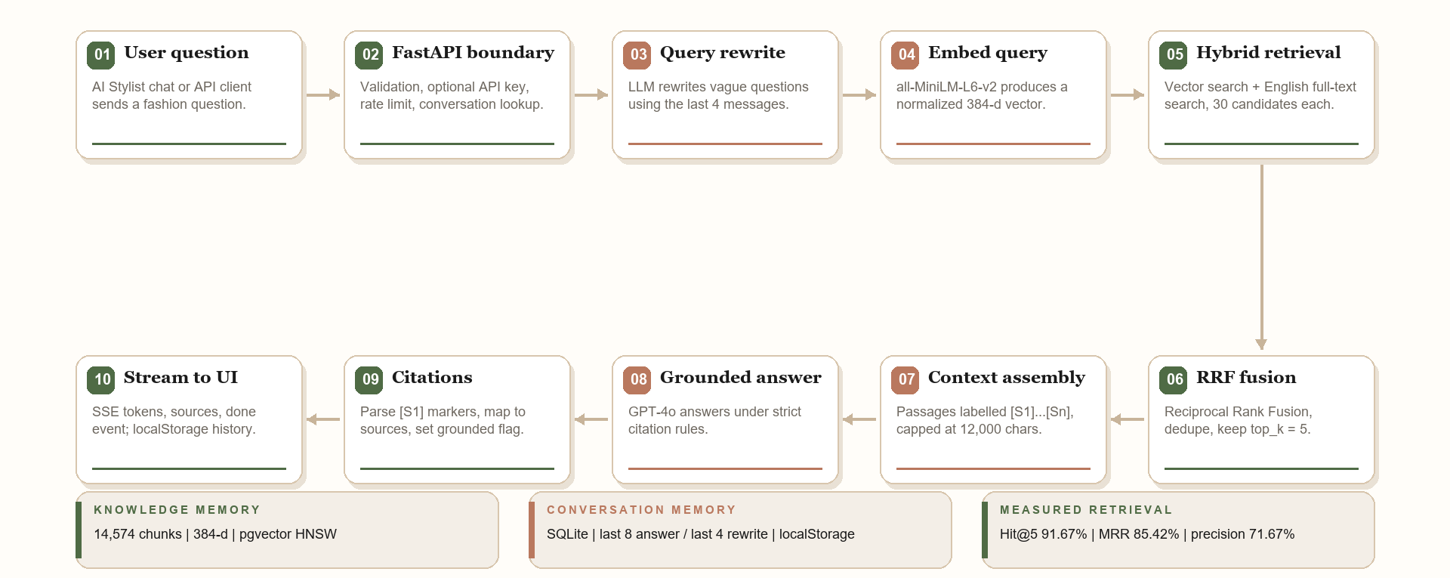
01 / RAG AI STYLIST
The complete pipeline
PIPELINE
From a question to a cited answer, with all processing steps visible.
DressMe / Agent implementation report
01 / RAG 13 / 30
Notes:
This is the full production path, not a conceptual sketch. The diagram is generated from the implementation.

Slide 14
01 / RAG AI STYLIST
AI techniques in the prototype
AI TECHNIQUES
Retrieval quality is measured, not assumed.
RAG
Hybrid retrieval
RRF
Answers are grounded in retrieved book passages.
Vector search + English full-text search.
Reciprocal Rank Fusion with k = 60.
Query rewriting
Citation grounding
OCR + evaluation
LLM rewrite with the last four messages.
Only markers in the answer become citations.
Tesseract for scanned books; Hit@5, MRR, precision.
Not used: fine-tuning, cross-encoder reranker, query-time metadata filters, multilingual retrieval, personal-wardrobe retrieval.
DressMe / Agent implementation report
01 / RAG 14 / 30
Notes:
The evaluation numbers are the evidence: 91.67% Hit@5, 85.42% MRR, 71.67% context precision on 12 questions.

Slide 15
02
SECTION 02
Trip Agent
Help Me Pack: a tool-using planner with a deterministic optimizer.
HELPMEPACK/TRY1 @ 8D90269
10
12
CP-SAT
native tools
max agent iterations
packing optimizer
DressMe / Agent implementation report
SECTION 02 15 / 30

Slide 16
02 / TRIP AGENT
GPT-4o chooses tools, not packing
LLM USED
The LLM orchestrates; Python validates; CP-SAT solves the constraint problem.
Model choice
MODEL CARD
• Default model: gpt-4o; override with LLM_MODEL.
• Native function calling, tool_choice = auto.
• Temperature 0; structured JSON extraction.
• 45 s timeout; one retry; bounded to 12 loop iterations.
• Fallback: deterministic regex parser + dependency loop.
Field | Value
Model | gpt-4o (configurable)
Interaction | Native tool calling
Extraction | JSON object + Pydantic
Temperature | 0
Loop limit | 12 iterations
Fallback | Regex + dependency loop
Why GPT-4o: reliable native tool calls, strict JSON, and good instruction following under negative constraints.
The model never computes the packing result; it only chooses and explains.
DressMe / Agent implementation report
02 / TRIP 16 / 30
Notes:
This is a neuro-symbolic split: language on the LLM side, correctness on the Python/CP-SAT side.

Slide 17
02 / TRIP AGENT
Memory is a session, not a profile
MEMORY
Working state, transcript, session store, and a small client cache.
WORKING
CONVERSATION
SESSION
CLIENT
AgentState
Last 16 messages
SessionStore
localStorage
Trip, weather, requirements, capsule, checklist, errors.
Injected into each LLM turn with a state summary.
TripAgent keyed by session_id, protected by a lock.
Current session_id so a refresh can resume.
STATE MACHINE
COLLECTING_DETAILS
->
NEEDS_CLARIFICATION
->
READY
->
OPTIMIZING
->
OPTIMIZED / INFEASIBLE
No long-term user profile, wear history, or cross-session learning yet.
DressMe / Agent implementation report
02 / TRIP 17 / 30
Notes:
The in-memory session store is the main limitation: a backend restart loses the trip.

Slide 18
02 / TRIP AGENT
What the agent accomplishes
ACTIONS
From a messy trip request to a validated checklist.
01
Understand
02
Clarify
Parse destination, dates, duration, activities, dress code, luggage.
Ask one concise question instead of inventing missing fields.
03
Retrieve context
04
Translate
Fetch daily weather and load the wardrobe snapshot.
Convert weather and activities into daily requirements.
05
Optimize
06
Build capsule
Run CP-SAT to minimize items under the weight constraint.
Produce daily outfits, selected items, total weight, status.
07
Checklist
08
Diagnose
Create packed:false items and track packing updates.
Explain INFEASIBLE; propose options; never relax silently.
Not in scope: computer vision, purchase evaluation, non-trip outfit generation, persistent profiling.
DressMe / Agent implementation report
02 / TRIP 18 / 30
Notes:
The important action is clarification: the agent is designed to ask rather than hallucinate trip fields.

Slide 19
02 / TRIP AGENT
Ten native tools, one deterministic core
TOOLS
Every tool has a schema, a Python implementation, and a backing resource.
get_trip_details
GPT-4o JSON + regex fallback
generate_checklist
Pydantic capsule -> checklist
get_weather
Open-Meteo + labelled fallback
suggest_alternatives
Diagnostic CP-SAT solve
get_wardrobe
wardrobe.csv + compatibility.csv
update_trip
Invalidate stale state, re-optimize
get_activity_requirements
Deterministic rules
update_checklist
No optimizer rerun
optimize_trip
OR-Tools CP-SAT
check_gaps
Optional Gap Agent hook
External services: OpenAI · Open-Meteo · OR-Tools CP-SAT · pandas/CSV · FastAPI · Pydantic · React/Vite.
DressMe / Agent implementation report
02 / TRIP 19 / 30
Notes:
Tool arguments are validated with Pydantic and dependencies are enforced in Python, not left to the model.

Slide 20
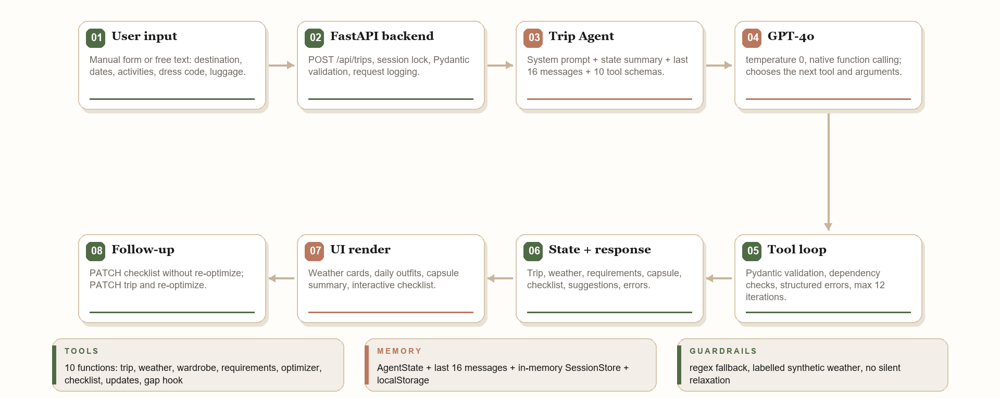
02 / TRIP AGENT
The complete pipeline
PIPELINE
Input, API, agent loop, LLM, tools, state, UI, and follow-up actions.
DressMe / Agent implementation report
02 / TRIP 20 / 30
Notes:
The compact diagram mirrors the original HelpMePack pipeline; the full detailed version is in the report assets.

Slide 21
02 / TRIP AGENT
AI techniques in the prototype
AI TECHNIQUES
Agentic orchestration around a deterministic solver.
Tool calling
Prompt engineering
Structured output
GPT-4o selects among ten tools; Python executes.
Ten system rules enforce order, clarification, and grounding.
JSON extraction plus Pydantic validation.
Neuro-symbolic
Guardrails
RAG (separate)
LLM language + CP-SAT combinatorial optimization.
Regex fallback, labelled synthetic weather, no silent relaxation.
The fashion knowledge layer is documented in section 01.
Not used: fine-tuning, RLHF, autonomous multi-agent orchestration, real computer vision.
DressMe / Agent implementation report
02 / TRIP 21 / 30
Notes:
The core evaluation is offline tool/optimizer testing, not only answer quality.

Slide 22
03
SECTION 03
Avatar & Try-On
Local two-photo capture, optional GPT-4o Vision and SciPy fitting, and procedural garment fitting.
AVATAR/TRY1 @ 22EEBCB + CURRENT WORKING TREE
2
15
36
photos for capture
controls fitted by SciPy
max evaluations
DressMe / Agent implementation report
SECTION 03 22 / 30

Slide 23
03 / AVATAR & TRY-ON
The LLM is a second opinion, not the ruler
LLM: OPTIONAL
Local pose and silhouette measurements are primary; optional GPT-4o Vision adds relative observations.
Local first. Optional VLM second.
PRIMARY: LOCAL CV
OPTIONAL: GPT-4O VISION
HARD BOUNDARY
MediaPipe pose + silhouette, height-scaled. Photos stay in the browser.
Consent-gated front/side analysis. Relative observations and bounded detail hints.
No centimetres and no replacement measurements. The local path works without an API key.
No fine-tuning. A separate SciPy optimizer fits silhouettes; the geometry path never depends on an LLM.
DressMe / Agent implementation report
03 / AVATAR 23 / 30
Notes:
This is the key nuance: the current worktree includes an optional GPT-4 Vision second opinion, but the measurements and geometry remain deterministic.

Slide 24
03 / AVATAR & TRY-ON
Memory is local, temporary, and explicit
MEMORY
No account, no durable body profile, no hidden personalization.
UI STATE
SAVED LOOKS
BACKEND JOB
React state
localStorage
Temp + lock
Photos, analysis, measurements, sliders, job result.
Up to 24 looks with garment and wardrobe IDs.
One active Blender job, params/details JSON, temp GLB.
GENERATED ASSETS
PHOTO PAIR
OPTIMIZER JOB
24 h TTL
Browser only
In-memory
avatar_<jobId>.glb in public/models/generated.
Front/side object URLs; optional upload only after consent.
Async /api/avatar/optimize job, progress, fitted targets.
Photos stay in the browser by default. 128 MPFB detail targets are whitelisted in the manifest; no durable body profile.
DressMe / Agent implementation report
03 / AVATAR 24 / 30
Notes:
The absence of a durable profile is deliberate. The local photo path never uploads images.

Slide 25
03 / AVATAR & TRY-ON
What the visual agent accomplishes
ACTIONS
From a photo pair to an optimized, body-shaped, dressed GLB.
01
Capture
02
Local pose
Front + side photos or the local questionnaire.
MediaPipe landmarks with view-specific checks.
03
Silhouette
04
Measure
Segment the body and scale widths by height.
Widths, depths, inseam, mass, BMI.
05
Optional VLM
06
SciPy fit
GPT-4V relative observations and detail hints.
Powell search over 15 controls; IoU + profile fit.
07
Map
08
Generate
MPFB macros plus up to 128 detail targets.
Blender + MPFB2 shapes the body.
09
Dress + GLB
10
Preview + correct
Garment shells and one dressed GLB.
Three.js viewer, metrics, one closed-loop regen.
Slot rule: one item per slot; a dress replaces top + bottom; outerwear layers over a top.
DressMe / Agent implementation report
03 / AVATAR 25 / 30
Notes:
The agent is a deterministic visual pipeline; SciPy fitting is optional and the VLM only nudges detail sliders.

Slide 26
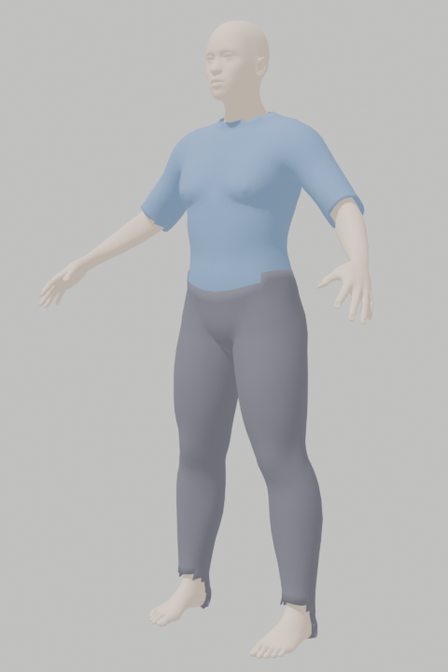
03 / AVATAR & TRY-ON
The tool stack, with actual output
TOOLS
Local vision, SciPy fitting, an optional VLM, Blender, and a 3D viewer.
MediaPipe Pose
MediaPipe Segmenter
Landmarks + view checks
Body silhouette mask
Actual Blender render
OpenAI Vision
SciPy Powell
public/models/dressed_avatar.glb
rendered with backend/blender/
render_preview.py
Optional relative opinion
15-control silhouette fit
NumPy + Pillow
FastAPI
Masks, IoU, profiles
Validation + job control
10 garments / 5 slots
Blender 5.4
MPFB2
Headless generation
Macros + 128 detail targets
bpy / bmesh
Three.js / R3F
Garment geometry
3D preview + controls
Photos stay in the browser; only the consent-gated vision route sends them to OpenAI.
DressMe / Agent implementation report
03 / AVATAR 26 / 30
Notes:
The render on the right is an actual output from the current prototype, not a mockup.

Slide 27
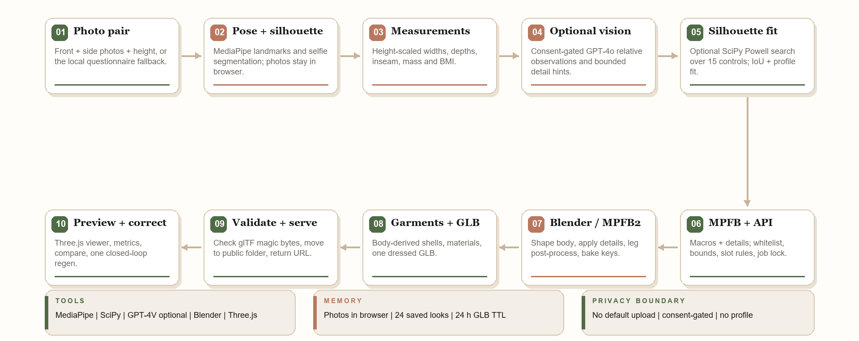
03 / AVATAR & TRY-ON
The complete two-photo pipeline
PIPELINE
Capture, local pose and silhouette, optional GPT-4V, SciPy fitting, Blender, garments, viewer.
DressMe / Agent implementation report
03 / AVATAR 27 / 30
Notes:
The default pipeline is local. The optional GPT-4 Vision call is a second opinion, not a measurement step.

Slide 28
03 / AVATAR & TRY-ON
AI techniques in the prototype
AI TECHNIQUES
Local vision and geometry first; optional VLM and optimization second.
Pose estimation
Silhouette segmentation
Height-scaled measurements
MediaPipe landmarks with visibility and view-specific checks.
Selfie segmenter extracts the body mask for width/depth.
Pixel widths become centimetres using the entered height.
Optional VLM opinion
SciPy silhouette fitting
Garments + correction
GPT-4o Vision returns relative observations and detail hints.
Powell search minimizes IoU loss + width-profile error.
Body-derived shells; achieved ratios nudge controls.
Not used for geometry: fine-tuning, skeletal skinning, morph targets, cloth simulation, persistent profiles.
DressMe / Agent implementation report
03 / AVATAR 28 / 30
Notes:
The AI is local pose/silhouette, optional GPT-4 Vision, and SciPy fitting. Geometry remains procedural.

Slide 29
CROSS-AGENT COMPARISON
Shared discipline, different intelligence
COMPARISON
The architecture uses each tool where it is strongest.
Dimension | RAG AI Stylist | Trip Agent | Avatar & Try-On
Primary intelligence | Retrieval + grounded generation | LLM orchestration + CP-SAT | Vision + geometry + optimization
LLM | GPT-4o (configurable) | GPT-4o (configurable) | Optional GPT-4o Vision
Memory | SQLite + pgvector + localStorage | AgentState + in-memory sessions | React + localStorage + file cache
External services | OpenAI, Supabase | OpenAI, Open-Meteo | MediaPipe, OpenAI (optional), Blender
Key technique | Hybrid RAG with citations | Tool calling + neuro-symbolic optimization | Pose + silhouette + SciPy fitting
Output | Cited answer + sources | Trip capsule + checklist | Body-shaped GLB + 3D try-on
Status | Implemented | Implemented | Implemented; capture work uncommitted
Use the LLM for language and relative visual judgment, solvers for fitting and constraints, and geometry for bodies.
DressMe / Agent implementation report
COMPARISON 29 / 30
Notes:
This is the architectural takeaway of the report.

Slide 30
CONCLUSION
Three working prototypes, three clear boundaries
CLOSING
What is real today, and what comes next.
RAG
TRIP AGENT
AVATAR
Real grounded answers
Real planning
Real visual try-on
14,574 chunks, hybrid retrieval, citations, measured Hit@5.
10 tools, weather, CP-SAT, capsule, checklist, fallbacks.
Local pose + silhouette, optional GPT-4V, SciPy fitting, Blender/MPFB2, GLB.
Next steps
• Connect the RAG layer to personal wardrobe and wear-history data.
• Expose RAG as a Trip Agent tool and connect the Gap Agent.
• Replace synthetic wardrobe data with real user data.
• Add persistent profiles, authentication, and production hardening.
See your wardrobe differently.
DressMe / Agent implementation report
CONCLUSION 30 / 30
Notes:
Close on the architectural lesson and the concrete next steps.

