Slide 1
DAVAO CITY MUNICIPAL ORDINANCES
Clean text. Full corpus.
Two comparable model paths.
Lexical TF-IDF + c-TF-IDF vs Legal-BERT + BERTopic
2,118 source documents · 7,832 modeled units
2016–2025 · Corpuz · Lamsin · Nuril
USER-VERIFIED TXT SOURCE / AUDITED PREPARATION / EXPERT MODEL VALIDATION PENDING

Slide 2
IMPROVEMENTS
What changed in this rerun
Only data/processed/clean_text/*.txt supplies model text.
The full eligible corpus replaces the previous 200-unit sample.
Content hashes remove duplicate copies without deleting sources.
Human year overrides take priority; every decision is auditable.
Specified boilerplate sections and signature blocks are excluded.
GPU batching and checkpointed embeddings support reproducible full runs.
Both models use identical units, years, vocabulary and evaluation inputs.
02
CORPUZ · LAMSIN · NURIL / CLEAN-TEXT FULL-CORPUS RUN · INITIAL INTRINSIC RESULTS

Slide 3
DATA ACCOUNTING
Exactly which data reached the models?
Input: 2,283 TXT files → 2,133 distinct contents.
150 duplicate copies removed from modeling, not from disk.
13 content groups excluded by existing human out-of-scope year corrections.
2 content groups had no usable text after deterministic extraction.
Modeled: 2,118 source documents / 2,073 distinct normalized ordinance numbers.
7,832 units; all eligible years included with their natural corpus sizes.
Verification is based on the researcher's confirmation of the cleaned source—not a new independent PDF audit.
03
CORPUZ · LAMSIN · NURIL / CLEAN-TEXT FULL-CORPUS RUN · INITIAL INTRINSIC RESULTS

Slide 4
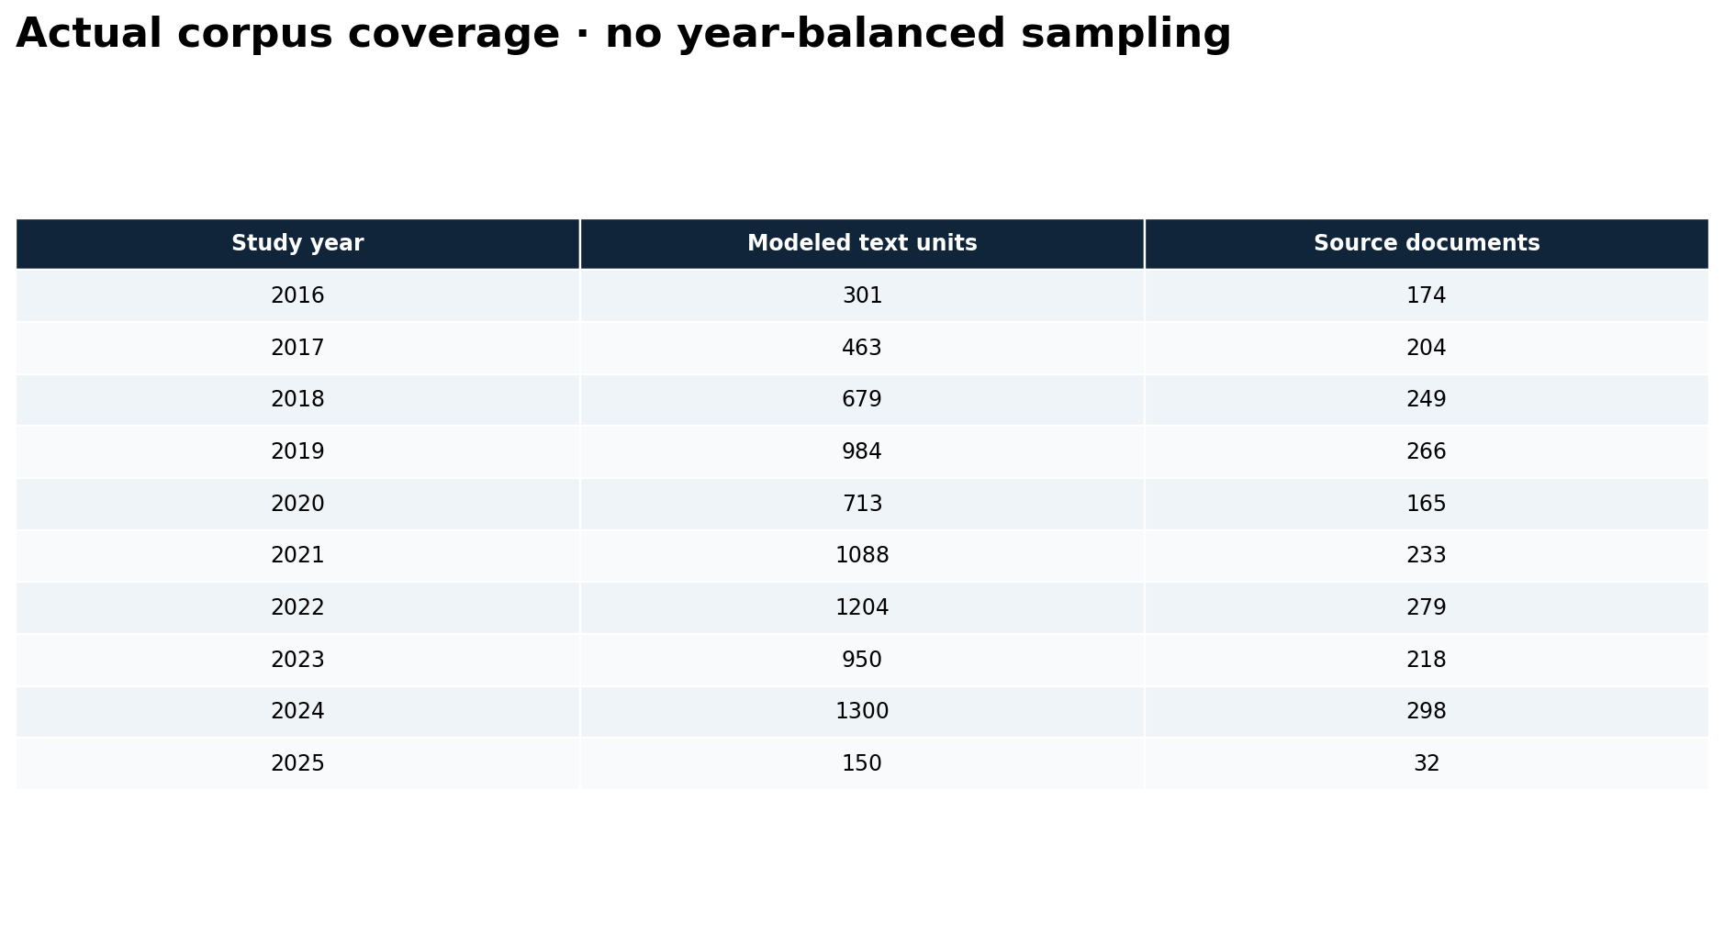
DATA ACCOUNTING
Year-by-year corpus coverage
04
CORPUZ · LAMSIN · NURIL / CLEAN-TEXT FULL-CORPUS RUN · INITIAL INTRINSIC RESULTS

Slide 5
EXTRACTION AUDIT
Source verification and extraction are different
7,235 automatically detected numbered sections.
597 whole-document fallback units for missing or repeated section headings.
623 effectivity/separability/repealing-clause units removed.
Explicit signature blocks are trimmed; source TXT files remain unchanged.
45 additional text versions share ordinance numbers and are flagged, not silently merged.
28 extracted enactment-year candidates disagree with assigned study years. Human overrides / user-verified folders remain authoritative.
These flags and mixed unit lengths remain interpretation limitations.
05
CORPUZ · LAMSIN · NURIL / CLEAN-TEXT FULL-CORPUS RUN · INITIAL INTRINSIC RESULTS

Slide 6
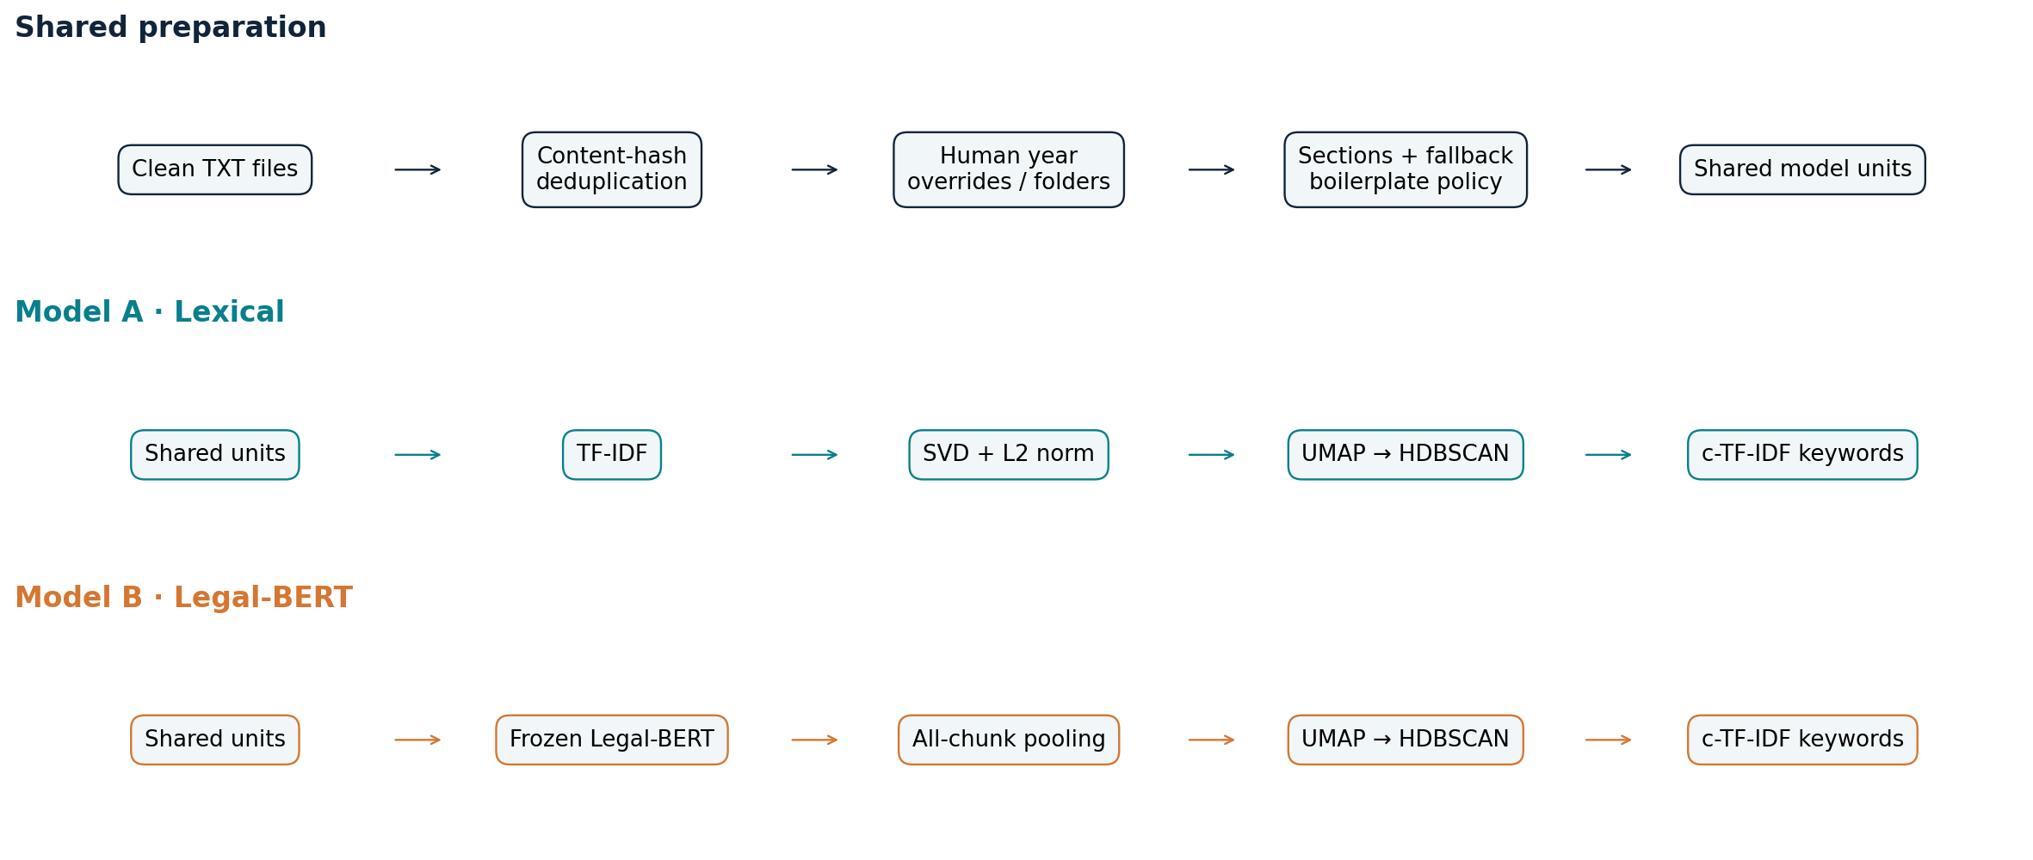
MODEL PIPELINES
A clean-text-only architecture
c-TF-IDF requires classes: lexical TF-IDF/SVD supplies initial assignments; both paths apply c-TF-IDF after clustering.
06
CORPUZ · LAMSIN · NURIL / CLEAN-TEXT FULL-CORPUS RUN · INITIAL INTRINSIC RESULTS

Slide 7
SEMANTIC PIPELINE
Legal-BERT: what actually ran
Encoder: nlpaueb/legal-bert-base-uncased; pinned revision.
11,546 non-overlapping chunks, maximum 512 tokens including specials.
Content-token weighted pooling excludes padding and special tokens; every chunk is included.
L2-normalized 768-dimensional vectors retain source file / unit / year associations.
Device: cuda · GPU inference uses unchanged pretrained weights.
No classifier training, learning rate or fine-tuning epochs are claimed. Encoder suitability still requires empirical and legal-expert assessment.
07
CORPUZ · LAMSIN · NURIL / CLEAN-TEXT FULL-CORPUS RUN · INITIAL INTRINSIC RESULTS

Slide 8
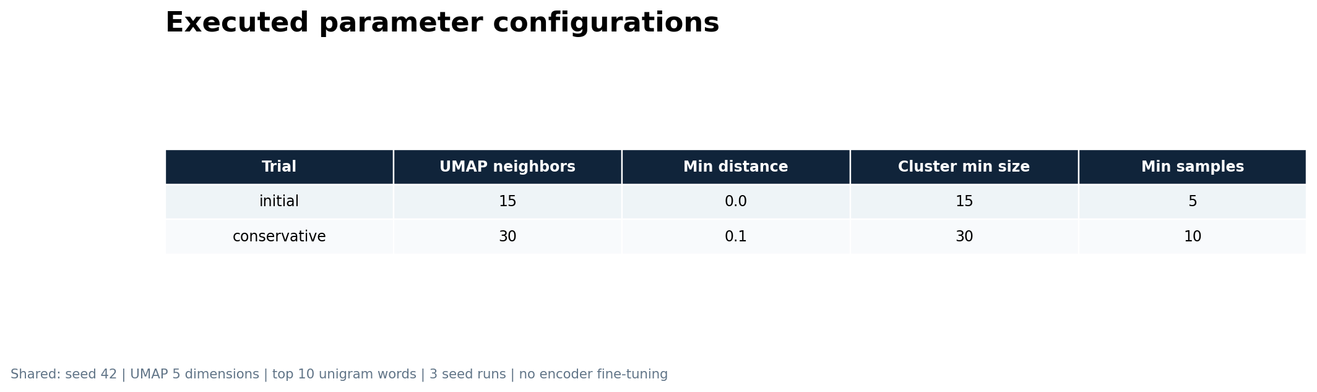
PARAMETER EVIDENCE
Actual tuning parameters
Rendered configuration evidence—not a training-interface screenshot. Three stability runs means one primary fit plus two extra seeds.
08
CORPUZ · LAMSIN · NURIL / CLEAN-TEXT FULL-CORPUS RUN · INITIAL INTRINSIC RESULTS

Slide 9
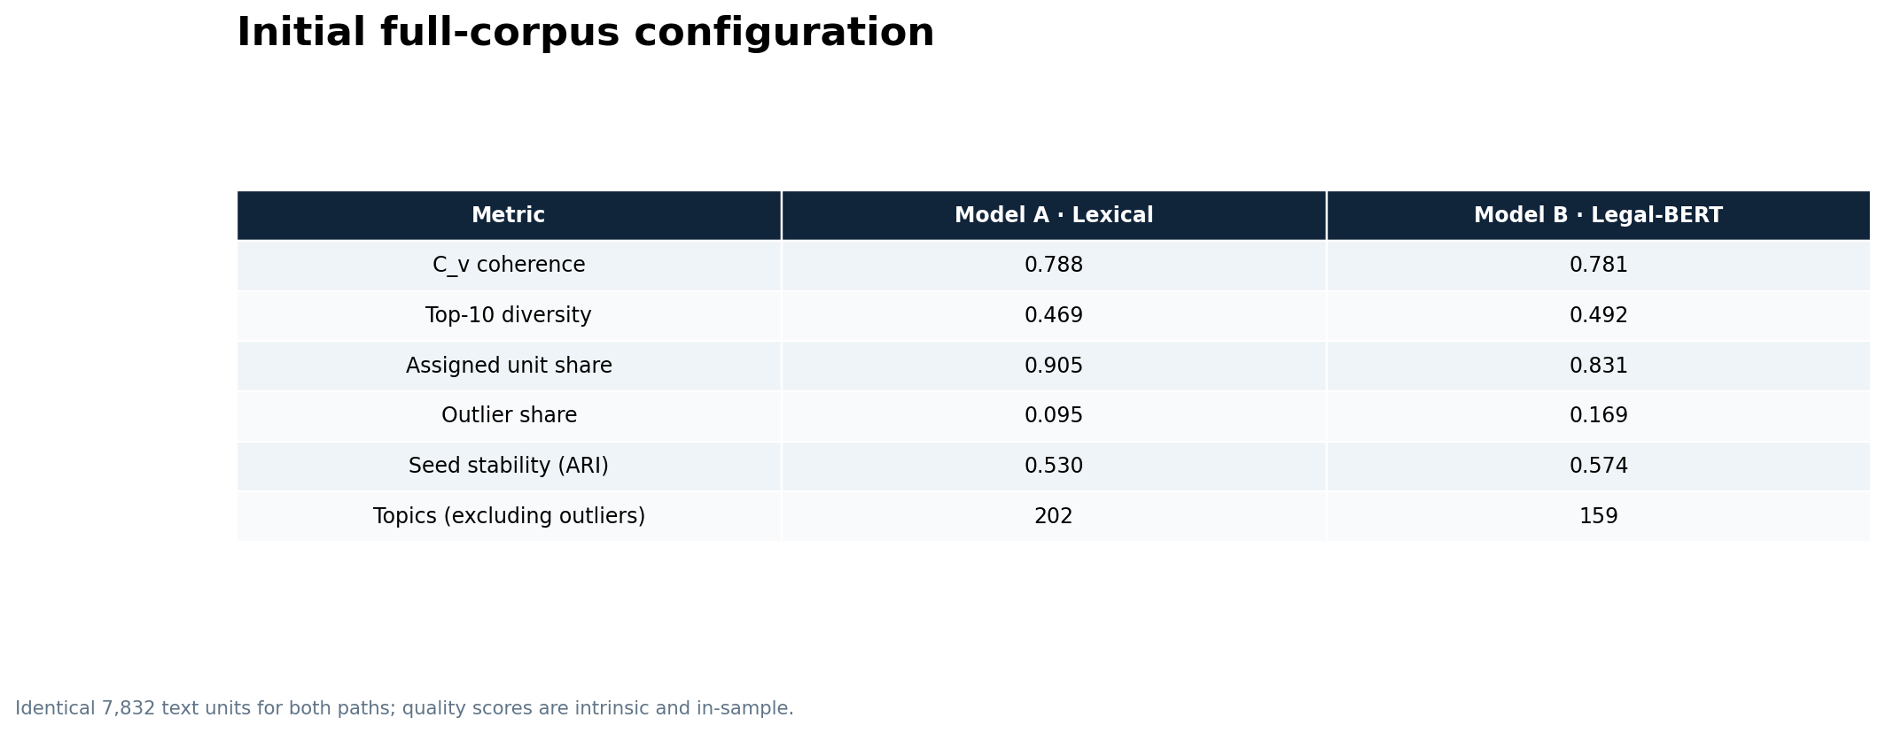
INITIAL RESULTS
Initial full-corpus metrics
These are in-sample intrinsic scores, not accuracy/F1 or proof of legal validity.
09
CORPUZ · LAMSIN · NURIL / CLEAN-TEXT FULL-CORPUS RUN · INITIAL INTRINSIC RESULTS

Slide 10
COMPARATIVE READING
Read the comparison as trade-offs
Coherence C_v: lexical 0.788 vs Legal-BERT 0.781.
Keyword diversity: lexical 0.469 vs Legal-BERT 0.492.
Coverage: lexical 90.5% vs Legal-BERT 83.1%.
Seed stability ARI: lexical 0.530 vs Legal-BERT 0.574.
The stronger model can differ by criterion. More coverage or fewer topics alone does not establish better policy themes.
Do not attribute differences from the old sample solely to the text-input change: corpus size, extraction and parameter settings also changed.
10
CORPUZ · LAMSIN · NURIL / CLEAN-TEXT FULL-CORPUS RUN · INITIAL INTRINSIC RESULTS

Slide 11
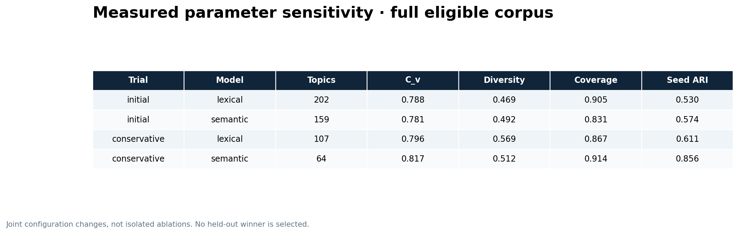
INITIAL RESULTS
Sensitivity to a second configuration
Both configurations are evaluated on the same units. This is not held-out tuning or a final model selection.
11
CORPUZ · LAMSIN · NURIL / CLEAN-TEXT FULL-CORPUS RUN · INITIAL INTRINSIC RESULTS

Slide 12
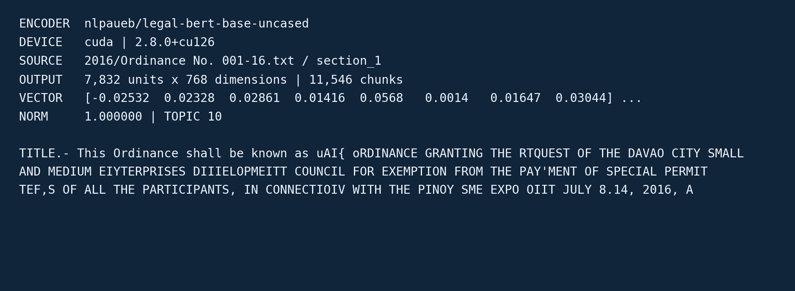
EXECUTION EVIDENCE
A real BERT output snippet
12
CORPUZ · LAMSIN · NURIL / CLEAN-TEXT FULL-CORPUS RUN · INITIAL INTRINSIC RESULTS

Slide 13
INTERPRETATION
Representative outputs retain TXT provenance
Model A · Lexical
T0: authorizing, memorandum, agreement
2016/Ordinance No. 0128-16.txt
section_1 / study year 2016
TITLE.- This Ordinance shall be known as "AN ORDINANCE GRANTING LEGISLATTVE AUTHORITY TO THE CITY MAYOR TO ENTER INTO AND SIGN, FOR AND IN BEHALF OF THE CITY GOVERNMENT OF DAVAO THE MEMORANDUM OF AGREEMENT TO BE ENTERED INTO BY AND BETWEEN TTIE CITY GOVERNMENT OF DAVAO AND THE DEPARTMENT OF INFORMAT
Model B · Legal-BERT
T0: street, closure, temporary
2016/Ordinance No. 100-16.txt
section_1 / study year 2016
TITLE.- This Ordinance shalt be known as..AN ORDINANCE FOR THE TEMPORARY CLOSURE TO VEHICULAR TRAFFIC OF THE ROAD BESIDE RIZAL PARK ALONG BOLTON AND SAN PEDRO STREETS, POBLACION, THIS CITY, ON NOVEMBER 30, 2016 FROM 1:00 P.M. TO 1O:00 p.M. FOR A RELIGIOUS PUBLIC RALLY UNDER THE THEME, ''EST'S REIGNS
Machine-generated keyword sets are not expert-approved policy labels.
13
CORPUZ · LAMSIN · NURIL / CLEAN-TEXT FULL-CORPUS RUN · INITIAL INTRINSIC RESULTS

Slide 14
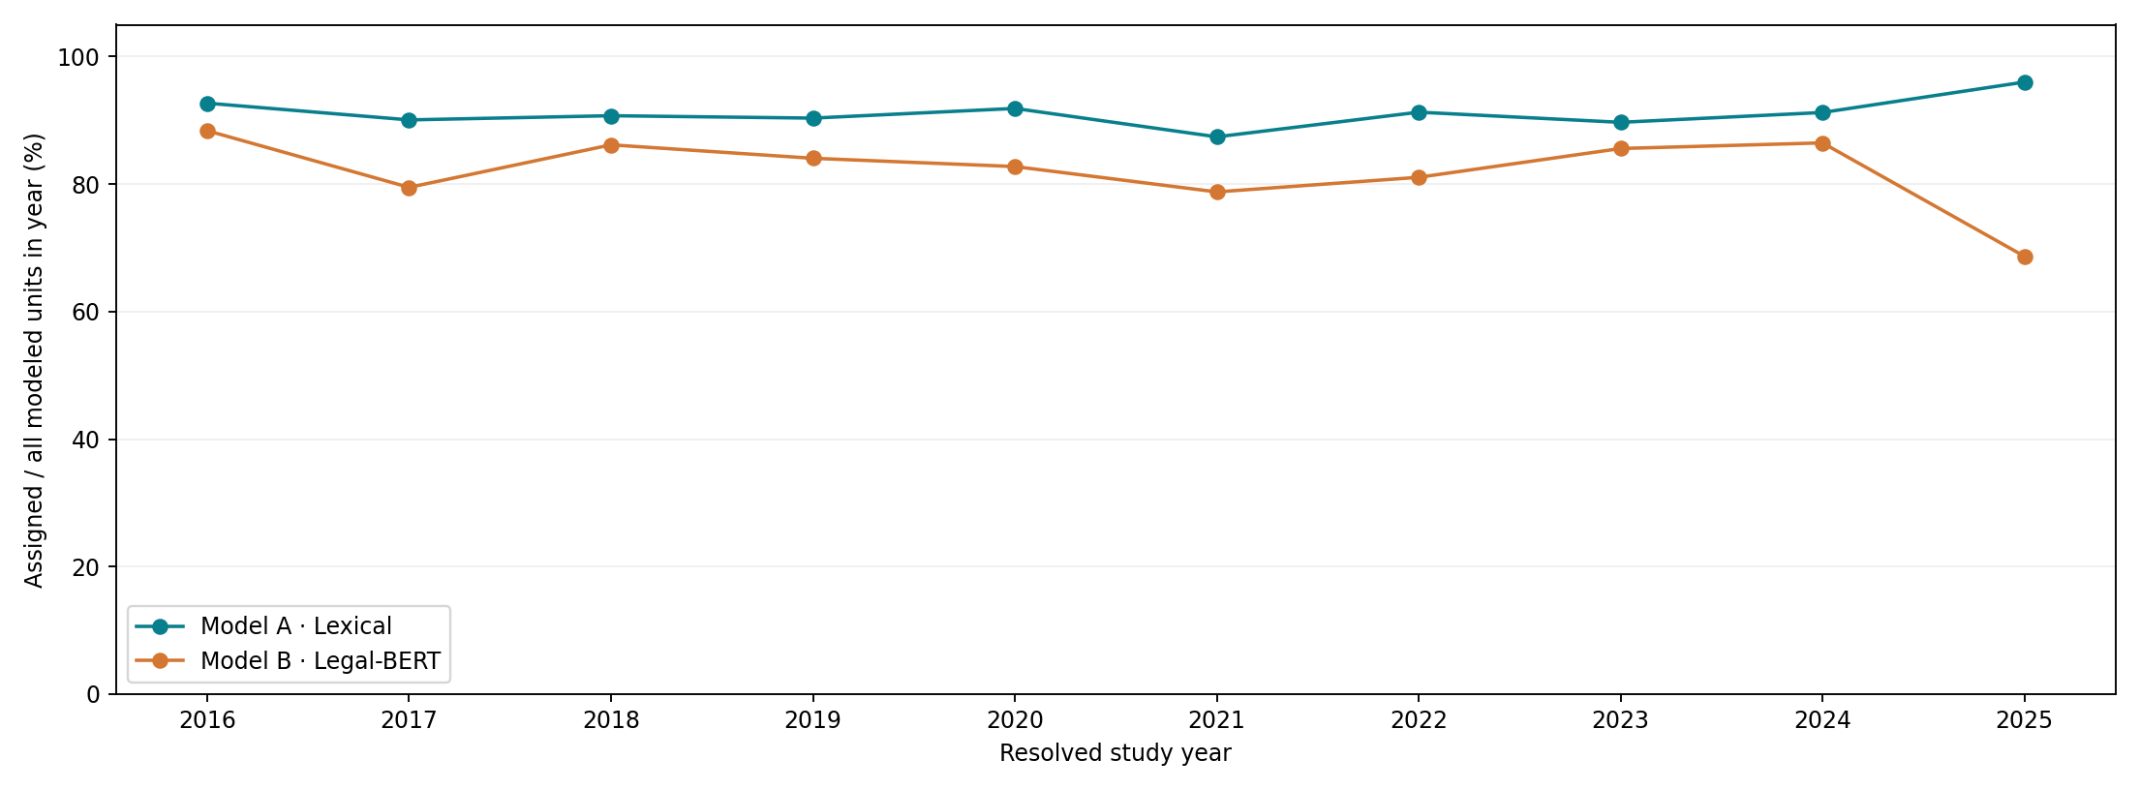
TEMPORAL COMPARISON
Yearly assignment coverage
Each year's denominator includes all modeled units, including outliers; corpus sizes differ across years.
14
CORPUZ · LAMSIN · NURIL / CLEAN-TEXT FULL-CORPUS RUN · INITIAL INTRINSIC RESULTS

Slide 15
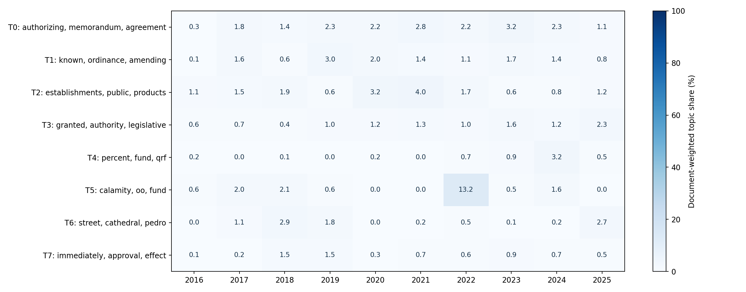
TEMPORAL COMPARISON
Model A · Lexical · document-weighted trends
Each source document contributes total weight 1, distributed across its unit topics. Top eight topics only; columns need not sum to 100%.
15
CORPUZ · LAMSIN · NURIL / CLEAN-TEXT FULL-CORPUS RUN · INITIAL INTRINSIC RESULTS

Slide 16
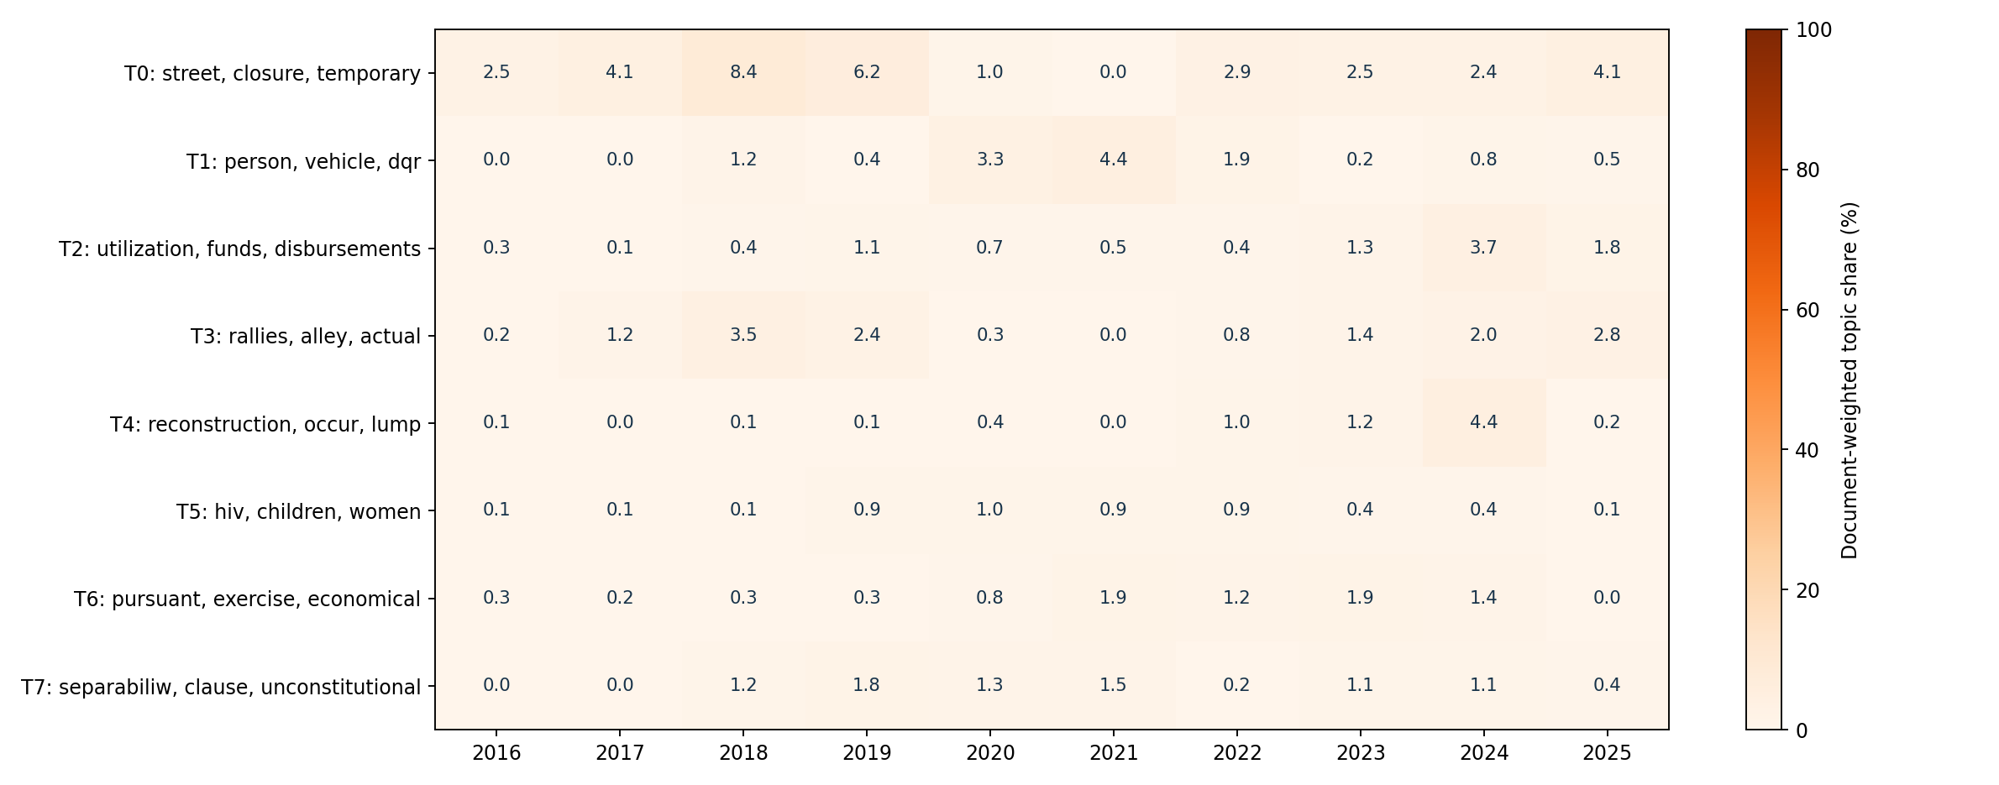
TEMPORAL COMPARISON
Model B · Legal-BERT · document-weighted trends
Each source document contributes total weight 1, distributed across its unit topics. Top eight topics only; columns need not sum to 100%.
16
CORPUZ · LAMSIN · NURIL / CLEAN-TEXT FULL-CORPUS RUN · INITIAL INTRINSIC RESULTS

Slide 17
RESEARCH STATUS
Evaluation contract and remaining limitations
C_v: shared unigram keywords and the same model-input texts.
Diversity: unique top keywords / actual keyword slots, excluding outliers.
Coverage: assigned units / all units. Seed ARI includes outliers as one cluster.
Yearly unit shares and document-weighted shares answer different questions.
No artificial BERTopic perplexity, supervised accuracy or fabricated expert scores.
Remaining work: inspect extraction/date/version flags, review topic labels with experts, and predefine ordinance-grouped holdouts before final tuning.
Source verification does not itself validate clusters or temporal policy interpretations.
17
CORPUZ · LAMSIN · NURIL / CLEAN-TEXT FULL-CORPUS RUN · INITIAL INTRINSIC RESULTS

Slide 18
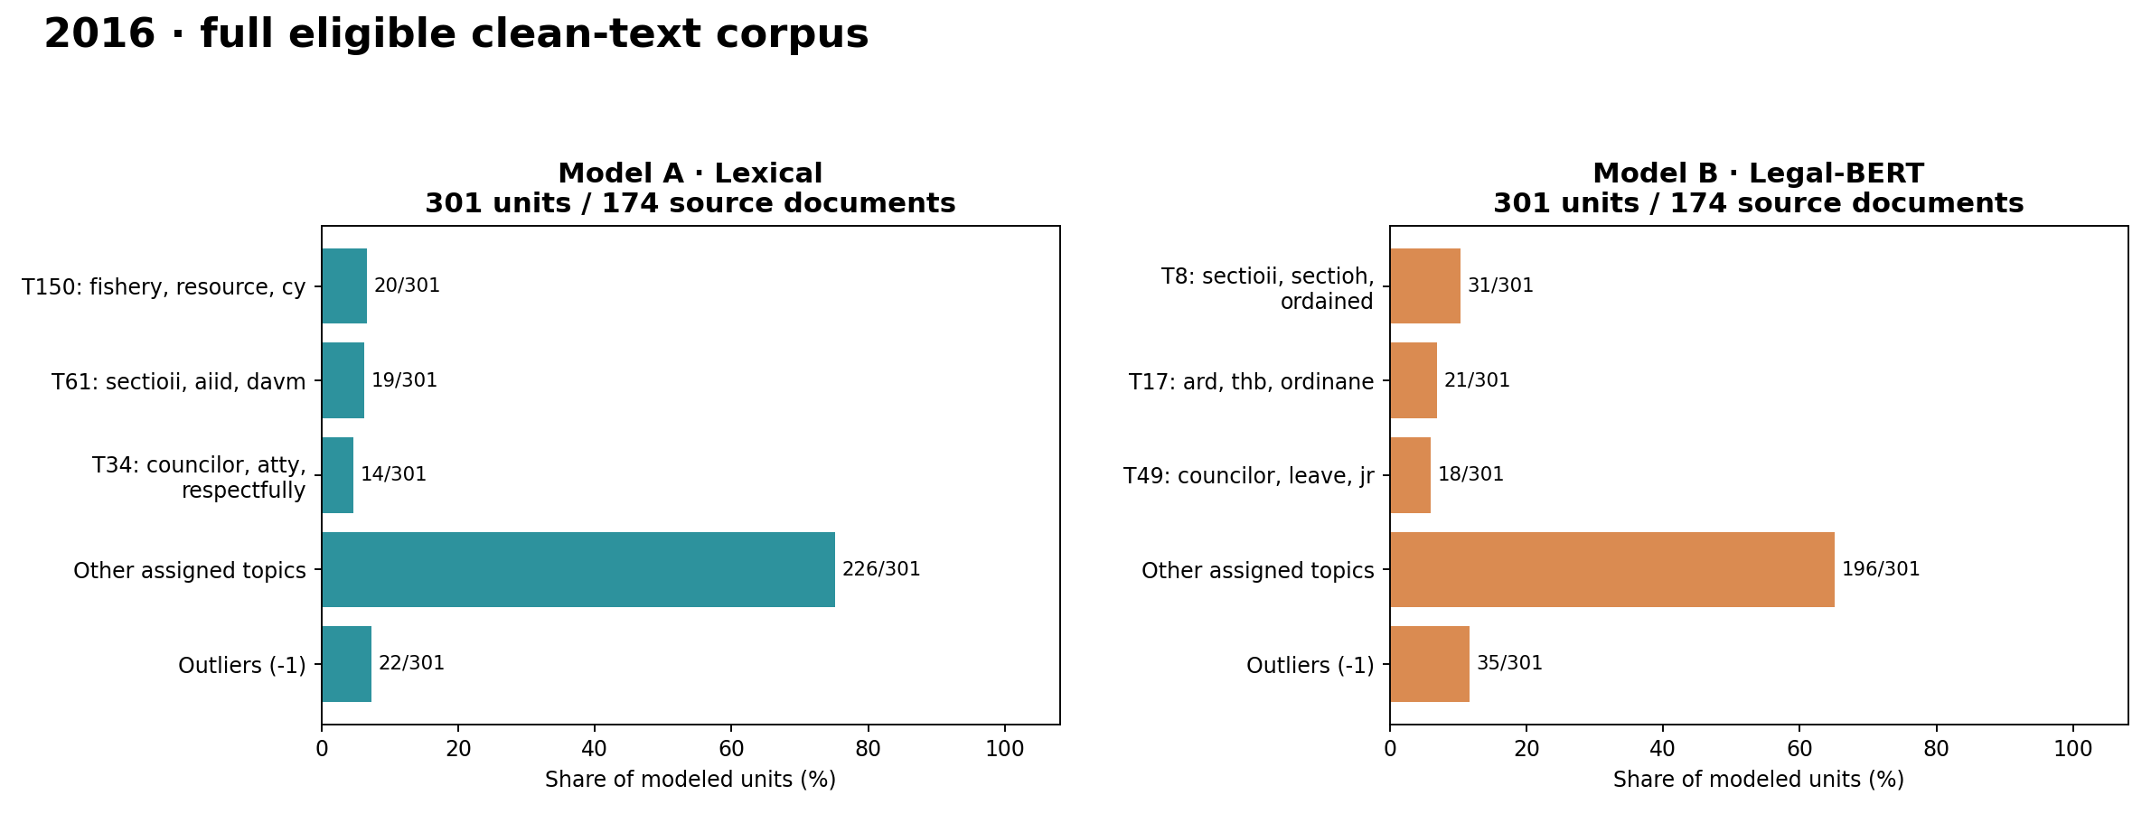
YEAR-BY-YEAR RESULTS
2016 · both models, full eligible texts
Topic numbers are model-local: A/T0 does not mean B/T0. Bars include top three topics, other assigned topics and outliers.
18
CORPUZ · LAMSIN · NURIL / CLEAN-TEXT FULL-CORPUS RUN · INITIAL INTRINSIC RESULTS

Slide 19
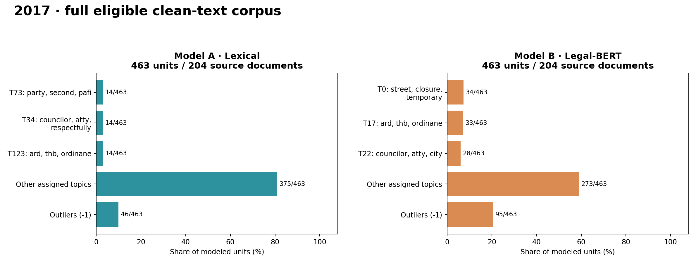
YEAR-BY-YEAR RESULTS
2017 · both models, full eligible texts
Topic numbers are model-local: A/T0 does not mean B/T0. Bars include top three topics, other assigned topics and outliers.
19
CORPUZ · LAMSIN · NURIL / CLEAN-TEXT FULL-CORPUS RUN · INITIAL INTRINSIC RESULTS

Slide 20
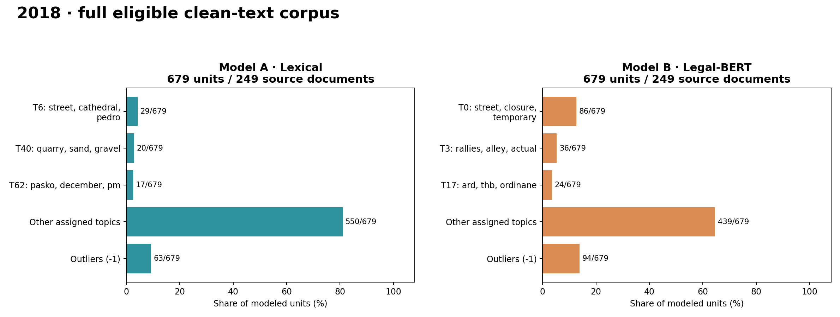
YEAR-BY-YEAR RESULTS
2018 · both models, full eligible texts
Topic numbers are model-local: A/T0 does not mean B/T0. Bars include top three topics, other assigned topics and outliers.
20
CORPUZ · LAMSIN · NURIL / CLEAN-TEXT FULL-CORPUS RUN · INITIAL INTRINSIC RESULTS

Slide 21
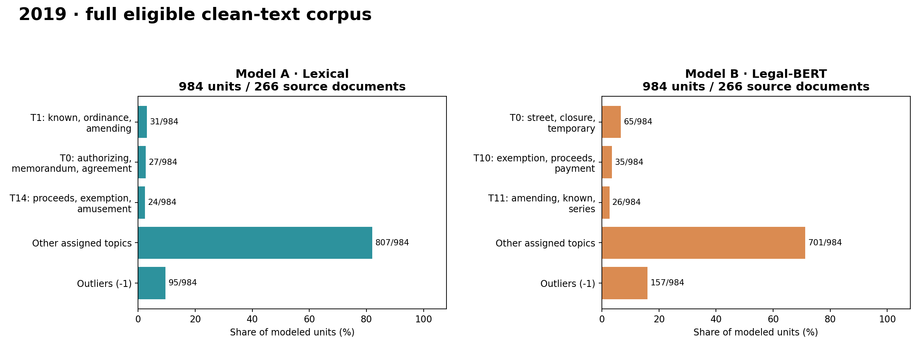
YEAR-BY-YEAR RESULTS
2019 · both models, full eligible texts
Topic numbers are model-local: A/T0 does not mean B/T0. Bars include top three topics, other assigned topics and outliers.
21
CORPUZ · LAMSIN · NURIL / CLEAN-TEXT FULL-CORPUS RUN · INITIAL INTRINSIC RESULTS

Slide 22
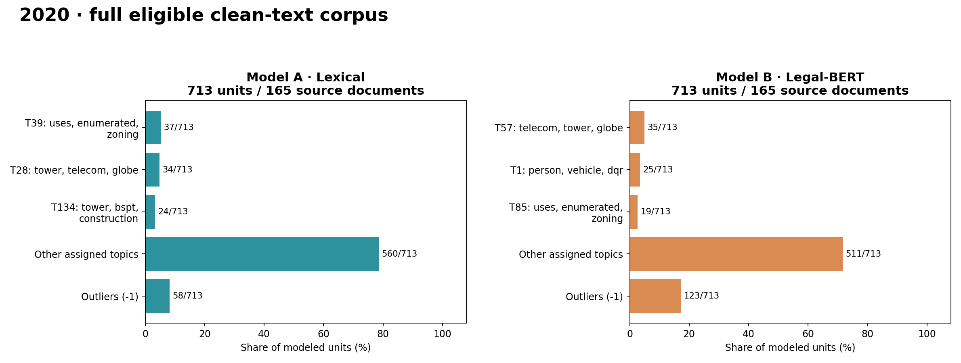
YEAR-BY-YEAR RESULTS
2020 · both models, full eligible texts
Topic numbers are model-local: A/T0 does not mean B/T0. Bars include top three topics, other assigned topics and outliers.
22
CORPUZ · LAMSIN · NURIL / CLEAN-TEXT FULL-CORPUS RUN · INITIAL INTRINSIC RESULTS

Slide 23
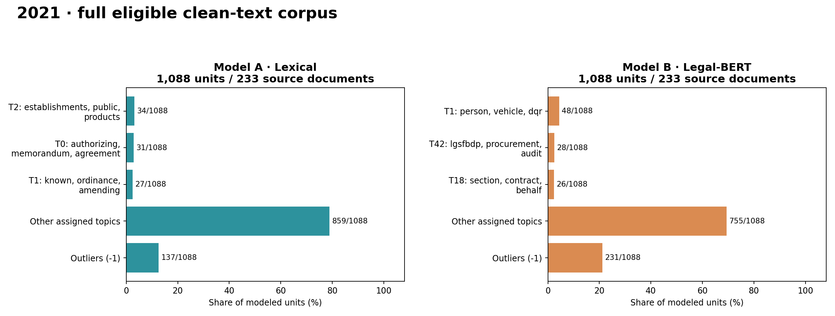
YEAR-BY-YEAR RESULTS
2021 · both models, full eligible texts
Topic numbers are model-local: A/T0 does not mean B/T0. Bars include top three topics, other assigned topics and outliers.
23
CORPUZ · LAMSIN · NURIL / CLEAN-TEXT FULL-CORPUS RUN · INITIAL INTRINSIC RESULTS

Slide 24
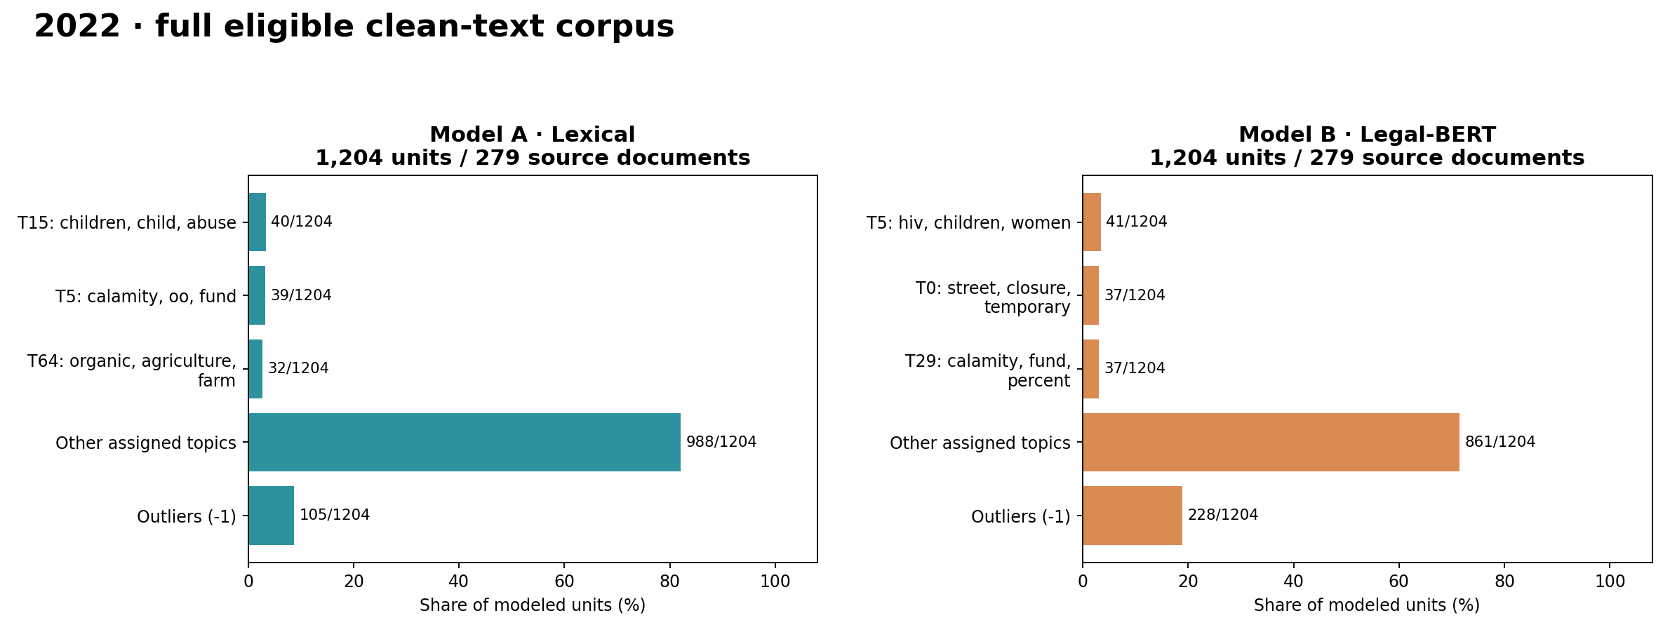
YEAR-BY-YEAR RESULTS
2022 · both models, full eligible texts
Topic numbers are model-local: A/T0 does not mean B/T0. Bars include top three topics, other assigned topics and outliers.
24
CORPUZ · LAMSIN · NURIL / CLEAN-TEXT FULL-CORPUS RUN · INITIAL INTRINSIC RESULTS

Slide 25
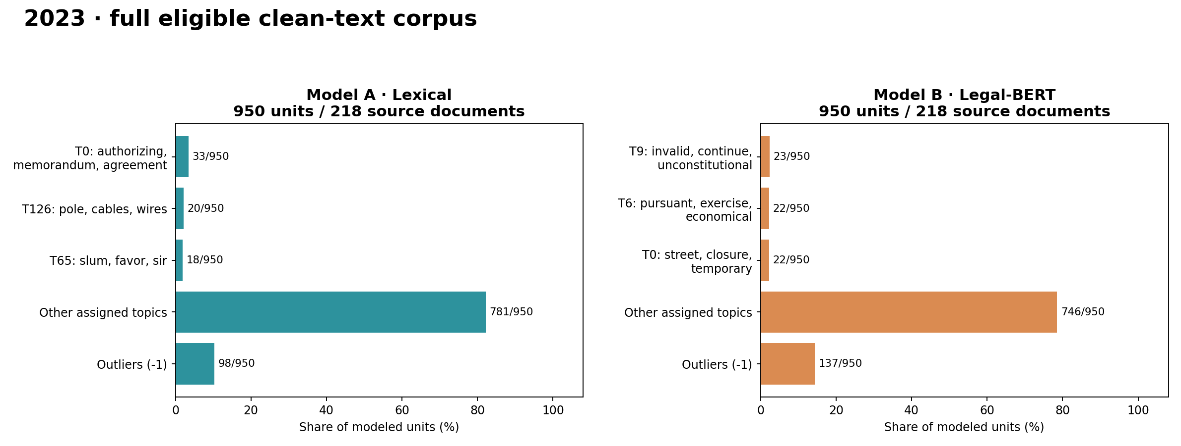
YEAR-BY-YEAR RESULTS
2023 · both models, full eligible texts
Topic numbers are model-local: A/T0 does not mean B/T0. Bars include top three topics, other assigned topics and outliers.
25
CORPUZ · LAMSIN · NURIL / CLEAN-TEXT FULL-CORPUS RUN · INITIAL INTRINSIC RESULTS

Slide 26
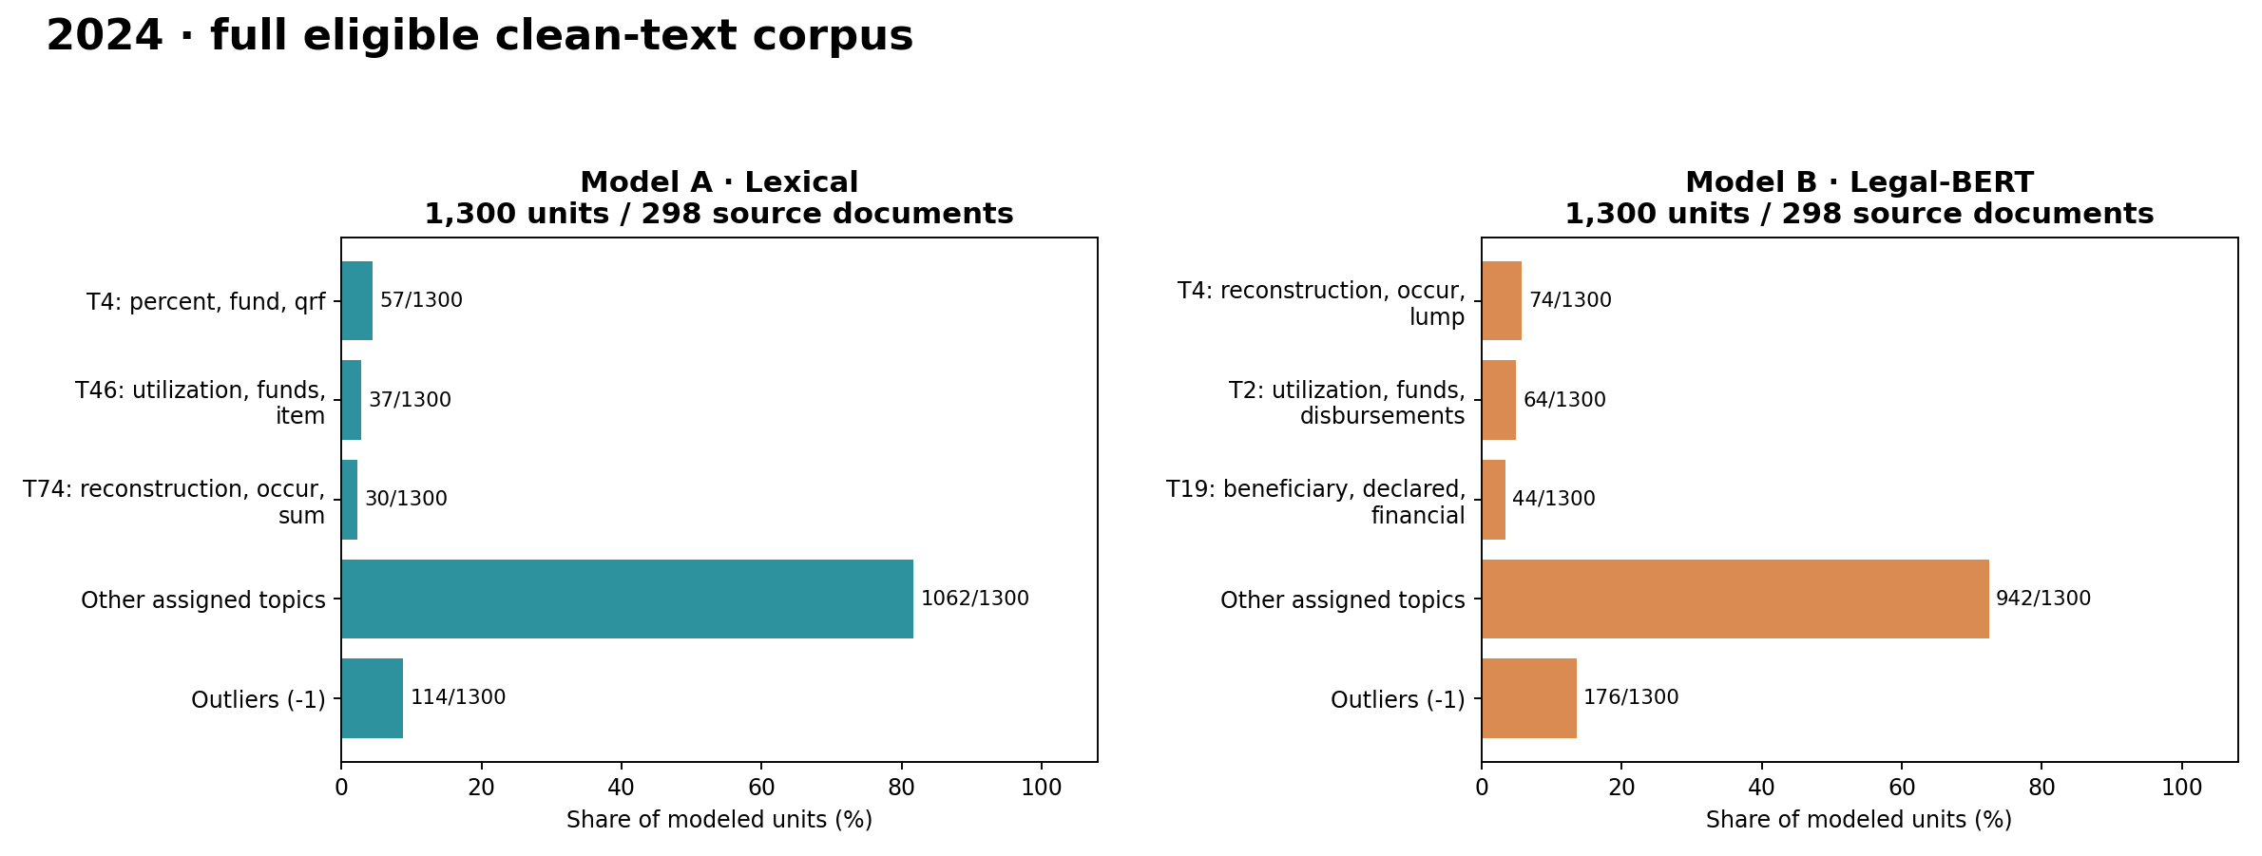
YEAR-BY-YEAR RESULTS
2024 · both models, full eligible texts
Topic numbers are model-local: A/T0 does not mean B/T0. Bars include top three topics, other assigned topics and outliers.
26
CORPUZ · LAMSIN · NURIL / CLEAN-TEXT FULL-CORPUS RUN · INITIAL INTRINSIC RESULTS

Slide 27
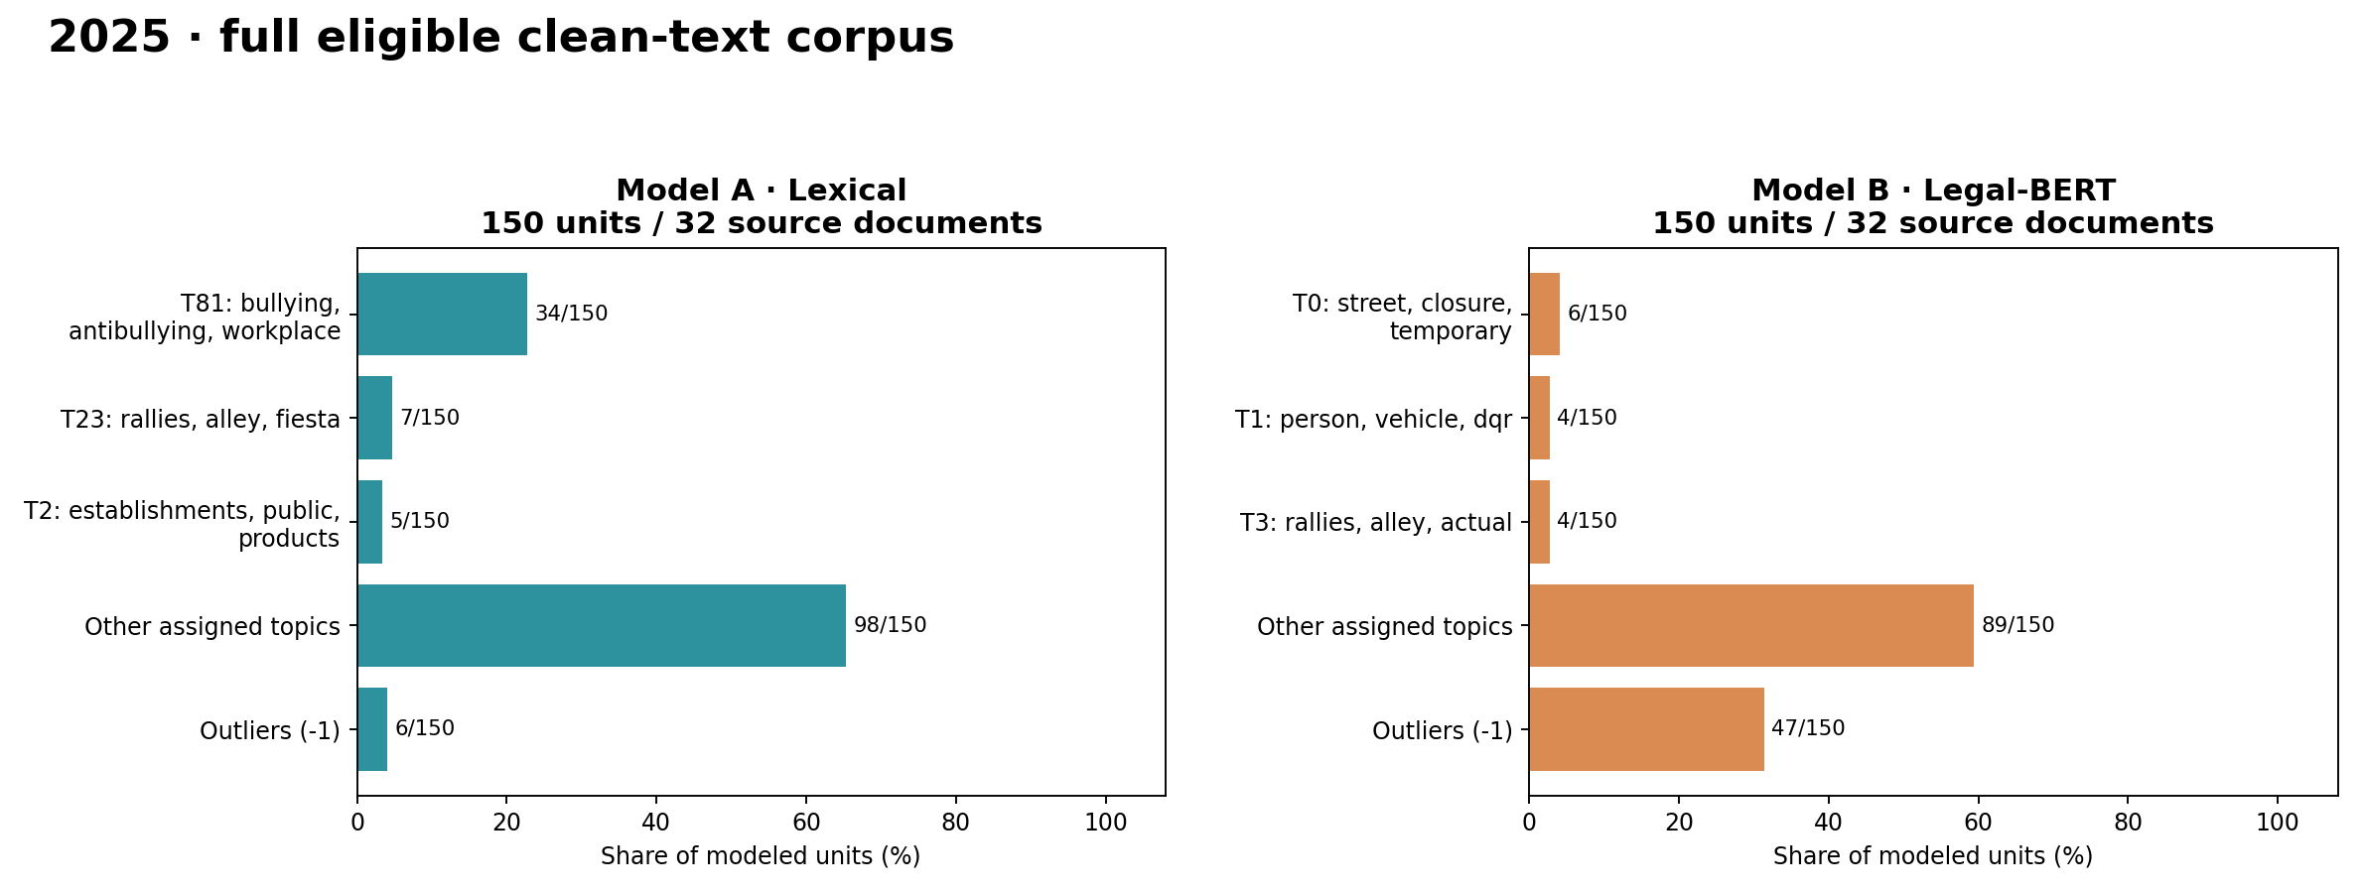
YEAR-BY-YEAR RESULTS
2025 · both models, full eligible texts
Topic numbers are model-local: A/T0 does not mean B/T0. Bars include top three topics, other assigned topics and outliers.
27
CORPUZ · LAMSIN · NURIL / CLEAN-TEXT FULL-CORPUS RUN · INITIAL INTRINSIC RESULTS

