Slide 1
DAVAO CITY MUNICIPAL ORDINANCES
Two models.
One shared ordinance sample.
Lexical TF-IDF + c-TF-IDF vs Legal-BERT + BERTopic
Initial measured results · 200 sections · 2016–2025
Corpuz · Lamsin · Nuril
EXPLORATORY / UNVERIFIED OCR / NOT A FINAL MODEL SELECTION

Slide 2
RESEARCH STATUS
What this experiment can—and cannot—show
MEASURED NOW
Two complete model paths on identical sections
Two parameter configurations with three seed runs
C_v, diversity, coverage, outliers and stability
Source-linked BERT vectors and yearly visualizations
NOT YET ESTABLISHED
Human-verified corpus or legal topic labels
Held-out generalization or optimal parameters
Expert validation and final thesis conclusions
Population-level changes in municipal policy
02
CORPUZ · LAMSIN · NURIL / EXPLORATORY PILOT — NOT VALIDATED THESIS FINDINGS

Slide 3
SOURCE ALIGNMENT
Newer methodology governs the implementation
Milestone-1_Corpus-Lamsin-Nuril.pdf
2016–2025; section-level Legal-BERT, UMAP, HDBSCAN, c-TF-IDF; temporal analysis and expert validation.
diagram.png
Explicit Model A lexical path versus Model B embedding path.
Thesis_Corpuz, Lamsin, Nuril.pdf
Earlier LDA proposal. Retained as historical context, not the current two-model specification.
03
CORPUZ · LAMSIN · NURIL / EXPLORATORY PILOT — NOT VALIDATED THESIS FINDINGS

Slide 4
DATA AUDIT
Corpus readiness is the largest limitation
7,627 source sections / 1,501 ordinances
7,614 source sections are unverified; 13 verified.
Pilot: 200 sections / 184 ordinances
20 seeded random sections per year; same ordered sample for both models.
200 sampled sections remain unverified; 2 exact repeated texts retained.
No silent OCR correction, semantic relabeling or invented expert scores.
04
CORPUZ · LAMSIN · NURIL / EXPLORATORY PILOT — NOT VALIDATED THESIS FINDINGS

Slide 5
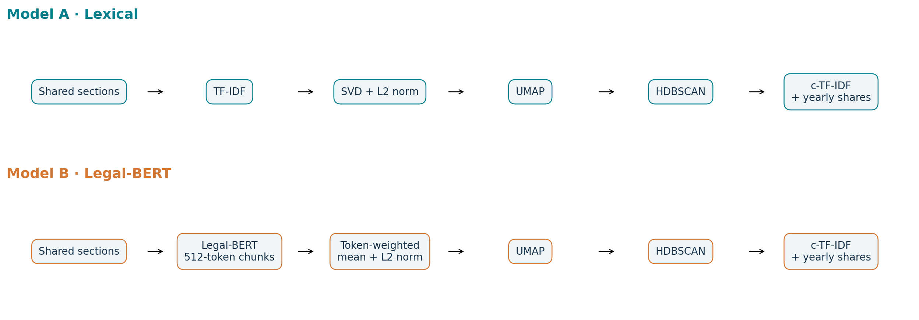
MODEL PIPELINES
Shared inputs; representation is the main difference
c-TF-IDF requires existing classes: Model A first clusters TF-IDF/SVD vectors. Both paths then derive topic keywords with c-TF-IDF.
05
CORPUZ · LAMSIN · NURIL / EXPLORATORY PILOT — NOT VALIDATED THESIS FINDINGS

Slide 6
SEMANTIC PIPELINE
The BERT module: frozen encoder, not fine-tuning
nlpaueb/legal-bert-base-uncased · pinned model revision
Long sections → non-overlapping chunks, up to 512 tokens including special tokens.
Token-weighted mean pooling excludes padding and special tokens.
Aggregate all chunks → L2-normalized section embedding → UMAP → HDBSCAN.
Embedding vectors retain section, ordinance and year associations.
Legal pretraining is not proof of suitability for Philippine municipal law. No learning rate or training epochs apply: encoder weights are frozen.
06
CORPUZ · LAMSIN · NURIL / EXPLORATORY PILOT — NOT VALIDATED THESIS FINDINGS

Slide 7
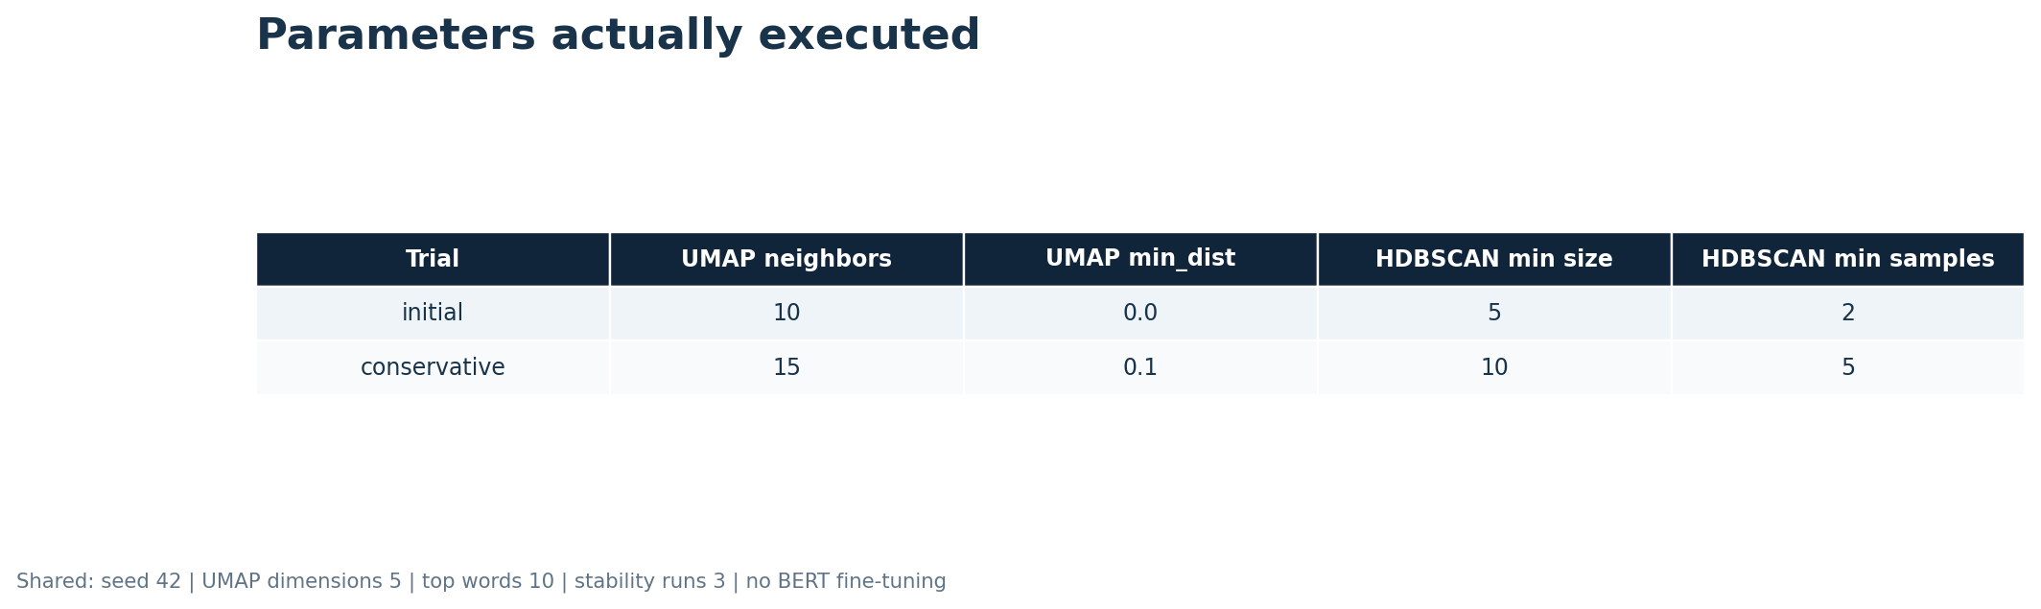
PARAMETER EVIDENCE
Recorded parameters—not hypothetical tuning
Pictures are rendered from the executed configuration. Sensitivity trials change several settings together; they do not isolate causal parameter effects.
07
CORPUZ · LAMSIN · NURIL / EXPLORATORY PILOT — NOT VALIDATED THESIS FINDINGS

Slide 8
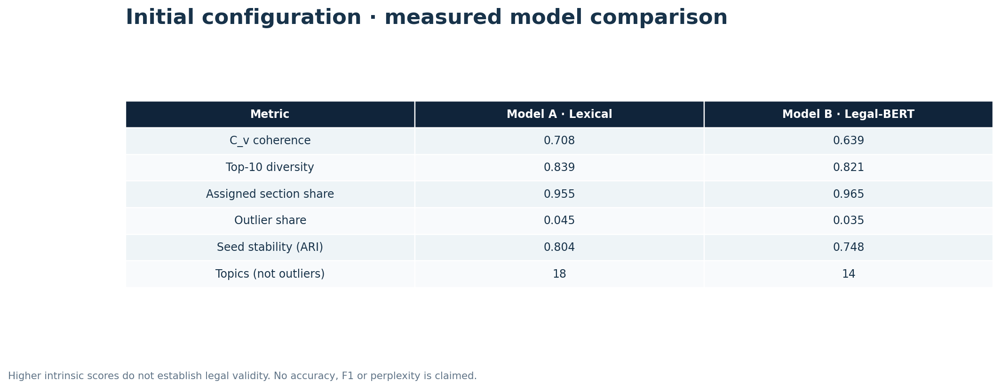
INITIAL RESULTS
Initial model comparison
08
CORPUZ · LAMSIN · NURIL / EXPLORATORY PILOT — NOT VALIDATED THESIS FINDINGS
Notes:
Source: evidence/lexical/metrics.json and evidence/semantic/metrics.json. In-sample intrinsic scores; unverified OCR pilot.

Slide 9
COMPARATIVE READING
What the initial numbers suggest—not prove
Coherence: lexical 0.708 vs Legal-BERT 0.639.
Keyword diversity: lexical 0.839 vs Legal-BERT 0.821.
Assigned sections: lexical 95.5% vs Legal-BERT 96.5%.
Seed stability: lexical 0.804 vs Legal-BERT 0.748.
The largest topics contain formal wording such as city, ordinance and attested. Strong intrinsic metrics may reward repeated boilerplate rather than substantive policy themes. More coverage alone does not mean better legal topics.
Treat this as a working baseline for corpus cleanup—not a verdict on either model.
09
CORPUZ · LAMSIN · NURIL / EXPLORATORY PILOT — NOT VALIDATED THESIS FINDINGS

Slide 10
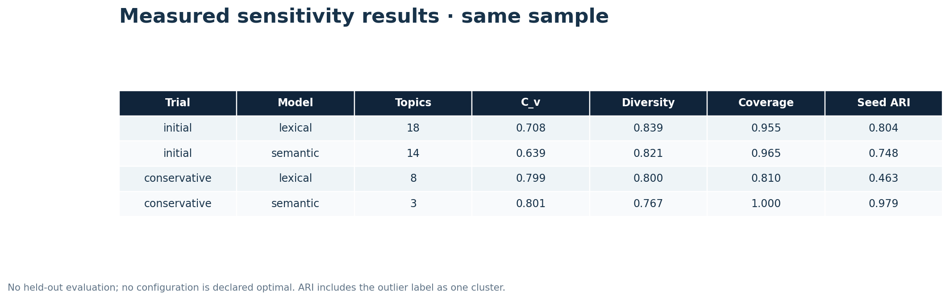
PARAMETER SENSITIVITY
Do results move when clustering settings change?
Same input, vocabulary and frozen encoder. Cached BERT embeddings are reused after text-hash validation. Runtime for a cached trial is not an end-to-end speed comparison.
10
CORPUZ · LAMSIN · NURIL / EXPLORATORY PILOT — NOT VALIDATED THESIS FINDINGS

Slide 11
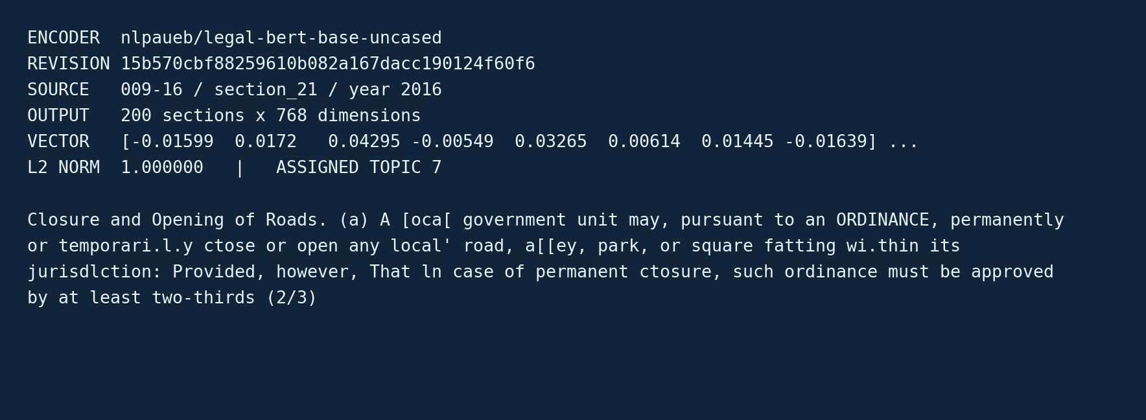
EXECUTION EVIDENCE
A real Legal-BERT output snippet
11
CORPUZ · LAMSIN · NURIL / EXPLORATORY PILOT — NOT VALIDATED THESIS FINDINGS

Slide 12
INTERPRETATION
Representative output: retain source context
Model A · Lexical
T0: attested, secretary, city, correct, enacted
0105-16 / section_4 / 2016
EFFECTMTY- This Ordinance shall take effect immediately upon approval; ENACTED, on the 22nd day of November, by a unanimous vote of all the Members of the Sanggunian present. CERTIFIED CORRECT: "For and in the absence of the Secretary" LMER M. CABALI Acting Secretary the SANGGUNIANG Panlungsod (Superuising Administrative Officerl ATTESTED: DUTERTE P cn Mayor ! t Ord. No. 0105-16 LAr';;'*f A[j't'HIt SARA Z.
Model B · Legal-BERT
T0: davao, city, ordinance, sign, known
0134-16 / section_1 / 2017
EIE - This Ordinance shall be known as " AN ORDINANCE GRANTING AUTHORIW TO THE CITY MAYOR TO SIGN THE PERFORMANCE COMMITMENT FOR HCIs (REVISION 2) AND PROVIDER DATA RECORD HEALTH CARE INSTITUTION OF TORIL HEATTH CENTER BIRTHING HOME FOR ITS APPLICATION FOR PHILHEATTH ACCREDITATION FOR MATERNITY CARE."
Keywords are machine-generated, not expert-approved policy labels. OCR artifacts and legal boilerplate remain visible.
12
CORPUZ · LAMSIN · NURIL / EXPLORATORY PILOT — NOT VALIDATED THESIS FINDINGS

Slide 13
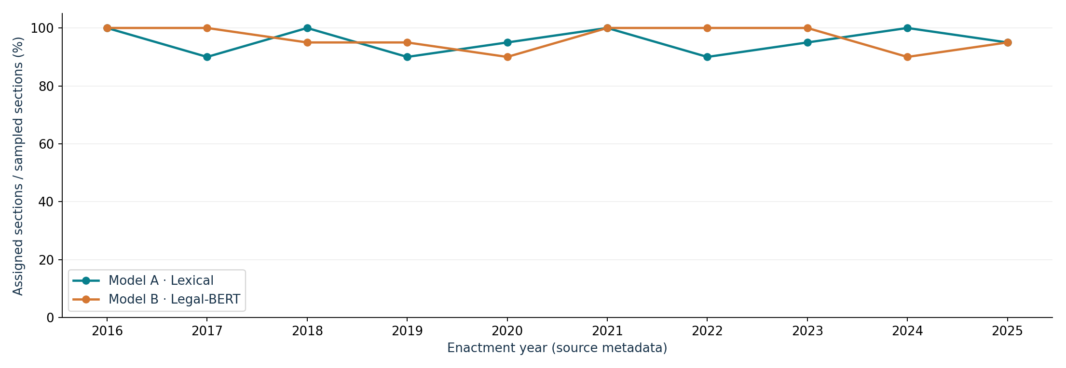
YEARLY COMPARISON
How much of each year's sample gets a topic?
Denominator: all sampled sections in each year, including outliers. Balanced sampling does not estimate ordinance production or full-corpus topic prevalence.
13
CORPUZ · LAMSIN · NURIL / EXPLORATORY PILOT — NOT VALIDATED THESIS FINDINGS

Slide 14
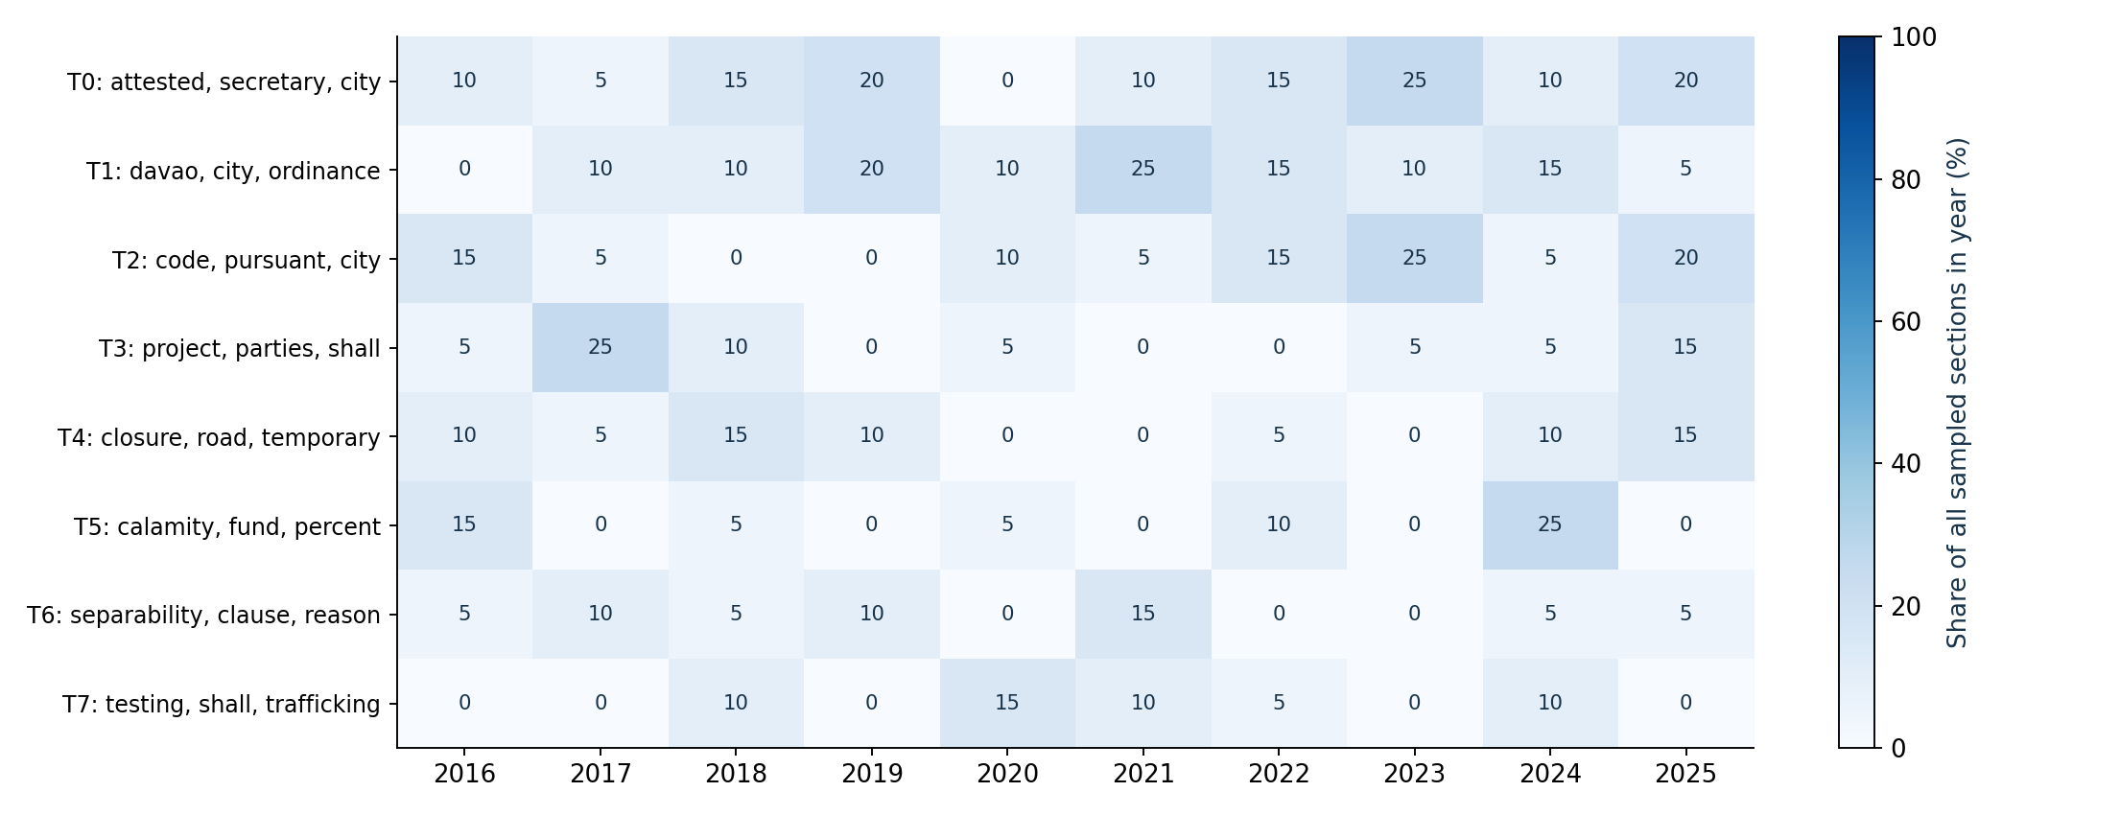
TEMPORAL SNAPSHOT
Model A · Lexical · topic shares across years
Top eight global topics only; omitted topics and outliers mean columns need not sum to 100%. These are sample-level patterns, not verified policy trends.
14
CORPUZ · LAMSIN · NURIL / EXPLORATORY PILOT — NOT VALIDATED THESIS FINDINGS

Slide 15
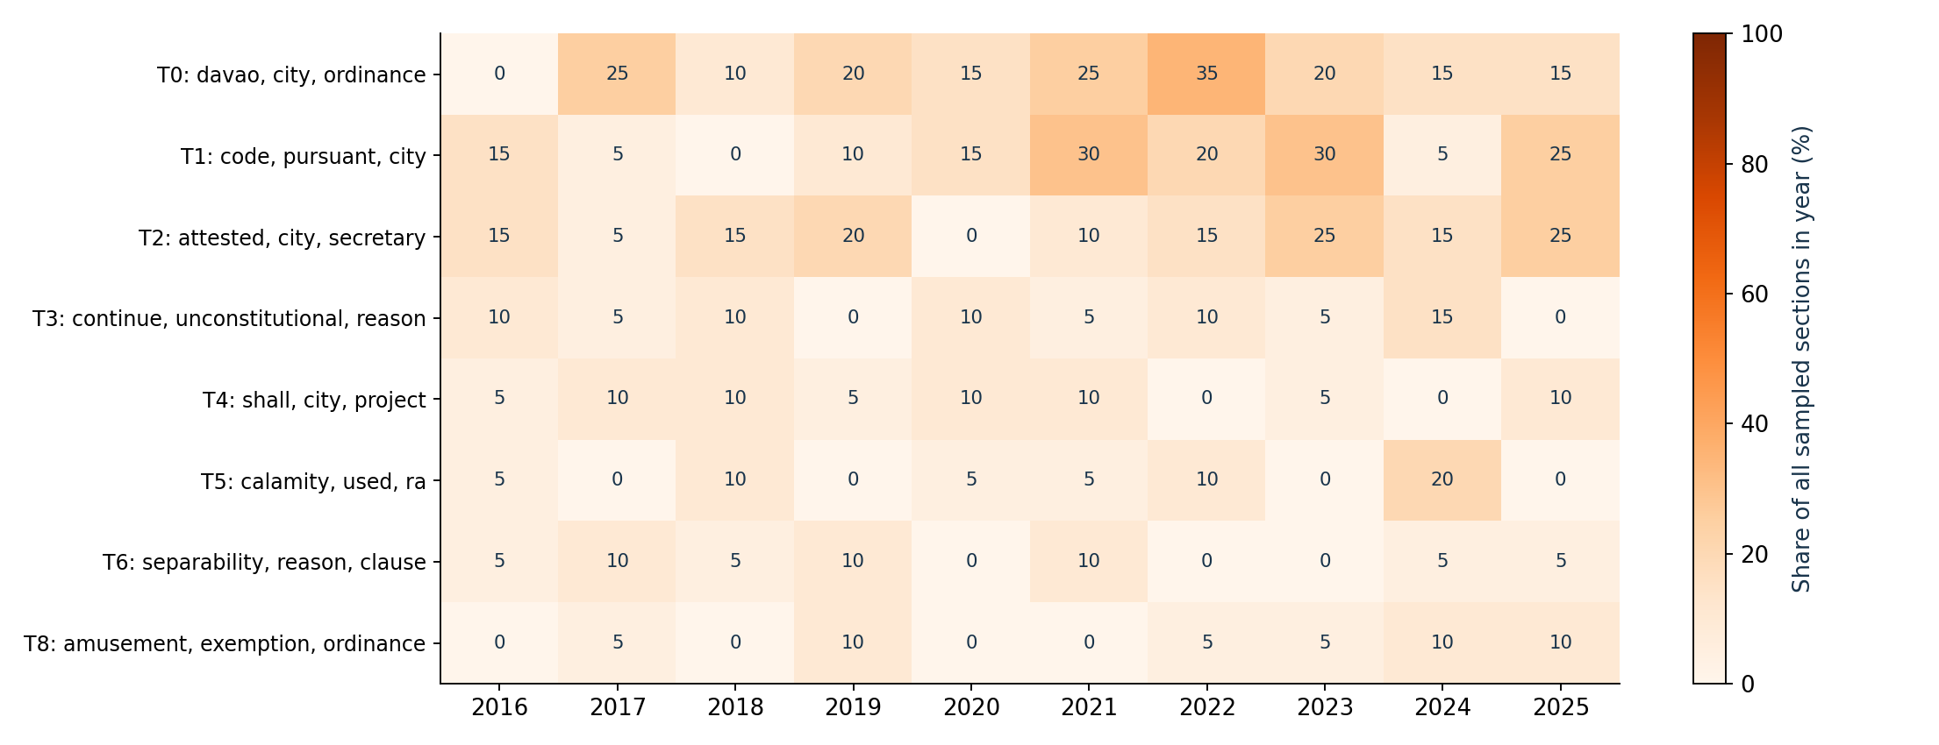
TEMPORAL SNAPSHOT
Model B · Legal-BERT · topic shares across years
Top eight global topics only; omitted topics and outliers mean columns need not sum to 100%. These are sample-level patterns, not verified policy trends.
15
CORPUZ · LAMSIN · NURIL / EXPLORATORY PILOT — NOT VALIDATED THESIS FINDINGS

Slide 16
EVALUATION CONTRACT
How to read the metrics
C_v: sliding-window coherence of top unigram keywords (Gensim; same input texts).
Diversity: unique topic keywords / all retained top-keyword slots; excludes outliers.
Coverage: assigned sections / all retained sections; outlier share is its complement.
Stability: mean adjusted Rand index vs two additional UMAP seeds; outliers treated as one cluster.
All scores are intrinsic and in-sample. Accuracy/F1 need reference labels. BERTopic has no directly comparable probabilistic perplexity. Expert validation is still pending.
16
CORPUZ · LAMSIN · NURIL / EXPLORATORY PILOT — NOT VALIDATED THESIS FINDINGS

Slide 17
NEXT MILESTONE
Before these can become thesis findings
1 Verify OCR, section boundaries, dates and provenance against the PDFs.
2 Review boilerplate, unusually long sections and repeated texts.
3 Freeze a verified corpus; rerun both paths on identical inclusion rules.
4 Use ordinance-grouped development / held-out evaluation before final selection.
5 Expert panel: legal coherence, relevance, label appropriateness, temporal interpretation, overall quality (1–5 / N/A).
6 Review any expert dimension below 3.00; regenerate the presentation from new evidence.
17
CORPUZ · LAMSIN · NURIL / EXPLORATORY PILOT — NOT VALIDATED THESIS FINDINGS

Slide 18
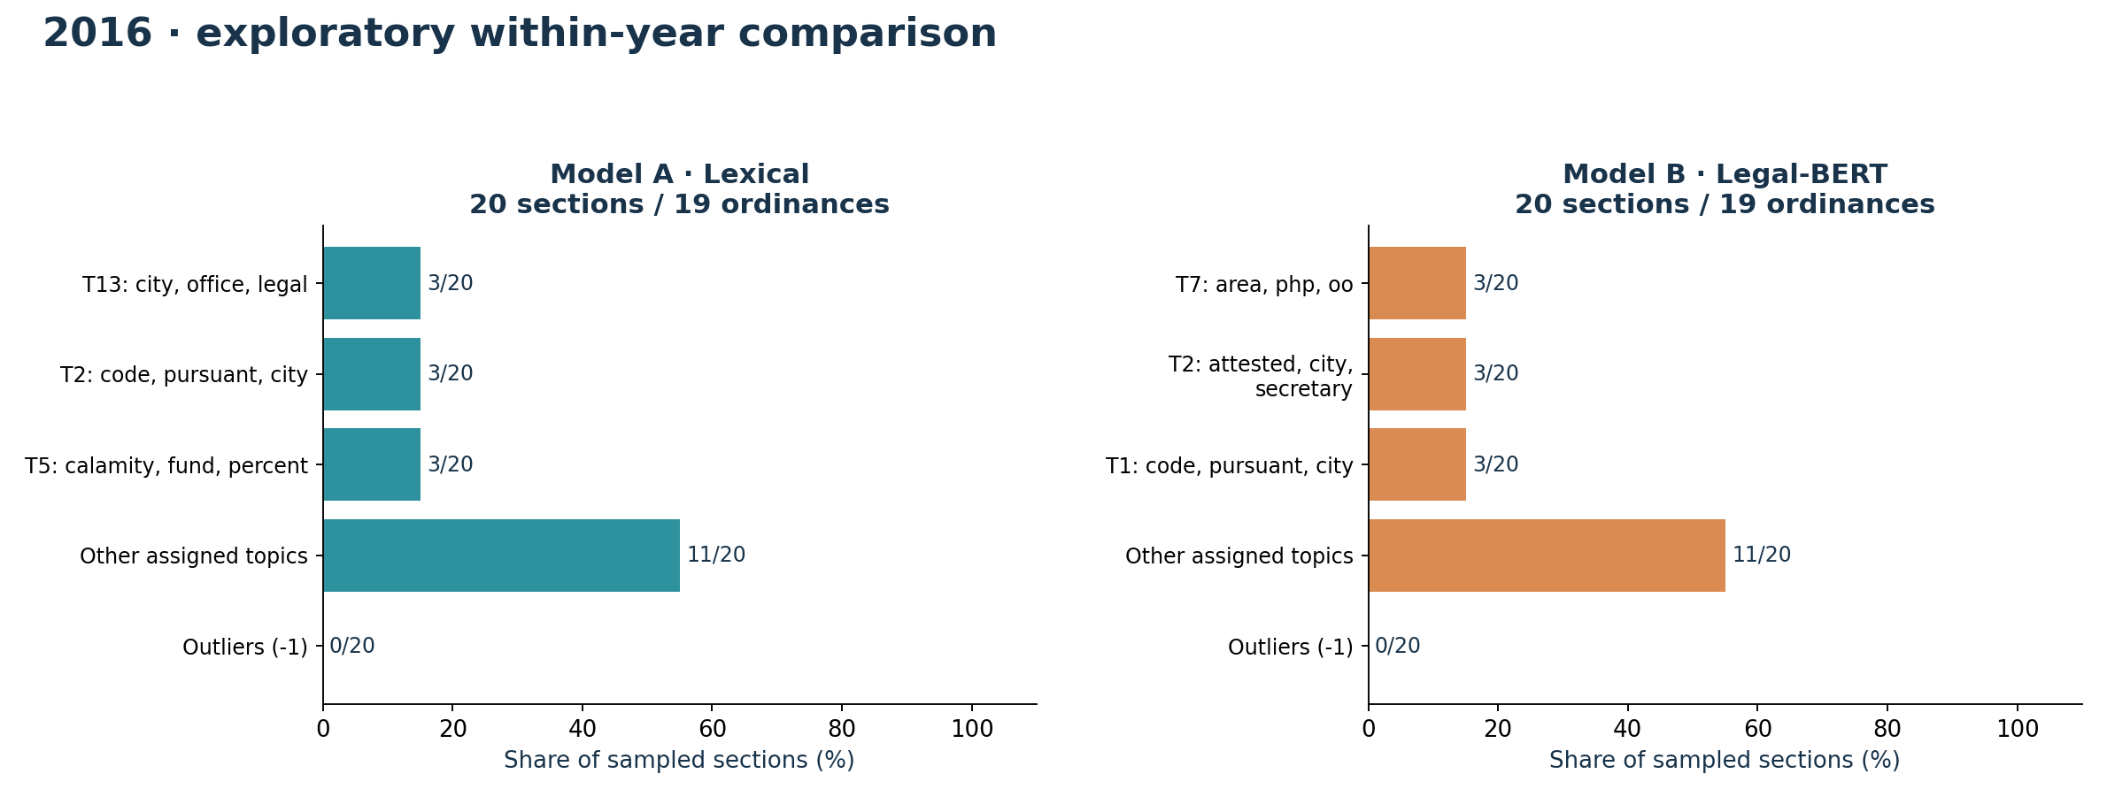
YEAR-BY-YEAR EVIDENCE
2016 · both models, side by side
Topic numbers are local to each model: A/T0 is not B/T0. Bars show the top three topics, other assigned topics and outliers within this year's sample.
18
CORPUZ · LAMSIN · NURIL / EXPLORATORY PILOT — NOT VALIDATED THESIS FINDINGS

Slide 19
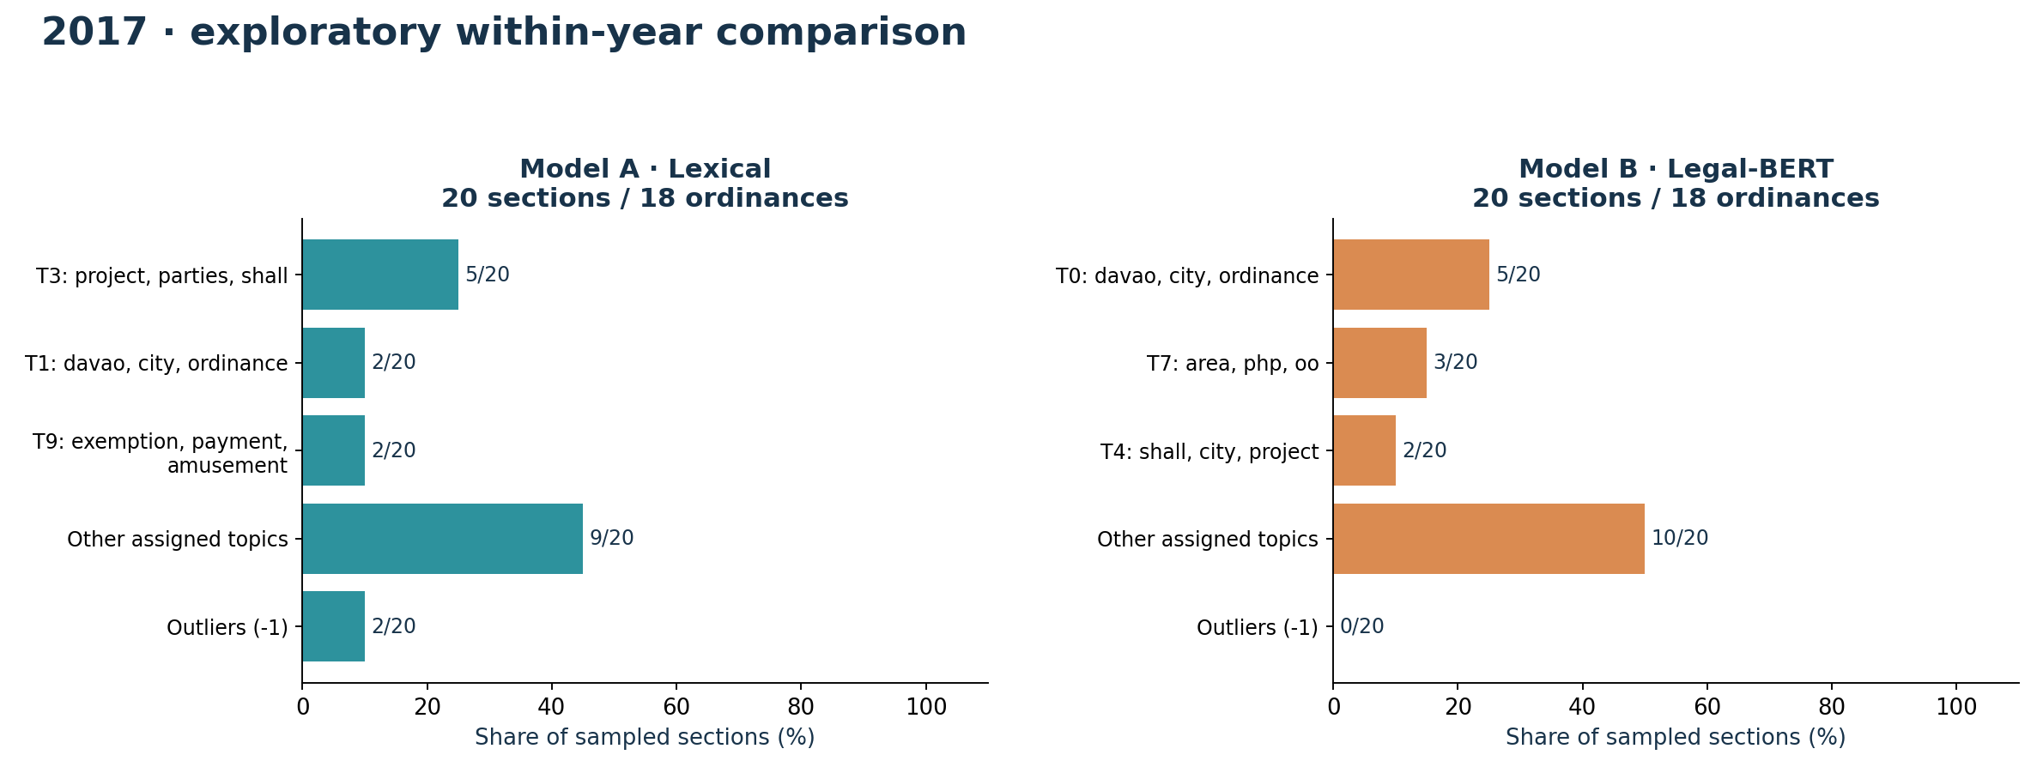
YEAR-BY-YEAR EVIDENCE
2017 · both models, side by side
Topic numbers are local to each model: A/T0 is not B/T0. Bars show the top three topics, other assigned topics and outliers within this year's sample.
19
CORPUZ · LAMSIN · NURIL / EXPLORATORY PILOT — NOT VALIDATED THESIS FINDINGS

Slide 20
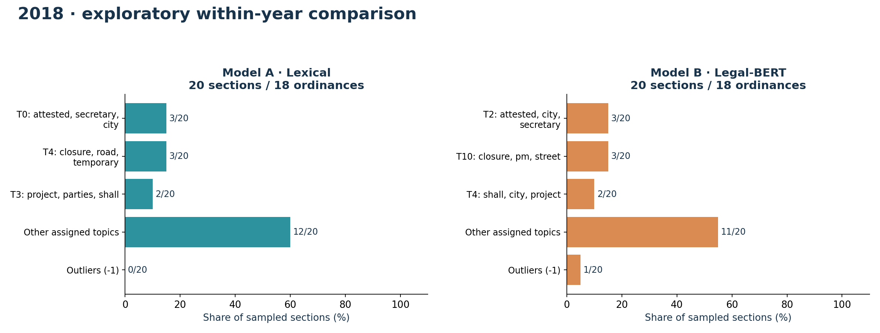
YEAR-BY-YEAR EVIDENCE
2018 · both models, side by side
Topic numbers are local to each model: A/T0 is not B/T0. Bars show the top three topics, other assigned topics and outliers within this year's sample.
20
CORPUZ · LAMSIN · NURIL / EXPLORATORY PILOT — NOT VALIDATED THESIS FINDINGS

Slide 21
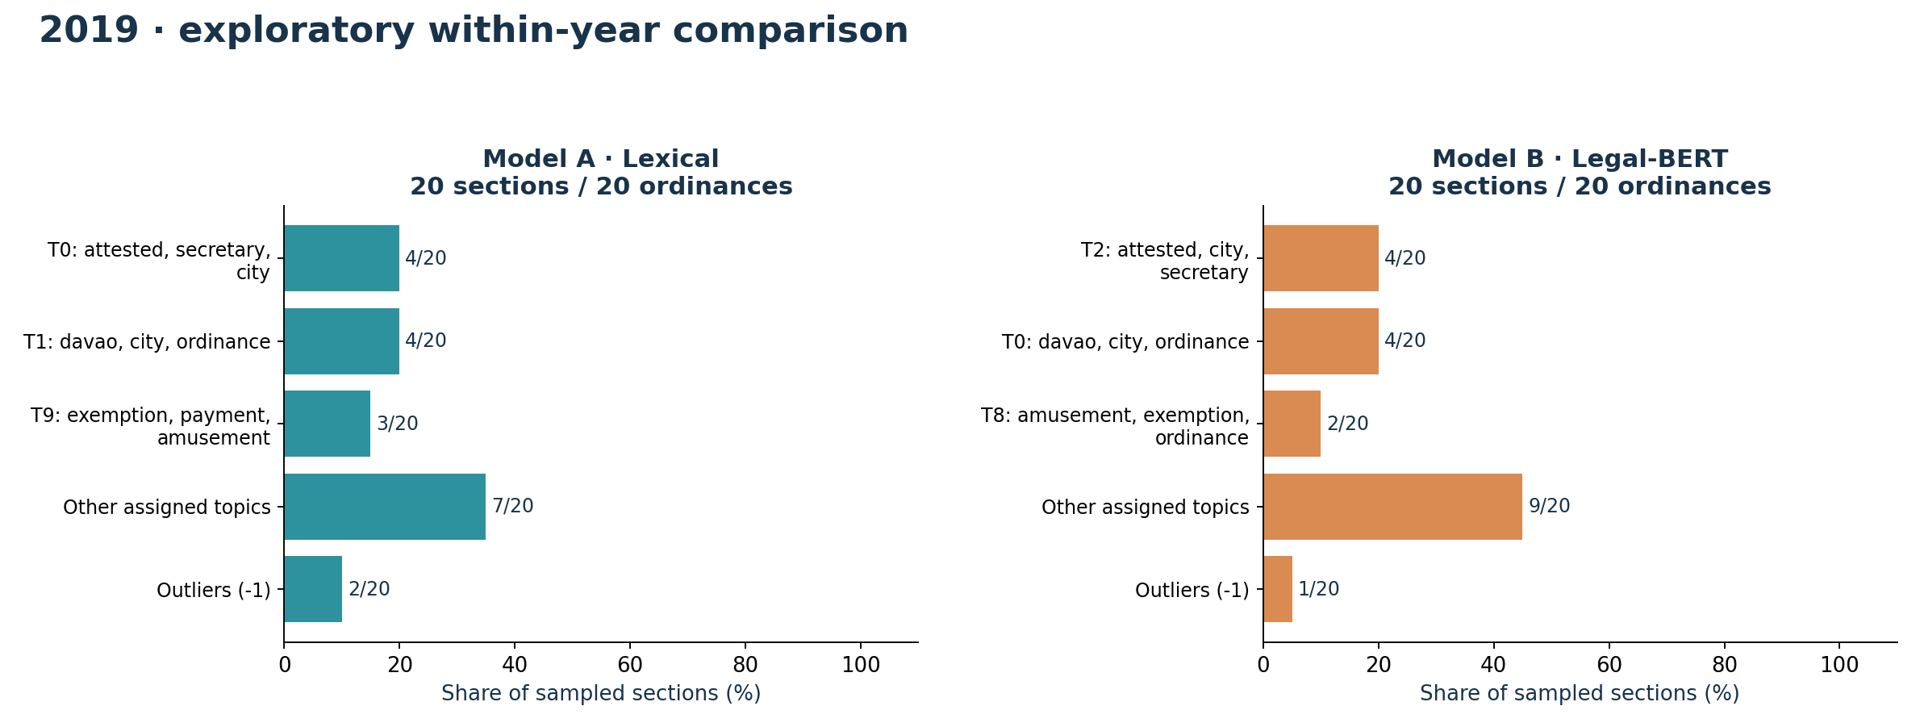
YEAR-BY-YEAR EVIDENCE
2019 · both models, side by side
Topic numbers are local to each model: A/T0 is not B/T0. Bars show the top three topics, other assigned topics and outliers within this year's sample.
21
CORPUZ · LAMSIN · NURIL / EXPLORATORY PILOT — NOT VALIDATED THESIS FINDINGS

Slide 22
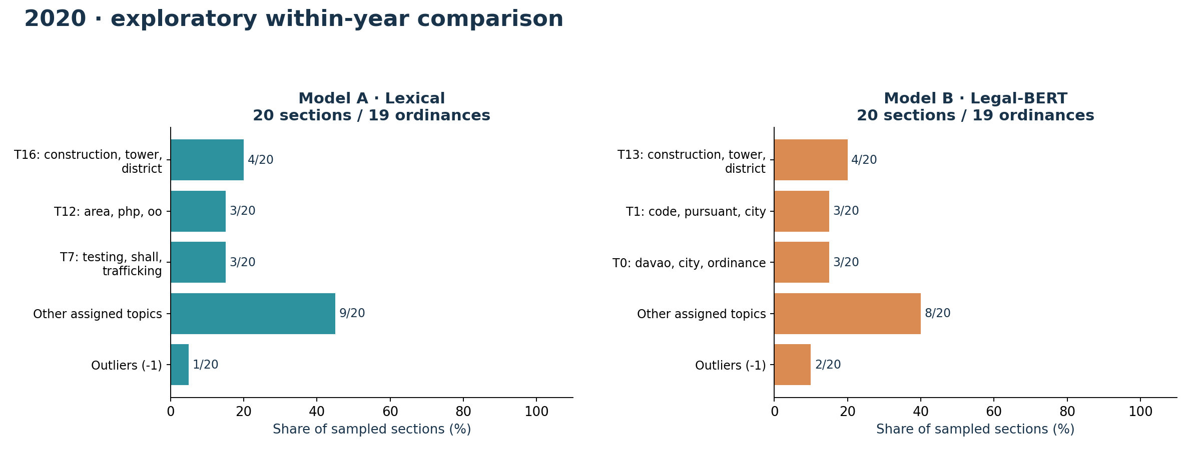
YEAR-BY-YEAR EVIDENCE
2020 · both models, side by side
Topic numbers are local to each model: A/T0 is not B/T0. Bars show the top three topics, other assigned topics and outliers within this year's sample.
22
CORPUZ · LAMSIN · NURIL / EXPLORATORY PILOT — NOT VALIDATED THESIS FINDINGS

Slide 23
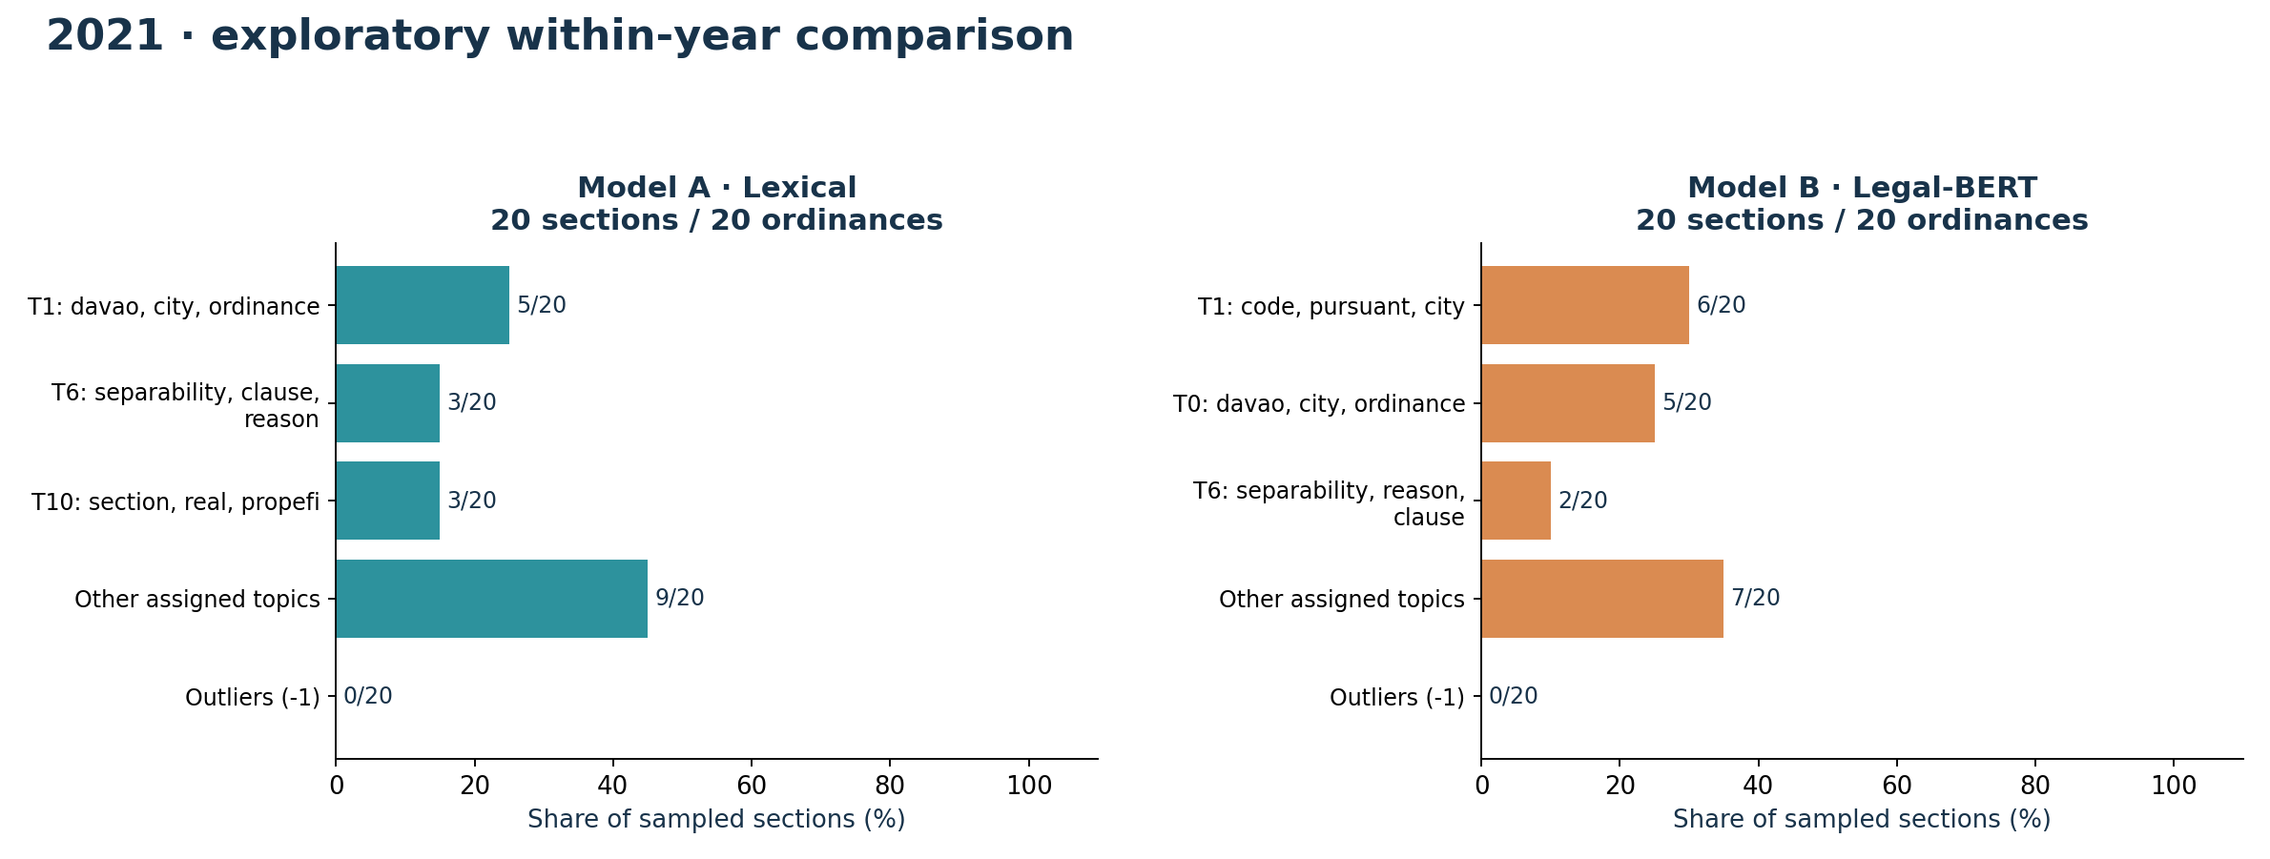
YEAR-BY-YEAR EVIDENCE
2021 · both models, side by side
Topic numbers are local to each model: A/T0 is not B/T0. Bars show the top three topics, other assigned topics and outliers within this year's sample.
23
CORPUZ · LAMSIN · NURIL / EXPLORATORY PILOT — NOT VALIDATED THESIS FINDINGS

Slide 24
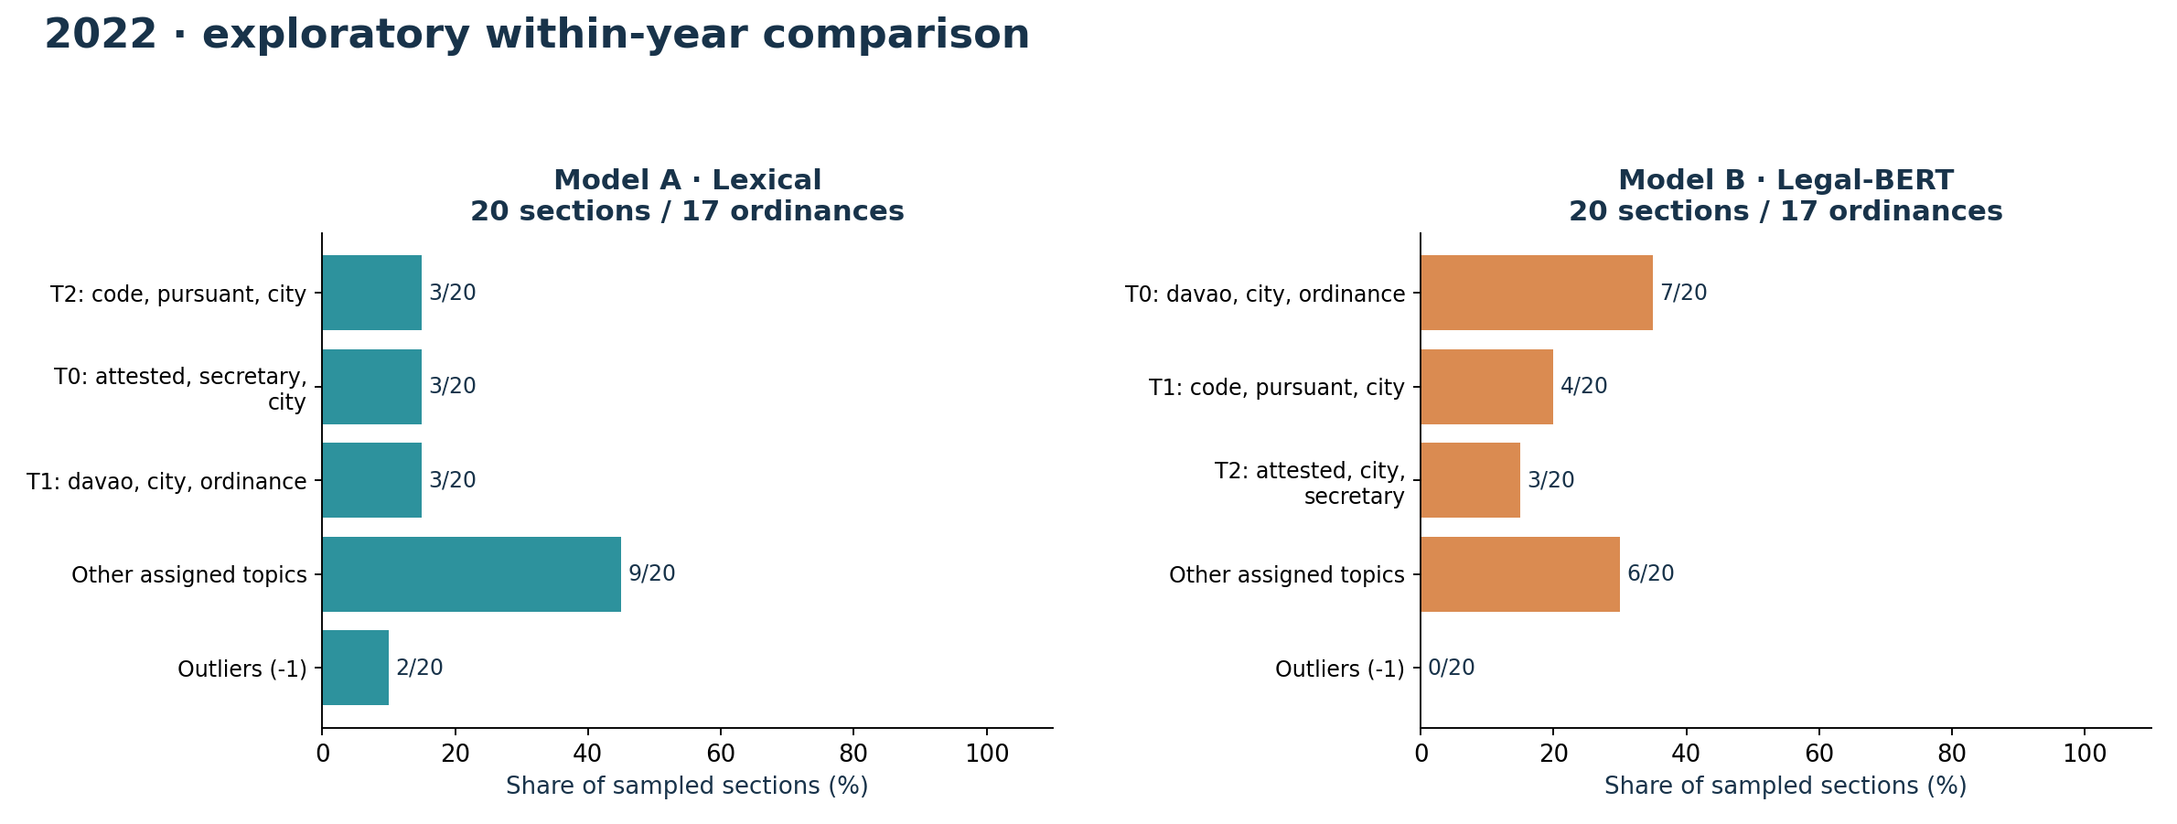
YEAR-BY-YEAR EVIDENCE
2022 · both models, side by side
Topic numbers are local to each model: A/T0 is not B/T0. Bars show the top three topics, other assigned topics and outliers within this year's sample.
24
CORPUZ · LAMSIN · NURIL / EXPLORATORY PILOT — NOT VALIDATED THESIS FINDINGS

Slide 25
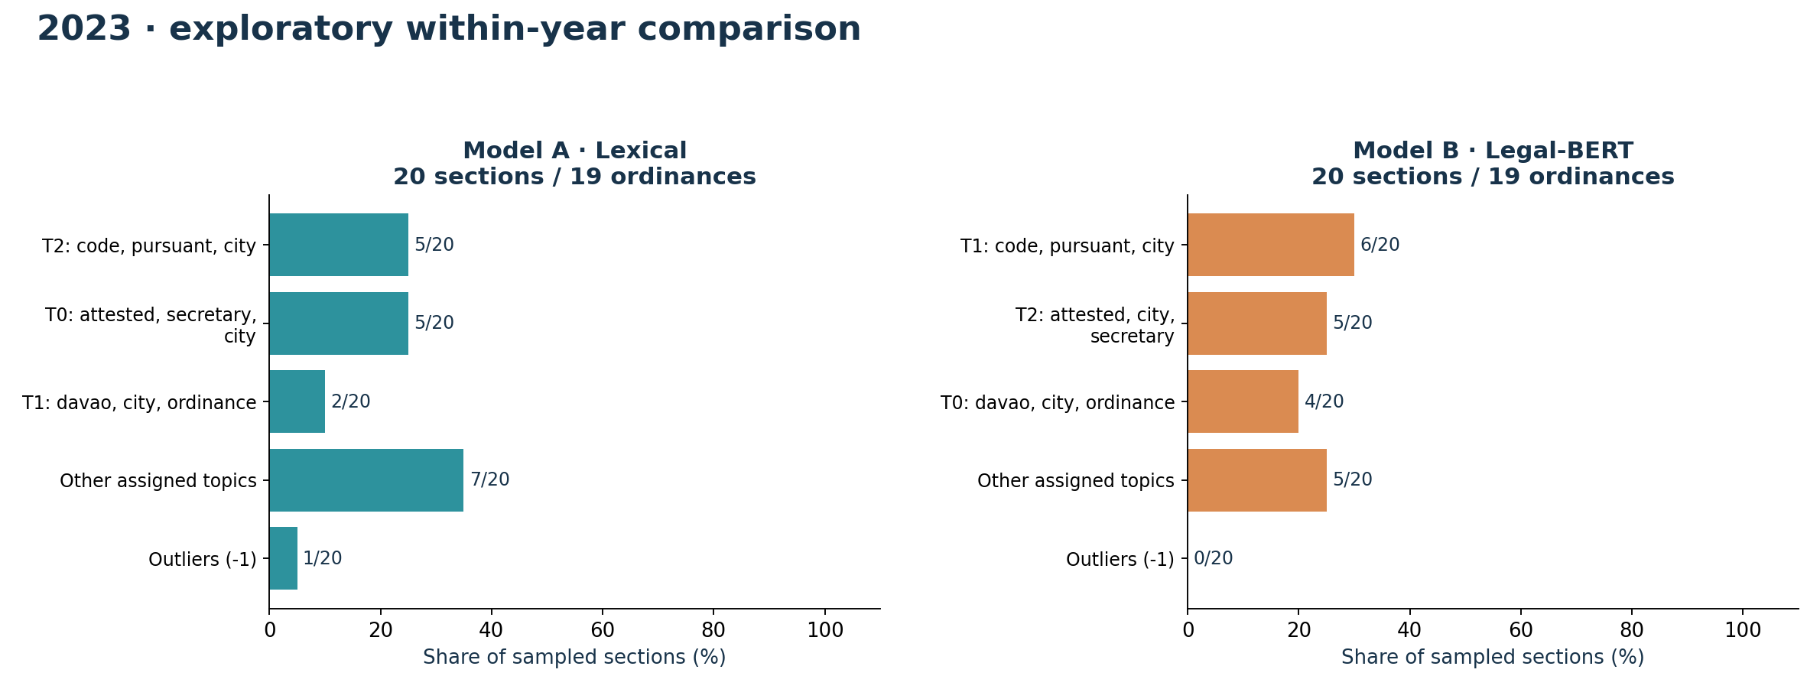
YEAR-BY-YEAR EVIDENCE
2023 · both models, side by side
Topic numbers are local to each model: A/T0 is not B/T0. Bars show the top three topics, other assigned topics and outliers within this year's sample.
25
CORPUZ · LAMSIN · NURIL / EXPLORATORY PILOT — NOT VALIDATED THESIS FINDINGS

Slide 26
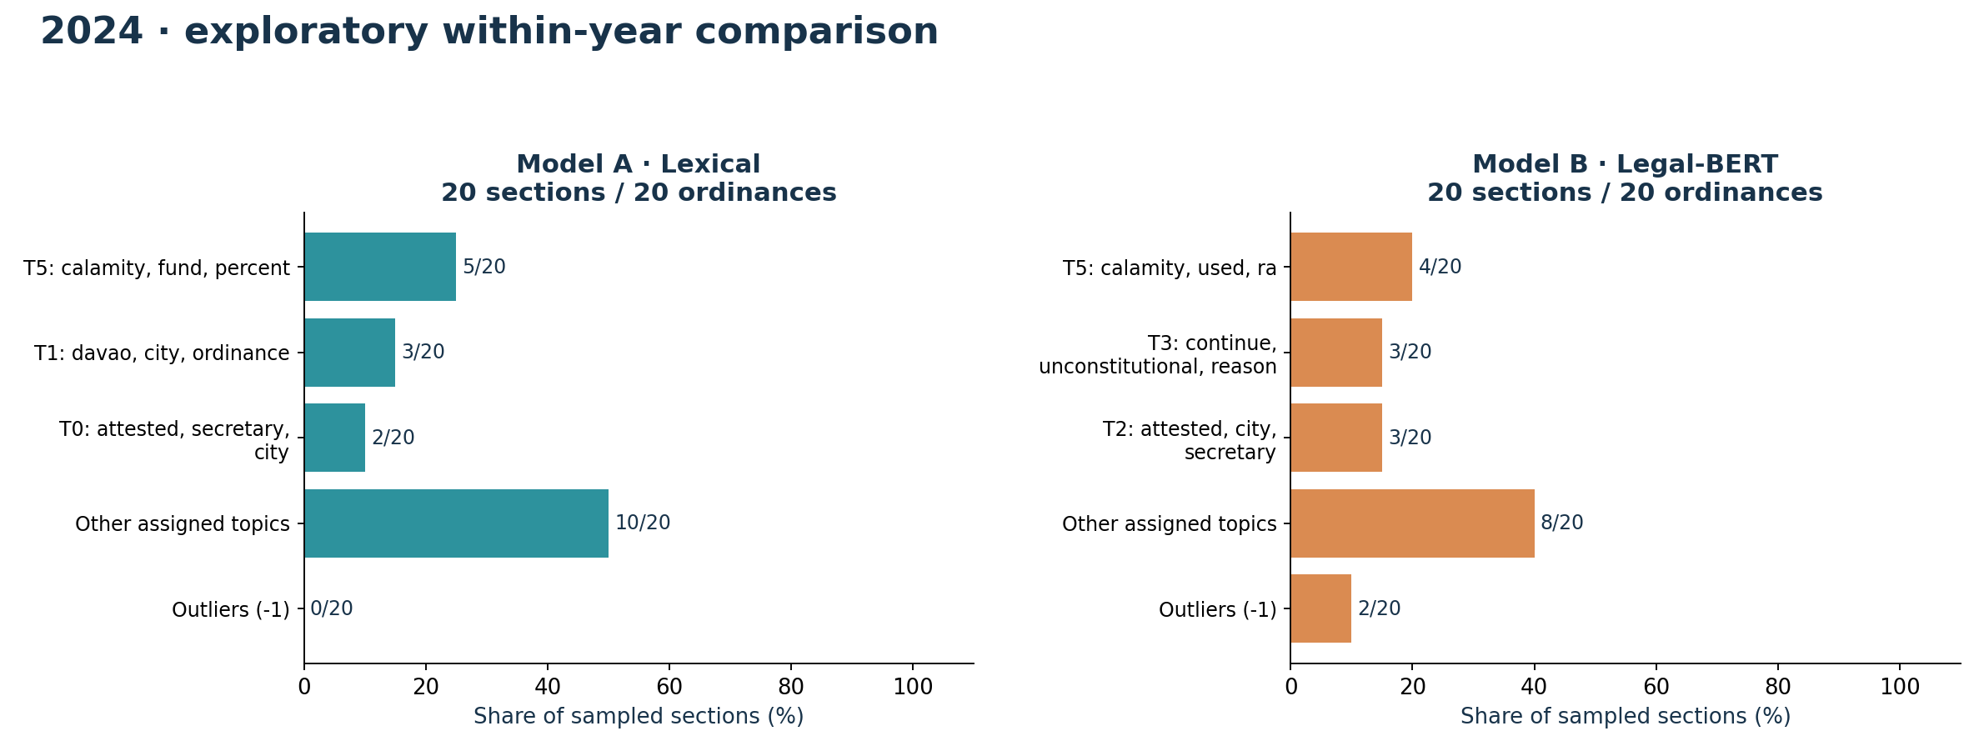
YEAR-BY-YEAR EVIDENCE
2024 · both models, side by side
Topic numbers are local to each model: A/T0 is not B/T0. Bars show the top three topics, other assigned topics and outliers within this year's sample.
26
CORPUZ · LAMSIN · NURIL / EXPLORATORY PILOT — NOT VALIDATED THESIS FINDINGS

Slide 27
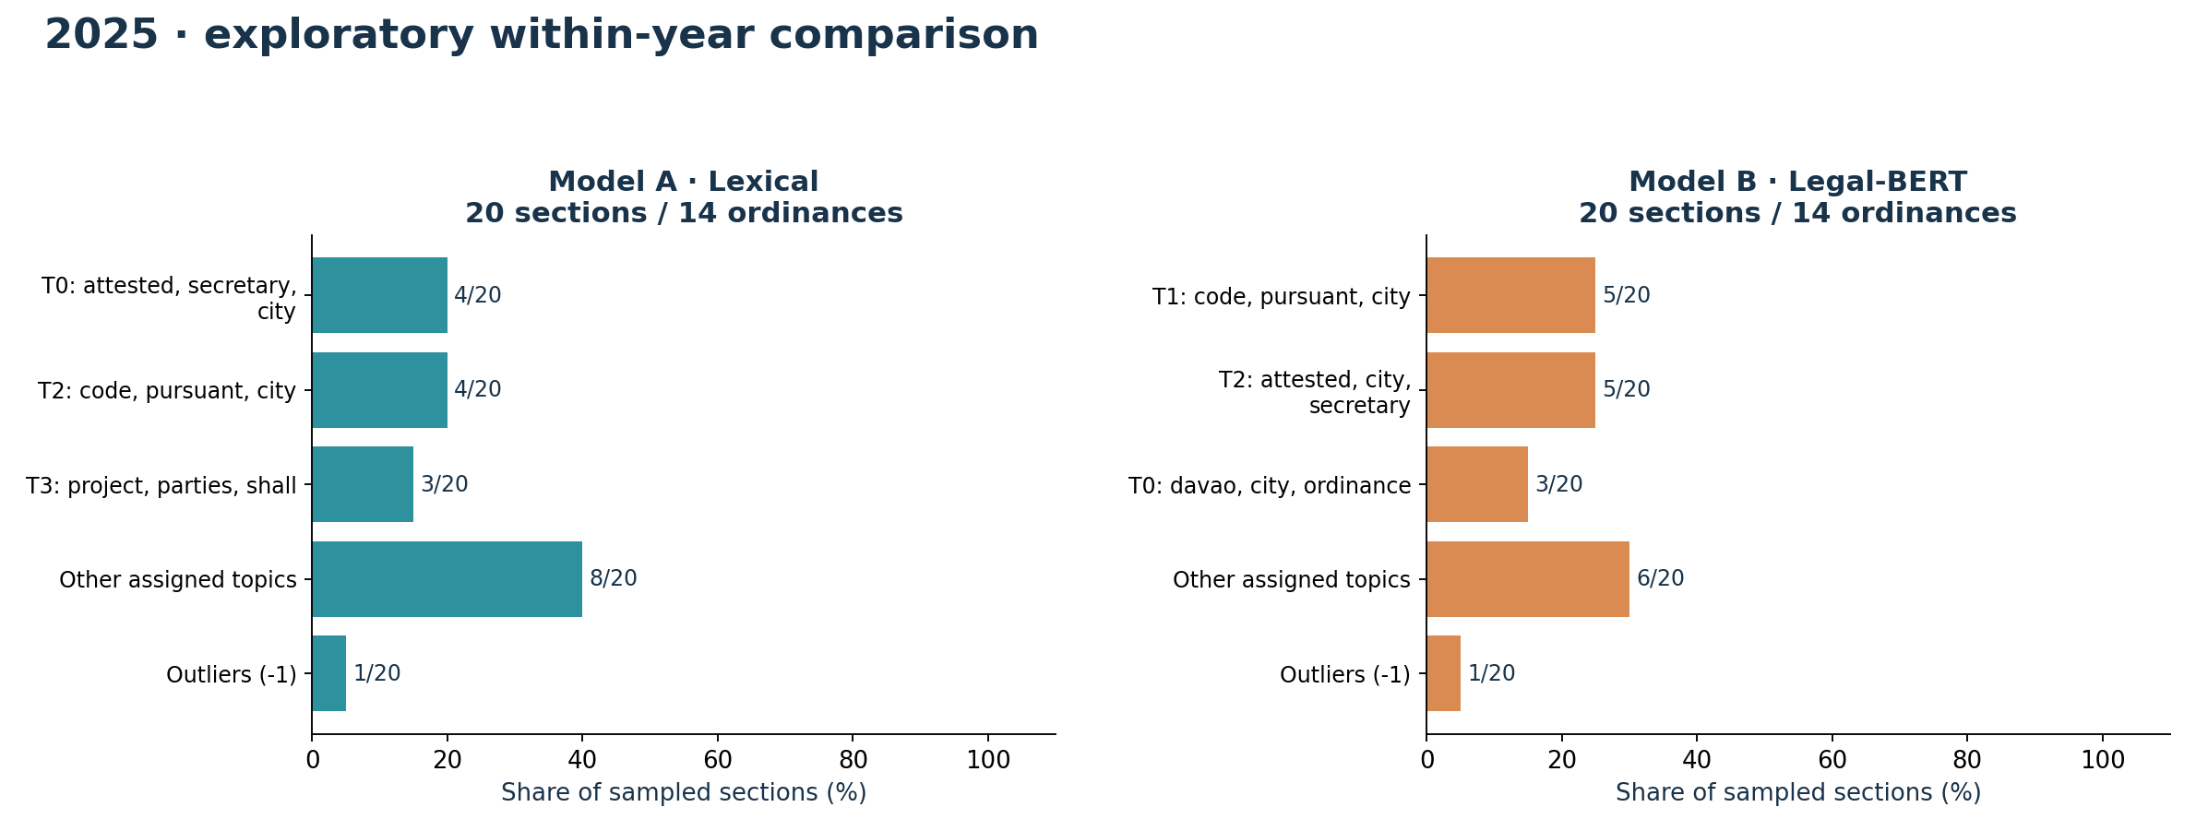
YEAR-BY-YEAR EVIDENCE
2025 · both models, side by side
Topic numbers are local to each model: A/T0 is not B/T0. Bars show the top three topics, other assigned topics and outliers within this year's sample.
27
CORPUZ · LAMSIN · NURIL / EXPLORATORY PILOT — NOT VALIDATED THESIS FINDINGS

Slide 28
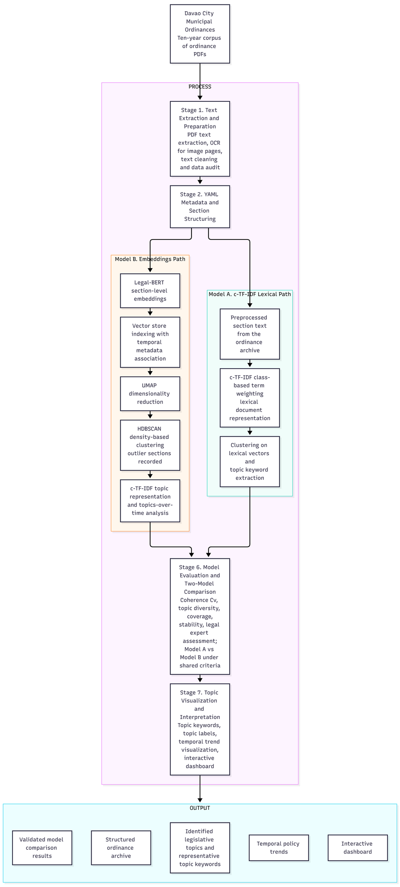
REFERENCE APPENDIX
Original supplied process diagram
Source: Downloads/diagram.png
Implementation clarification:
c-TF-IDF needs class assignments. The lexical path therefore uses TF-IDF/SVD before clustering, then c-TF-IDF for topic representation.
The current deliverable is an exploratory modeling and reporting pipeline—not a completed expert-validated system.
28
CORPUZ · LAMSIN · NURIL / EXPLORATORY PILOT — NOT VALIDATED THESIS FINDINGS

