Slide 1
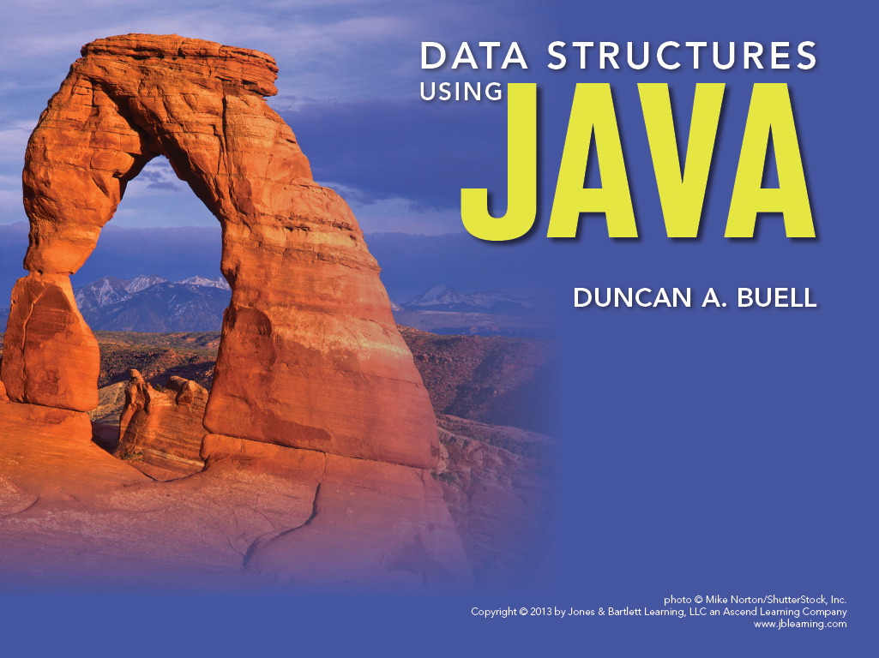
Chapter 8
Recursion

Slide 2

Objectives
An introduction to the concept of recursion
Examples of recursively-defined functions, such as factorials, the Fibonacci sequence, the “3n + 1 function,” and the Ackermann function
Use of recursion in program code, including binary divide-and- conquer algorithms
Recursion for computing permutations and combinations
Recursion for gaming and search tree computation
Dealing with memory use in recursion

Slide 3
Basics
A recursive algorithm, function, or program is one that calls itself.
Fibonacci numbers:
  F(N) = F(N-1) + F(N-2), subject to F(1) = 1, F(0) = 1
Factorials:
  N! = N * (N-1)!, subject to 0! = 1
Need a steady state F(N) = G(values smaller than N)
  Need a base condition (e.g., 0! = 1) so we can stop and not go on forever

Slide 4
Examples
Factorials
Fibonacci numbers
Binary search: split the data in half, determine which half is relevant, and repeat
Game programming and tree search: Determine which move is optimal, assume that move, and repeat, descending down the tree
Mergesort, that we will deal with later
Web crawling

Slide 5
Factorial
public int factorial(int n)
{
int returnValue = 1;
if(n == 1)
{
returnValue = n;
}
else
{
returnValue = n * factorial(n-1);
}
return returnValue;
}

Slide 6
Examples (2)
Greatest common divisor
The greatest common divisor g = gcd(a,b) of two integers a and b is the largest integer evenly dividing both a and b.
A fundamental theorem is that
g = gcd(a,b) = gcd(a-b,b) = gcd(a,b-a) = gcd(a, b%a)
Steady state recursion is
g = gcd(a,b) = gcd(a, b%a) = gcd(b%a, a%(b%a))
Don’t forget the base case: a = gcd(a, 0)

Slide 7
Examples (3)
Greatest common divisor
(39, 75) = (39, 75%39) = (39, 36) = (36, 39%36) = (36, 3) = (3, 36%3) = (3, 0) = 3
(21, 92) = (21, 92%21) = (21, 8) = (8, 21%8) = (8, 5) = (5, 8%5) = (5, 3) = (3, 5%3) = (3, 2) = (2, 3%2) = (2, 1) = (1, 2%1) = (1, 0) = 1
Reduce larger mode smaller (a, b) → (a, b%a)
Then exchange and repeat
(a, b%a) → (b%a, a) → (b%a, a%(b%a))
Naturally recursive

Slide 8
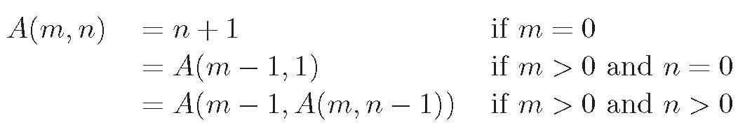
Examples (4)
The Ackermann Function is a double recursion
Look up Ackermann function
Figure 8.01: The formulas defining the Ackerman function

Slide 9
Ackermann
public int ackermann(int m, int n)
{
int returnValue = 0;
if(m == 0)
{
returnValue = n+1;
}
else if((m > 0) && (n == 0))
{
returnValue = ackermann(m-1, 1);
}
else
{
returnValue = ackermann(m-1, ackermann(m, n-1));
}
return returnValue;
}

Slide 10
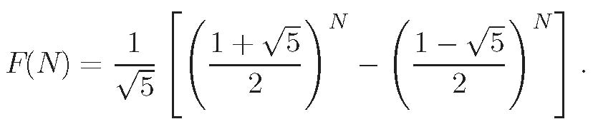
Closed versus Open Form
Factorials have a non-recursive definition
  F(N) = 1 * 2 * … * N
Fibonacci numbers have a non-recursive definition
Not all recursions work this way

Slide 11
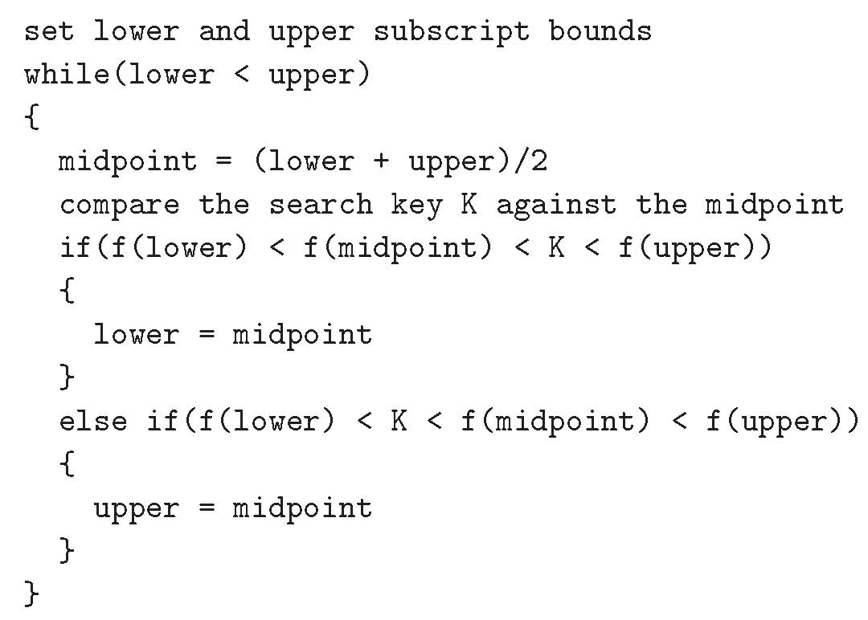
Binary Search—Iterative Form
We move pointers to an array

Slide 12
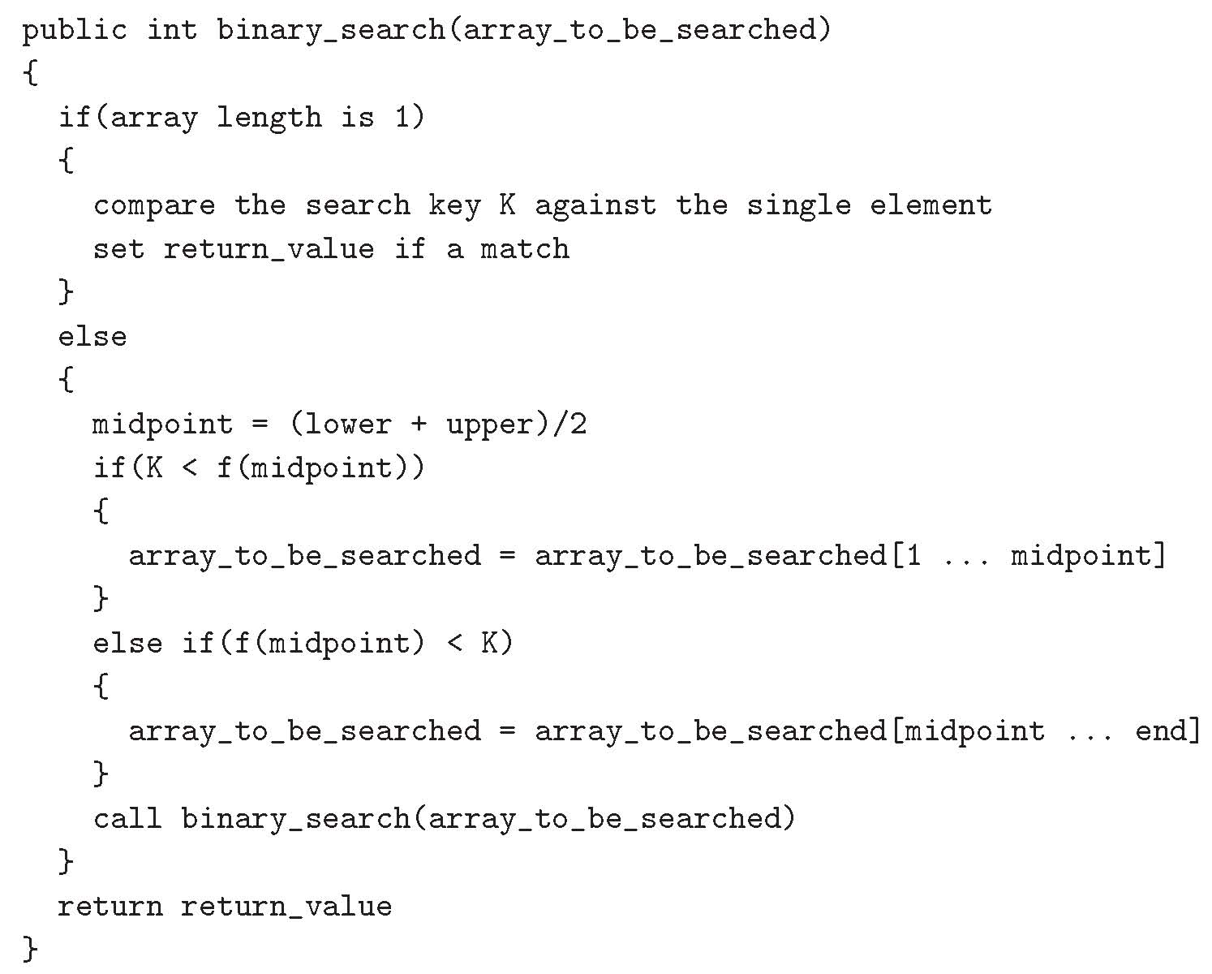
Binary Search—Recursive Form
Package up the data – all pointers are local to the individual method call
Note the base case/steady state if else

Slide 13
Not All Recursion Results Are Known
Collatz problem, Syracuse problem 3n+1 problem
    C(n) = 3n+1 if n is odd
    C(n) = n/2 if n is even
Does C(k) reduce to 1 from all inputs k?
This is an open question.
We don’t really have any good idea how to do the mathematical analysis of this problem.

Slide 14
Permutations and Combinations
The permutations P(S) of a set S={a_{i}} are all the strings of the a_{i} sampling without replacement.
P({1, 2, 3})={123, 132, 213, 231, 312, 321}
P({1,2,3,4}) = {1234,1243,1324,1342,1423,1432,
2134,2143,2314,2341,2413,2431,
3124,3142,3214,3241,3412,3421,
4123,4132,4213,4231,4312,4321}

Slide 15
Permutations
Permutations of {1,2,3,4} are
  1 + perms of {2,3,4}
  2 + perms of {1,3,4}
  3 + perms of {1,2,4}
  4 + perms of {1,2,3}
A naturally recursive process
N! permutations on a set of N items, and this is exponentially large in N

Slide 16
Recursive Tree Searching
Chess, checkers, Go:
An objective function computes the goodness of the board position for White if a possible move is made.
Then the opponent computes the goodness for the possible moves by Black.
This is one ply in the search—White assumes Black plays properly. White chooses the move for which White’s board position is best given Black’s best possible response.
Naturally recursive for as many plies as one has time and space to hold.
Pruned search
Objective functions

Slide 17
Implementations
Recursion can be great
But it can also be tricky
Especially when passing data down and back the calling chain
The context of an executing process is the totality of its memory, assigned variables, etc.
With each recursive call, one copy of the context must be pushed on the memory stack (or else we couldn’t pop our way back home when done).
Too many recursive calls will blow up for memory

Slide 18
Implementations
Passing parameters down and one functional value back is easy—not much context there.
Things are more delicate when dealing with memory and lists—copying long lists with each recursive call and forcing the entire list to be part of the context is a lose in time and space.
If there is a long array, or there need to be many recursive calls, have the method operate on an instance variable of the class and not a local variable.

Slide 19
Jumble Puzzle
Permutations on 5 or 6 letters to form words
Pass in the jumbled string of letters.
Generate the 5!= 120 or 6!=720 permutations.
Test each putative word against a dictionary.

Slide 20
End of Chapter 8

