Slide 1
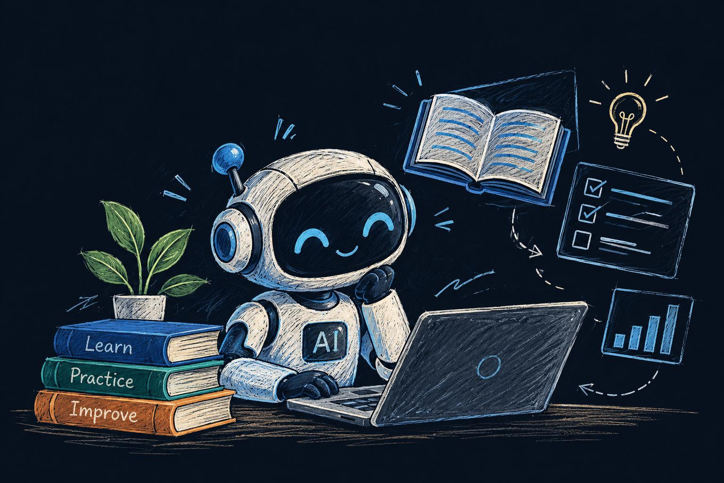
PROBLEM STATEMENT 1 • 3RD SEM AIML PROJECT
Academic Year 2026
AI-Based Personalized Learning Content Generator
Dynamic adaptive curriculum generation using LLM prompt
engineering & score feedback loops
TEAM MEMBERS
Krish koushal
Shahejan shaikh
Sohan Khan
Arkan khan
Shaksham thakur
PROJECT GUIDE
INSTITUTION
BTE25AIM10006
BTE25AIM100011
BTE25AIM00056
BTE25AIM100
BTE25AIM100
Ankit singh
Sage university bhopal

Slide 2



CONTEXT & CHALLENGE
Why Static Learning Materials Fail Modern Students
Fixed Pace Mismatch
Unaddressed Gaps
Delayed Feedback
Static textbooks force uniform pacing across students with wildly disparate baselines.
Standardized lecture notes cannot diagnose or remediate localized conceptual misconceptions.
Traditional evaluations take days to grade without producing instant targeted study guides.

Slide 3
CORE GOALS
Key Engineering Objectives
Personalized Explanations
Dynamic Difficulty Adjuster
Generate tailored breakdowns tuned to student self-ratings or test histories.
Automate step progression between beginner, intermediate, and advanced levels.
Instant Practice Assessment
Low-Latency Generation
Formulate active evaluation quizzes and answer keys on-the-fly.
Deliver structured summaries in under 3 seconds using LLM endpoints.

Slide 4
SOLUTION BLUEPRINT
Applied Generative AI Pipeline
Prompt Engineering over Retraining
THE TRANSFORMATION
Rather than training heavy foundation models from scratch, our solution leverages state-of-the-art Generative AI APIs guided by deterministic prompt templates and learner metric heuristics.
TRADITIONAL CLASSROOM
One textbook, static explanations, passive multi-week evaluation cycles.
Role-conditioned system instructions
PROPOSED AI PLATFORM
Automated heuristic difficulty routing
Adaptive depth, real-time remediation, automated difficulty recalibration.
Lightweight web application interface

Slide 5





ENGINEERING BLUEPRINT
System Architecture Diagram
Student Input
Proficiency Logic
Prompt Engine
LLM API
Custom Content
Topic, Self-Rating, Prior Scores
Difficulty Heuristic Mapping
System + Context Injection
Gemini / OpenAI API Call
Notes + Practice Questions

Slide 6




APPLIED TECH STACK
Tools & Frameworks
Python 3.10+
Streamlit
Generative AI API
Pandas & JSON
Core application logic & API orchestration engine.
Rapid interactive UI for student prompts and outputs.
Gemini 1.5 Flash / OpenAI for dynamic synthesis.
Session tracking & quiz response scoring.

Slide 7
EXECUTION PIPELINE
Working Methodology
01
02
03
04
Capture Input
Build Prompt
Call LLM API
Feedback Loop
Collect target topic and self-evaluation rating.
Inject difficulty constraints into persona templates.
Stream formatted explanations and review MCQs.
Grade quiz responses to update user level score.

Slide 8
ADAPTIVE ALGORITHM
Score-Driven Difficulty Adjustment
Score: < 50%
Score: 50% - 80%
Score: > 80%
Beginner
Intermediate
Advanced
Analogies, simple terminology, foundational focus.
Practical workflows, syntax examples, applied theory.
Edge cases, optimization, algorithmic mechanics.
Target: Core intuition building
Target: Implementation skill
Target: Deep technical mastery

Slide 9
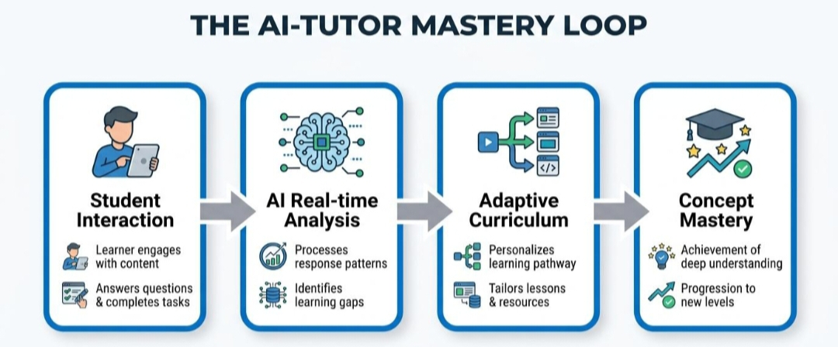
EVALUATION PROOF
Sample Outputs: "Recursion in Python"
LEVEL 1: BEGINNER
LEVEL 2: INTERMEDIATE
LEVEL 3: ADVANCED
Russian Dolls Analogy
Call Stack Tracing
Tail Call & Memory
"Think of recursion like opening nested Russian dolls until you reach the smallest doll (the base case)."
"Each recursive step pushes a stack frame containing local scope until base condition triggers return unwinding."
"Python lacks native Tail-Call Optimization (TCO), making deep recursion subject to RecursionError overflow."
Quiz: What stops infinite calls? (Base case)
Quiz: Calculate factorial(4) stack frame depth.
Quiz: Refactor recursive tree walk to iterative stack.

Slide 10

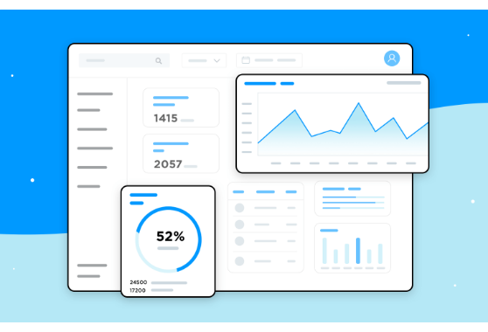
FRONT-END PROTOTYPE
Interactive Streamlit Dashboard
Input Controls
Topic text input box + self-assessed proficiency radio buttons.
Live Generation
One-click generation rendering explanations in formatted Markdown.
In-App Quiz Widget
Auto-grades answers to automatically advance the student difficulty level.

Slide 11
IMPACT & ROADMAP
Results & Future Scope
Current Capabilities
Future Roadmap
Sub-3s Latency: Instant explanation generation.
RAG Integration: Plug syllabus PDFs & verified notes.
Adaptive Scaffolding: Automatic difficulty adjustment.
Speech Synthesis: Audio narration for multimodal learners.
Zero Training Cost: Built using existing LLM endpoints.
Persistent Profiles: Longitudinal knowledge gap tracking.

Slide 12
PROJECT SUMMARY
Democratizing Personalized Tutoring with Generative AI
By combining heuristic difficulty routing with structured prompt engineering, we transform static classroom material into an interactive personal mentor.
Thank You

