Slide 1


SMART INDIA HACKATHON 2025
Problem Statement ID – SIH25111
Problem Statement Title- Smart Waste Segregation
Theme- STUDENT INNOVATION
PS Category- SOFTWARE + HARDWARE
Team ID- 07
Team Name (Registered on portal)

Slide 2

SMART WASTE SEGRIGATION
.
AI POWERED SMART WASTE Segregation WORK FLOW )
PROBLEM STATEMENT
IDEA /SOLUTION
Lack of monitoring causes waste mixing.
Systemic mismanagement overloads landfills, costs rise.
No easy e-waste pickup system.
Smart bins can automate waste segregation.
Optimize collection routes to save costs
AI and sensors classify waste.
Lid opens with ultrasonic sensor.
Real-time alerts guide users.
Web app schedules e-waste pickups.
Sensors verify waste after AI.
Alerts use buzzer and LEDs.
User manual guides home segregation.
GPS tracks and schedules collection.
UNIQUE VALUE PROPOSITION
Hybrid AI classifies waste accurately.
EDs provide real-time user feedback.
Automated lid opens for convenience.
Web app schedules e-waste pickups.
Sensors and GPS optimize collection routes.

Slide 3
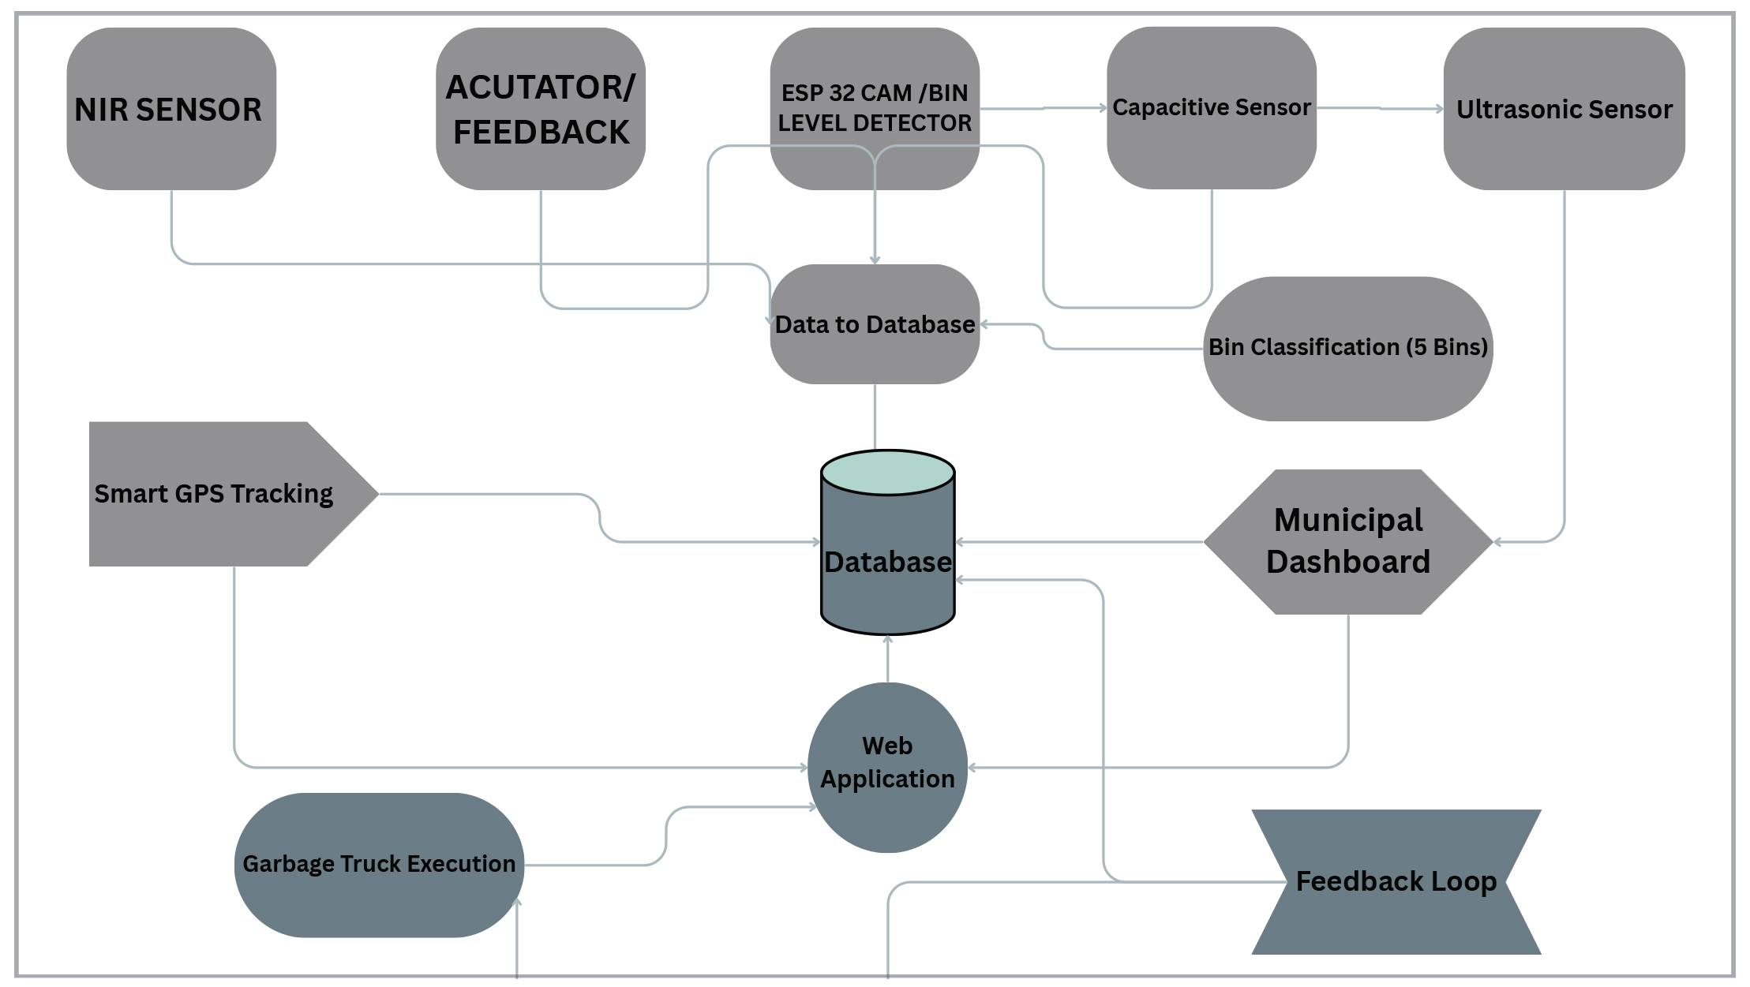
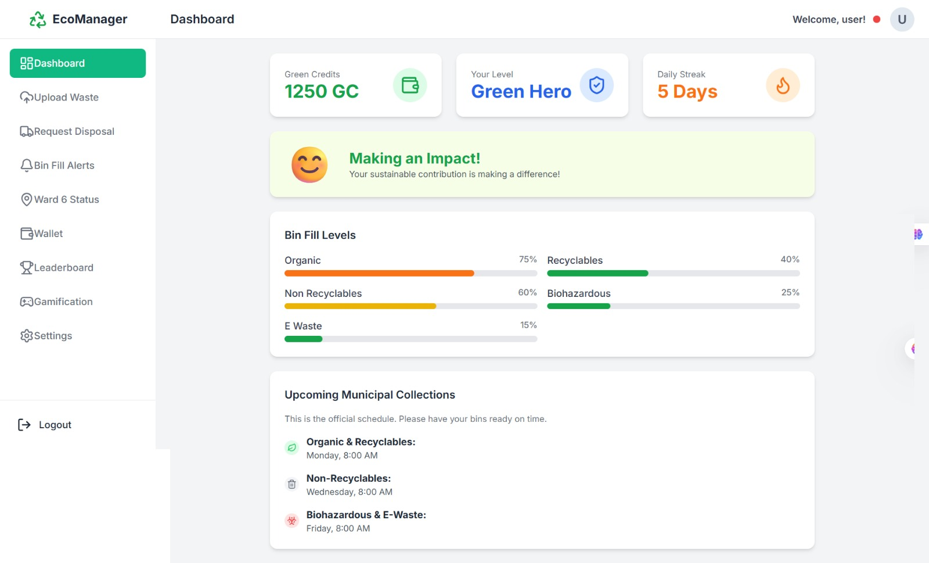
TECHNICAL APPROACH
TECH STACK:
ESP32 camera captures waste images
Raspberry Pi processes the data.
Sensors detect objects, measure distance.
Servos automate bin lid control.
Python AI scripts sort waste.
Web app helps users and city.

Slide 4
FEASIBILITY AND VIABILITY
.
FEASIBILITY:
VIABILITY:
Improved Sorting: The system uses AI and sensor fusion to analyze waste with high accuracy, ensuring it is sorted correctly.
Automated Lid: A servo motor and ultrasonic sensor provide a touchless, smooth lid opening for user convenience and hygiene.
User Motivation: An incentive system encourages users to properly sort their waste, rewarding good behavior.
E-Waste Management: A dedicated web app simplifies the process of scheduling e-waste and scrap pickups for users.
Reliable Operation: The system's real-time sensor data and robust communication between components ensure dependable, consistent performance.
Future-Ready: The system's scalability allows for easy upgrades and the addition of new features down the line.
.
Incentives solve user laziness, increasing responsibility.
User alerts minimize improper disposal errors.
Scrap disposal generates revenue, promoting a circular economy
A web app supports engagement and scheduling for pickups.
The system reduces the operational load for municipal collection.
High accuracy gains user and municipal trust.
System integration ensures maintenance and uptime.
The solution is competitive and cost-effective, unmatched by alternatives

Slide 5

IMPACT AND BENEFITS
BENEFITS:
. Cuts fuel use via GPS.
Eases worker sorting and exposure.
Improves collection scheduling efficiency.
Lowers operational and maintenance costs.
Creates scrap-based revenue streams
IMPACT:
Reduces landfill waste significantly.
Lowers toxic and biohazard pollution.
Protects soil and groundwater health.
Minimizes e-waste environmental threats.
Reduces fossil fuel reliance.
Enhances municipal waste management.
Decreases greenhouse gas emissions.
Improves public health and safety.

Slide 6
RESEARCH AND REFERENCES
Smart Segregation, ML, Raspberry Pi: https://www.irjmets.com/uploadedfiles/paper/issue_7_july_2022/27781/final/fin_irjmets1657461174.pdf https://ijcrt.org/papers/IJCRT2309288.pdf
Arduino, Servo, Ultrasonic: https://thegrenze.com/pages/servej.php?fn=345.pdf&name=Smart+Dustbin+using+Arduino&id=3305&association=GRENZE&journal=GIJET&year=2024&volume=10&issue=2 https://vayuyaan.com/blog/smart-dustbin-using-arduino-and-ultrasonic-sensor/
ESP32 Bin Fill Monitoring: https://ijrpr.com/uploads/V6ISSUE3/IJRPR40420.pdf https://www.irjet.net/archives/V10/i11/IRJET-V10I1105.pdf
Smart GPS Route Optimization: https://www.semanticscholar.org/paper/Smart-Garbage-Collection-Using-GPS-&-Shortest-Path-Kariapper-Pirapuraj/01d6185868252ac02025a8d648aaef3f59bd95c9 https://ijrpr.com/uploads/V6ISSUE1/IJRPR38015.pdf
Biogas, Recycling, Incineration & Disposal: https://pmc.ncbi.nlm.nih.gov/articles/PMC10209407/ https://www.sciencedirect.com/science/article/pii/S1110062118301375 https://www.sciencedirect.com/science/article/abs/pii/S0956053X06001371 https://archive.ipcc.ch/publications_and_data/ar4/wg3/en/ch10s10-references.html

