Slide 1
Analysis on CFA Image Compression Methods
EE398A Final Project
Sung Hee Park
(shpark7@stanford.edu)
Albert No
(albertno@stanford.edu)

Slide 2
EE398A Final Project
Contents
1 Abstract
2 Existing Solutions I – Apply JPEG
3 Results of Existing Solutions I
4 Existing Solutions II
5 Results of Existing Solutions II
6 Conclusion

Slide 3
EE398A Final Project
1
Abstract
What is CFA?
Motivation
Our Goal

Slide 4
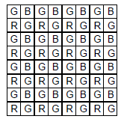
EE398A Final Project
1
Abstract
What is CFA? / Motivation / Our Goal
Color Filter Array (CFA)
⊙ Each point only have one value among RGB
⊙ Bayer patterned CFA are mostly used.
Fig. 1. Bayer patterned color filter array.
Demosaic
⊙ Based on CFA data, reconstruct original full RGB image
⊙ There are numerous method in demosaic
Notes:
Most inexpensive digital cameras use a color filter array (CFA) with each pixel element of the sensor recording intensity information of one color component, typically red, green, or blue. Although several different CFAs have been proposed, the Bayer CFA [1] shown in Figure 1 is widely used. Here the green filters are in a quincunx (interlaced) grid with the red and blue filters filling up the empty locations. This paper considers only the Bayer CFA, but the algorithm can be adapted to other CFAs as well.

Slide 5
EE398A Final Project
1
Abstract
What is CFA? / Motivation / Our Goal
Current Image Compression
⊙ Currently, Image is compressed after demosaicking.
⊙ Demosaic is kind of interpolating.
There should be an redundant.
Motivation
⊙ Compress after demosaic is wasteful.
⊙ What about compress CFA data directly!
Notes:
Many image compression methods are designed to handle 3-channel image data represented in RGB color space. While actual image coding is performed in different color space that has less correlation between each component, they still assume that every pixel has three color components. However, it is common that color image data is captured with a single image sensor and a color filter on it, followed by demosaicking operation which interpolates pixel values to obtain full color image. This demosaicking stage introduces redundant data that will be removed again in the compression stage afterward. Thus, it may not be optimal to apply image compression methods after demosaicking is done.

Slide 6
EE398A Final Project
1
Abstract
What is CFA? / Motivation / Our Goal
Our Goal
⊙ Compressed data before demosaic.
Method
⊙ Compare CFA images before and after compression.
⊙ Compare original images after demosaic.

Slide 7
EE398A Final Project
2
Existing Solutions I – Apply JPEG
Conventional Method
Structure Conversion
Structure Separation
Low-pass Filtering

Slide 8
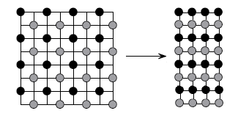
EE398A Final Project
2
Existing Solutions I – Apply JPEG
Conventional Method / Structure Conversion / Structure Separation / Low-pass Filtering
Direct apply JPEG
⊙ Directly apply JPEG on CFA Images
Simple Merging
⊙ Merging green Array.
⊙ Apply JPEG on each RGB color components.

Slide 9
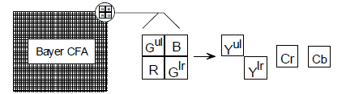
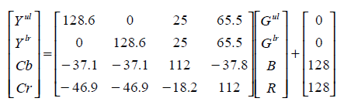
EE398A Final Project
2
Existing Solutions I – Apply JPEG
Conventional Method / Structure Conversion / Structure Separation / Low-pass Filtering
Structure Conversion
⊙ Color space conversion

Slide 10
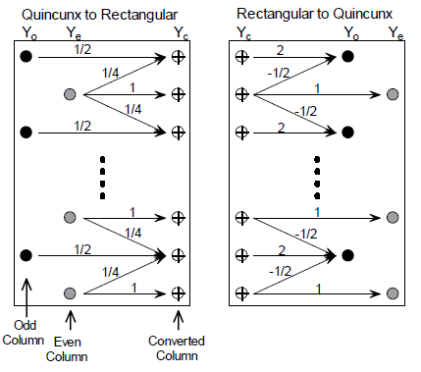
EE398A Final Project
2
Existing Solutions I – Apply JPEG
Conventional Method / Structure Conversion / Structure Separation / Low-pass Filtering
Structure Conversion
⊙ Convert Y component
⊙ Apply JPEG to each YCbCr Color components

Slide 11
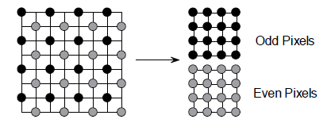
EE398A Final Project
2
Existing Solutions I – Apply JPEG
Conventional Method / Structure Conversion / Structure Separation / Low-pass Filtering
Structure Separation
⊙ Color space conversion.
⊙ Separate Y array.
⊙ Apply JPEG to each YCbCr Color components.

Slide 12
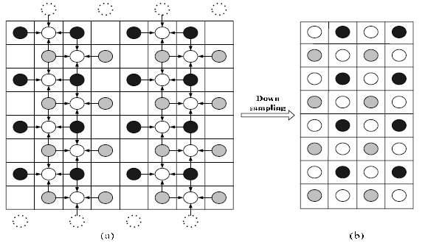
EE398A Final Project
2
Existing Solutions I – Apply JPEG
Conventional Method / Structure Conversion / Structure Separation / Low-pass Filtering
Low-pass Filtering -1
⊙ Low-pass filtering (G – space)
Notes:
The virtual pixels of upper boundary are got from the first even row, i.e., the second row. The virtual pixels of bottom are equal to the original pixels of the second last row, i.e., the pixels of the seventh row. In this method, the smooth filter is applied to the blank points to get pixels ‘ ’ firstly, and then down-sampling operation is realized by the way that the first column and the fourth column are removed in every four columns.

Slide 13
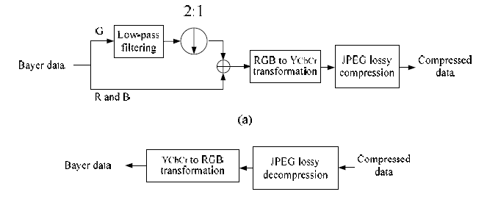
EE398A Final Project
2
Existing Solutions I – Apply JPEG
Conventional Method / Structure Conversion / Structure Separation / Low-pass Filtering
Low-pass Filtering -1
⊙ Color conversion to YCbCr.
⊙ Apply JPEG to each YCbCr color components.
Notes:
The virtual pixels of upper boundary are got from the first even row, i.e., the second row. The virtual pixels of bottom are equal to the original pixels of the second last row, i.e., the pixels of the seventh row. In this method, the smooth filter is applied to the blank points to get pixels ‘ ’ firstly, and then down-sampling operation is realized by the way that the first column and the fourth column are removed in every four columns.

Slide 14
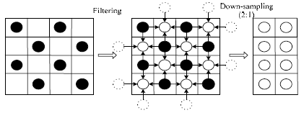
EE398A Final Project
2
Existing Solutions I – Apply JPEG
Conventional Method / Structure Conversion / Structure Separation / Low-pass Filtering
Low-pass Filtering -2
⊙ Low-pass filtering (G – space)
Notes:
In this method, the smooth filter is applied to the blank points to get pixels ‘ O ’ firstly, and then down-sampling operation is followed to removed the original pixels ‘ (colored) O ’. Those down-sampled pixels are lastly emerged into a rectangular shape, which is the transformation operation of G component from quincunx to rectangle. The low-pass filter reduces high frequency contents not only in the vertical direction but also in the horizontal direction, which can improve the compression performance.

Slide 15
EE398A Final Project
2
Existing Solutions I – Apply JPEG
Conventional Method / Structure Conversion / Structure Separation / Low-pass Filtering
Low-pass Filtering -2
⊙ Color conversion to YCbCr.
⊙ Apply JPEG to each YCbCr color components.
Notes:
The virtual pixels of upper boundary are got from the first even row, i.e., the second row. The virtual pixels of bottom are equal to the original pixels of the second last row, i.e., the pixels of the seventh row. In this method, the smooth filter is applied to the blank points to get pixels ‘ ’ firstly, and then down-sampling operation is realized by the way that the first column and the fourth column are removed in every four columns.

Slide 16
EE398A Final Project
3
Results of Existing Solutions I
Conventional Method
Structure Conversion
Structure Separation
Low-pass Filtering

Slide 17
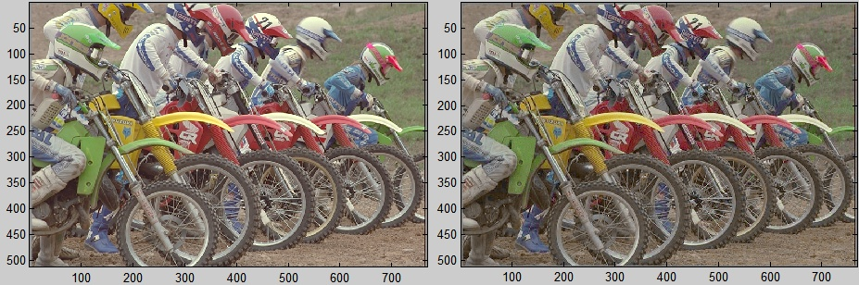
EE398A Final Project
3
Results of Existing Solutions I
Conventional Method / Structure Conversion / Structure Separation / Low-pass Filtering
Direct apply JPEG
Quality : 75 , Demosaic method : frequency

Slide 18
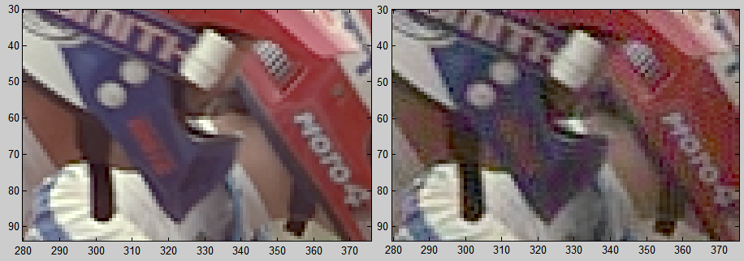
EE398A Final Project
3
Results of Existing Solutions I
Conventional Method / Structure Conversion / Structure Separation / Low-pass Filtering
Direct apply JPEG
Quality : 75 , Demosaic method : frequency

Slide 19
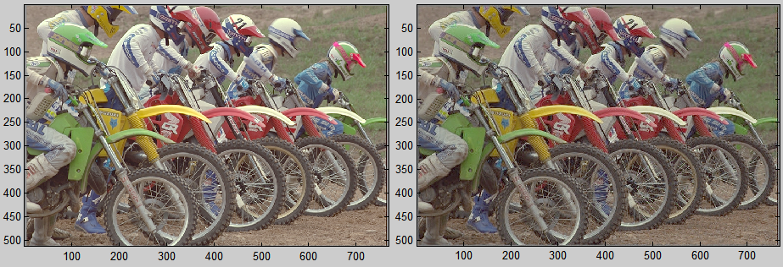
EE398A Final Project
3
Results of Existing Solutions I
Conventional Method / Structure Conversion / Structure Separation / Low-pass Filtering
Simple Merging
Quality : 75 , Demosaic method : frequency

Slide 20
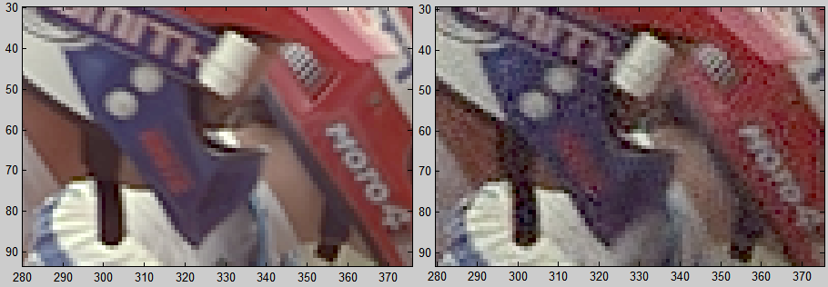
EE398A Final Project
3
Results of Existing Solutions I
Conventional Method / Structure Conversion / Structure Separation / Low-pass Filtering
Simple Merging
Quality : 75 , Demosaic method : frequency

Slide 21
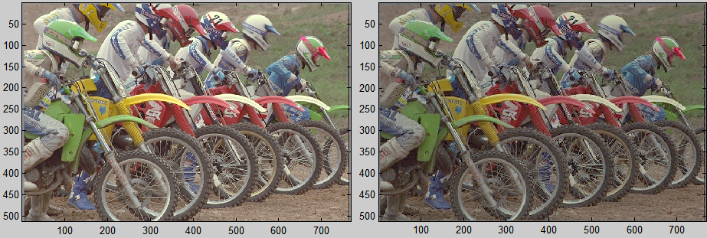
EE398A Final Project
3
Results of Existing Solutions I
Conventional Method / Structure Conversion / Structure Separation / Low-pass Filtering
Structure Conversion
Quality : 75 , Demosaic method : frequency

Slide 22
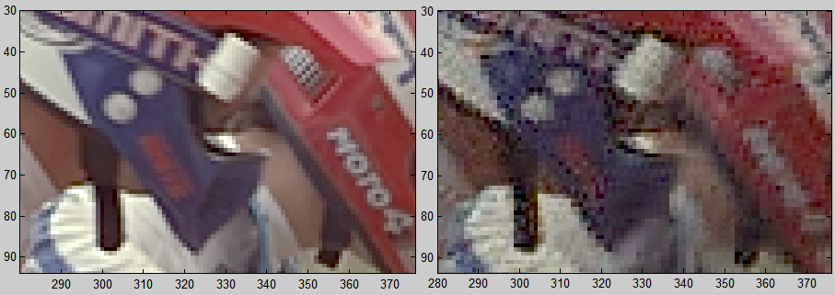
EE398A Final Project
3
Results of Existing Solutions I
Conventional Method / Structure Conversion / Structure Separation / Low-pass Filtering
Structure Conversion
Quality : 75 , Demosaic method : frequency

Slide 23
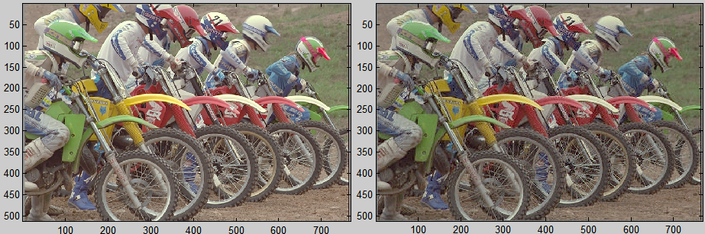
EE398A Final Project
3
Results of Existing Solutions I
Conventional Method / Structure Conversion / Structure Separation / Low-pass Filtering
Structure Separation
Quality : 75 , Demosaic method : frequency

Slide 24
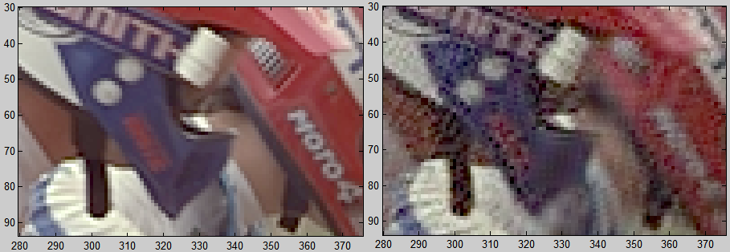
EE398A Final Project
3
Results of Existing Solutions I
Conventional Method / Structure Conversion / Structure Separation / Low-pass Filtering
Structure Separation
Quality : 75 , Demosaic method : frequency

Slide 25
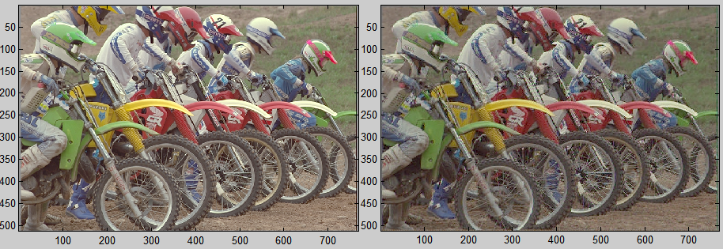
EE398A Final Project
3
Results of Existing Solutions I
Conventional Method / Structure Conversion / Structure Separation / Low-pass Filtering
Low-pass Filtering -1
Quality : 75 , Demosaic method : frequency

Slide 26
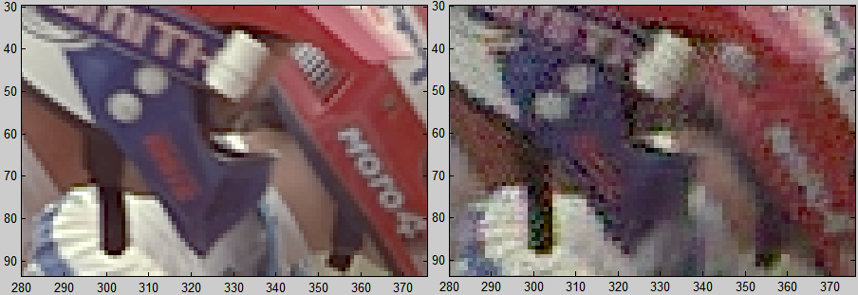
EE398A Final Project
3
Results of Existing Solutions I
Conventional Method / Structure Conversion / Structure Separation / Low-pass Filtering
Low-pass Filtering -1
Quality : 75 , Demosaic method : frequency

Slide 27
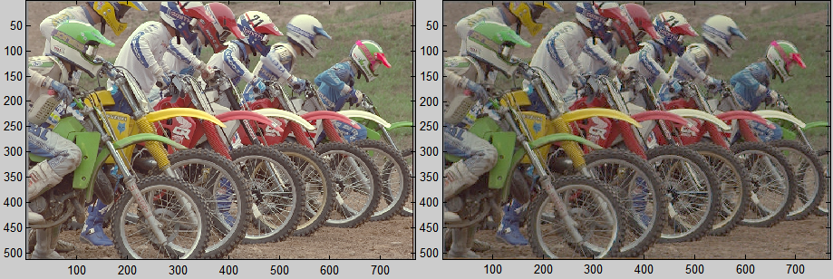
EE398A Final Project
3
Results of Existing Solutions I
Conventional Method / Structure Conversion / Structure Separation / Low-pass Filtering
Low-pass Filtering -2
Quality : 75 , Demosaic method : frequency

Slide 28
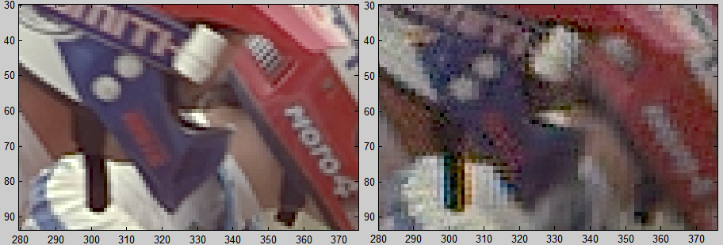
EE398A Final Project
3
Results of Existing Solutions I
Conventional Method / Structure Conversion / Structure Separation / Low-pass Filtering
Low-pass Filtering -2
Quality : 75 , Demosaic method : frequency

Slide 29
Thank you,
EE398A Final Project
Q&A

