Slide 1
Agents
From ReAct to {insert most recent paper}

Slide 2
Agenda
What are agents?
Why use agents?
Typical implementation
ReAct
Challenges with agents
Memory
Recent papers/projects

Slide 3
What are agents?
Use LLM as the “reasoning engine”
Non-deterministic sequence of actions

Slide 4
Why use agents?
Connect LLM to outside sources of data/computation
  Search
  APIs
  Database
  Calculators
  Run code
Recover from errors, handle multi-hop tasks
Example: SQL query
Chain: Natural Language -> SQl Query -> Result -> Natural Language
What if error in SQL Query?
What if multiple queries need to be made?

Slide 5
Typical Implementation
Pseudocode:
Choose tool to use
Observe output of the tool
Repeat until stopping condition met
Stopping condition:
LLM determined
Hardcoded rules

Slide 6
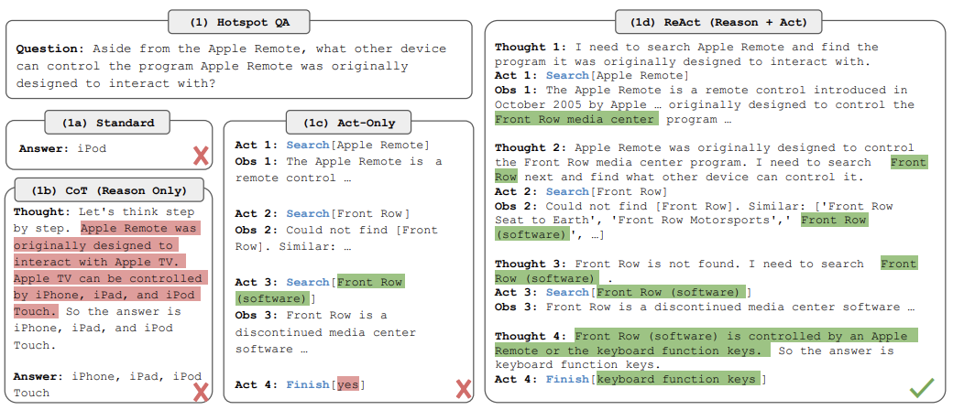
ReAct

Slide 7
Challenges with agents
Getting them to use tools in appropriate scenarios
Getting them to not use tools when not needed
Parsing LLM Output to tool invocation
Getting them to “remember” previous steps taken
Getting them to incorporate long observations
Getting them to stay focused
Evaluation

Slide 8
Challenge #1: Getting them to use tools in appropriate scenarios
Instructions
Tool descriptions in prompts
Tool retrieval before hand
Few shot examples
Fine tuned model (toolformer)

Slide 9
Challenge #2: Getting them to not use tools when not needed
Instructions
“Human Input” tool

Slide 10
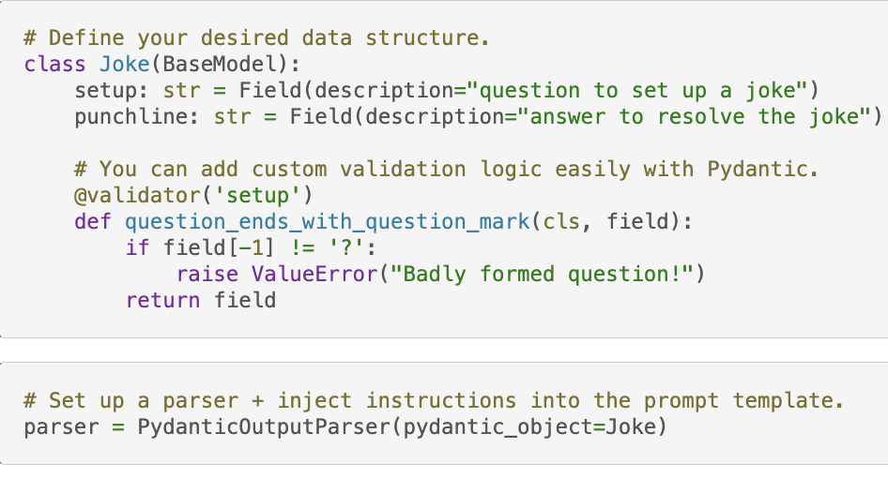
Challenge #3: Parsing LLM Output to tool invocation
JSON/Typescript schema
Retrying/fixing logic
Output Parsers!

Slide 11
Challenge #4: Getting them to “remember” previous steps taken
List of steps in memory
Fetch previous steps with retrieval

Slide 12
Challenge #5: Getting them to incorporate long observations
Parsing the long output
Storing long output and doing retrieval

Slide 13
Challenge #6: Getting them to stay focused
Reiterate the objective
Separate planning/execution step

Slide 14
Challenge #7: Evaluation
Evaluate end result
Evaluate intermediate steps
  Correct action
  Correct action input
  Correct sequence of steps
  Most efficient sequence of steps

Slide 15
Memory
Memory of User <> AI interactions
Memory of AI <> Tool interactions
Used to achieve personalization

Slide 16
AutoGPT
Long term memory of Agent <> Tool interactions
https://github.com/Significant-Gravitas/Auto-GPT

Slide 17
BabyAGI
Long term memory of Agent <> Tool interactions
Separate planning / execution steps
https://github.com/yoheinakajima/babyagi

Slide 18
CAMEL
Simulation environment
https://www.camel-ai.org/

Slide 19
Generative Agents
Memory
  Time weighted
  Importance weighted
  Relevancy weighted
Reflection step
Simulation environment
https://arxiv.org/abs/2304.03442

