Slide 1
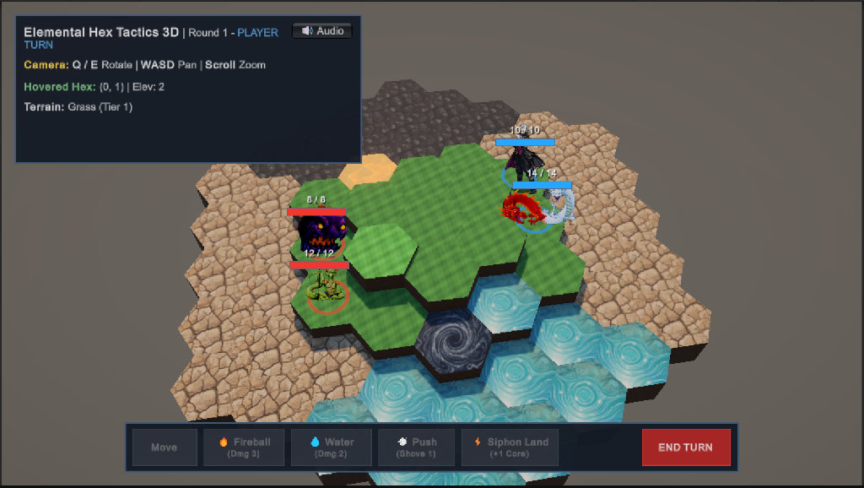
TOGE GAME FUND INITIATIVE (TGFI) PITCH
ELEMENTAL HEX TACTICS
"Brigandine meets Final Fantasy Tactics"
A rich, streamlined 2.5D tactical RPG where players directly command both Human Masters and colossal Monsters. Reshape 3D terrain with elemental magic, shove enemies into hazards, and harvest the land to unleash devastating Titan Cataclysms.
👤 Developer: Elang Esa Yudhistira (Solo Indie Dev)
📍 Location: Indonesia 🇮🇩
🌐 Portfolio: https://nealverse.itch.io
✉️ Email: yelangesa@gmail.com
⚙️ Engine: Unity 6 (URP 3D)
🎮 Playable Prototype: Standalone Windows .exe Ready
Notes:
Hi Kris and the Toge team, I'm Elang, a solo indie developer from Indonesia. Today I'm pitching Elemental Hex Tactics, a 2.5D tactical RPG inspired by Brigandine and Final Fantasy Tactics, where players directly command both human Masters and monster cohorts while terraforming the board as an interactive weapon.

Slide 2
TGFI PITCH SECTION 2: EXECUTIVE SUMMARY
TL;DR Overview: One-Page Executive Summary
🎮 High Concept & Gameplay Pillars
• High Concept:
A streamlined 2.5D tactical RPG where players command both Human Masters and colossal Monsters, terraforming 3D hex terrain with elemental magic to fuel Titan Cataclysms.
• Genre & Engine:
2.5D Turn-Based Tactical RPG (Hex Grid) | Unity 6 URP 3D
• Core Gameplay Experience:
Deliberate turn-based tactical maneuvering without filler turns. Masters reshape terrain and push enemies, while Monsters hold the frontline and siphon land for ultimate abilities.
• Key Features:
1. Offensive 3D Terraforming (Lava moats, steam clouds, ice bridges)
2. Master & Monster Dual-Command (Asymmetric squad synergy)
3. Kinetic Shove Physics & Collision Impacts
4. Land Siphoning & Room-Clearing Titan Cataclysms
🎯 Market, Platform & Business Model
• Target Audience:
Ages 18–35. Passionate fans of classic turn-based tactics (Brigandine, Final Fantasy Tactics, Tactics Ogre) and modern tactical hits (Triangle Strategy, Into the Breach).
• Target Platform:
PC Steam (Windows 10/11) with Steam Deck verified targets. Console ports (Switch / PlayStation) feasible upon full commercial publishing.
• Business Model:
Premium Single-Player Indie ($14.99 – $19.99 USD) with zero microtransactions or paywalls.
• Current State & Demo Scope:
Verified Unity 6 vertical slice (Month 0). $6,000 TGFI grant funds 6 months to expand into a high-retention 30-minute Steam Next Fest demo.
Notes:
Here is our one-page executive summary covering high concept, genre, key features, target audience, and business model. This proves our product scope is clear, commercial, and realistic from day one.

Slide 3
TGFI PITCH SECTION 3: MARKET OPPORTUNITY
Market Opportunity: Problems, Solutions & Benchmark
🧠 Problem 1: Cognitive Overload
The Frustration in Classic SRPGs:
Confusing status effect spreadsheets, hidden percentage tables, and mental fatigue.
➔ Our Solution: Ghost UI (Predictive Preview)
Hovering any spell previews exact terrain mutation & shove trajectory before committing. Deep tactics, zero fatigue.
⏳ Problem 2: Setup Tax
The Frustration in Classic SRPGs:
Wasting valuable turns just setting tiles without dealing damage to enemies.
➔ Our Solution: Hybrid Attack-Spells
Every spell attacks AND mutates terrain in 1 action (Fireball burns lava; Push deals damage). Zero filler turns.
♟️ Hex & Tactical RPG Comps
• Brigandine: Runersia (Happinet | 1,300+ Reviews, Very Positive):
Proves hex-grid monster commanding market. We replace slow 45-min AA battle animations with streamlined tactical flow and Active Terraforming.
• Vanaris Tactics (Toge Productions):
Proves retro FFT charm. We add 3D multi-level elevations, kinetic shoves, and terrain harvesting.
⚔️ Push Puzzle & HD-2D Comps
• Into the Breach (Subset Games | Overwhelmingly Positive):
Masterpiece of shove puzzles. We marry push physics with fantasy RPG squad progression and land siphoning for Titan cataclysms.
• Triangle Strategy (Square Enix):
HD-2D tactical presentation. We eliminate 20-hour level grinding, focusing on pure spatial skill.
🎯 Market Opportunity: Tactics fans crave Brigandine's monster fantasy and FFT's nostalgic depth, but want streamlined pacing without spreadsheet bloat.
Notes:
Slide 3 combines our target persona, the two major SRPG frustrations we solve with Ghost UI and Hybrid Spells, and our benchmark matrix against Brigandine, Vanaris, Into the Breach, and Triangle Strategy.

Slide 4
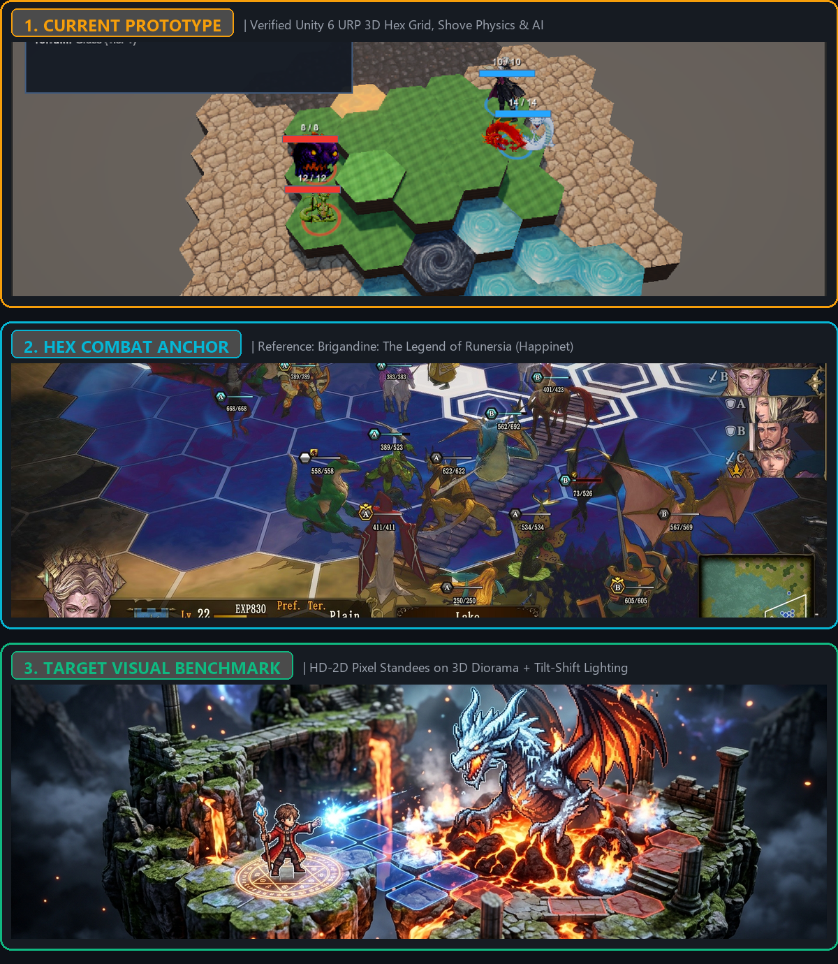
TGFI PITCH SECTION 4: PRODUCT & SOLUTION
Product & Solution: Gameplay, Prototype & Visual Target
⚡ The 3-Step Tactical Loop
• 1. Master Infuses (Terraform):
Fireballs scorch grass into molten lava moats; water blasts create steam.
• 2. Monster Attunes (Adapt):
Allied Monsters thrive in their element (fire beasts gain +2 ATK on lava).
• 3. Monster Consumes (Unleash):
Titans siphon active terrain into Barren Earth to trigger Magma Cataclysms.
💡 Dual-Command: Master shapes the map; Monster anchors the frontline.
🏆 Verified Working Vertical Slice (Month 0)
• Fully working 2v2 skirmish (Master + Titan vs Boss + Minion) in Unity 6
• 3D procedural hex grid with multi-level cliff elevations
• Kinetic shove physics with wall-impact collisions & lava hazard burns
• Land siphoning & camera screen-shake Magma Cataclysm
• Zero-dependency procedural audio engine with mute toggle active
• Standalone playable Windows .exe build ready for review
Notes:
Slide 4 delivers the complete product solution: our 3-Step core loop, our verified Month 0 working prototype in Unity 6, and our 3-part visual progression panel showing Prototype, Brigandine reference, and the HD-2D visual benchmark.

Slide 5
TGFI PITCH SECTION 5: EXECUTION PLAN
Execution Plan: Scope, Timeline & $6,000 Budget
🗺️ 6-Month Production Roadmap to Steam Demo
• Month 1–2: Character Sprite Pipeline
Commission freelance pixel artist for 2-directional animated sprite sheets (6 classes) and character portraits. Implement sprite animation controller.
• Month 3: New Biomes & Mechanics
Implement Glacial Peak (ice slide shove physics) and Conductive Marsh (water + lightning chain electrocution).
• Month 4: Campaign Node Map & Smart AI
Build node-based world map progression and enhance enemy AI (flanking, hazard evasion, and tactical retreating).
• Month 5–6: Steam Demo & Next Fest
Commission OST battle themes, polish UI/audio, and release a public 30-minute playable demo for Steam Next Fest.
🛡️ Execution Risk = Near Zero:
Core combat engine, hex math, kinetic displacement, and land-siphoning loops are ALREADY complete (Month 0). Months 1–6 are strictly for content & asset commissioning.
💰 High-Approval $6,000 USD Lean Budget
• [60%] Solo Dev Living Runway (6 Mos @ $600/mo): $3,600
(~Rp 9.300.000/month living runway to work full-time in Indonesia)
• [20%] Core Character Sprite Pipeline (Demo Milestone): $1,200
(6 foundational classes with 2-dir retro loops; scalable to 20+ classes upon full publishing deal)
• [10%] Original Tactical Soundtrack Commission: $600
(2 tactical battle themes by an indie composer)
• [10%] Steam Listing Fee & Unity Editor Tools: $600
($100 Steam fee + essential editor productivity tools)
TOTAL REQUESTED: $6,000 USD (~Rp 93.000.000)
🤝 Accountability & Milestone Tracking:
Bi-weekly playable builds uploaded to private itch.io / GitHub milestone branches for Toge production review.
Notes:
Slide 5 covers our execution plan: a 6-month roadmap leading to a public Steam Next Fest demo, backed by a disciplined $6,000 budget where $3,600 covers my living costs in Indonesia and $2,400 covers art, music, and Steam fees.

Slide 6
TGFI PITCH SECTION 6: THE ASK
The Ask: Funding, Support & Commercial Path
💰 Funding Request & Milestone Deliverables
• Grant Funding Requested:
$6,000 USD (~Rp 93.000.000) lean prototype funding from TGFI.
• Purpose of Funds:
Directly funds 6 months of disciplined full-time solo development, professional pixel sprite sheets, tactical OST, and Steam release fees.
• Target Milestone Deliverable:
A polished, feature-complete 30-minute playable demo ready for Steam Next Fest showcase.
• Lean & Disciplined Management:
Zero budget waste. Every dollar is mathematically allocated to living runway and essential external commissions.
🤝 Publisher Support & Commercial Path
• Support Needed from Toge:
1. Milestone feedback & production mentorship from Toge's veteran producers.
2. Publishing evaluation and market positioning guidance for Steam Next Fest.
• What Toge Gets:
1. Right of First Refusal (RoFR) for a full commercial publishing partnership ($50k–$150k USD) to expand into 20+ classes and full continental campaign.
2. Transparent bi-weekly verified milestone builds.
3. First access to a unique SEA tactical title marrying classic JRPG nostalgia with modern terraforming mechanics.
Notes:
Slide 6 outlines our ask: $6,000 in prototype grant funding and production mentorship, in exchange for transparent milestones and Right of First Refusal for a full publishing deal.

Slide 7
TGFI PITCH SECTION 7: MORE INFO
More Info: Playable Prototype & Developer Profile
🎮 Playable Prototype (Verified in Unity 6)
• Standalone Windows Executable (.exe) Ready Today:
A fully compiled Windows 10/11 standalone demo is ready for evaluation.
• What You Can Test Right Now:
- Interactive 3D hex grid with dynamic 360° camera orbit
- Master Fireball casting & kinetic shove wall-slams
- Real-time grass-to-lava terrain mutation
- Titan lava immunity, attunement buffs & land siphoning
- Screen-shaking Magma Cataclysm finisher
- Zero-dependency procedural audio engine
• Playable Demo Link:
Included in TGFI submission form (Private itch.io / Google Drive link).
👤 Developer Profile & Contact Details
• Developer Profile:
Elang Esa Yudhistira
Solo Game Designer, Story Writer & Lead Programmer
Location: Indonesia 🇮🇩
• Contact Email:
yelangesa@gmail.com
• Portfolio & Web Links:
- Itch.io: https://nealverse.itch.io
- GitHub: https://github.com/nealverseprime
- Game Repo: https://github.com/nealverseprime/ElementalHexTactics3D
- Web Pitch Deck: https://nealverseprime.github.io/ElementalHexTactics3D/
Thank you for considering Elemental Hex Tactics for the TGFI grant!
Notes:
Thank you Kris and the Toge team for your time and consideration. You can play the standalone Windows demo today and reach me at yelangesa@gmail.com.

