Slide 1
Force Sensor-Based Weight Measurement System
Using Arduino and LCD Display

Slide 2
Introduction
This project develops a force sensor-based weight measurement system. A force sensor detects applied pressure, converting it into a weight value, which is displayed on an LCD screen using Arduino. The system is designed for practical applications like digital weighing.

Slide 3
Objectives
To design a weight measurement system using Arduino and a force sensor.
To calibrate the sensor for accurate weight measurement.
To display measured weight on an LCD screen.
To ensure precision and reliability in the system’s output.

Slide 4
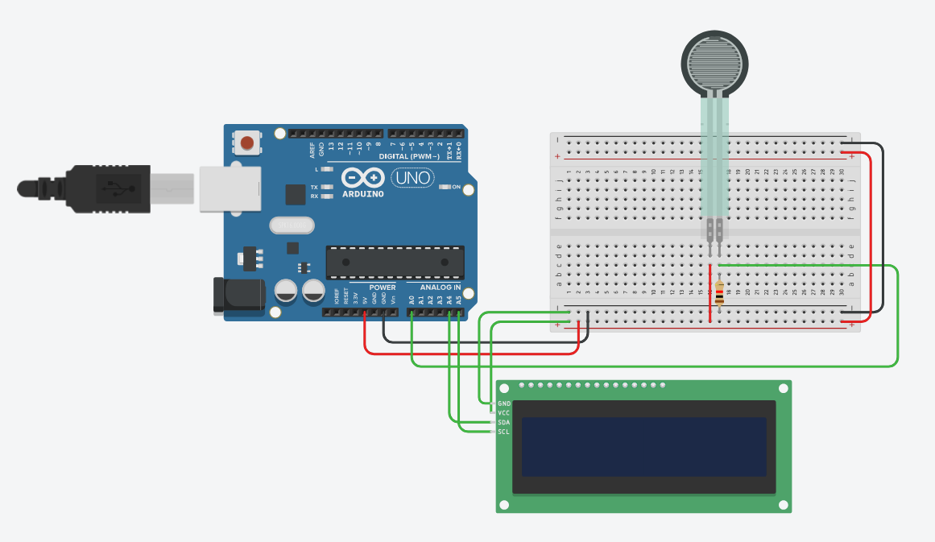
Figure 1: Circuit Diagram of the system

Slide 5
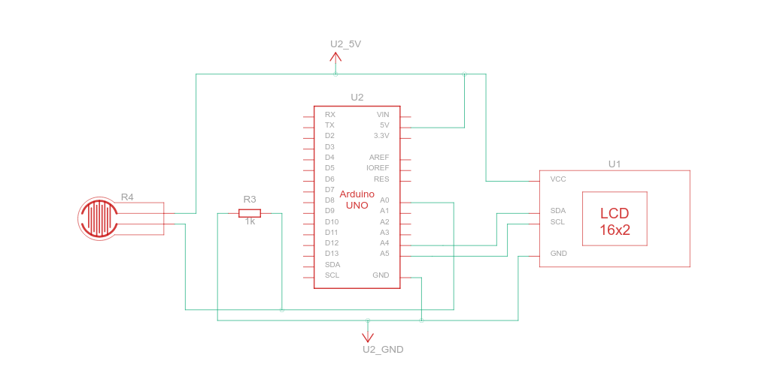
Figure 1: Schematic Diagram of the system

Slide 6
C++ Code
#include <Adafruit_LiquidCrystal.h>
Adafruit_LiquidCrystal lcd(0);
float slope = 0.01;
float offset = 0.0;
void setup()
{
lcd.begin(16, 2);
lcd.setBacklight(1);
lcd.print("Welcome!!!");
pinMode(A0, INPUT);
}
void loop()
{
int forceSensorValue = analogRead(A0);
float voltage = forceSensorValue
* (10.0 / 1023.0);
float weight = voltage * 10.0;
lcd.setCursor(0, 1);
lcd.print("Weight: ");
lcd.print(weight);
lcd.print(" g");
}

Slide 7
Callibration
Importance of Sensor Calibration
Ensures accurate, reliable weight readings.
Establishes sensor-weight linearity.
Reduces errors and inconsistencies.
Maintains system accuracy over time.
Inaccuracy: Improper calibration led to inaccurate data in this project.

Slide 8

Thank you
Md. Abdullah Al Mamun

