Slide 1
Learning From Examples (Decision Trees)
Md. Nurul Muttakin
Lecturer, CSE, BUET

Slide 2
Example problem: Restaurant waiting
Supervised Learning Problem → deciding whether to wait for a table at a restaurant
Output, y → a boolean variable, WillWait
Input, x → a vector of ten attribute values, each of which has discrete values
Notes:
Image source: AI-generated

Slide 3
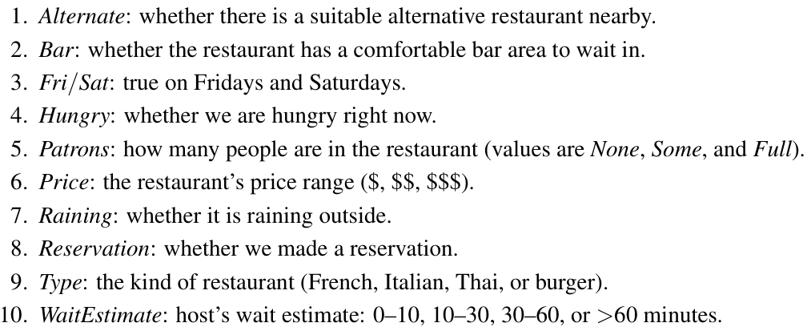
Example problem: Restaurant waiting
Supervised Learning Problem → deciding whether to wait for a table at a restaurant
Output, y → a boolean variable, WillWait
Input, x → a vector of ten attribute values, each of which has discrete values
Notes:
Image source: AI-generated

Slide 4
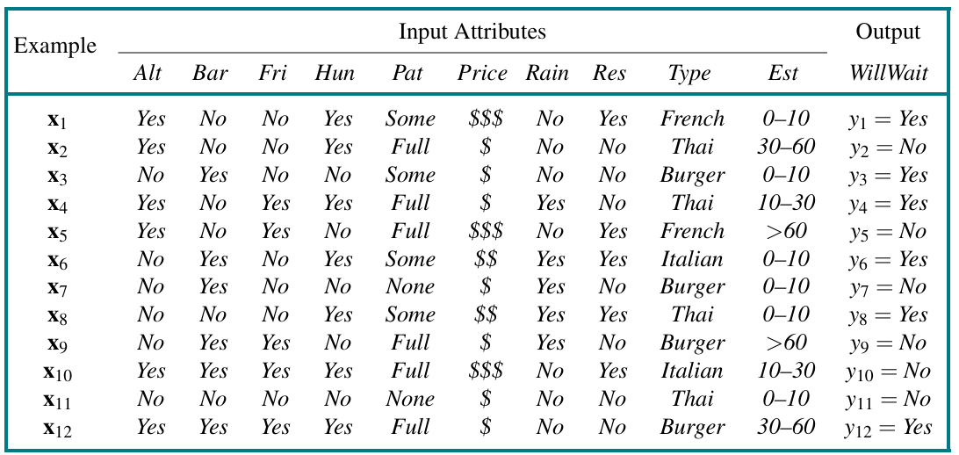
Example problem: Restaurant waiting
Can you tell the input space size? Or what is the number of all possible inputs
Notes:
Image source: AI-generated

Slide 5
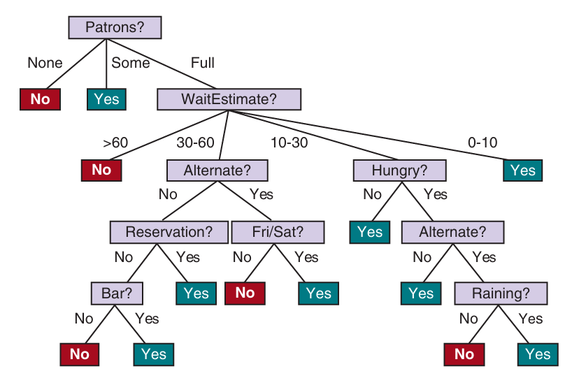
Example problem: Restaurant waiting
Notes:
Image source: AI-generated

Slide 6
Supervised Learning
Model Class / Hypothesis Space:
Decision Trees
Linear Models
Non-parametric Models: Nearest Neighbors
Ensemble Models: Random Forest etc.
Neural Networks
Notes:
Image source: https://miro.medium.com/v2/resize:fit:720/format:webp/1*oEqzFfEfIKtkKwa5LoaCog.png

Slide 7
A Decision Tree
Notes:
Image source: https://miro.medium.com/v2/resize:fit:720/format:webp/1*oEqzFfEfIKtkKwa5LoaCog.png

Slide 8
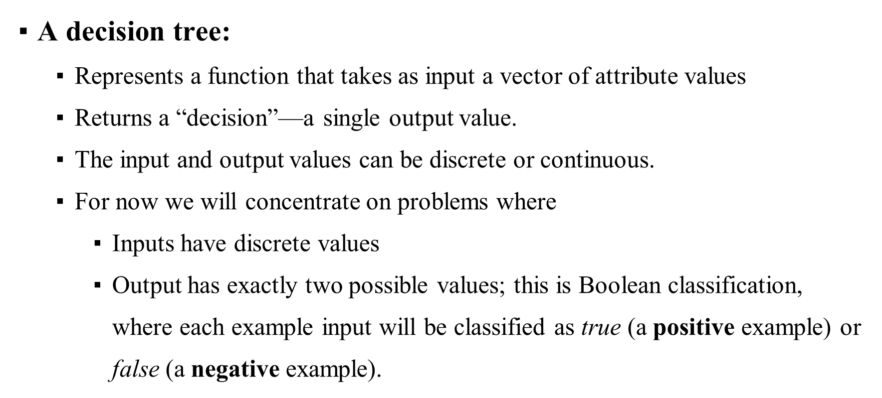
A Decision Tree
Notes:
Image source: https://miro.medium.com/v2/resize:fit:720/format:webp/1*oEqzFfEfIKtkKwa5LoaCog.png

Slide 9
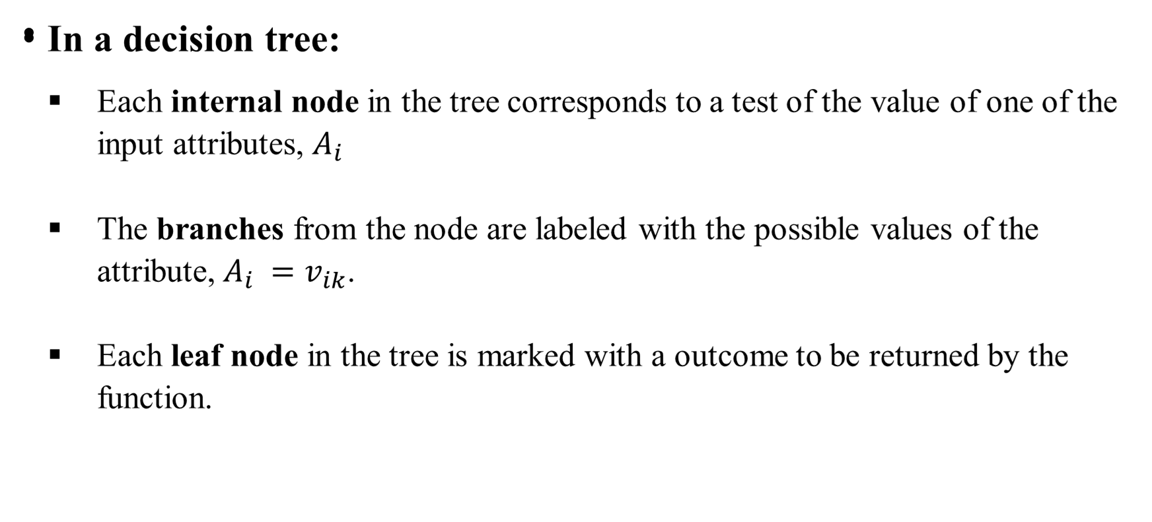
A Decision Tree
Notes:
Image source: https://miro.medium.com/v2/resize:fit:720/format:webp/1*oEqzFfEfIKtkKwa5LoaCog.png

Slide 10
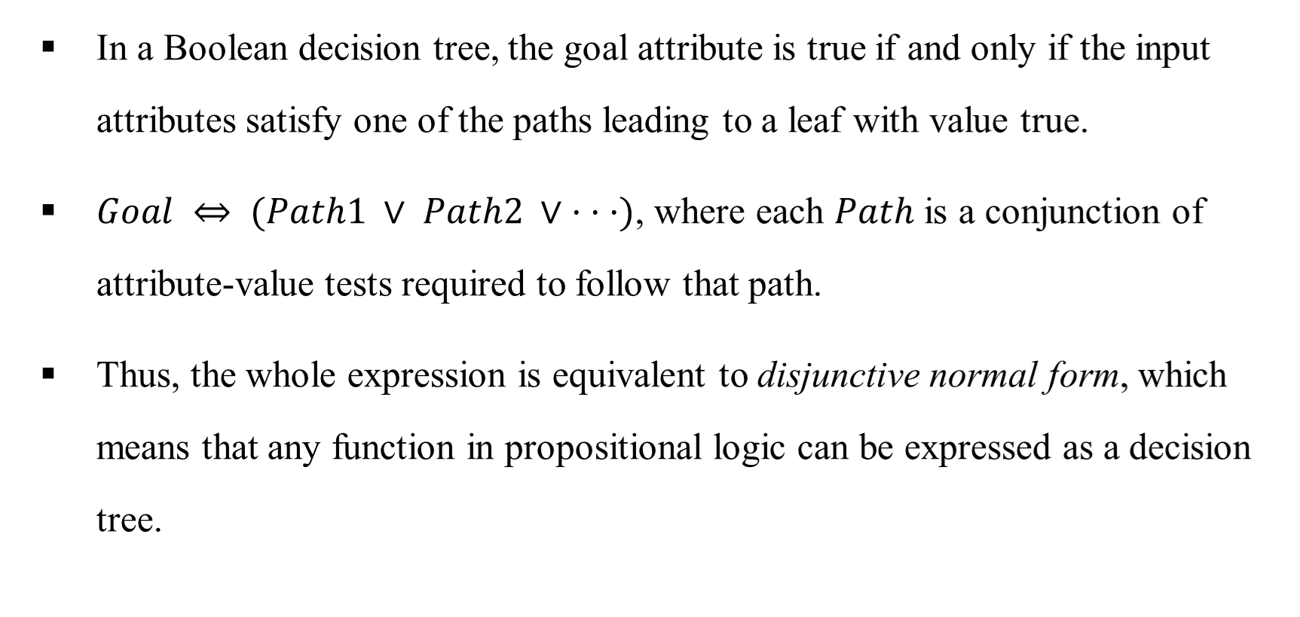
Decision Tree: Expressiveness
Notes:
Image source: https://miro.medium.com/v2/resize:fit:720/format:webp/1*oEqzFfEfIKtkKwa5LoaCog.png

Slide 11
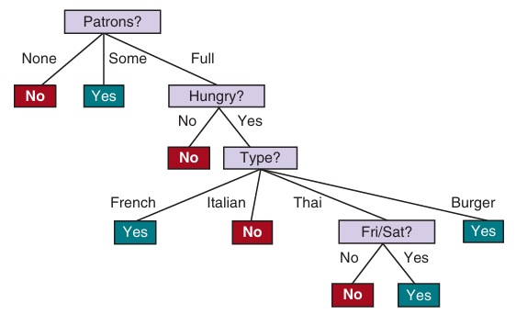
Represent the Decision Tree DNF
Notes:
Image source: https://miro.medium.com/v2/resize:fit:720/format:webp/1*oEqzFfEfIKtkKwa5LoaCog.png

Slide 12
Decision Tree (DT) Expressiveness
How many Possible Boolean Functions?
with n Boolean variables
How many Possible DT?
with n Boolean variables
Notes:
Image source: https://miro.medium.com/v2/resize:fit:720/format:webp/1*oEqzFfEfIKtkKwa5LoaCog.png

Slide 13
Feedback
Please share your valuable feedback .
Form link: bit.ly/feedback_mnm
Notes:
Image source: https://miro.medium.com/v2/resize:fit:720/format:webp/1*oEqzFfEfIKtkKwa5LoaCog.png

Slide 14
Acknowledgement
Chapter 18 (3rd ed.)/19(4th ed.) (AIAMA) (Textbook)
Sukarna Barua sir, Associate Professor, CSE, BUET.
Dr. Muhammad Ali Nayeem sir, Assistant Professor, CSE, BUET.
And many other online resources including LLMs.

